Slide 1
KanchiLUG presents
Learn python with us
Session 10
By
Syed Jafer

Slide 2
Agenda
Set
    Declaring
    Data Types
    Built Ins ( len, in, not in, max, min, any, all)
    Adding Values
    Removing Values
    Sorting
    Copy

Slide 3
Agenda
Set - Mathematical
    Union
    Intersection
    Difference
    Symmetric Difference
    Subset & Superset
    Disjoint Set

Slide 4
Sets
A set is a collection which is unordered, unchangeable*, and unindexed.
Since it doesnot maintain the order, we can't be using the index.

Slide 5
Sets - Declaring
{} - Curly Brackets
set() - Constructor
data = { ‘d1’, ‘d2’, ‘d3’ }

Slide 6
Sets
Order is not maintained
Unchangeable*
No duplicate values
Unindexed

Slide 7
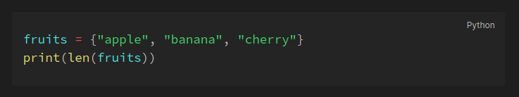
Set – Set Length
To determine how many items a set has, use the len() function

Slide 8
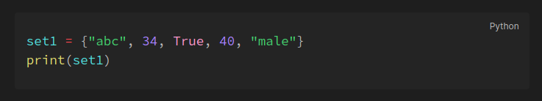
Sets – Data Types
Set items can be of any data type or a combination of data types which are hashable

Slide 9
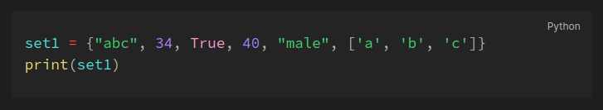
Sets – Tryout

Slide 10
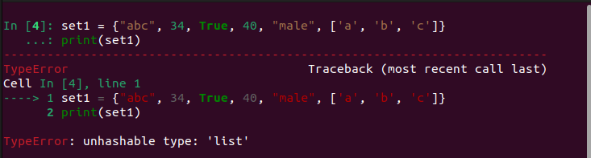
Sets – Tryout

Slide 11
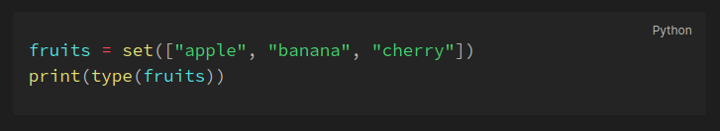
Set – type()
sets are defined as objects with the data type 'set'

Slide 12
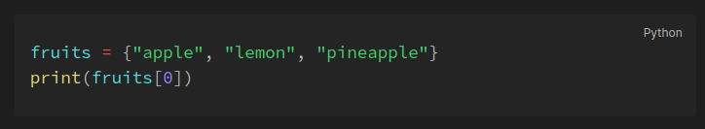
Sets – Indexing
Set items are unindexed. It will throw error while accessing with index.

Slide 13
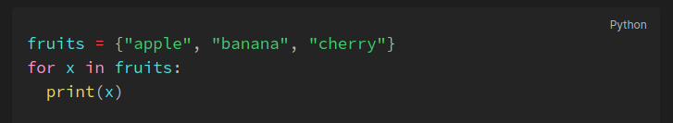
Sets – For Loop

Slide 14
Sets – in & not in
In – Element present in the set.
Not in – Element not present in the set.

Slide 15
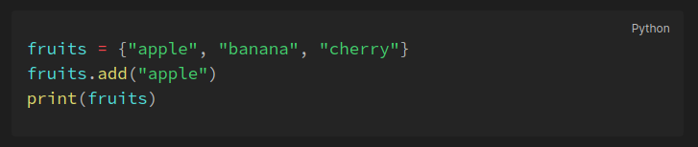
Sets Method - add()
Adds an element in to the set. (if the element is already presents it ignores)

Slide 16
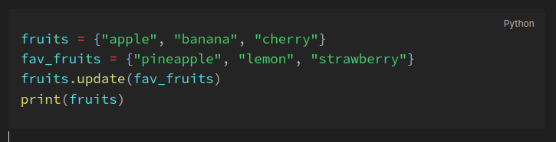
Sets Method - update()
update() function adds elements from a set (passed as an argument) to the set.

Slide 17
Sets Removal - remove()
If the element is present then it will remove, else it will throw error.
fruits = {‘apple’, ‘orange’, ‘banana’}
fruits.remove(‘apple’)
print(fruits)

Slide 18
Sets Removal - discard()
Same as remove, but even if the word is not present, it will fail safe.
fruits = {‘apple’, ‘orange’, ‘banana’}
fruits.discard(‘apple’)
print(fruits)

Slide 19
Set Removal - pop()
pop(index) will remove the random index element.
fruits = [‘apple’, ‘orange’, ‘banana’, ‘appple’]
fruits.pop()
print(fruits)

Slide 20
Sets Removal – del
Del will delete the object itself.
fruits = {‘apple’, ‘orange’, ‘banana’}
del fruits
print(fruits)

Slide 21
Set Removal – clear
Clears the entire set.
fruits = {‘apple’, ‘orange’, ‘banana’}
fruits.clear()
print(fruits)

Slide 22
Sets Sorting – sorted
Sorting: Default – Ascending.
states = {'Tamil Nadu', 'Kerala', 'Andra'}
res = sorted(states)
print(res)
Sorted will return a list

Slide 23
Sets Sorting – sorted
Sorting: Default – Descending.
states = {'Tamil Nadu', 'Kerala', 'Andra'}
res = sorted(states, reverse=True)
print(res)
Sorted will return a list

Slide 24
Set Copy – Direct Assignment
states = {Tamil Nadu', 'Kerala', 'andra', ‘andaman’}
states_copy = states
states.add(‘bihar’)
print(states)
print(states_copy)

Slide 25
Mathematical Functions

Slide 26
    A
    B

Slide 27


Slide 28
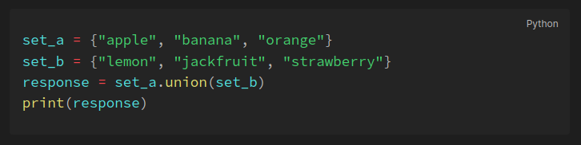
Sets - Union
Union of two sets will return all the items present in both sets (all items will be present only once). This can be done with either the | operator or the union() method.

Slide 29
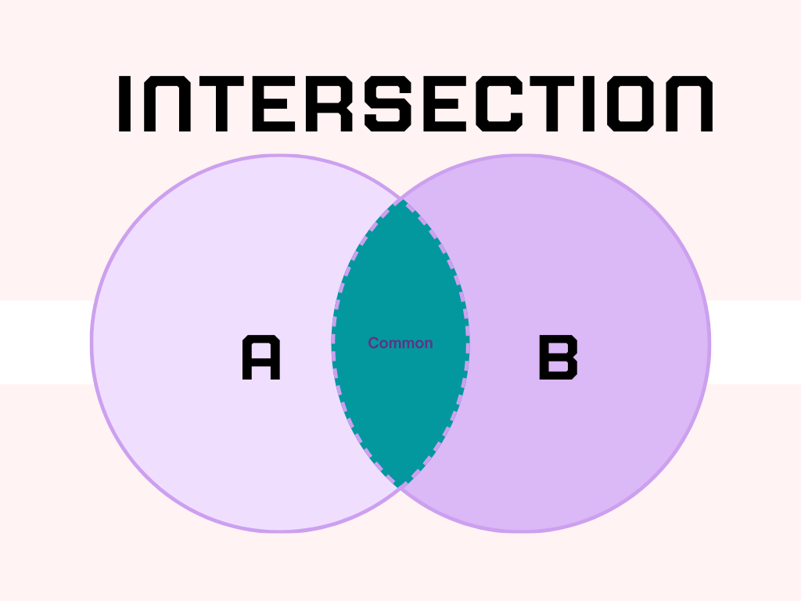

Slide 30
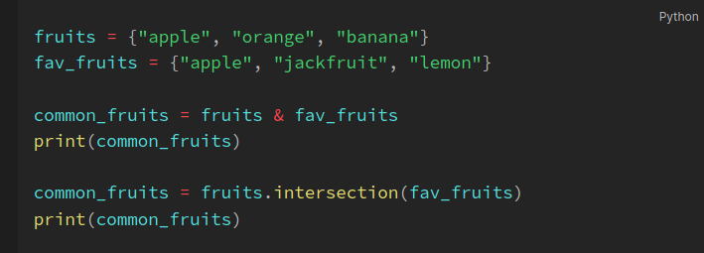
Sets - Intersection
The intersection of two sets will return only the common elements in both sets. The intersection can be done using the & operator and intersection() method.

Slide 31
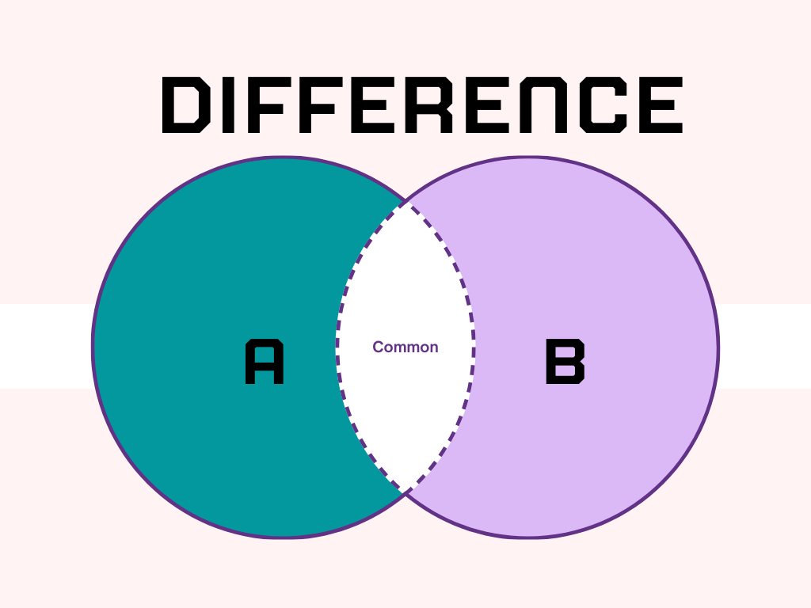

Slide 32
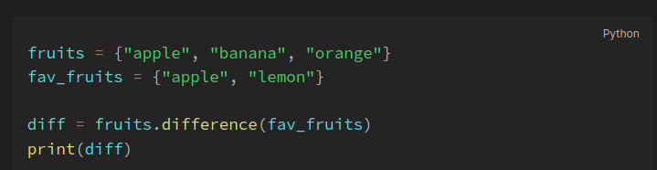
Sets - Difference
The difference operation will return the items that are present only in the first set i.e the set on which the method is called. This can be done with the help of the - operator or the difference() method.

Slide 33
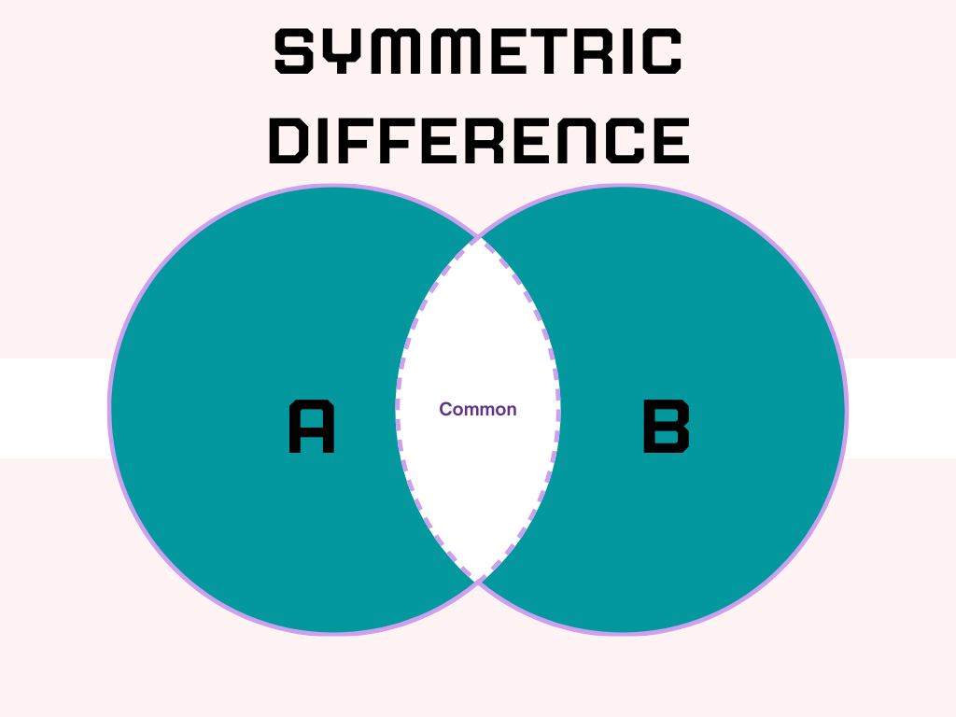

Slide 34
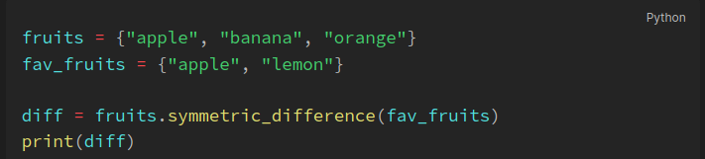
Sets - Symmetric difference
The Symmetric difference operation returns the elements that are unique in both sets. This is the opposite of the intersection. This is performed using the ^ operator or by using the symmetric_difference() method.

Slide 35
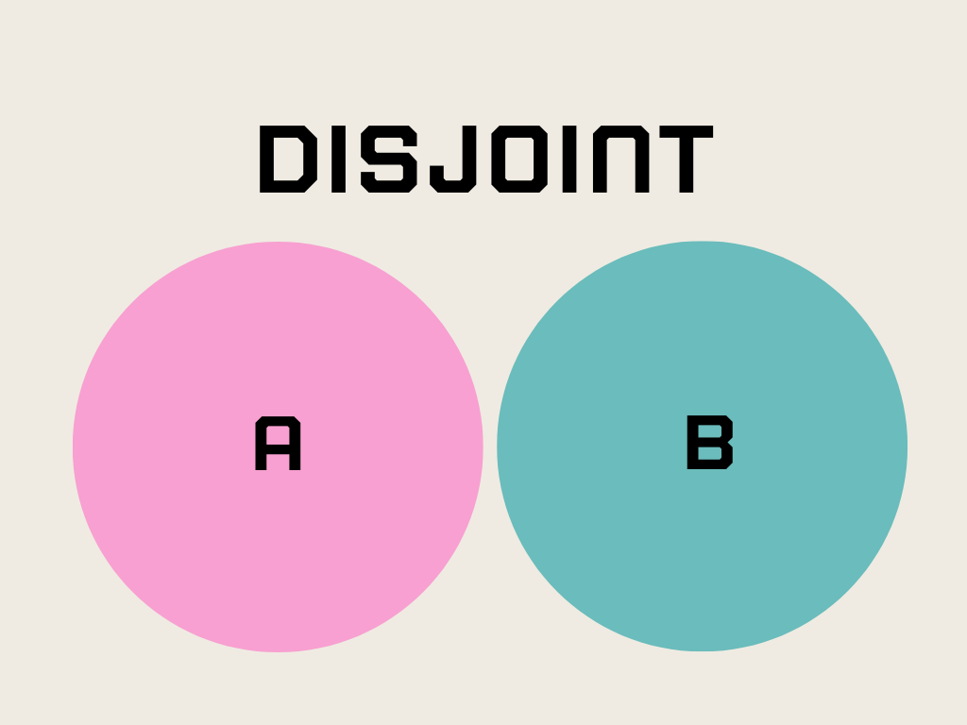

Slide 36


Slide 37
Q & A

