Slide 1
KanchiLUG presents
Learn python with us
Session 8
By
Syed Jafer

Slide 2
Agenda
Datastructure
    Need of Datastructure.
    What is Datastructure?
    Types

Slide 3
Agenda
List
    Declaring
    Indexing
    Modify – Mutable
    Adding Values
    Removing Values
    Sorting
    Copy

Slide 4

Need of Datastructures

Slide 5

Need of Datastructures

Slide 6
Benefits
1. Store
2. Search and Retrieve
3. Modify

Slide 7
Everything is data
In computer world, everything is data. It needs more efficient access.
1. Store
2. Search and Retrieve
3. Modify

Slide 8
Tradeoff
With respect to speed, space and ease of use

Slide 9
Types of Datastructures
1. Built In
2. User Defined

Slide 10
Built-In Datastructures
Data Structures are built-in with Python which makes programming easier.
1. List
2. Set
3. Tuple
4. Dictionary

Slide 11
Userdefined Datastructures
users define how the Data Structure would work and define functions in it.
1. Stack
2. Queue
3. Tree
4. Linked List
5. Graph
6. HashMap

Slide 12
Lists
a data structure in Python that is a mutable, or changeable, ordered sequence of elements.

Slide 13
Lists - Declaring
[] - Square Brackets
list() - Constructor
data = [ ‘d1’, ‘d2’, ‘d3’ ]

Slide 14
Lists
Order is maintained
Changeable
Allow Duplicate Values

Slide 15
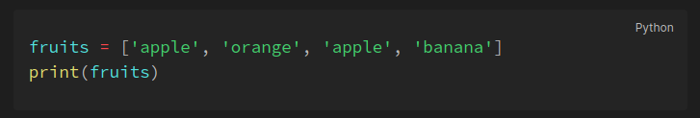
Lists – Allow Duplicates
Since lists are indexed, lists can have items with the same value:

Slide 16
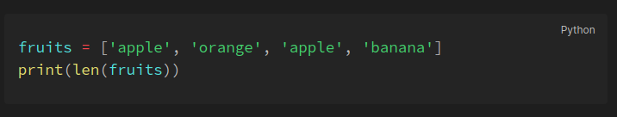
Lists – List Length
To determine how many items a list has, use the len() function

Slide 17
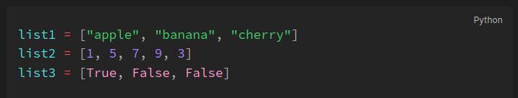
Lists – Data Types
List items can be of any data type or a combination of data types.

Slide 18
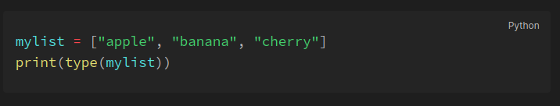
Lists – type()
lists are defined as objects with the data type 'list'

Slide 19
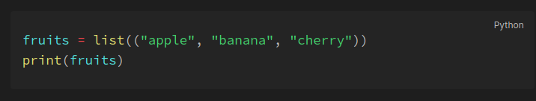
Lists – list() Constructor
It is also possible to use the list() constructor when creating a new list.

Slide 20
Lists – Indexing
List items are indexed, the first item has index `[0]`, the second item has index `[1]` etc.

Slide 21
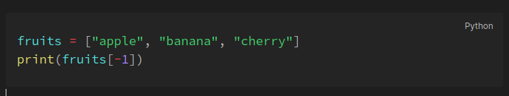
Lists – Negative Indexing
Negative indexing means start from the end. `-1` refers to the last item, `-2` refers to the second last item etc.

Slide 22
Lists – Range of Indexes
You can specify a range of indexes by specifying where to start and where to end the range.
When specifying a range, the return value will be a new list with the specified items.

Slide 23
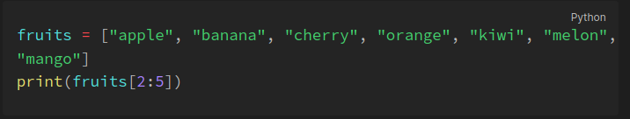
Lists – Range of Indexes

Slide 24
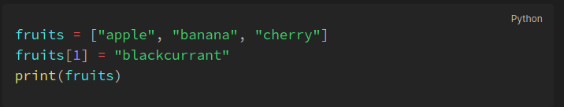
Lists – Change Values

Slide 25
Lists Method - insert()
Insert an item at a given position.
The first argument is the index of the element before which to insert.
a.insert(0, x) inserts at the front of the list, and a.insert(len(a), x) is equivalent to a.append(x).

Slide 26
Lists Method - append()
Insert an item at a given position.
The first argument is the index of the element before which to insert.
a.insert(0, x) inserts at the front of the list, and a.insert(len(a), x) is equivalent to a.append(x).

Slide 27
Q & A

Slide 28
Next session
Date : October 22 (next saturday)
Time : will be announced on friday
Link : same as today

