Slide 1



the potential of employees leaving the company (become terminated) MODEL TITANS
Devila Bakrania
CWID : 10457590
Course Section: A
Department: CS
Level: Graduate
Syed Mahvish
CWID : 10456845
Course Section: A
Department: CS
Level: Graduate
Priya Gupta
CWID : 10457442
Course Section: A
Department: CS
Level: Graduate

Slide 2
Problem Statement
To develop a classification model(s) to predict the potential of employees leaving the company (become terminated)

Slide 3
Data SET EXPLANATION
The dataset attrition_data.csv has 9613 rows and 27 columns
The dataset contains data of Active and terminated employees of the company
The Task is to predict the potential of employees leaving the company (become terminated)
Target: Status - Active or Terminated
Among them training data is: 6728 and testing data is: 2884

Slide 4
GOALs and Objectives
Major reason of termination is performance rating and Job satisfaction or not?
Which year has high amount of termination?
Which department has high termination rate?
Termination pattern in terms of education
Frequency of rehired employees being terminated
Does Highly paid employees were terminated?
Ratio of disable/vet vs normal in term of termination

Slide 5
Algorithms
K-Nearest Neighbor (KNN)
Classification and Regression Trees (CART)
C5.0 Methodology
K-Mean Cluster
Artificial Neural Networks (ANN)

Slide 6
K Nearest Neighbor (KNN) CASE STUDY RESULTS ON BASIS OF SALARY
K value | Error rate | Accuracy
5 | 0.4472954 | 55.27046
10 | 0.4403606 | 55.96394
20 | 0.4226768 | 57.73232
50 | 0.4133148 | 58.66852
100 | 0.4223301 | 57.76699
150 | 0.4188627 | 58.11373
200 | 0.4147018 | 58.52982
300 | 0.417129 | 58.2871
500 | 0.4199029 | 58.00971
1000 | 0.4202497 | 57.97503
From above table it is clear that the accuracy lies between 55% to 58% for salary-based classification

Slide 7
K NEAREST NEIGHBOR (KNN) CASE STUDY Results based on Job-SATISFACTION
K value | Error rate | Accuracy
5 | 0.4282247 | 57.17753
10 | 0.4212899 | 57.87101
20 | 0.4088072 | 59.11928
50 | 0.4056865 | 59.43135
100 | 0.4095007 | 59.04993
150 | 0.3966713 | 60.33287
200 | 0.3987517 | 60.12483
300 | 0.398405 | 60.1595
500 | 0.398405 | 60.1595
1000 | 0.4053398 | 59.46602
From above table, it is clear that the accuracy lies between 57% to 60% for Performance and job-satisfaction based classification

Slide 8
K NEAREST NEIGHBOR (KNN) CASE STUDY RESULTS BASED on ALL data
From above table, it is clear that the Accuracy lies between 58% to 61% for all data
K value | Error rate | Accuracy
5 | 0.4119279 | 58.80721
10 | 0.4084605 | 59.15395
20 | 0.4001387 | 59.98613
50 | 0.397018 | 60.2982
100 | 0.398405 | 60.1595
150 | 0.3987517 | 60.12483
200 | 0.3914702 | 60.85298
300 | 0.389043 | 61.0957
500 | 0.3883495 | 61.16505
1000 | 0.3942441 | 60.57559

Slide 9
K NEAREST NEIGHBOR (KNN)
Conclusion
Following conclusion are drawn from KNN classification on given set of employment data:
1- As value of K increases, accuracy increases in all three cases
2- The accuracy increases when multiple columns are considered
As in case of salary, lowest accuracy is observed while in case of all data highest accuracy is observed
Hence from above observation, it can be concluded that termination of employee is based on all factor (majorly), and not limited to few factors such as salary or performance or job satisfication

Slide 10
Classification and Regression Trees
(CART)
The decision tree method is a powerful and popular predictive machine learning technique that is used for both classification and regression. So, it is also known as Classification and Regression Trees (CART)
The algorithm of decision tree models works by repeatedly partitioning the data into multiple sub-spaces, so that the outcomes in each final sub-space is as homogeneous as possible. This approach is technically called recursive partitioning

Slide 11
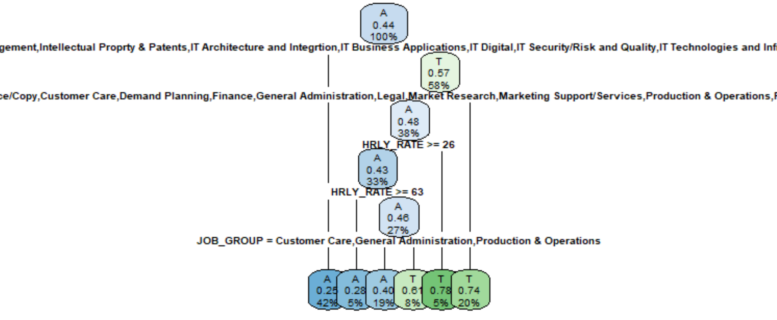
CART Plot
Data Set classified on the basis of Hourly Rate >= 26 and Hourly Rate >= 63

Slide 12
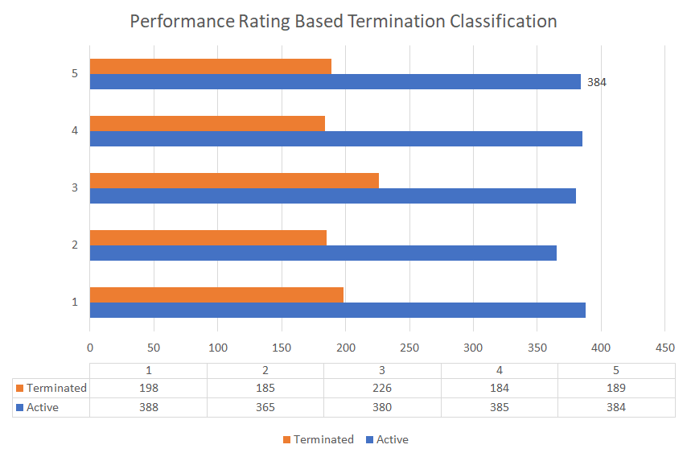
Performance Rating based Classification (CART)

Slide 13
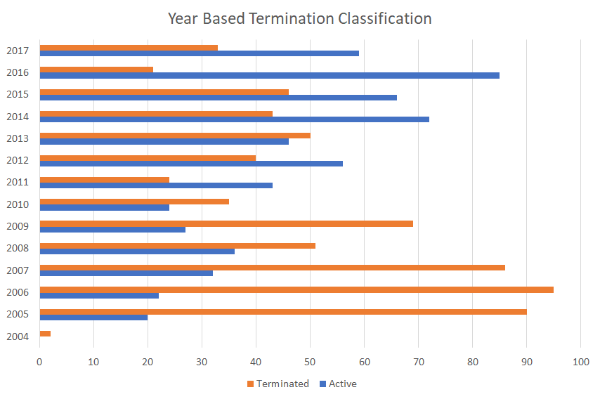
Yearly classification using CART

Slide 14
CART CONCLUSION
Classification is done basis of :
-Performance Rating
-Department
-Education
-Year
Error Rate: .3068655
Accuracy: 70%

Slide 15
C5.0
The C5.0 algorithm has become the industry standard for producing decision trees, because it does well for most types of problems directly out of the box. Compared to more advanced and sophisticated machine learning models (e.g. Neural Networks and Support Vector Machines), the decision trees under the C5.0 algorithm generally perform nearly as well but are much easier to understand and deploy

Slide 16
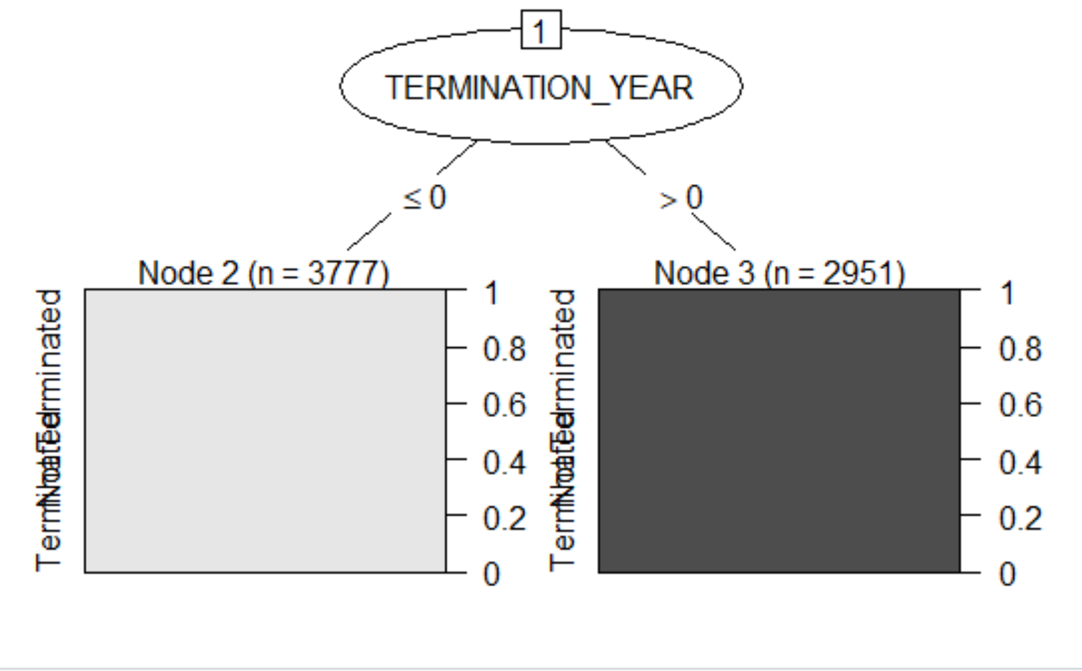
C5.0 Plot
Data Set classified on the basis of Termination Year​

Slide 17
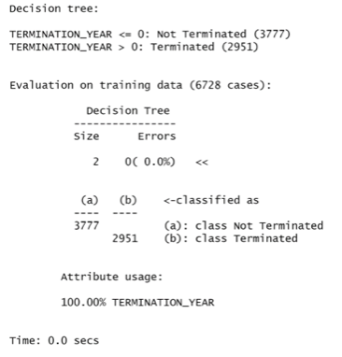
Status Based C5.0 classification

Slide 18
C5.0 CONclusion
After taking 12 columns into consideration, algorithm C5.0 is giving Decision Tree of size 2 and it's Accuracy is 100%

Slide 19

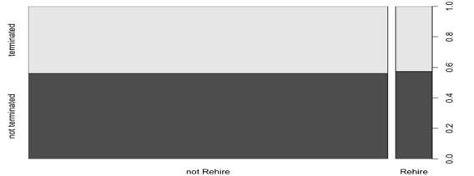
K-MEan Cluster for Rehire
Clustering is done for employee rehired or not. That creates two clusters. Cluster of rehired and not rehired are tabulate against Status column i.e. terminated or not terminated

Slide 20
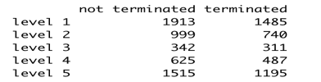
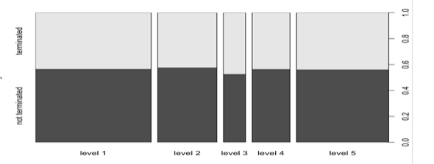
K-MEAN CLUSTER For Education level
Clustering is done for employee education level. That creates five clusters. Cluster of education level are tabulate against Status column i.e. terminated or not terminated

Slide 21

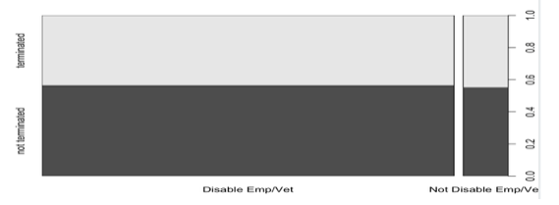
K-MEAN CLUSTER FOR DISABLE EMPLOYEE/VETERan
Clustering is done for disable employee and vet. That creates two clusters. Cluster of disable employee and vet are tabulate against Status column i.e. terminated or not terminated

Slide 22
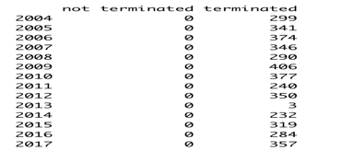
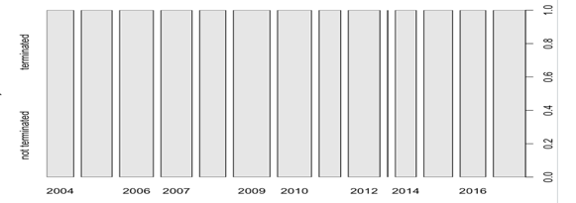
K-MEAN CLUSTER For Year of termination
Clustering is done for Year of termination. That creates 14 clusters. Cluster of Year of termination are tabulate against Status column i.e. terminated or not terminated

Slide 23
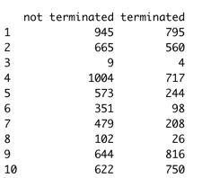
K-MEAN CLUSTER FOR CLUSTER of all DATA
Clustering is done for all factors. We creates 10 clusters. Cluster are tabulate against Status column i.e. terminated or not terminated

Slide 24
K-MEAN CLUSTER CONCLUSION
Following conclusion are drawn from K-mean cluster on given set of employment data:
- Get a meaningful intuition of the structure of the data we’re dealing with
- Cluster-then-predict where different models will be built for different subgroups if we
believe there is a wide variation in the behaviors of different subgroups

Slide 25
Artificial Neural Networks(ANN)
a system of neurodes (nodes) and weighted connections (synapses) inside the memory of a computer
nodes are data storage locations (like variables in a program, cells in a spreadsheet)
nodes are arranged in layers with weighted connections running between layers
balls represent nodes and lines represent connection weights
input layer nodes (Considered all columns) receive the data
output layer nodes (Target Node : Status) relay the response of the neural network out of the net
hidden layer nodes (5 columns considered hidden from the outside world) conduct the internal processing
data are fed into the net through the input nodes
data are processed internally by hidden nodes, based on the inter-node connection weights
result are passed on to the outside world by output nodes
“learning” takes place through adjusting connection weights
a “learned” neural network has adjusted its weights properly

Slide 26
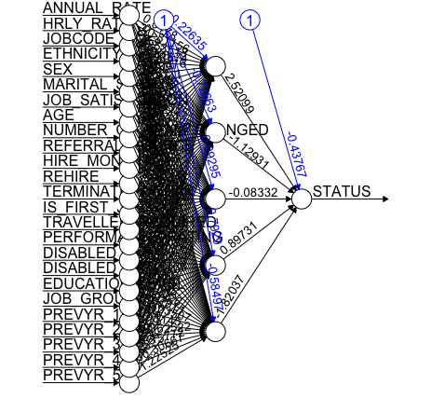
APPLICATION OF ARTIFICIAL NEURAL NETWORKS

Slide 27
Artificial Neural Networks STATUS OUTPUT
A | T
5394 | 4218

Slide 28
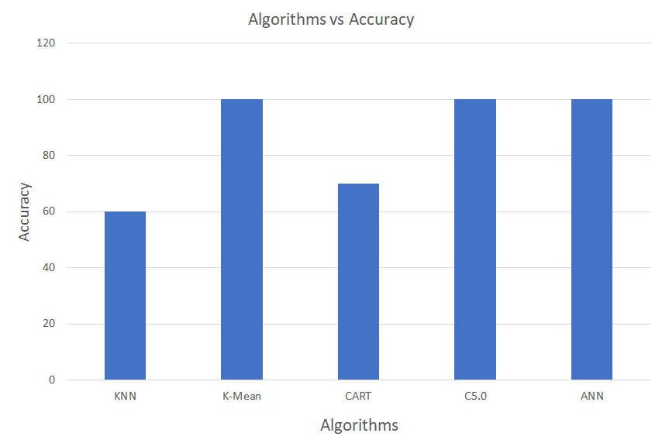
Comparison of Classification Algorithm

Slide 29
CONCLUSION
We have explored different prediction models. By measuring the performance of the models using real data, we have seen interesting results on the potential of employees leaving the company (become terminated)
As per comparison between algorithms, ANN has 0 error rate and the Maximum Accuracy of 100% for most of the attributes in predicting the potential of employees leaving the company(become terminated) data

Slide 30
Future SCOPE
Employee Efficiency and Transparent appraisal decision related data can lead to again more accuracy to predicate the potential of employees leaving the company (become terminated)
THANK YOU!

