Slide 1

Hackathon Project Identify Courses
Team – Hi Five
Aswin S 2318691
Sharan V 2318694
Syed Mateen 2318702
Gokul Rajan S 2318705
Jayagovindhan Gopu 2318706

Slide 2
Introduction
Our project is to automate the Identify Courses webpage in the Coursera website.
We achieved automation using selenium with Cucumber framework.
We used selenium java for the automation purposes, we wrote script in java and integrated with tools like Cucumber, Apache POI, Extend Reports, Maven and Jenkins.
Our team of five efficiently distributed project modules. Guided by mentors and coach, we effectively addressed any uncertainties, ensuring project completion.

Slide 3
Features
Selenium WebDriver:4.15.0
Selenium Grid: 4.19.1
Maven Repository: Maven 3.12.1
Extent Report: 5.1.1
Loggers: 2.22.0
Property File
Apache POI:5.2.5
Cucumber :7.16.1

Slide 4
Requirement
1. Search for web development courses for Beginners level & English Language and extract the course names, total learning hours & rating for first 2 courses. 2. Look for Language Learning; Extract all the languages and different levels with its total count & display them. 3. In Home page, go to "For Enterprise"; Look into Courses for Campus under Product; Fill the "Ready to transform" form with any one input invalid (example: email); Capture the error message & display (Suggested Site: coursera.org however you are free to choose any other legitimate site)

Slide 5
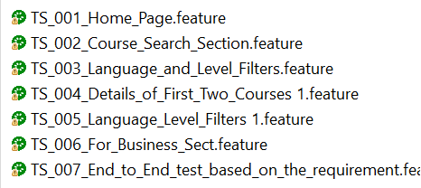
Test Scenario

Slide 6
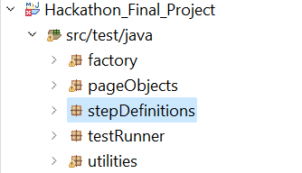
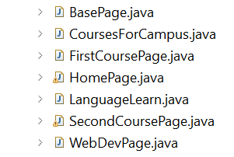


Hierarchy
(40 Test Cases)

Slide 7
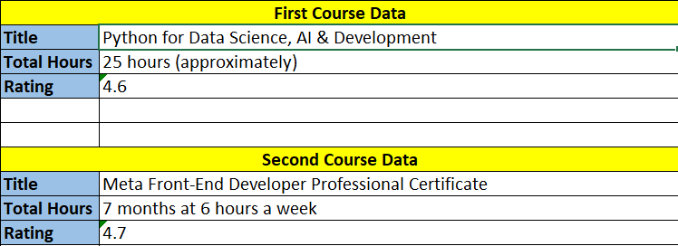
Results – Course Data of 1&2

Slide 8
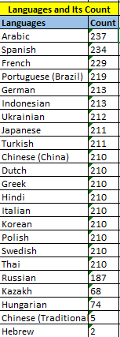
Results – Languages and its Count

Slide 9
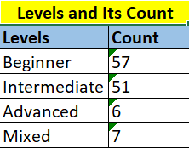
Results – Levels and its Count

Slide 10

Results – Error Message

Slide 11
Thank You

