Slide 1

Ministry/Organization Name: Ministry of Skill Development and Entrepreneurship (MSDE)
Problem Statement : "There is a need to create an engaging, supportive alumni network which is crucial to an institutions
/organizations success. Currently, there is no mechanism for the Directorate to keep a track of the trainees passing out year by year."
Team Leader Name : Syed Mazhar Ali Raza
Problem Code : DB874
College Code : Maharaja Agrasen Institute of Technology
Team Members: Darpan Chanana, Atulya Gaur, Ayushi, Chaitanya Bisht, Ashutosh Jha, Syed Mazhar Ali Raza

Slide 2

Prototype/Solution to the Problem
Due to the unavailability of a Centralised Alumni track system, we come up with the solution AlumNET. Our online portal contains the following features and will join that missing link between Admin and Alumni.
The portal will contain a centralized dashboard that will maintain the details of activity logs. Through the portal Alumni will be able to register themselves, even the previous registered Alumni can update their information accordingly.
Since Authentication is one of the important features. Hence, we will provide an
Authentication process through LinkedIn and Email.
The details can be viewed through various criteria like: passing year, placements, institutes, and much more.
Sending emails and messages, group chats are the most prominent part of our portal. This all-in-one portal is not limited to Alumni, it will allow the current student to register themselves and will help them to interact with alumni.
Considering the fact any mischievous behavior can happen features such as reporting unprofessional behavior and blocking spam content will be provided.

Slide 3





Technology Stack
FRONTEND
Reactjs for building a component- based user interface.
Redux library for storing and managing a central state of data in the frontend.
React-router library for enabling routing within the application and creating single page web app by preventing page refresh
Axios for fetching data from APIs or backend.

Slide 4


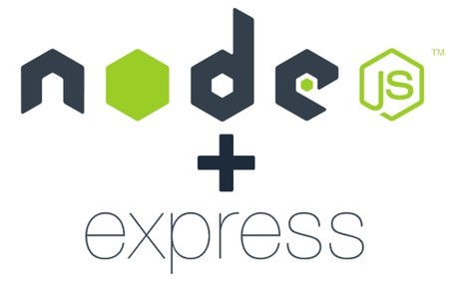



BACKEND
Node.js and Express.js for running the server and writing the middleware.
Socket.io for enabling a chat system in AlumNet.
Firebase for tracking analytics, reporting, and fixing app crashes
MongoDB for the database. We are using MongoDB Atlas for storing and maintaining data of alumni and students.
JSON Web Token (JWT) for registration, login, and authentication feature.

Slide 5

Use Case Description
For Institutes
SOFTWARE SOLUTION FOR CLEAN ALUMNI CONTACT DATA
FINANCIAL SUPPORT FOR THE INSTITUTION
INCREASED EMPLOYABILITY FOR THE STUDENT
MUTUAL SUPPORT from alumni and institute to students
Leveraging on the success of alumni
2. For Alumni
Alumni network offer networking opportunities
Participating in alumni events
Discounts from various businesses owned by the alumni
Alumni can participate in a variety of volunteer opportunities through alumnet

Slide 6
Use Case Description
3. For Students
Appropriate guidance
Referrals for internships and jobs
NETWORKING AND EXPOSURE OPPURTUNITIES
Helping new talent in brand building
Access to various college resources at one place

Slide 7
Dependencies/Show-Stopper
The main and most important thing is verification of the user, and large number of verifications can be a show-stopper. Here, it will be done through email and LinkedIn that will be saved in the college database. The alumni will get an email of its successful account completion.
Considering the fact malicious and mischievous things can occur. In the portal, there will be a report feature available. Even though we will include the things like a block from community feature as well if a number of times that things will occur from a user side.
For Dependencies below things are must:
Google-based Authentication along with an in-built login and registration system.
Need of college alumni’s database for data verification.
Data connection (3G/4G)

Slide 8


