Slide 1

SmartGrid Renewable Energy Management

Slide 2
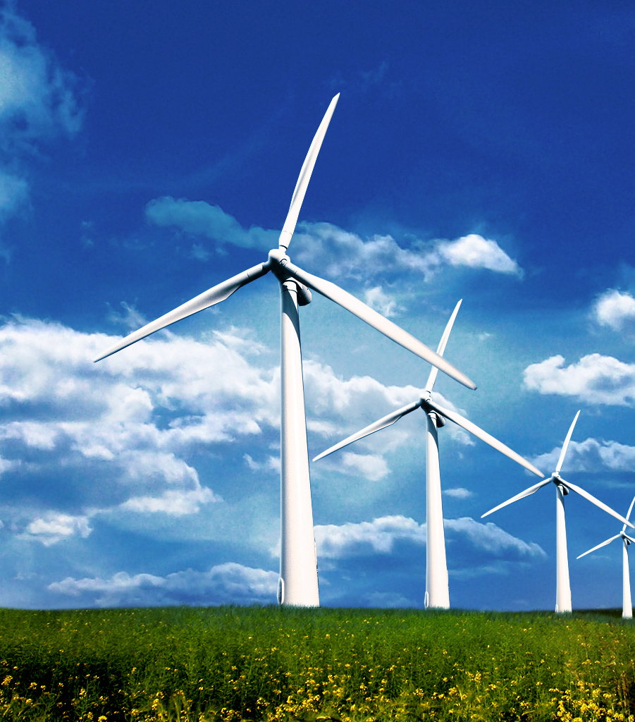
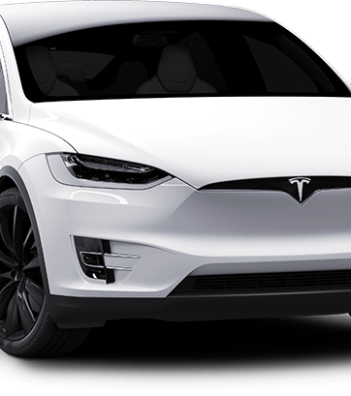
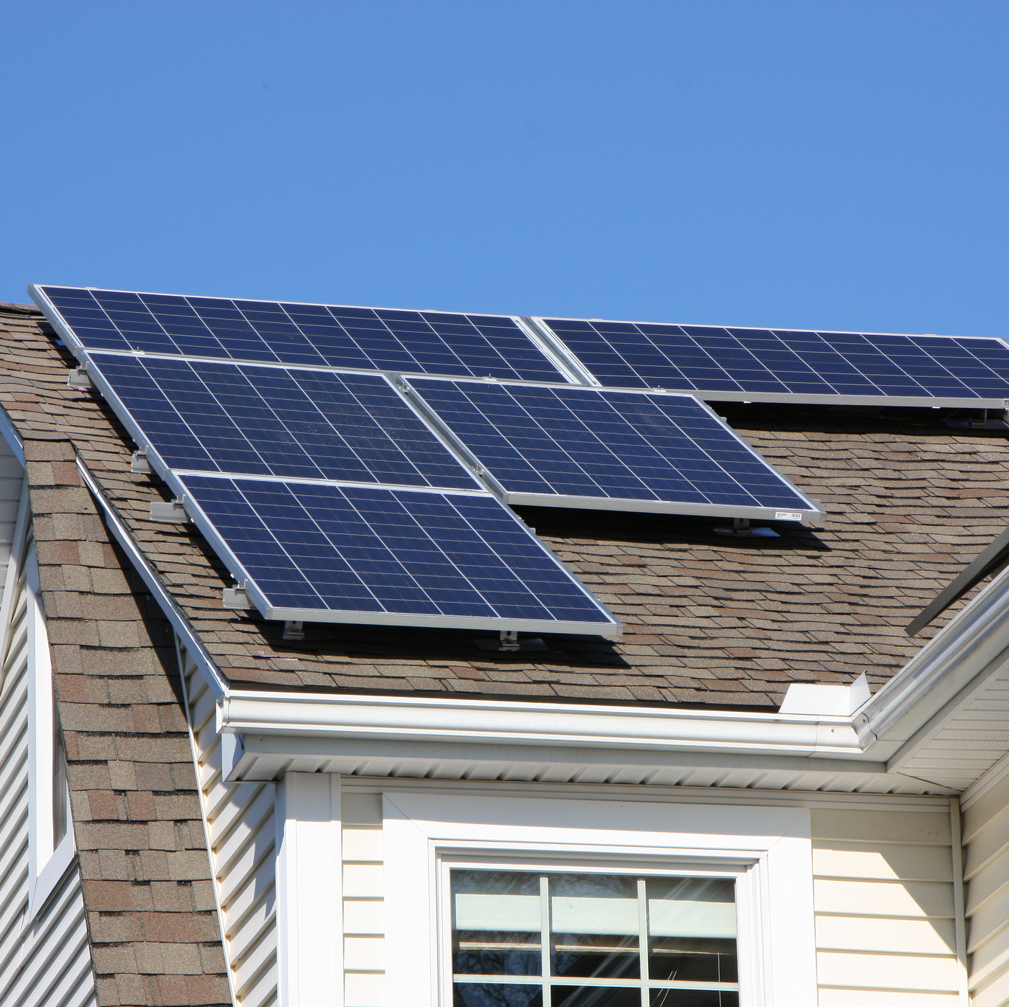

Slide 3
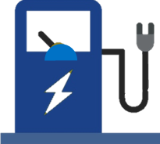
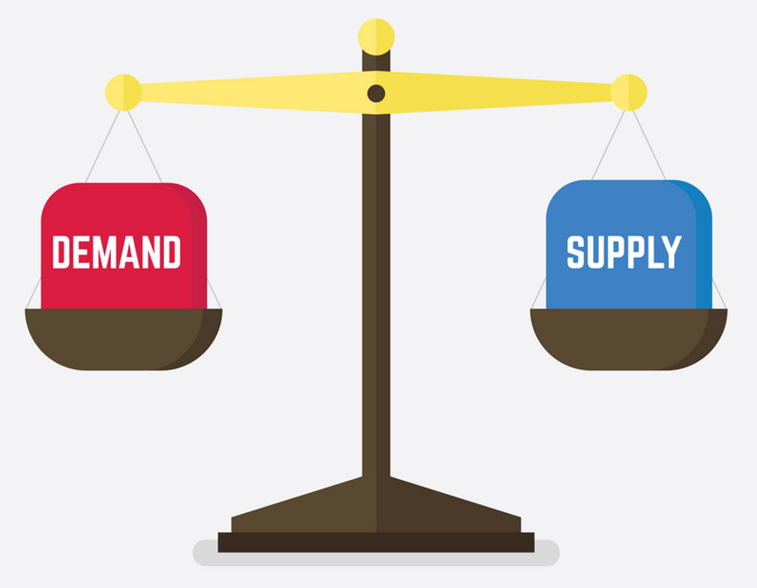
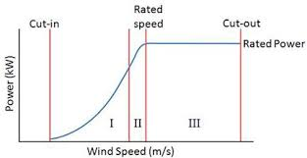
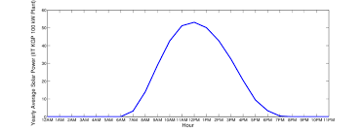
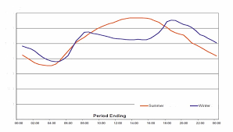

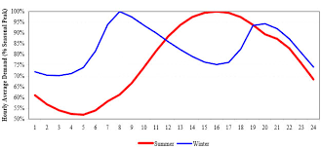
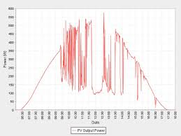
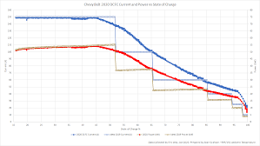
Managing Increasing Complexity
Utility-scale Storage
Producer
Retail
Transmission network
Distribution Network
Gas
Coal
Industry
Home
EV Charging Stations
Baseload Power Station
Solar Farms
Wind Farms
Nuclear Power
Supply
Demand
Commercial Buildings
EV Fleet
Local Solar Farms
Prosumer
Consumer
Notes:
1. Wind Speed vs. Power output
2. Daily Power Variability
3. Seasonal Power Supply Variability
4. Seasonal Power Demand Variability
5. Consumer DER Power Supply

Slide 4
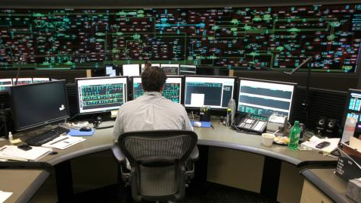
Notes:
Current methods require solvers that are run once or twice a day based on current predictions. Operators monitor the system and can make minor changes througout the day based on a few PMU sensors on the grid.
What happens when clouds unexpectedly form and all of the generation from one part of the grid disappears?
DOn’t have the computing power to run the solvers continuously. Can’t react at the frequency that the renewable energy generation might change once it gets to more than 50% of the available power.

Slide 5

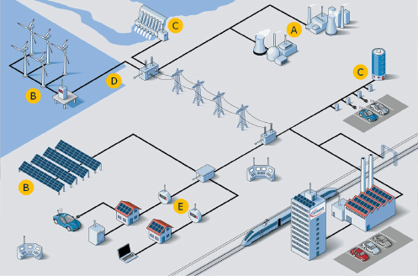
Notes:
Enter Autonomous AI
A data scientist is hired to take the current grid circuit model and PMU sensors to monitor frequency and create a deep reinforcement learning model to build a brain that can adapt to changes in weather and community behavior (like plugging in EVs as they move around town or adding new solar power systems to their homes).
The new AI is connected to the Distribution Management System and takes over for the operator on parts of the grid with large amounts of solar energy. It manages the switches and battery storage to more efficiently power the grid when there are fluctuations in the demand or supply of energy

Slide 6
CO2e
Emissions
Wasted
Energy
Outages
C
C
C
Notes:
Significantly reduce CO2e emissions by increasing use of renewable energy beyond 50% of the grid
Avoid dumping extra generation = increased profit
Avoid cascading grid failures since operators have simplified job and not as prone to make mistakes from data overload
https://www.bing.com/newtabredir?url=https%3A%2F%2Fwww.smart-energy.com%2Findustry-sectors%2Fsmart-energy%2Famerican-powernet-halts-dumping-excess-solar-grid%2F

