Slide 1
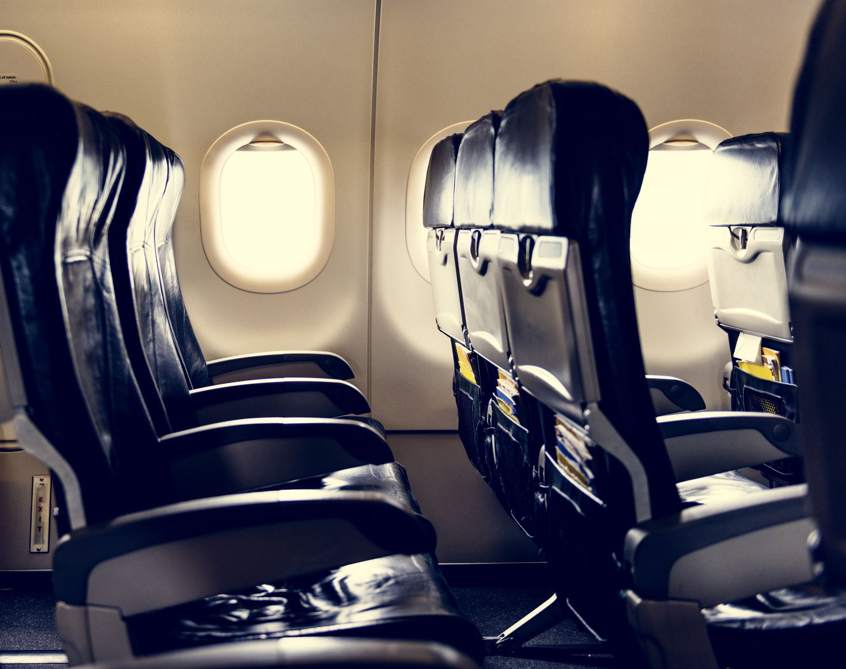
Airline Baggage Handling Opportunity
Airlines handle and move tens of thousands of baggage a day
Human baggage handlers have a labor intensive and logistically intensive job to move bags to their destination
Because of the scale, bags can be mishandled or lost during the transportation process
Airlines want to optimize this process by aiding baggage handlers

Slide 2

Automation helps
Automated conveyor belts help speed up the process
The airline knows how far away the destination is
Baggage handlers track bag checkpoints from scanning the baggage tag

Slide 3
Challenges
Bottlenecks and baggage congestion can accumulate which further slow down the baggage transportation process
Environmental changes such as flight delays due to weather and staffing are dynamically changing
There could be multiple different routes to take a baggage from point A to B
Human baggage handlers could still misplace bags

Slide 4

Solution
Design a brain to apply autonomous AI
Learn best baggage route
Learn to calibrate for environmental variables
Switch strategies when bottlenecks occur
Provide suggestions for best action on transporting baggage
Compare efficiency and performance against current human and semi-automated processes

Slide 5
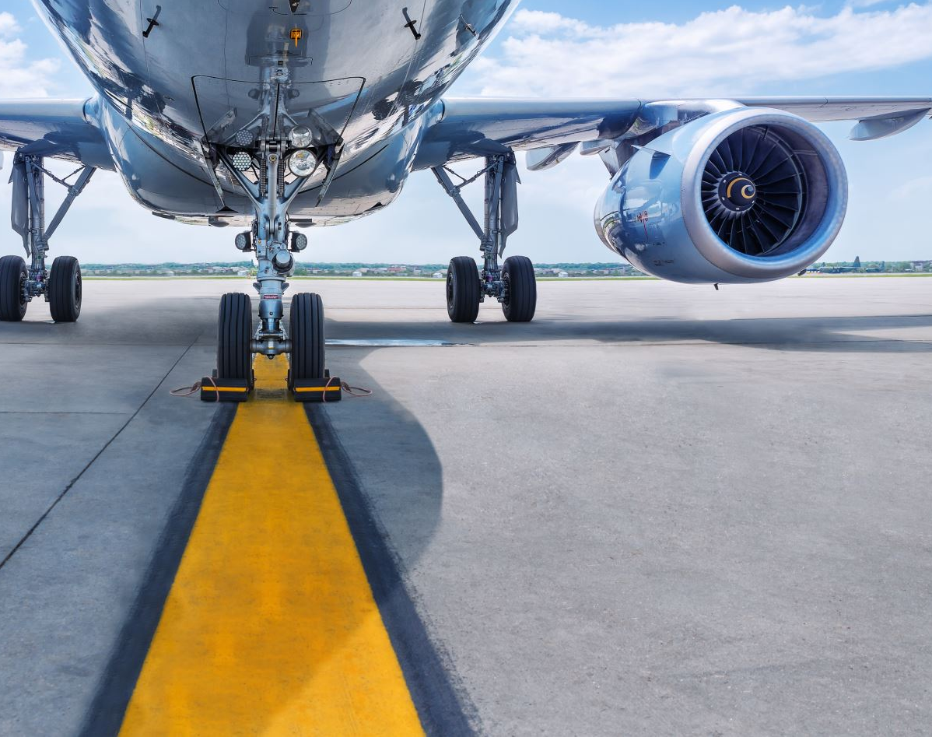
Value
More efficient baggage handlers from smarter automation
Reduce baggage mishandling, loss, and damage
Reduce time to load and unload airplane
Provide better ETAs for passengers on when to expect their bag

