Slide 1
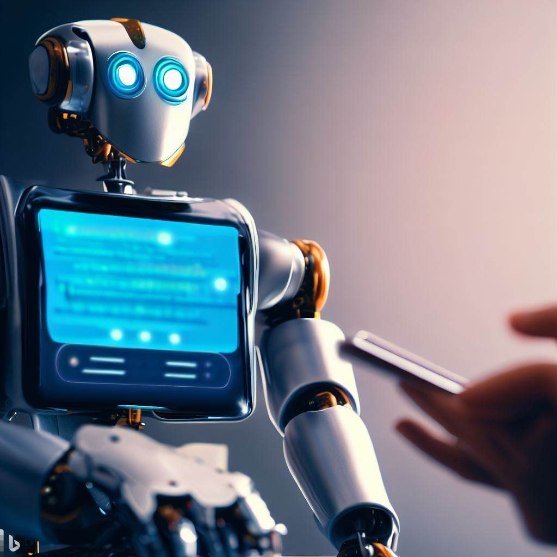
Chatgpt
A giant neural network of 175 billion parameters

Slide 2
Neural networks
ChatGPT is basically a neural network of type “Deep Learning Neural Networks”
It tries to represents natural language in the form of neural network language
One interesting analogy is to call ChatGPT a “Stochastic Parrot” or “Autocomplete on steroids” – we will see soon why is that?

Slide 3
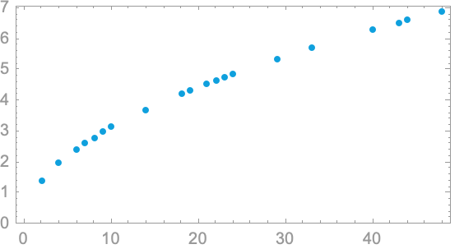
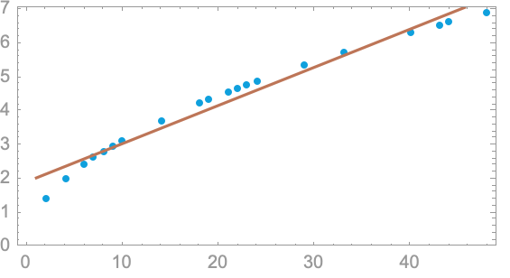
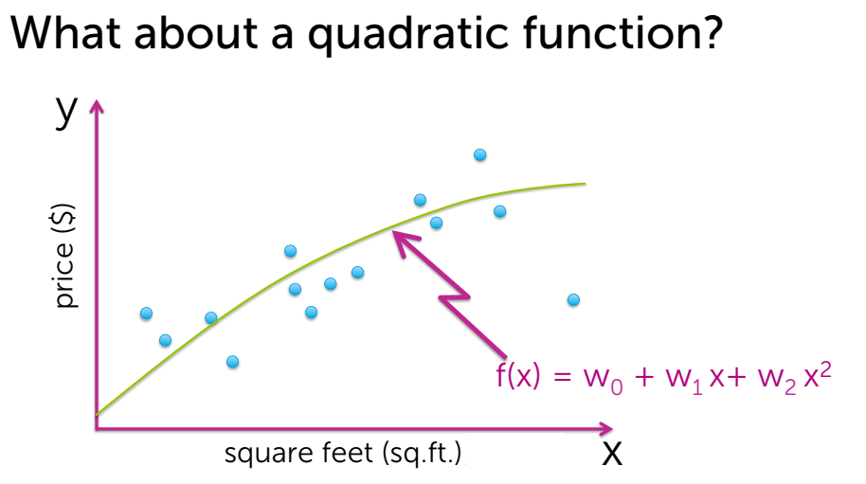
Simple Machine Learning Model

Slide 4
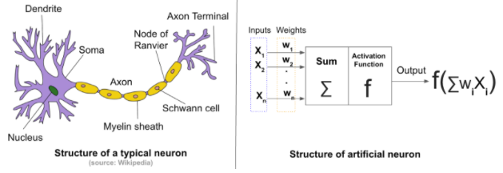
Neural networks
Neural networks are a type of machine learning algorithm that are inspired by the structure and function of the human brain
They are used for a wide range of applications, including image recognition, natural language processing, and predictive analytics

Slide 5
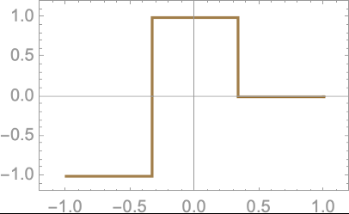
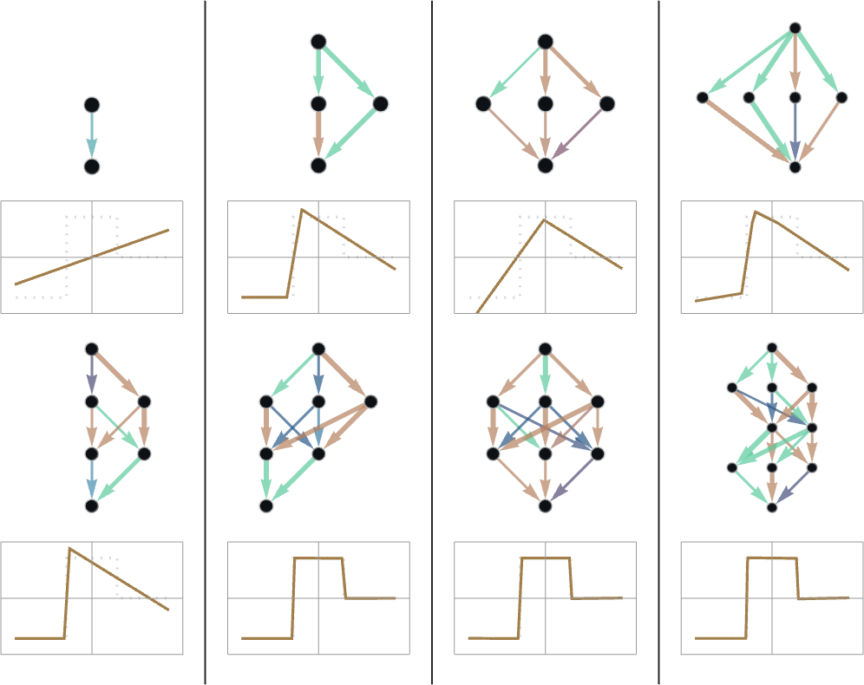
What is Learning in Neural Nets?
Example function
Learning here means “Finding weights that make the neural net successfully reproduce the examples given”
The basic idea is to supply lots of “input → output” examples to “learn from”—and then to try to find weights that will reproduce these examples.
Learning is measured by “How accurately target function is learnt by a neural network?
Learning the function by neural net

Slide 6
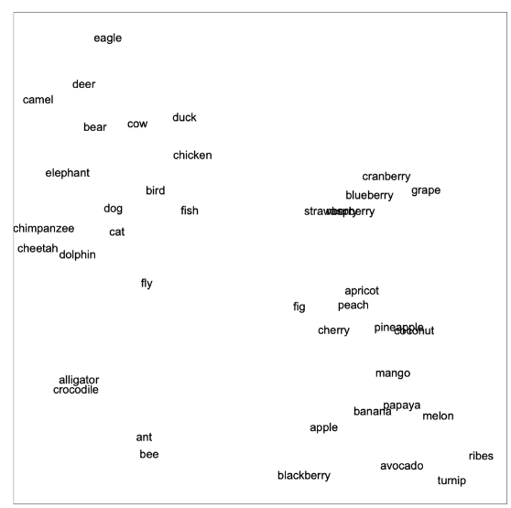
ChatGPT?
Embeddings
- Text is represented as numbers because neural networks work on numbers only
Nearby in meaning
Roughly 5 billion words from the web
Alligator is close to crocodile
One number is assigned to each of the most common 50,000 ENGLISH words
GPT-3 Network
Specialized neural network trained on 175 billion weights
Particularly trained for dealing with languages
Particular architecture is called as “Transformer”
Overall goal is to continue text in a “reasonable” way, based on what it’s seen from the training it’s had

Slide 7
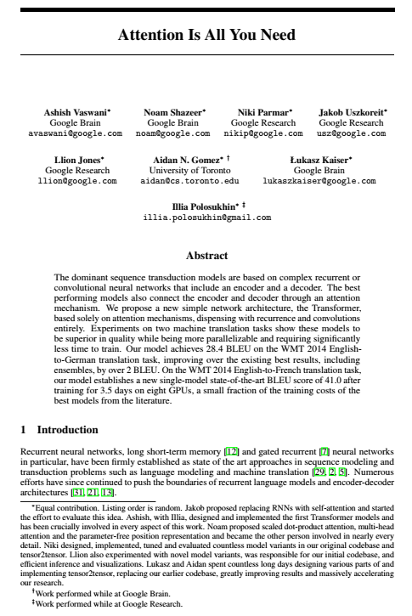
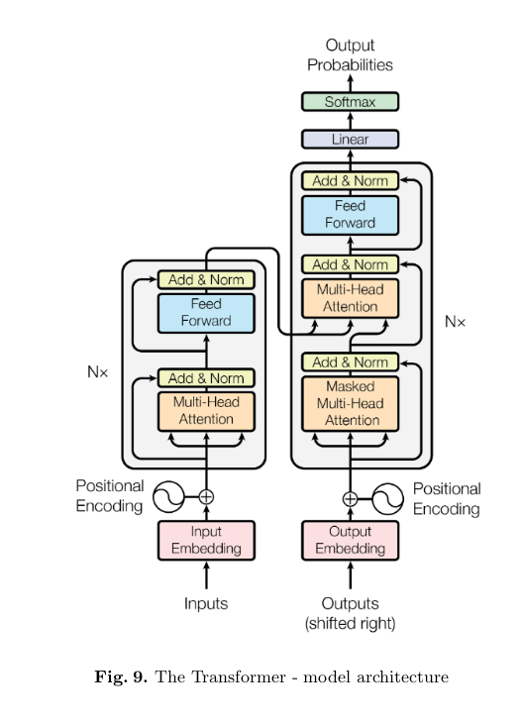
Attention is all you need!
This is the title of paper released in 2017 on Transformer neural networks which forms the original inspiration of various Large language models (LLMs); one of them being latest iteration of GPT3.5 or commonly called as “ChatGPT”.
A neural network is an effort to mimic human brain actions in a simplified manner. Attention Mechanism is also an attempt to implement the same action of selectively concentrating on a few relevant things, while ignoring others in deep neural networks.
Encoder – decoder architecture based on transformer neural networks is introduced in this paper.

Slide 8
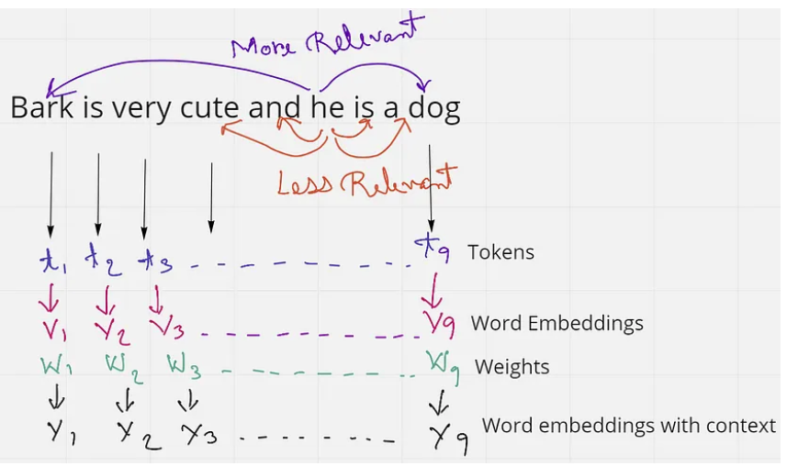
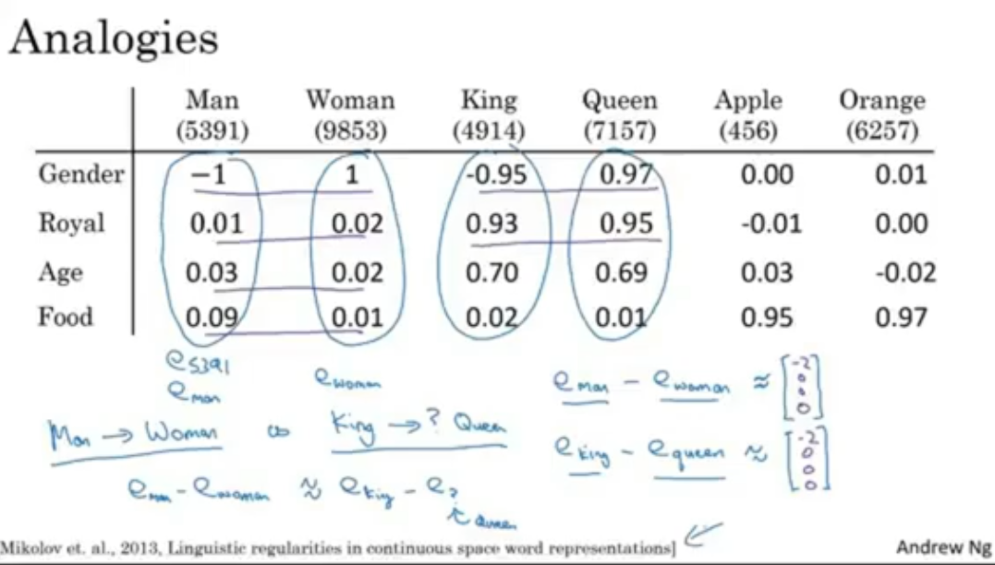
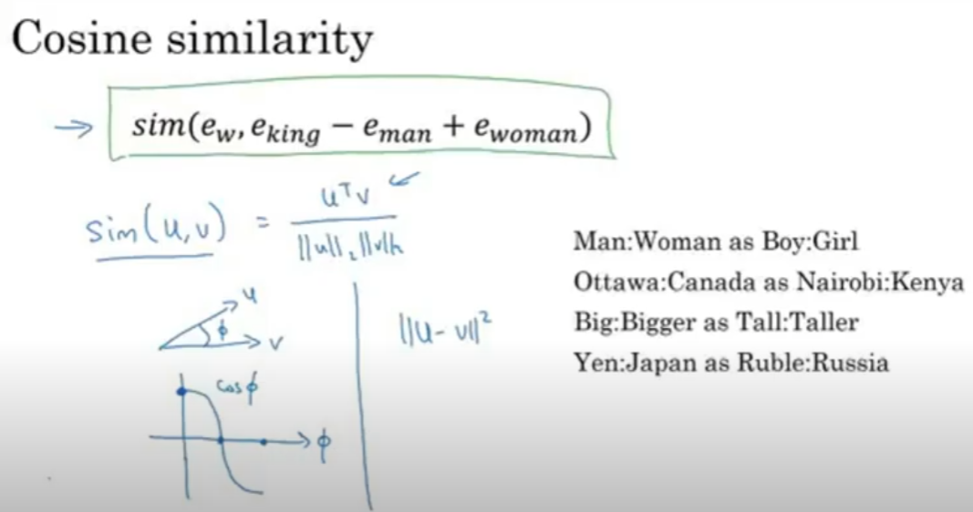
Self-Attention
This sentence has 9 words or tokens. If we just consider the word ‘he’ in the sentence, we see that ‘and’ and ‘is’ are the two words in close proximity to it. But these words do not give the word ‘he’ any context. Rather the words ‘Bark’ and ‘dog’ are much more related to ‘he’ in the sentence. From this, we understand that proximity is not always relevant, but context is more relevant in a sentence.
In an embedding space, similar words appear closer together or have similar embeddings. Such as the word ‘king’ will be more related to the word ‘queen’ and ‘royalty’, than with the word ‘zebra’. Similarly, ‘zebra’ will be more related to ‘horse’ and ‘stripes’, than with the word ‘emotion’.

Slide 9
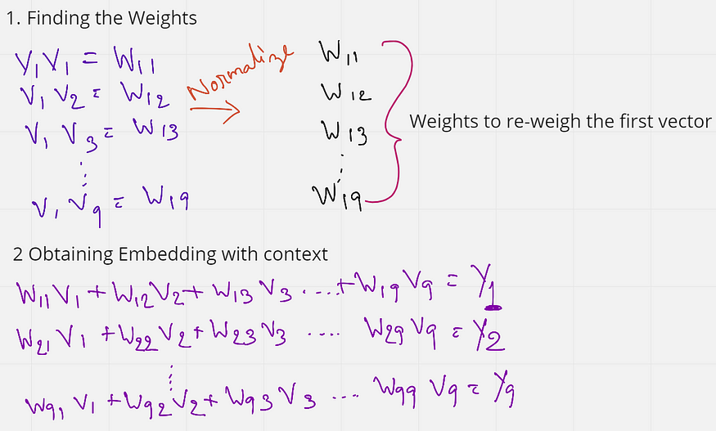
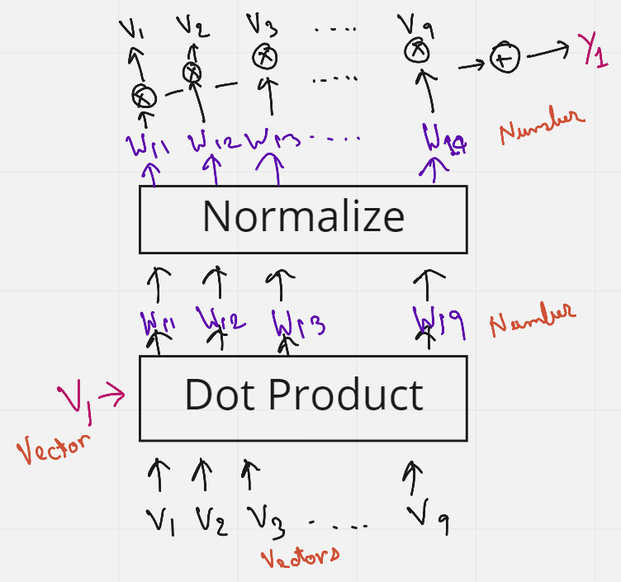
We first find the weights by multiplying (dot product) the initial embedding of the first word with the embedding of all other words in the sentence. These weights (W11 to W19) are also normalized to have a sum of 1. Next, these weights are multiplied with the initial embeddings of all the words in the sentence.
W11 V1 + W12 V2 + …. W19 V9 = Y1
W11 to W19 are all weights that have the context of the first word V1. So when we are multiplying these weights to each word, we are essentially reweighing all the other words towards the first word. So in a sense, the word ‘Bark’ is now tending more towards the words ‘dog’ and ‘cute’, rather than the word that comes right after it. And this, in a way gives some context.
What is interesting here is that no weights are trained, the order or proximity of the words have no influence on each other. Also, the process has no dependency on the length of the sentence, that is, more or fewer words in a sentence do not matter. This approach of adding some context to the words in a sentence is known as Self-Attention.

Slide 10
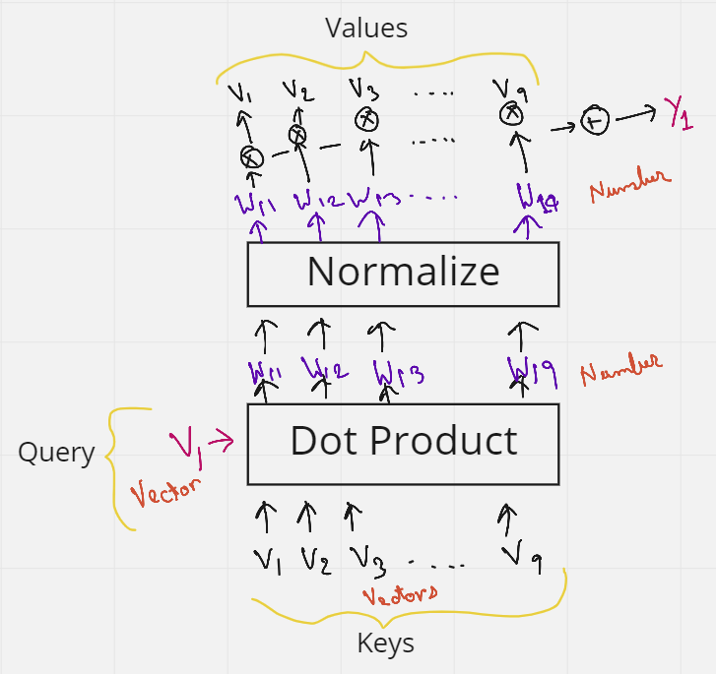
Query, Key & Values
Let's say we want to make all the words similar with respect to the first word V1. We then send V1 as the Query word. This query word will then do a dot product with all the words in the sentence (V1 to V9) — and these are the Keys. So the combination of the Query and the Keys give us the weights. These weights are then multiplied with all the words again (V1 to V9) which act as Values. There we have it, the Query, Keys, and the Values.
The issue with Self-Attention is that nothing is being trained. But maybe if we add some trainable parameters, the network can then learn some patterns which give much better context. This trainable parameter can be a matrix whose values are trained. So the idea of Query, Key, and Values was introduced.
Let's again consider the previous sentence — “Bark is very cute and he is a dog”. We saw earlier that the initial word embeddings (V) are used 3 times. 1st as a dot product between the first word embedding and all other words (including itself, 2nd) in the sentence to obtain the weights, and then multiplying them again (3rd time) to the weights, to obtain the final embedding with context. These 3 occurrences of the V’s can be replaced by the three terms Query, Keys, and Values.

Slide 11
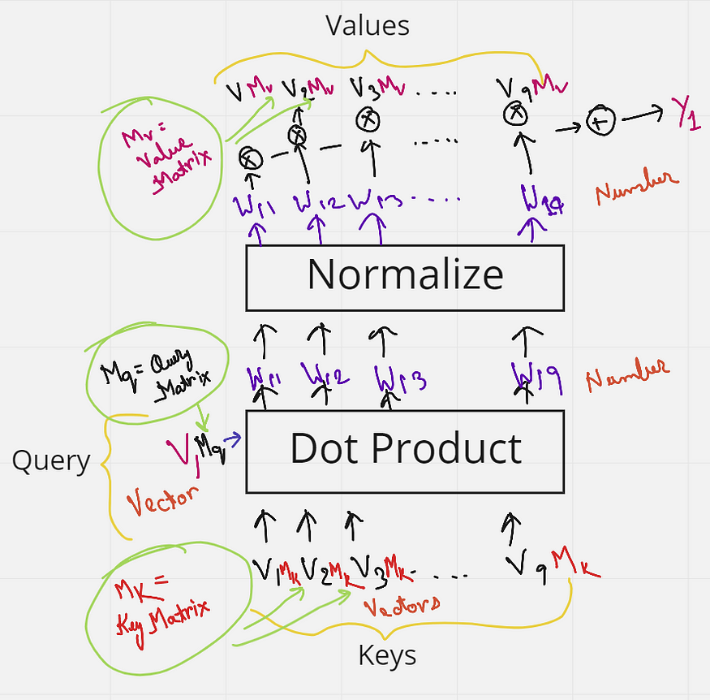
Trainable Matrix
But we have not added any matrix that can be trained yet. We know, if a 1 x k shaped vector is multiplied with a k x k shaped matrix, we get a 1 x k shaped vector as output. Keeping this in mind let's just multiply each key from V1 to V10 (each of shape 1 x k), with a matrix Mk (Key matrix) of shape k x k. Similarly, the query vector is multiplied with a matrix Mq (Query matrix) and the Values vectors are multiplied with Values matrix Mv. All the values in these matrices Mk, Mq, and Mv can now be trained by the neural network, and give much better context than just using self-attention.

Slide 12
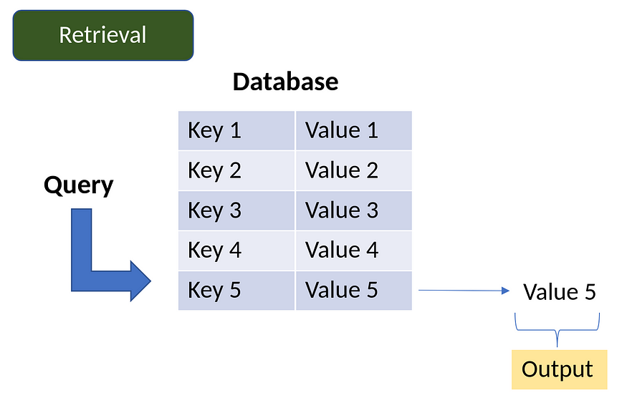
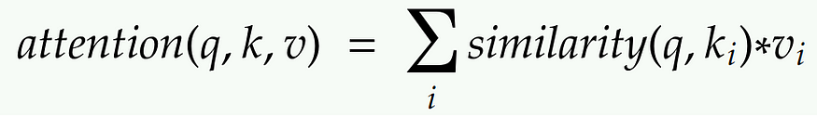
Database Analogy
So, in a database, if we want to retrieve some value vi based on a query q and key ki, some operations can be done where we can use a query to identify a key that corresponds to a certain value. Attention can be thought to be a similar process to this database technique but in a more probabilistic manner. This is demonstrated in the figure below. Suppose we send a query into the database, some operations will find out which key in the database is the most similar to the query. Once the key is located, it will send out the value corresponding to that key as an output. In the figure, the operation finds that the Query is most similar to Key 5, and hence gives us the value 5 as output.
The Attention mechanism is a neural architecture that mimics this process of retrieval.
1. The attention mechanism measures the similarity between the query q and each key-value ki.
2. This similarity returns a weight for each key value.
3. Finally, it produces an output that is the weighted combination of all the values in our database.
The only difference between database retrieval and attention in a sense is that in database retrieval we only get one value as input, but here we get a weighted combination of values. In the attention mechanism, if a query is most similar to say, key 1 and key 4, then both these keys will get the most weights, and the output will be a combination of value 1 and value 4.

Slide 13
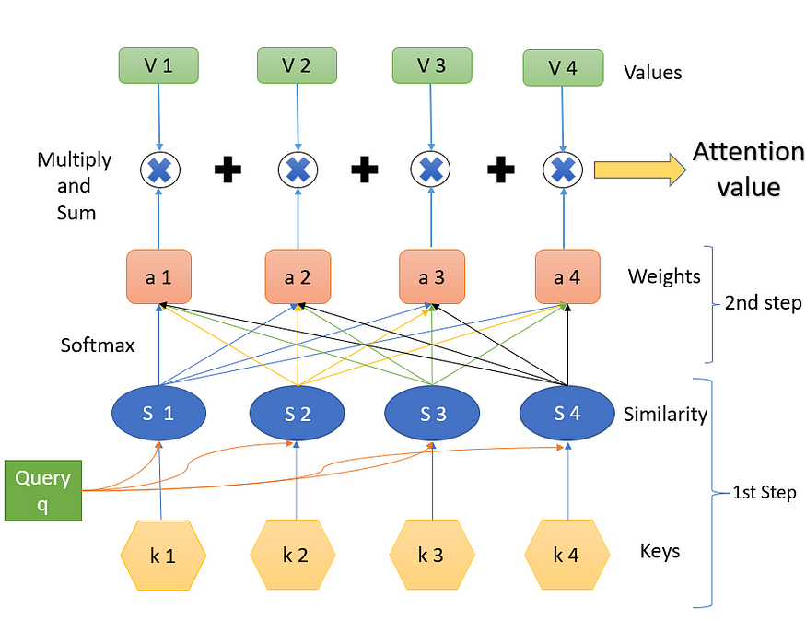
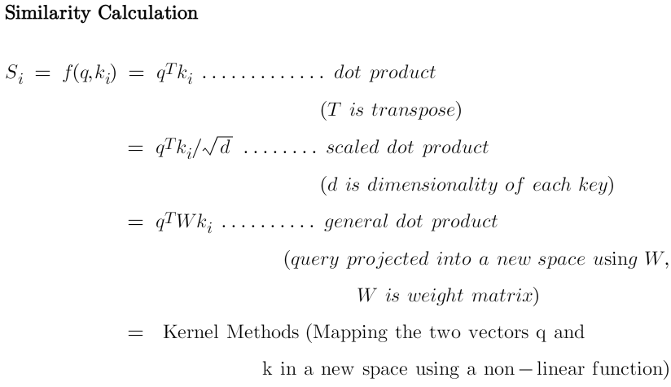
Attention Value
(The key values k are vectors, the Similarity values S are scalars, the weight values (softmax) values a are scalars, and the Values V are vectors)
Step-1
Step 1 contains the keys and the query and the respective similarity measures. The query q influences the similarity. What we have are the query and the keys, and we calculate the similarity. The similarity is some function of the query q and the keys k. Both the query and the keys are some embedding vectors. Similarity S can be calculated using various methods as below.

