Slide 1
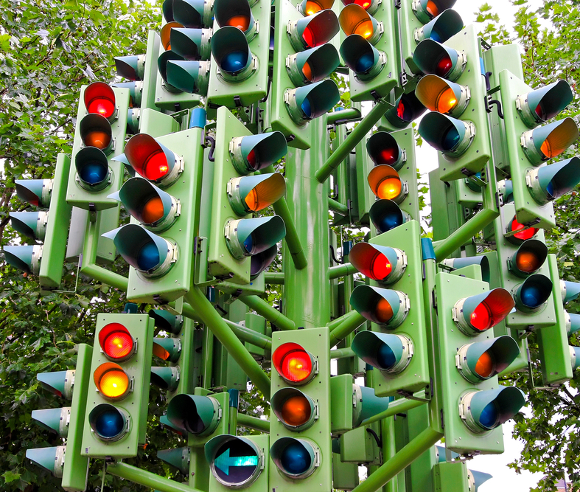
Adaptive Traffic Lights Control By Autonomous AI Brain
Harry Zhang
Assignment-3
Jan 21, 2022

Slide 2
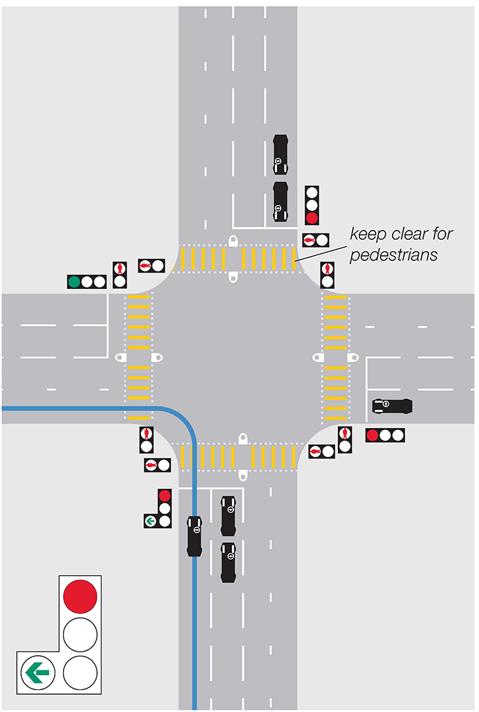
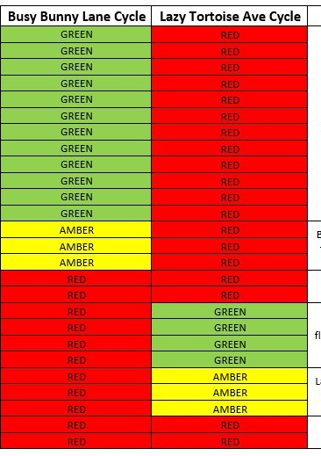
Traditional Traffic Light Control System
The Green, Yellow and Red lights go On and Off at regular and synchronized intervals

Slide 3
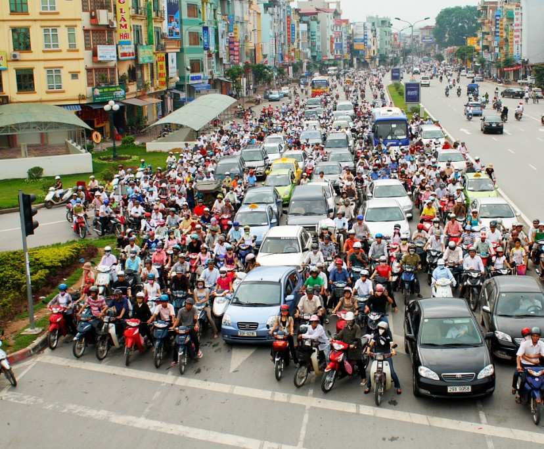
Opportunities
Traffic congestion is one of the most burning problems faced by many metropolitans
Traffic flow change can be caused by large number of factors (working hours, holiday, weather, accident, tourist, police /ambulance on duty, pedestrians et al.)
Traditional traffic lights control are not able to adapt dynamic change of the traffic at the cross section
With limited traffic infrastructure resources in the city, adaptive traffic light will help to reduce the traffic ingestion

Slide 4
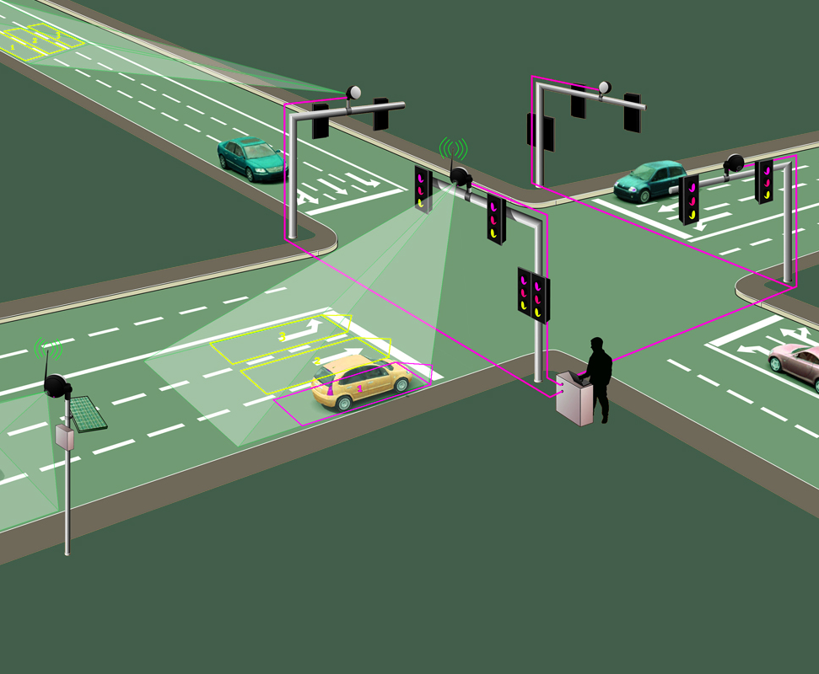
Build Autonomous AI Brain For Adaptive Traffic Light Control
Simulation of traffic flow at cross section
State: traffic status at each time point
Action: traffic light change control and duration
Optimization by reward: Minimize average waiting time or Maximize traffic flow throughput.
Training goal: optimal light control policy at each traffic status to maximize the traffic throughput at the cross section.
Real world implementation
Camera or LiDR sensor can be used to collect traffic status data
Adaptive traffic light control for multiple cross sections.

Slide 5
Benefit
Reduce traffic congestion to improve commute efficiency
Reduce traffic accidents caused by frequent stops
Reduce gas emission amount to have better urban environment

