Slide 1
Catering Services Inception
Review, Scope, Architecture, Release Plan
July 2, 2018

Slide 2
Agenda
Assessment
System Overview
Logical Architecture & Technology Stack
Themes & Epics
Environment
Epics- Iteration Plan
Risk & Mitigation
Timeframe – Release Plan
Q & A

Slide 3
Assessment
During the four days of Inception, team has brainstormed to perform the design and planning activities needed to create a proposal that presents different meal plans based on employee count available on a particular day.
The aim of the project is to develop a simple, intuitive and appealing web application that would send a request with employee count to system which gives meal plan as an output
The goal of the project is to build a web application targeted to prepare food plan that has below features:
Light weight business rule engine with input as employee count, outputs no. of sandwich, salads and smoothie
Create web-app for user to check out manually what he/she bought, this should be registered for eating pattern for him/her.
Each menu item assigned with some heath points which goes into loyalty program for user
Each Friday top 5 users from loyalty program gets food on discount
At the end of each day – Inventory report for stock and create requisition in p2p system.
Feedback app – simulated via web-app running on tab screen.

Slide 4
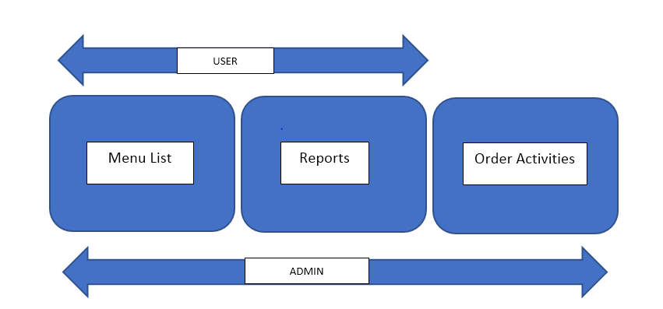
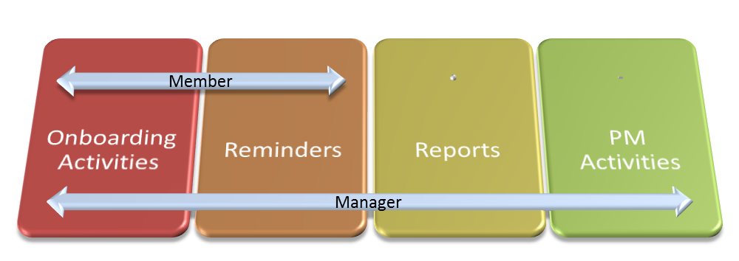
System Overview

Slide 5
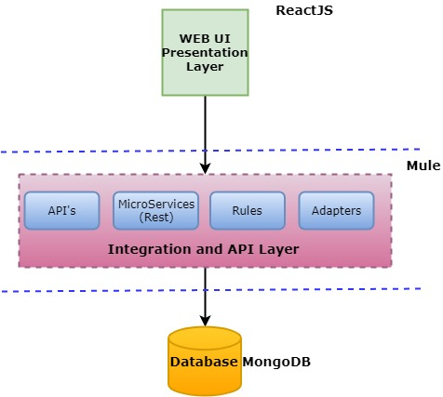
Proposed Logical Architecture & Technology Stack

Slide 6
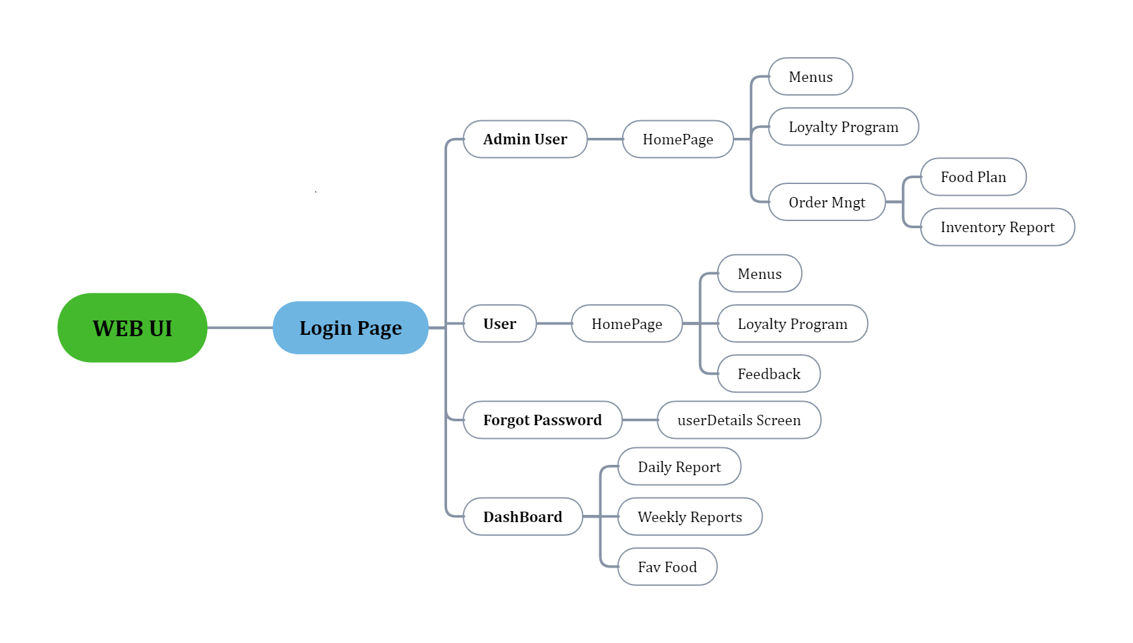
Themes & Epics with business priority

Slide 7
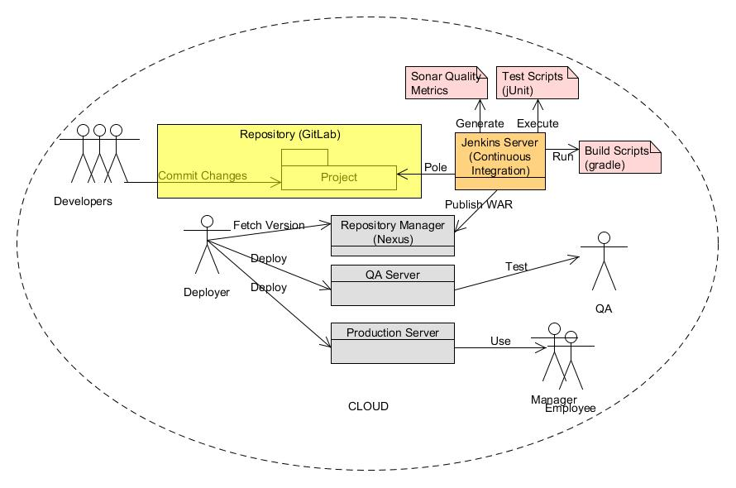
Environment

Slide 8
Epics – Iterations Plan
Iteration 1 – Deliverables
Environment Setup
Technical Readiness
Login Implementation
Feed back Implementation
Project Management
Iteration 2 – Deliverables
User Perspective--Order Management( Place & View Order)
Admin Perspective—Inventory Management(View Stock)
Rule Engine Framework
CI/CD Implementation
User– Loyalty Program
Project Management
Iteration 3 - Deliverables
Admin Perspective— Order Management
Rule Engine –Food Patterns
Reports
Inventory Management
Iteration 4 – Deliverables
Rule Engine –Food Patterns\
Order Management
Reports
Project Management

Slide 9
Risk and Mitigation
Technology Challenges
Get help from a lead on ReactJS
Exploring Business Rules in Mule

Slide 10
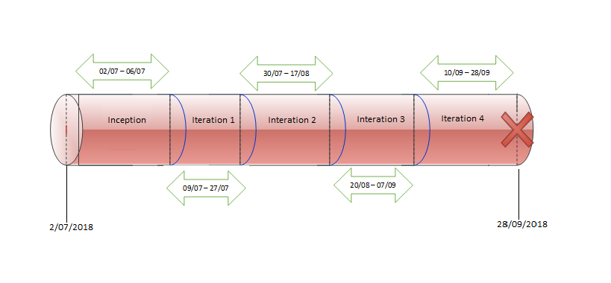
Timeframe - Releases Plan

Slide 11
Questions & Answers
Q & A

Slide 12
Thank-you

