Slide 1
Onboarding Inception
Review, Scope, Architecture, Release Plan
March 22, 2016

Slide 2
Agenda
Assessment
System Overview
Themes & Epics
Model Diagram
Wireframes
Logical Architecture & Technology Stack
Environment
Epics - Release Plan - MVP
Epics - Release Plan – Good To Have
Out of Scope
Risk & Mitigation
Timeframe – Release Plan
Cost Estimate
Q & A

Slide 3
Assessment
During the four days of Inception, team has brainstormed to perform the design and planning activities needed to create a proposal that presents different meal plans based on employee count available on a particular day.
The aim of the project is to develop a simple, intuitive and appealing web application that would send a request with employee count to system which gives meal plan as an output
The goal of the project is to build a web application targeted to prepare food plan that has below features:
Light weight business rule engine with input as employee count, outputs no. of sandwich, salads and smoothie
Create web-app for user to check out manually what he/she bought, this should be registered for eating pattern for him/her.
Each menu item assigned with some heath points which goes into loyalty program for user
Each Friday top 5 users from loyalty program gets food on discount
At the end of each day – Inventory report for stock and create requisition in p2p system.
Feedback app – simulated via web-app running on tab screen.

Slide 4
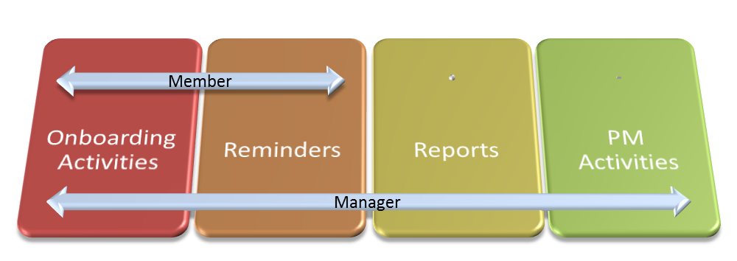
System Overview

Slide 5
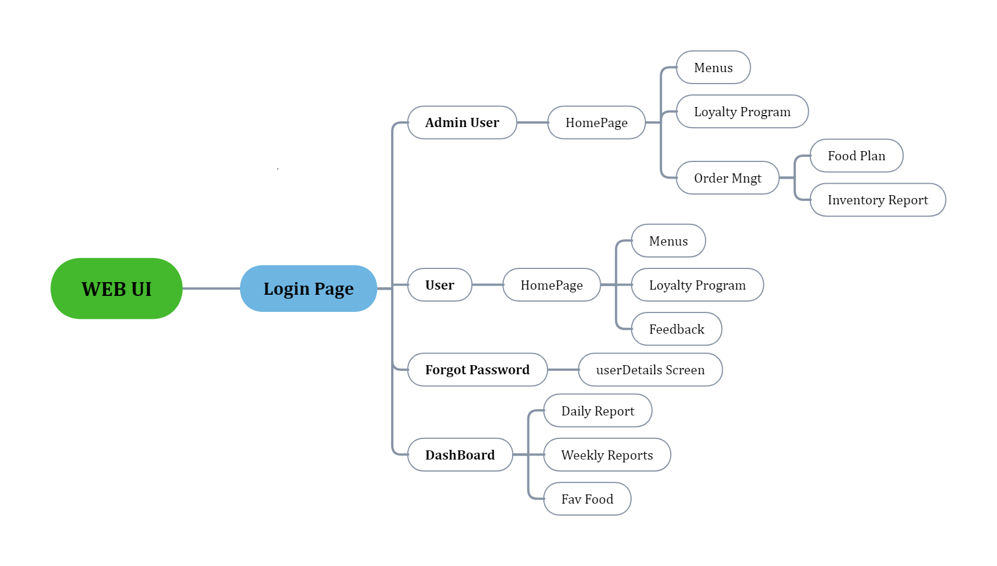
Themes & Epics with business priority

Slide 6
Model Diagram

Slide 7
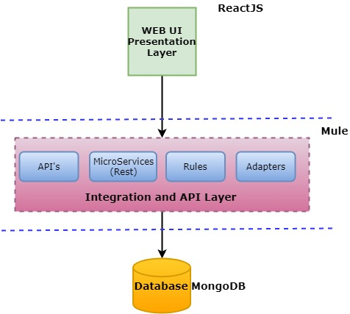
Proposed Logical Architecture & Technology Stack

Slide 8
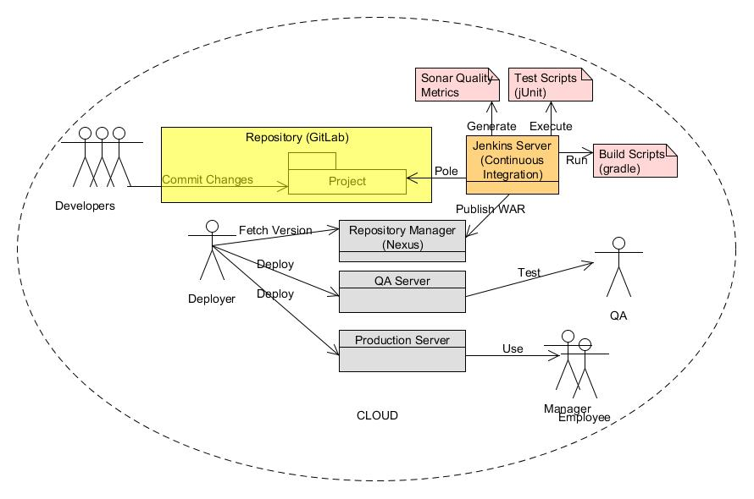
Environment

Slide 9
Primary Scope
Onboarding Activities
Reminders
Reports
Project Management Activities

Slide 10
Epics – Iterations Plan
Iteration 1 – Deliverables
Member tasks
Member profile
Manager tasks
Project members
Manage projects
Reminders
Framework setup
Iteration 2 – Deliverables
Member tasks
Member profile
Manager tasks
Project members
Manage projects
Reminders
Iteration 3 - Deliverables
Iteration 4 - Deliverables

Slide 11
Risk and Mitigation
Technology Challenges
Mitigate by ensuring we get training on AngularJS
Get help from a lead on SpringWS
Mobile first strategy
Mitigated by creating POCs at the beginning of the project.
Jazzy UI
Mitigated by creating POCs at the beginning of the project.

Slide 12
Timeframe - Releases Plan

Slide 13
Questions & Answers
Q & A

Slide 14
Thank-you

