Slide 1
Proxy Courses
A peer-tutoring and advising platform for IUB students
Progress review · Tasks 1–3: Software Process, Requirements, Design
Syed Mehedi Hussain · 2310690
Arafat Hossain · 2420834
Rukaiya Tabassum · 2420183
Meharab Hossen Opi · 2420832
CSE451 / CSC445 Software Engineering
Autumn 2026 · Independent University, Bangladesh
Faculty: Md Masum Billah
Proxy Courses · 1/19

Slide 2
CONTEXT
The problem and our answer
• Problem
  – Learners struggle in specific IUB courses; coaching is costly and off-syllabus
  – Seniors who aced the course are found only by luck (Facebook groups)
  – No trust: no grade check, no reviews, no refunds
  – Faculty and club advice is scattered
• Proxy Courses
  – Tutors with an admin-verified A / A- in the course
  – ৳500 semester subscription; 70/30 split (80/20 for top tutors)
  – Free intro video + free live demo before paying; clear refund rule
  – Free booking with faculty advisors and club executives
  – Responsive web app first; one API ready for mobile later
Proxy Courses · 2/19

Slide 3
STATUS
Where we are
Task | Marks | Status
1 Software Process | 10 | Done: 3 / 3 items, 1 diagram
2 Requirements Engineering | 22 | Done: 16 / 16 items, 6 diagrams
3 Software Design | 16 | Done: 9 / 9 items, 6 diagrams
4 Product Metrics | 14 | Next
5 Quality Attributes | 10 | Planned
6 Testing | 18 | Planned (test plan drafted)
7 Project Management | 18 | Planned
8 Risk Management | 12 | Planned (6 risks drafted)
• Also written
  – PRD: 36 FRs, 12 NFRs
  – Architecture, data model, API
  – Roadmap M1–M4
  – Stack ADR: Next.js + PostgreSQL
  – Payments ADR: mock gateway → SSLCommerz
• 48 of 120 marks' worth of work drafted
Proxy Courses · 3/19

Slide 4
SOFTWARE PROCESS
Task 1 · Choosing the process model
Criterion | Weight | Waterfall | Spiral | Scrum + XP
C1 Copes with changing requirements | 0.25 | 1 | 4 | 5
C2 Early working software | 0.20 | 1 | 3 | 5
C3 Fits 14 weeks, task every 2 weeks | 0.20 | 3 | 2 | 5
C4 Produces graded documents | 0.20 | 5 | 4 | 3
C5 Risk control, small team | 0.15 | 2 | 5 | 4
Weighted score | 1.00 | 2.35 | 3.55 | 4.45
• Chosen: Scrum + XP + MoSCoW
  – Pricing and refund rules will change after interviews
  – 7 two-week sprints = 7 task deadlines
  – XP: pair work, PR review, CI on every push
  – Weak spot (docs) fixed: each sprint's Definition of Done includes its task document
Proxy Courses · 4/19

Slide 5
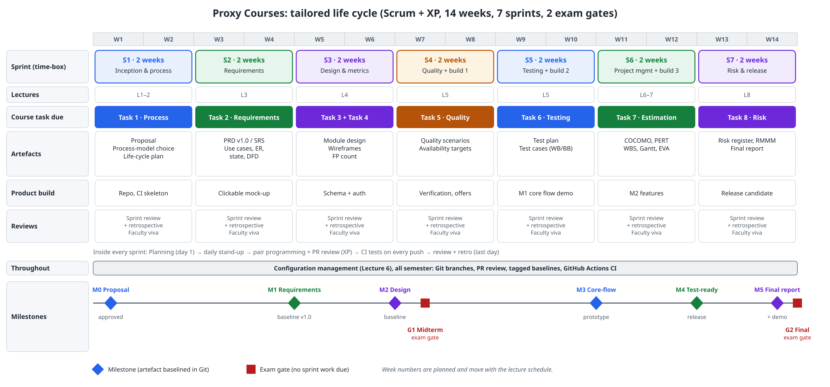
SOFTWARE PROCESS
Task 1 · Tailored life cycle
Proxy Courses · 5/19

Slide 6
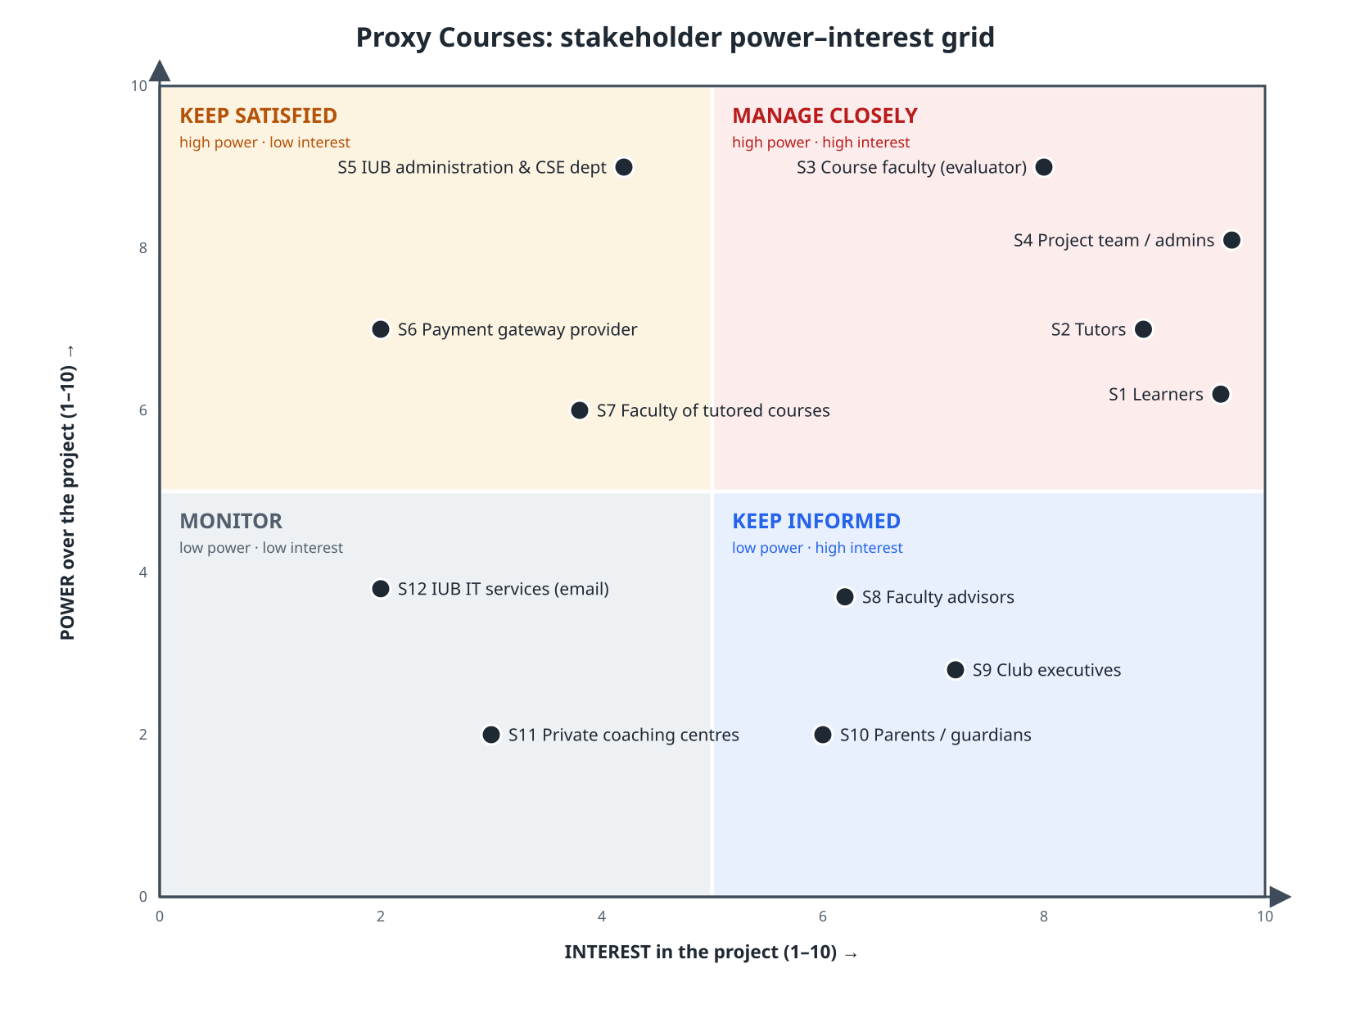
REQUIREMENTS
Task 2 · 12 stakeholders on a power–interest grid
• Manage closely: learners, tutors, course faculty, team
• Keep satisfied: IUB administration, payment gateway, faculty of tutored courses
• Keep informed: advisors, club executives, parents
• Monitor: coaching centres, IUB IT
• Elicitation: 9 interviews · survey (≥ 50) · analysis of 30 Facebook posts
Proxy Courses · 6/19

Slide 7
REQUIREMENTS
Task 2 · Requirements catalogue and user stories
Catalogue | Count
Functional requirements | 36
Must / Should / Could | 28 / 7 / 1
Won't (v1) | 6 items
Non-functional, each with a metric | 12
User stories (INVEST-checked) | 6
Use cases | 15
• Example NFR metrics
  – Search p95 ≤ 500 ms with 1,000 offerings
  – ≥ 99.0% monthly uptime (≤ 7.3 h down)
  – 0 transcripts reachable by other users
  – WCAG 2.1 AA: 0 serious axe-core issues
• INVEST caught 2 problems
  – US-3 too big → split into mock-pay and real gateway
  – US-5 depended on US-4 → seeded test data
Proxy Courses · 7/19

Slide 8
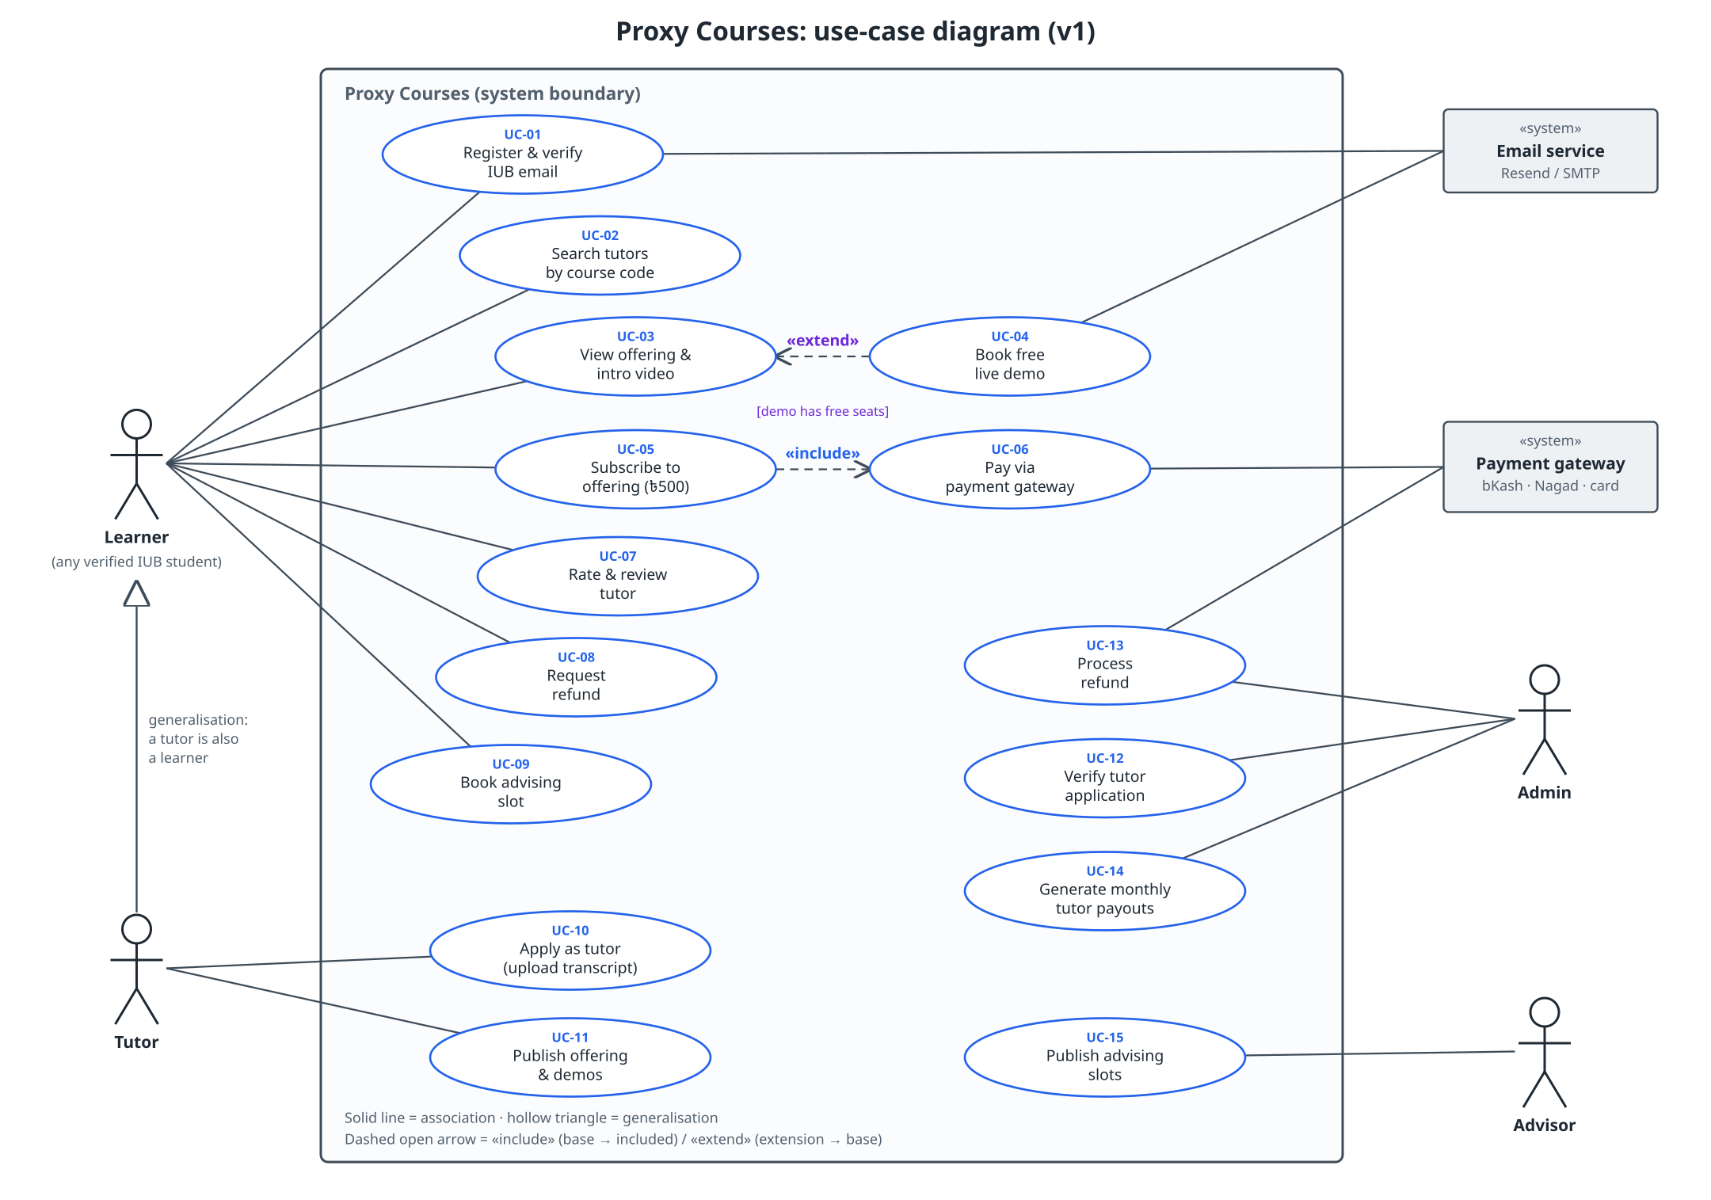
REQUIREMENTS
Task 2 · Use-case diagram (15 use cases, 6 actors)
• «include»: Subscribe always includes Pay via gateway
• «extend»: Book free demo extends View offering [seats free]
• Generalisation: a tutor is also a learner
• Fully dressed: UC-05 Subscribe, with 6 extensions (failed payment, forged callback, duplicate callback…)
Proxy Courses · 8/19

Slide 9
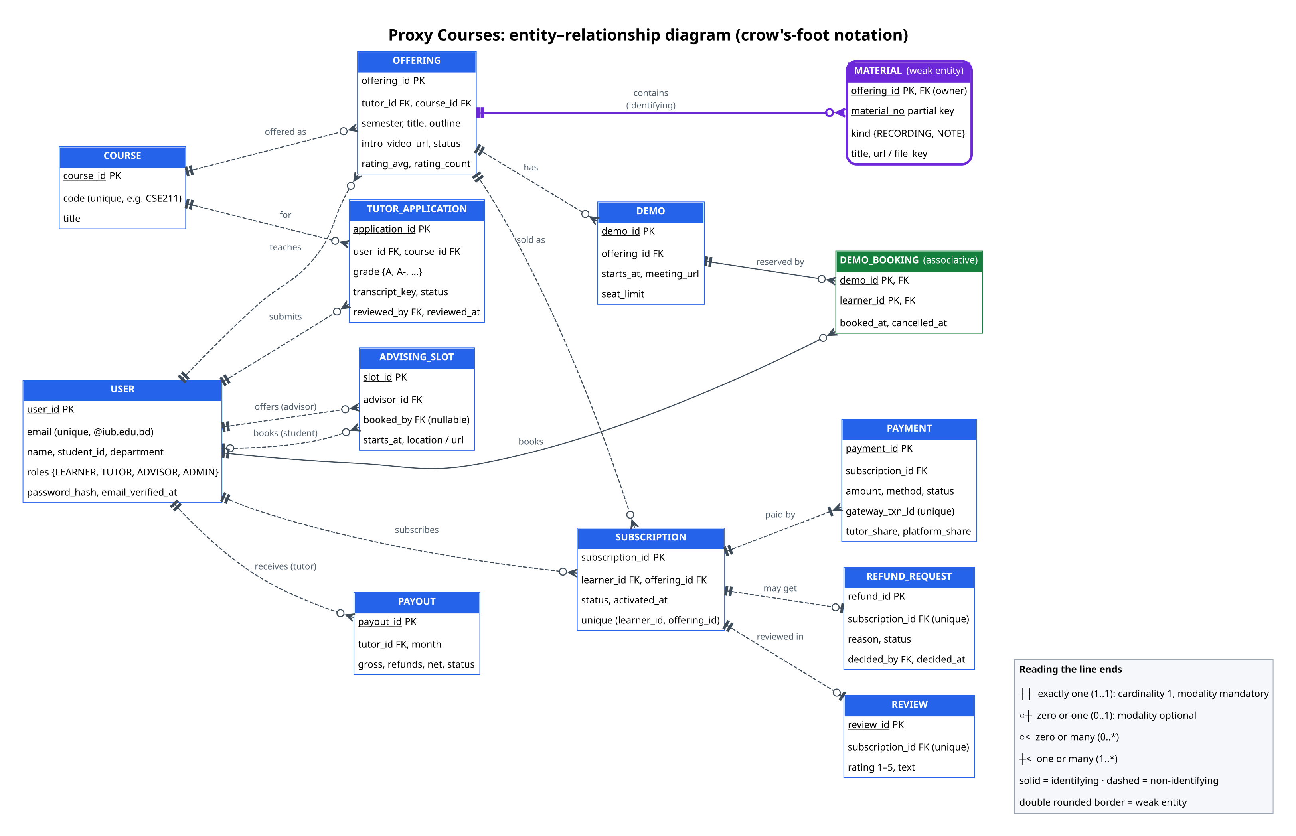
REQUIREMENTS
Task 2 · ER diagram (crow's foot)
• 13 entities, PKs underlined
• Weak entity: MATERIAL (owner OFFERING + material_no)
• Associative: DEMO_BOOKING
• Rules in the model: REVIEW and REFUND hang off SUBSCRIPTION (0..1), so only subscribers can review
Proxy Courses · 9/19

Slide 10
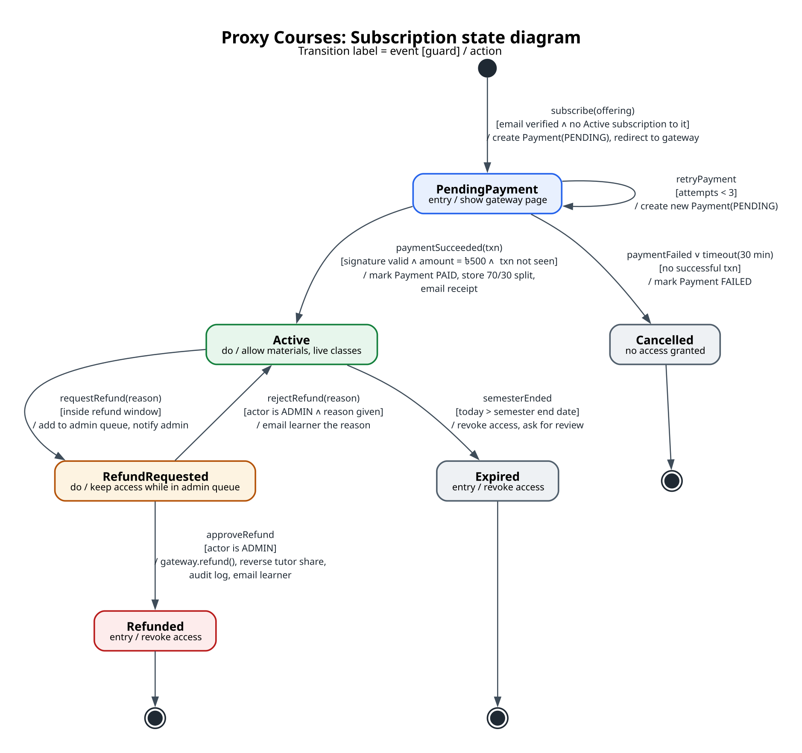
REQUIREMENTS
Task 2 · Subscription state diagram
• 6 states: PendingPayment, Active, Cancelled, RefundRequested, Refunded, Expired
• Every transition = event [guard] / action
  – paymentSucceeded [signature valid ∧ amount = ৳500 ∧ txn new] / mark PAID, store split
  – requestRefund [inside window] / add to admin queue
• Guards prevent double charging and access without payment
Proxy Courses · 10/19

Slide 11
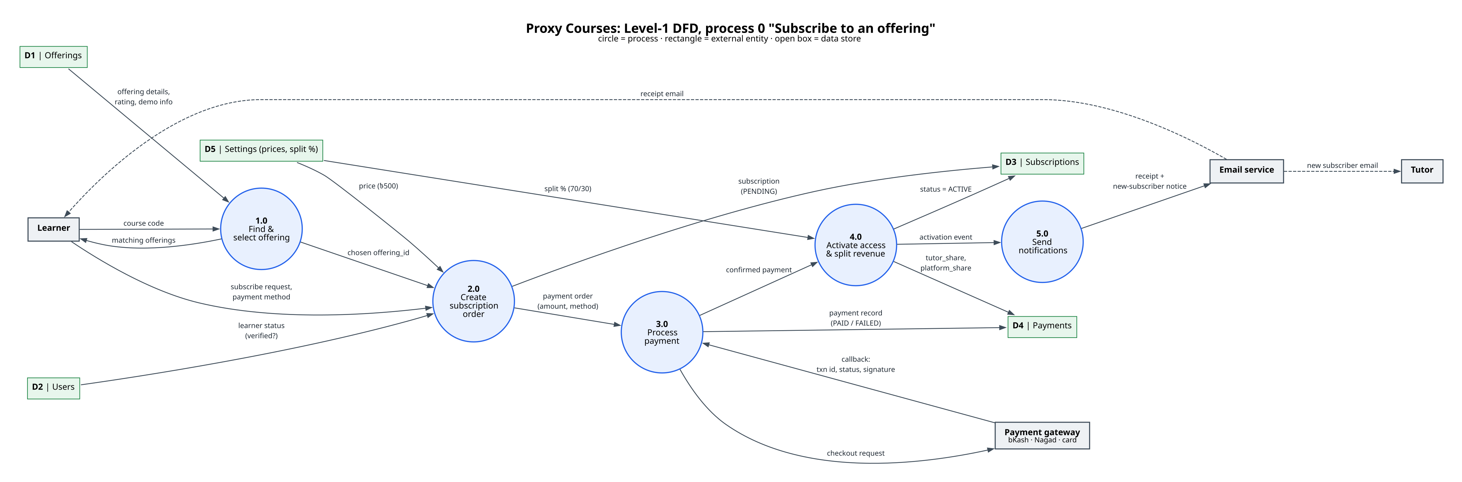
REQUIREMENTS
Task 2 · Level-1 DFD: “Subscribe to an offering”
5 processes (find → order → pay → activate & split → notify) · 4 external entities · 5 data stores · flows balance with the context-level process
Proxy Courses · 11/19

Slide 12
REQUIREMENTS
Task 2 · Negotiation, review and traceability
• Win-win 1: refunds vs tutor income
  – Full refund within 14 days and before the 3rd live class; later only by dispute (to confirm with interviews)
• Win-win 2: trust vs transcript privacy
  – Public sees “✓ Verified A in CSE211”; only admins see the transcript
• 8-question review on FR-16, FR-25, NFR-01
  – Found 3 ambiguities, 2 gaps, 1 conflict, all fixed
Req. | Use case | Module | Test
FR-16 | UC-02 | M4 Discovery | TC-06
FR-19 | UC-04 | M5 Booking | TC-07
FR-22 | UC-06 | M7 Payments | TC-09
FR-25 | UC-08 | M6 Subscriptions | TC-12
NFR-05 | UC-10/12 | M2, M12 | TC-18
… 21 rows in total
Proxy Courses · 12/19

Slide 13
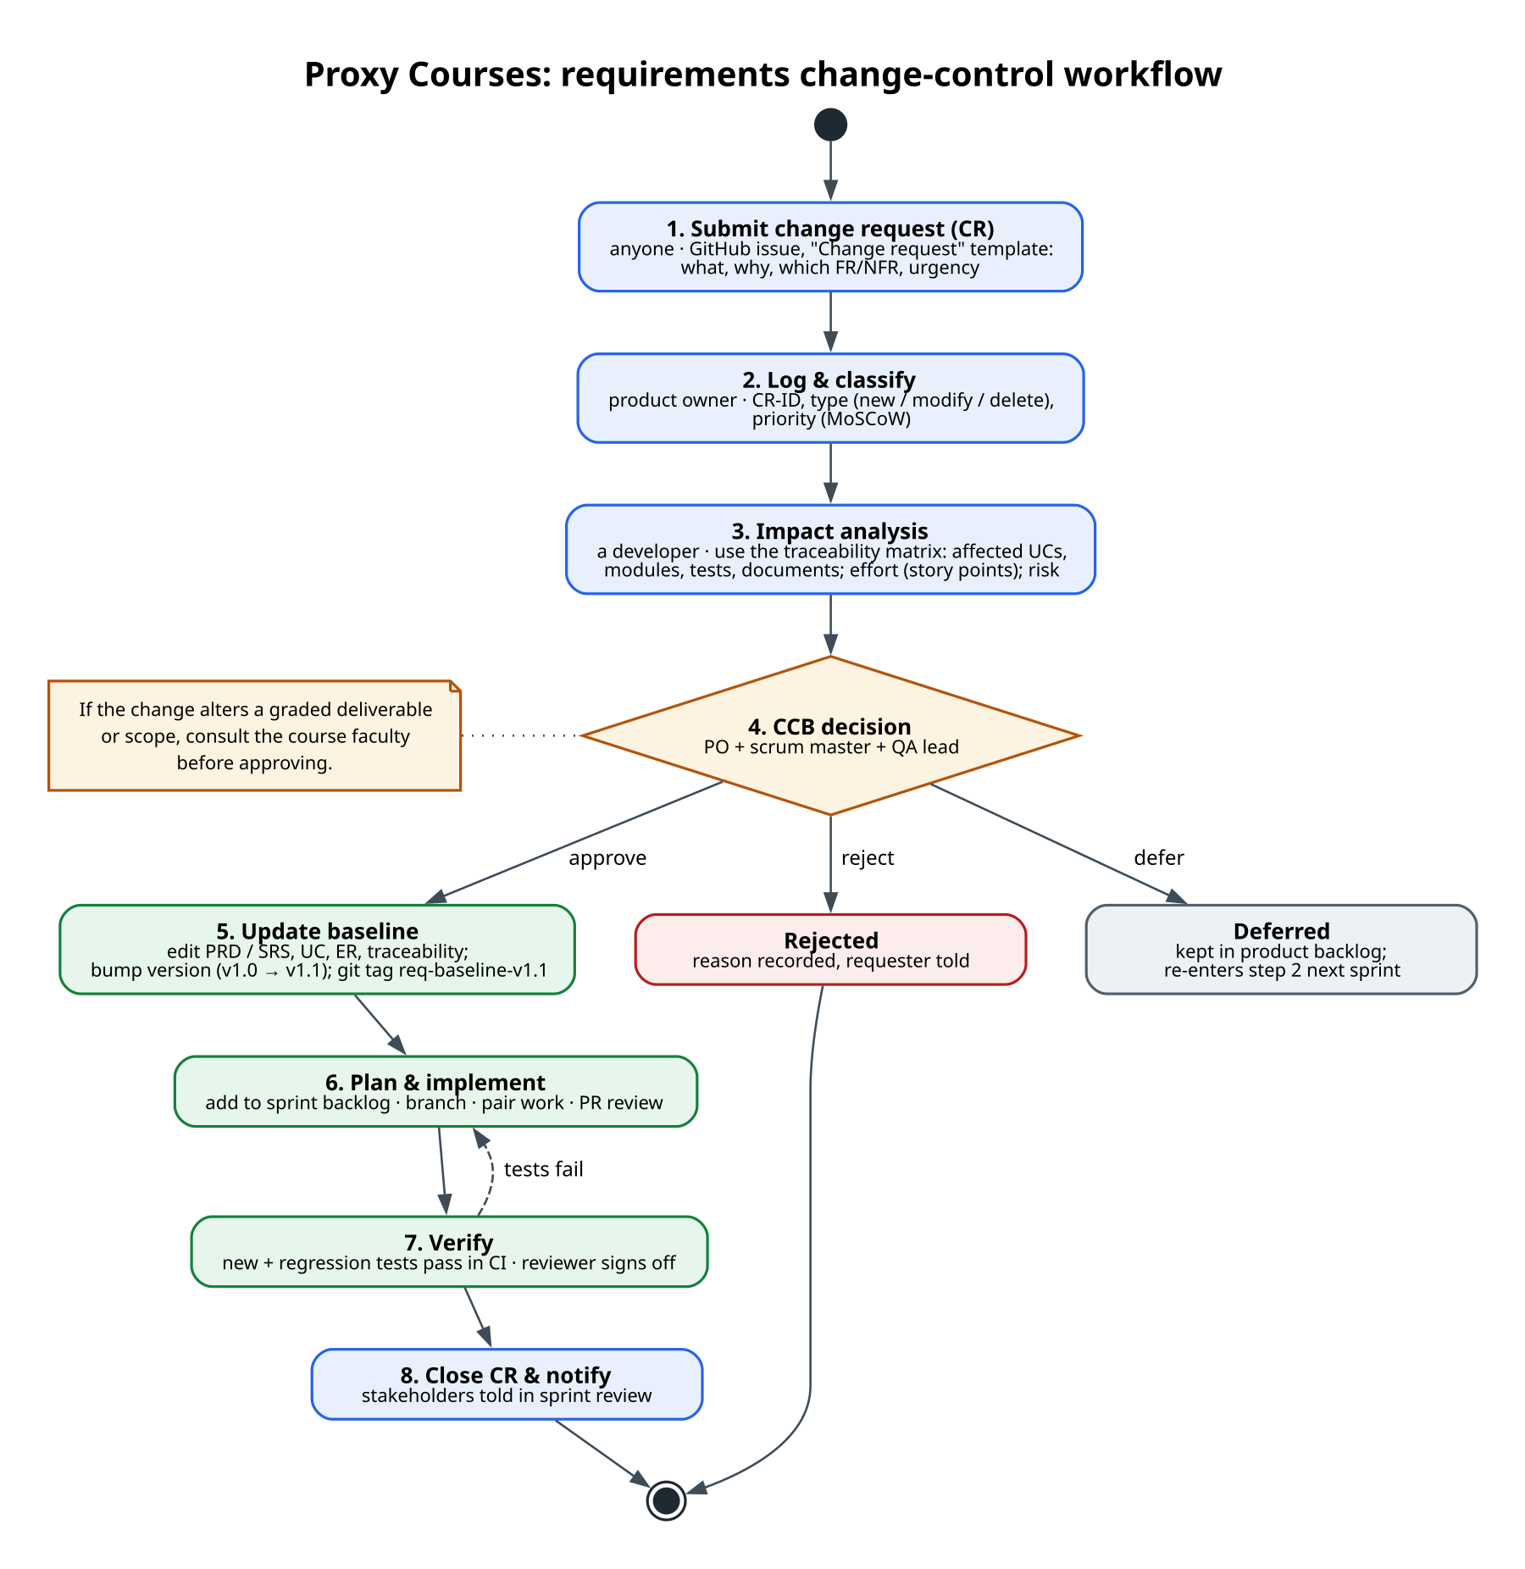
REQUIREMENTS
Task 2 · Change control and the requirements baseline
• Baseline v1.0: PRD + Task 2 models, approved at the Sprint 2 review
  – Frozen as git tag req-baseline-v1.0
• After baselining: change only through a CR
  – Impact analysis uses the traceability matrix
  – CCB: product owner + scrum master + QA lead
  – Approved → v1.1 with a new tag
• Scope or graded-deliverable changes are checked with the faculty first
Proxy Courses · 13/19

Slide 14
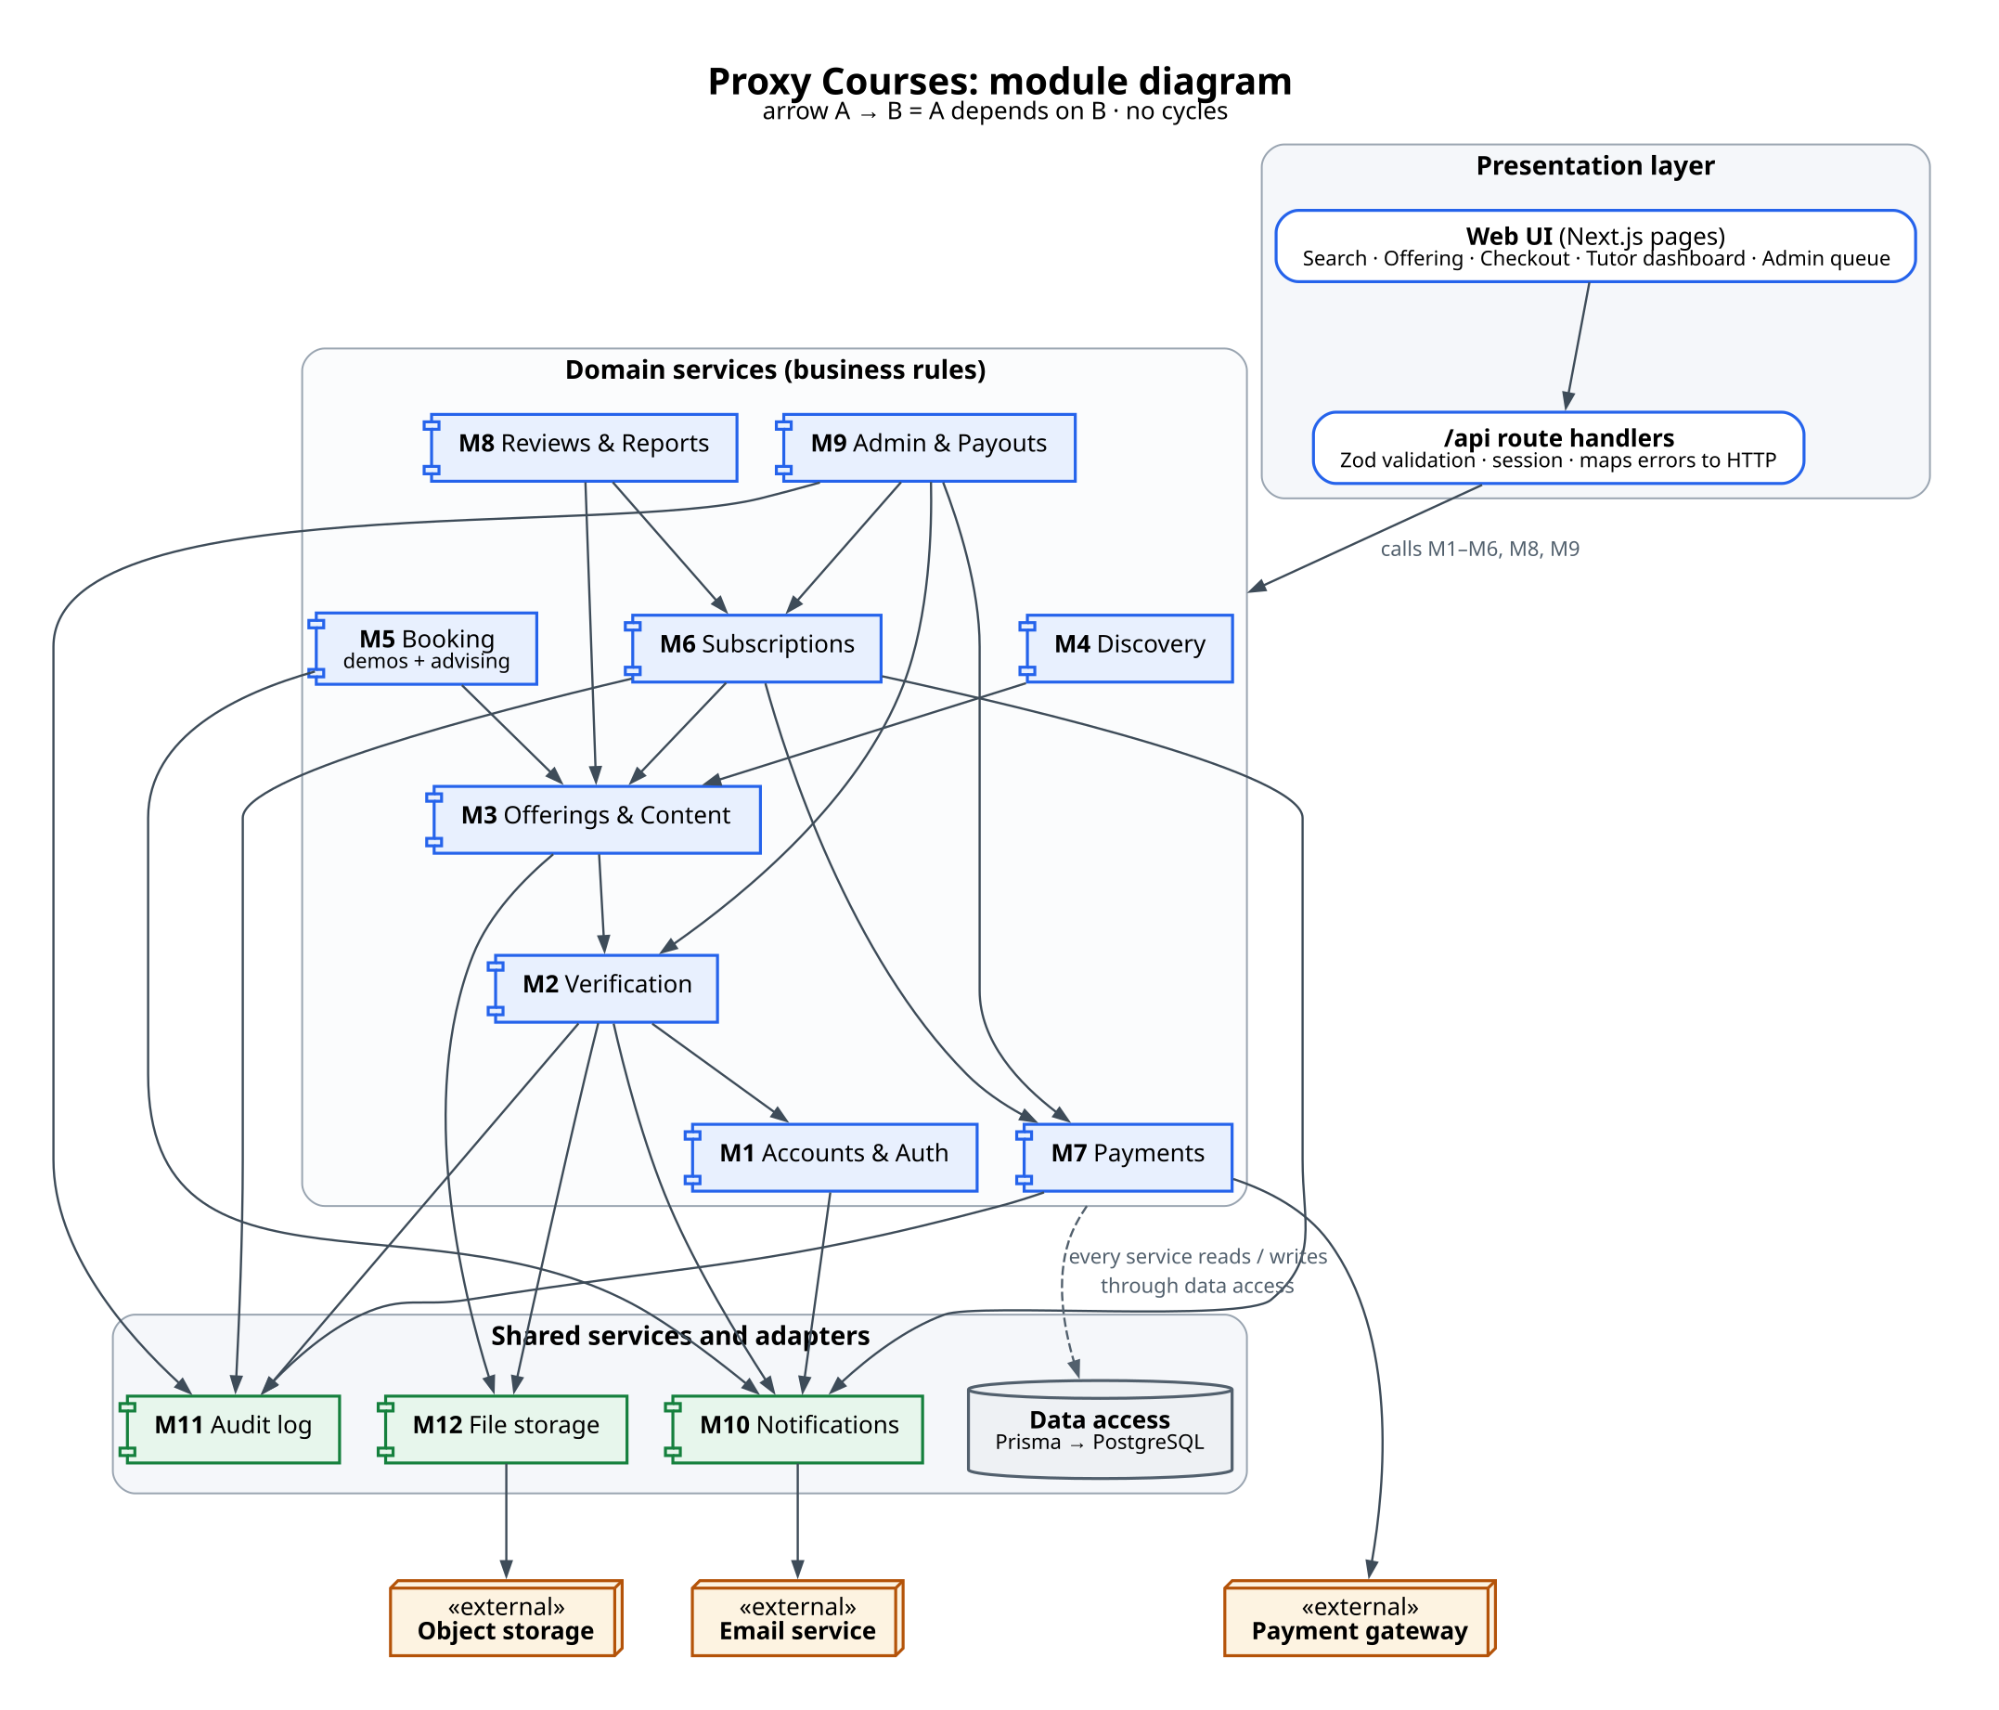
DESIGN
Task 3 · 12 modules in three layers
• Each module: responsibility, interface, hidden information, dependencies
• No cycles: M6 Subscriptions → M7 Payments, never back
• Hidden: only M7 knows which gateway is used
• Cross-cutting: roles, audit log, validation, error mapping
Proxy Courses · 14/19

Slide 15
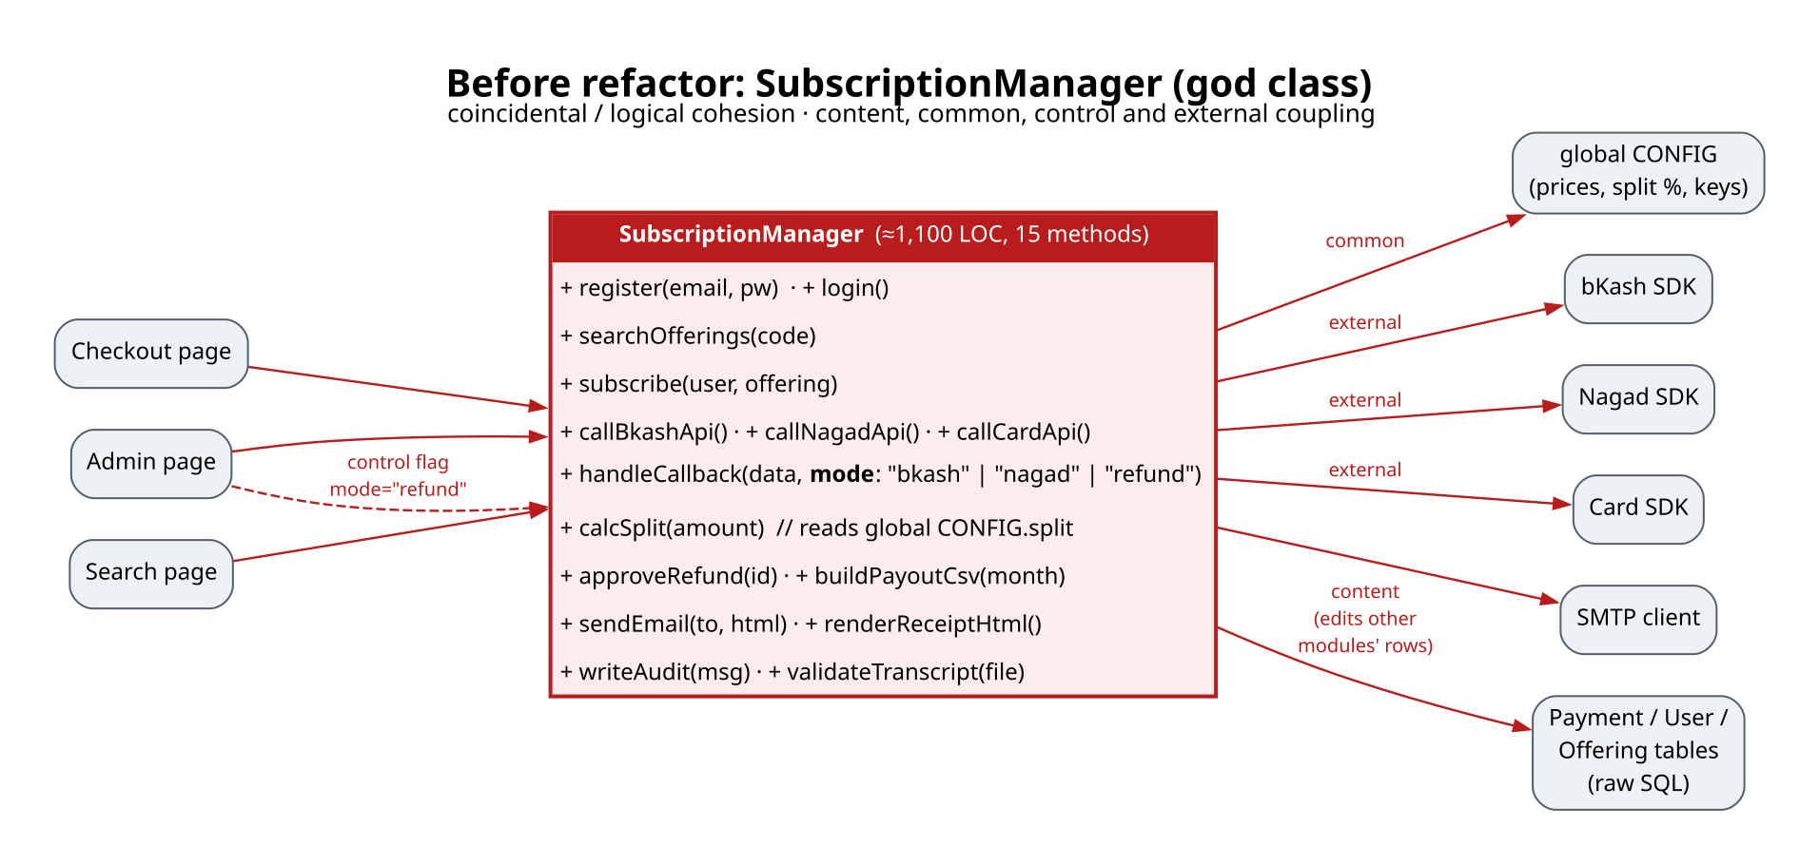
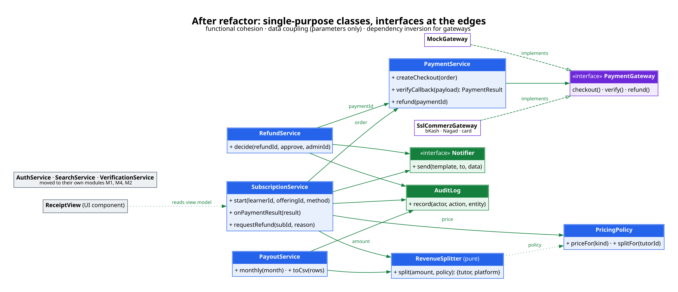
DESIGN
Task 3 · Fixing a god class
• Before: SubscriptionManager had coincidental and logical cohesion, and content, common, control and external coupling (15 methods, 9 collaborators)
• After: functional cohesion, data coupling and a PaymentGateway interface (mock or SSLCommerz). The control flag is replaced by polymorphism.
Proxy Courses · 15/19

Slide 16
DESIGN
Task 3 · Mandel's golden rules, personas, task analysis
Golden rule | In Proxy Courses
User in control | ✕ on every checkout step; cancel demo; withdraw refund
Reduce memory load | Step 2 of 3; refund as a date; last method pre-selected
Consistent interface | One blue bottom button; same status colours; same words
Persona | Goal
Nusrat · learner | Pass CSE211, spend ≤ ৳1,000
Tanvir · tutor | Earn about ৳10k a semester
Dr. Farhana Rahman · advisor | Stop the email ping-pong
Task analysis (HTA) of “Subscribe to help for CSE211”: 4 sub-goals, 11 leaf steps (12 with demo)
→ comparison data on result cards · one-screen checkout · demo email links straight to checkout
Proxy Courses · 16/19

Slide 17
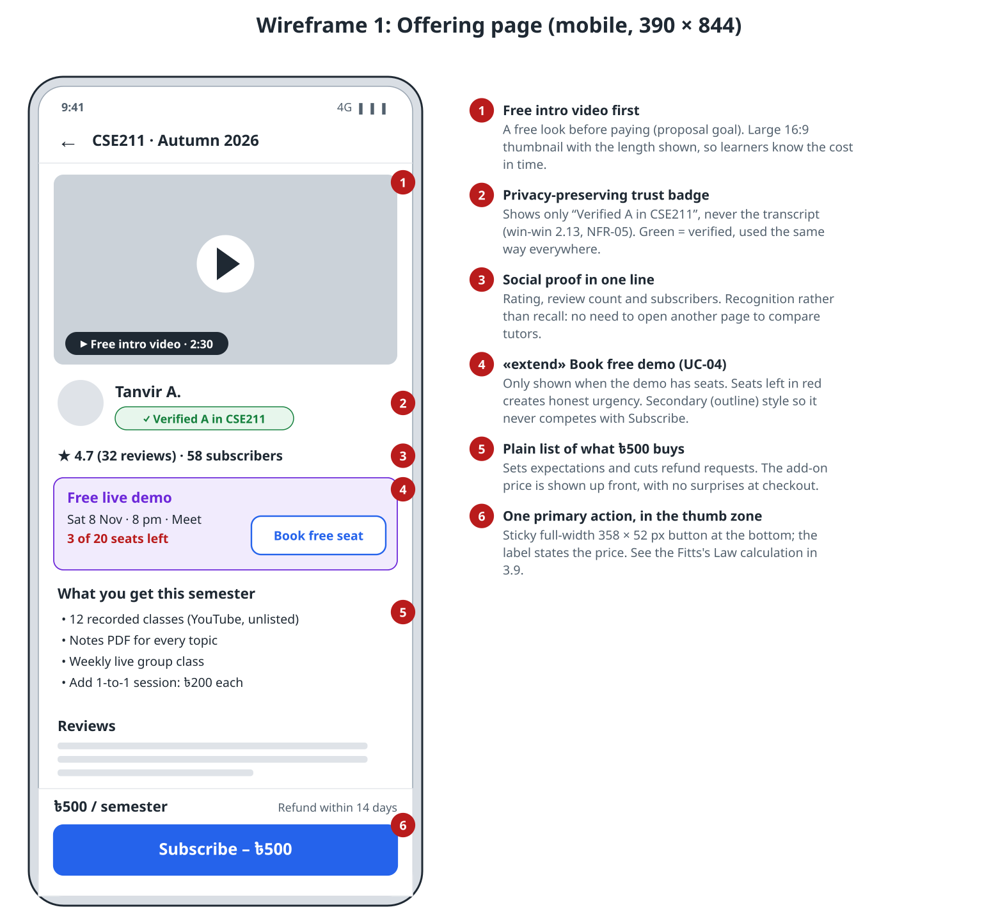
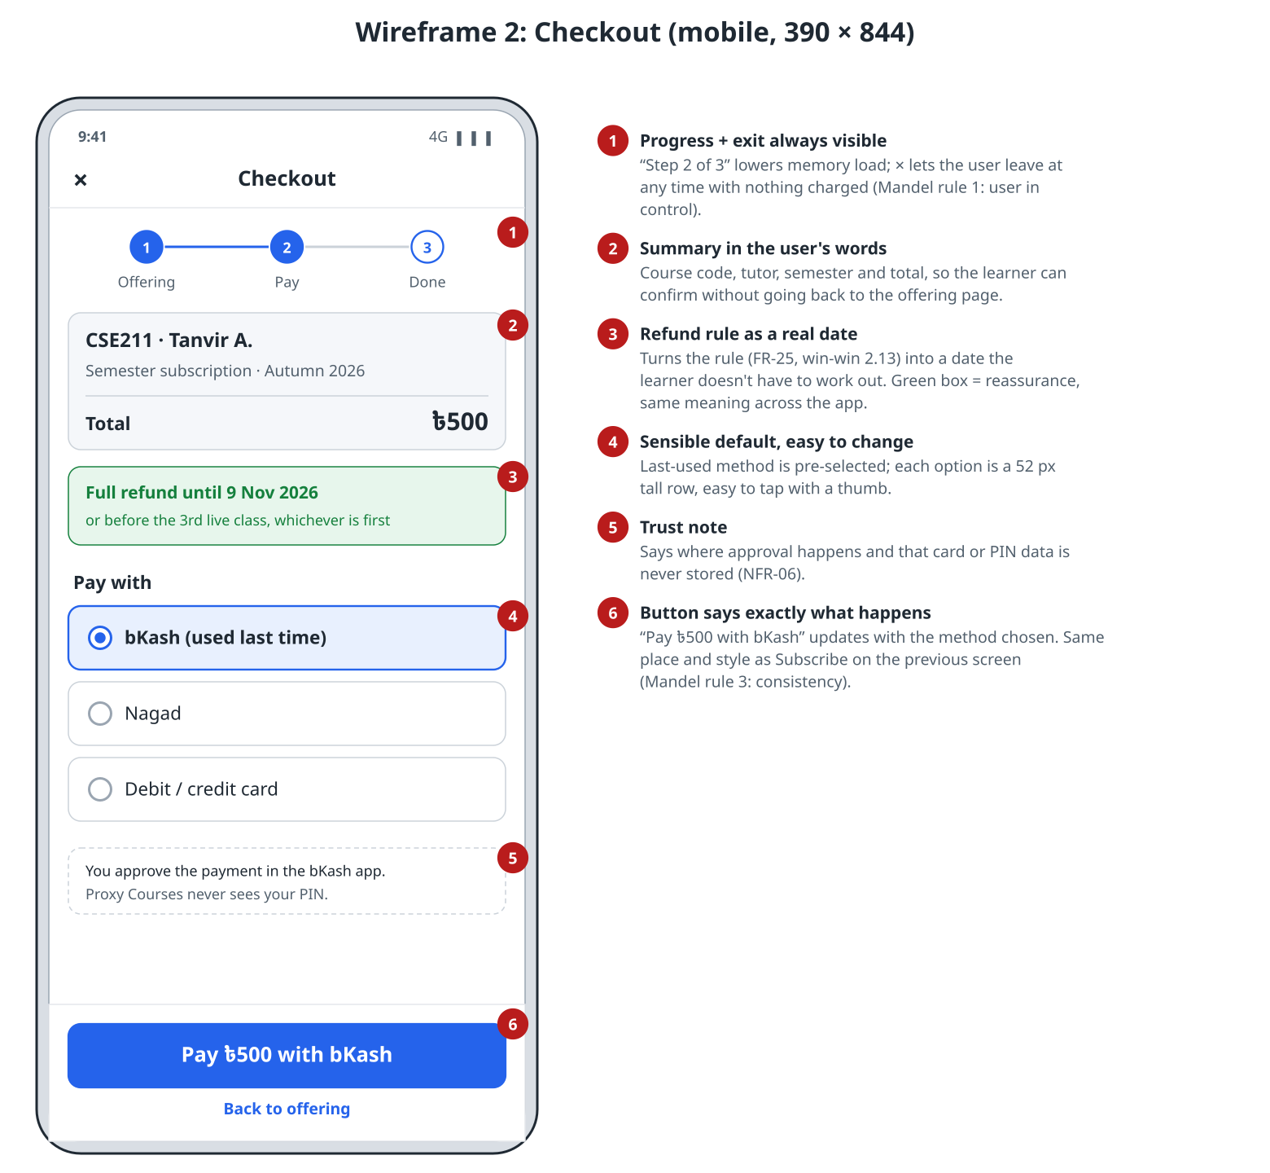
DESIGN
Task 3 · Annotated wireframes: offering page and checkout
Proxy Courses · 17/19

Slide 18
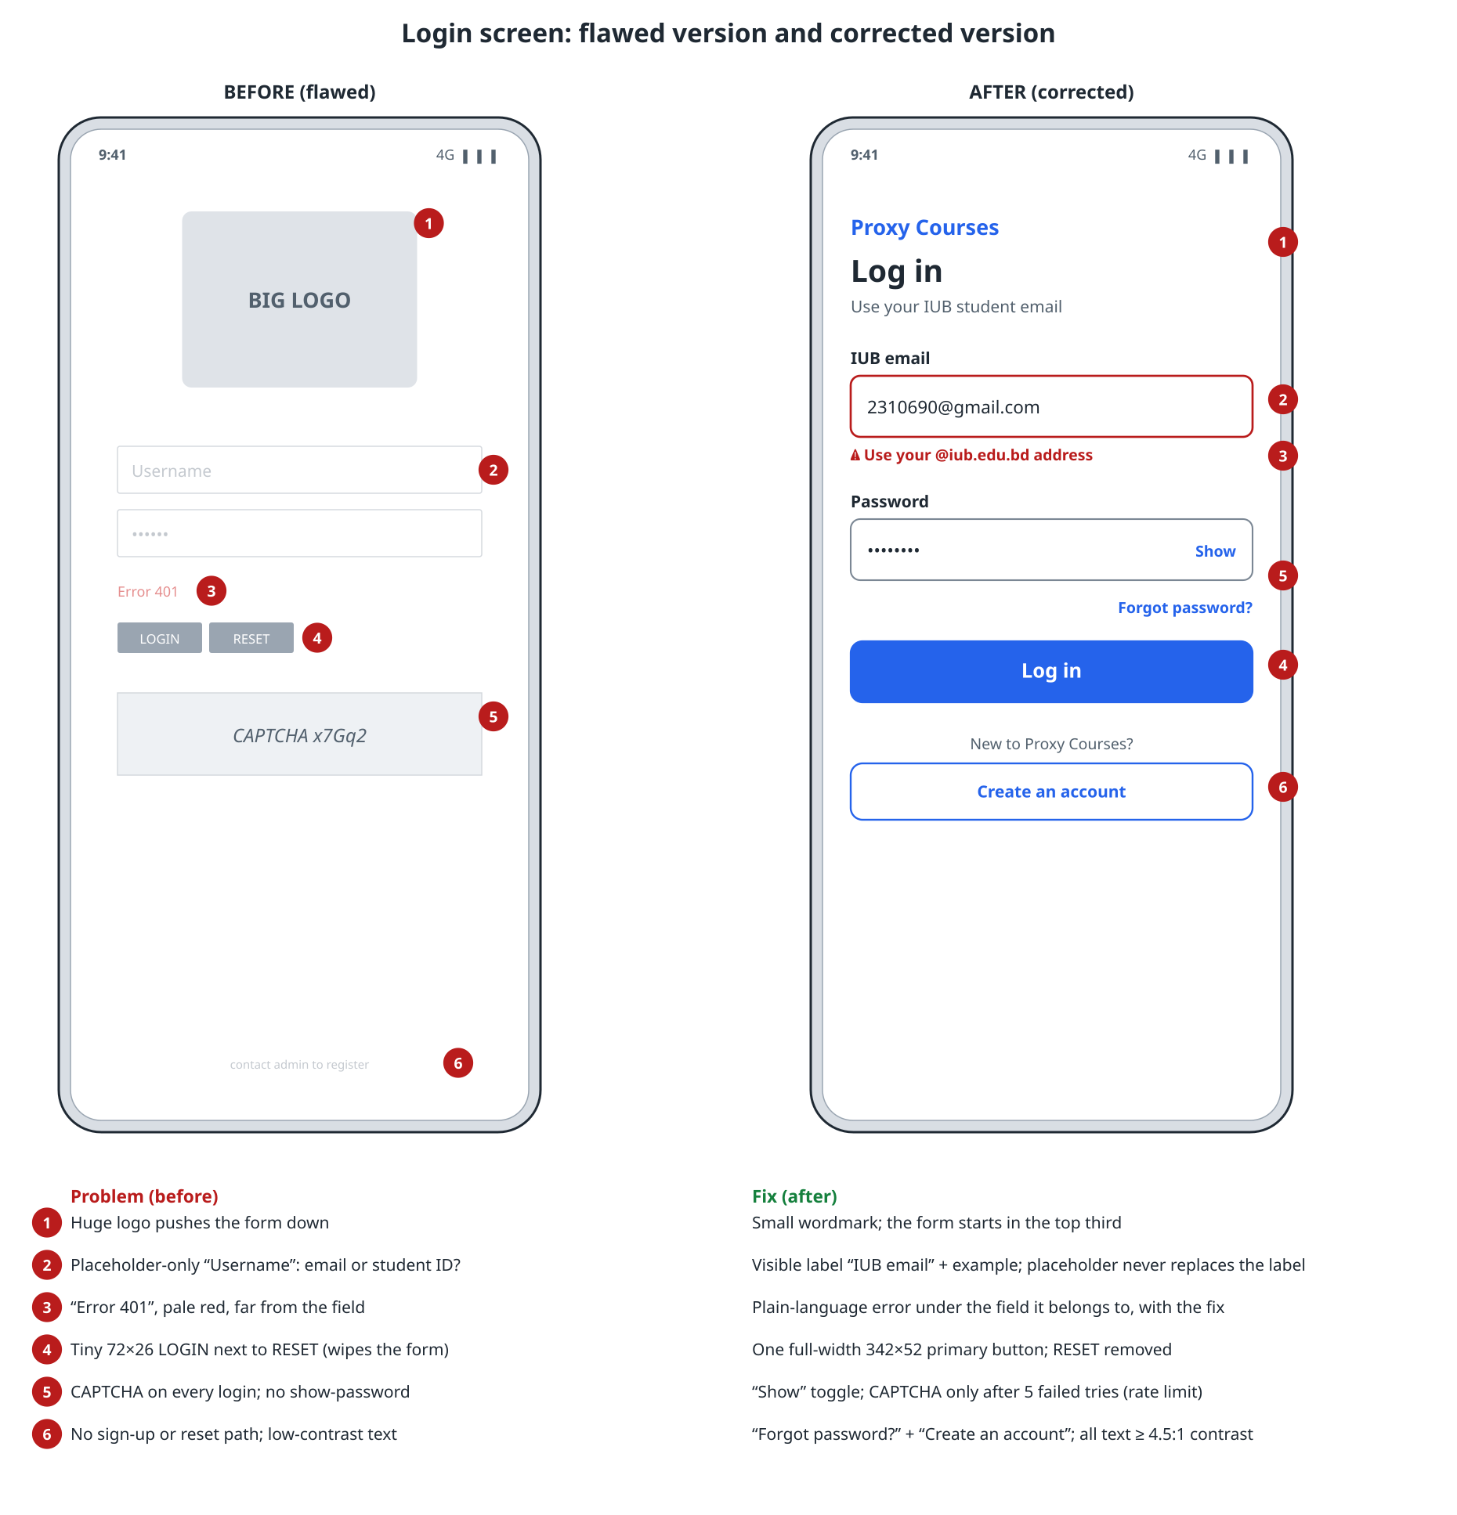
DESIGN
Task 3 · Corrected login screen and Fitts's Law
MT = a + b·log₂(D/W + 1) | A: small, top right | B: sticky bottom
Size | 90 × 36 px | 358 × 52 px
D (from (195, 500)) | 450.7 px | 304.0 px
ID = log₂(D/W+1) | 3.76 bits | 2.78 bits
MT (a = 0.10, b = 0.15) | 0.66 s | 0.52 s
• B is 22% faster, in the thumb zone and above the 44–48 px minimum
• Login fixes: real labels, an error under the field, one 342 × 52 button, no RESET, a sign-up path
Proxy Courses · 18/19

Slide 19
PLAN
Next steps and questions for sir
• Next
  – Task 4: function points (feeds COCOMO in Task 7), OO metrics, Halstead
  – Run the interviews and survey → confirm the refund rule and price
  – Agree team roles: PO, scrum master, QA lead
  – Build M1: sign-up → search → demo → mock payment
• Questions for Masum sir
  – Are the swimlane, sequence and class diagrams required?
  – Is a full SRS (ISO 29148) required, or is the PRD enough?
  – Do we use UniRide's figures (activity list, Halstead) or our own?
  – Which week is each task due?
Proxy Courses · 19/19

