Slide 1
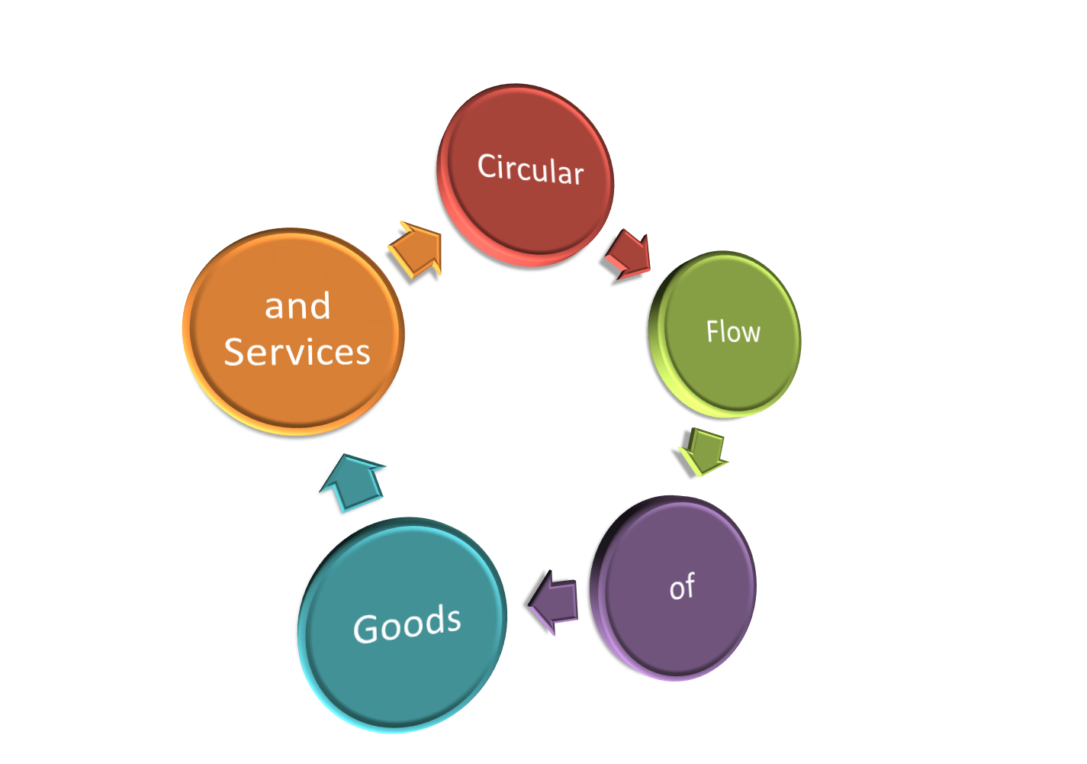

Slide 2

What do you know?
Answer this question in at least 4 sentences:
What role do you play in the economy?
Can you define these terms?
Capital Good
Market
Mechanism
Interact
Interdependent
Facilitate
Illustrate

Slide 3
By the end of this lesson you should know….
Essential Questions
When do we engage in voluntary and involuntary exchange in the American economy?
How are households, business, and government interrelated through markets and the flow of money?
What role do I play in the economy?
Terms
Content Terms
Market
Capital Goods
Productive Resources
Product Market
Factor/Resource Market
Circular Flow Diagram
Academic Terms
Mechanism
Interact
Interdependent
Facilitate
Illustrate
Georgia Performance Standard
SSEMI1 The student will describe how households, businesses, and governments are interdependent and interact through flows of goods, services, and money.
a. Illustrate by means of a circular flow diagram, the Product market; the Resource market; the real flow of goods and services between and among businesses, households, and government; and the flow of money.
b. Explain the role of money and how it facilitates exchange.
Literacy Standards
RH.11-12.3 Analyze a complete set of ideas or sequence of events and explain how specific individuals, ideas, or events interact and develop over the course of the text.
RH.11-12.7 Integrate and evaluate multiple sources of information presented in different media or formats as well as in words in order to address a question or solve a problem.

Slide 4
We are all Interdependent
A market economy works through a process of voluntary exchange or interaction between willing parties in the system. This circular flow of goods and services is what creates a country’s wealth.
The key factor in this circular flow is the market. The market is the place where buyers and sellers meet to exchange goods and services for money.
Interdependent- we are mutually dependent in a market economy. A decision made by one individual affects other participants in intended and unintended ways.
Interact- to act in a way that affects another

Slide 5


Lets identify each participant in the market
Individuals/Households- This is your role in the circular flow. You provide a service, labor to the factor market in exchange for wages. You also purchase goods and services from the product market using your income.
Factor or Resource Market- This is where factors of production are bought and sold. The Factor Market gives productive resources (goods used to produce other goods; like capitol goods) to Businesses in exchange for payment.

Slide 6

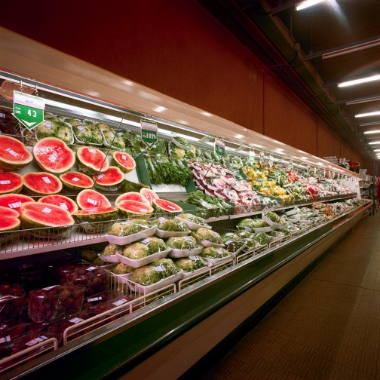
Lets identify each participant in the market cont..
Businesses- Businesses buy productive resources from factor markets to create a product that they sell to the Product Market.
Product Market- the Product Market receives products from businesses and provides goods and services directly to the individual consumer in exchange for payment.

Slide 7
So far can you…
Answer these Questions?
When do we engage in voluntary and involuntary exchange in the American economy?
How are households, business, and government interrelated through markets and the flow of money?
What role do I play in the economy?
Define these Terms
Content Terms
Market
Capital Goods
Productive Resources
Product Market
Factor/Resource Market
Academic Terms
Interact
Interdependent
We still need to…
Define
Facilitate
Mechanism
Circular Flow Chart
and…
Illustrate by means of a circular flow diagram, the Product market; the Resource market; the real flow of goods and services between and among businesses, households, and government; and the flow of money.
Explain the role of money and how it facilitates exchange.
Illustrate- to draw or make clear by using examples

Slide 8
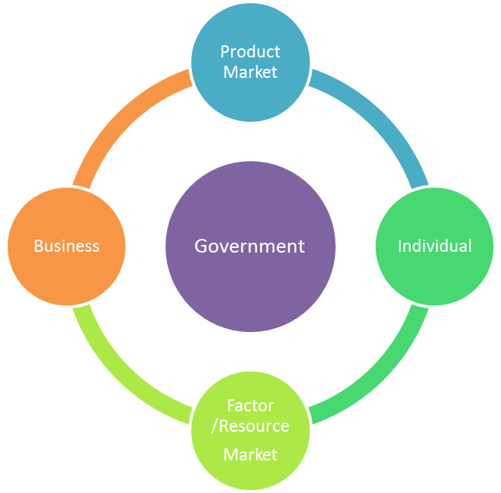
Circular Flow Chart Participants
The Circular Flow Chart is a diagram that illustrates the circular flow of goods and services and money in a market.
Participants
Individual
Factor/Resource Market
Business
Product Market
Government
  in a market economy, the government plays an indirect role by regulating for fairness and equality

Slide 9
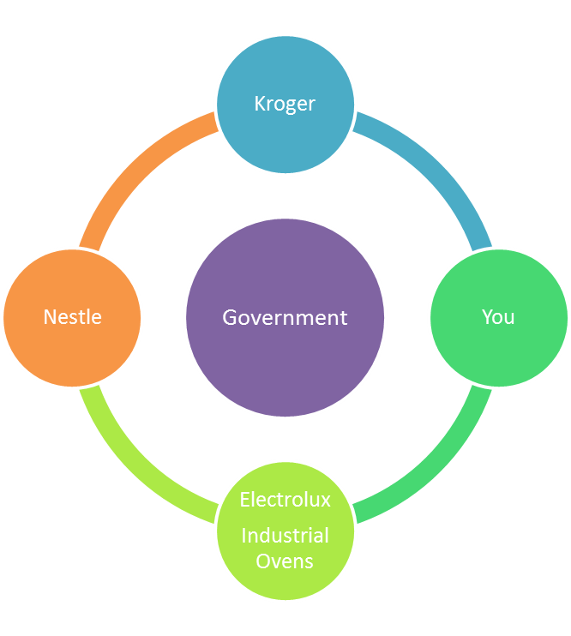
Example
You the individual work at the Electrolux industrial oven factory in exchange for wages.
Electrolux is the Factor Market that sells ovens to Nestle.
Nestle is the Business that makes Willy Wonka Candy which it sells to Kroger.
Kroger is the Product Market where you purchase candy using your income.

Slide 10
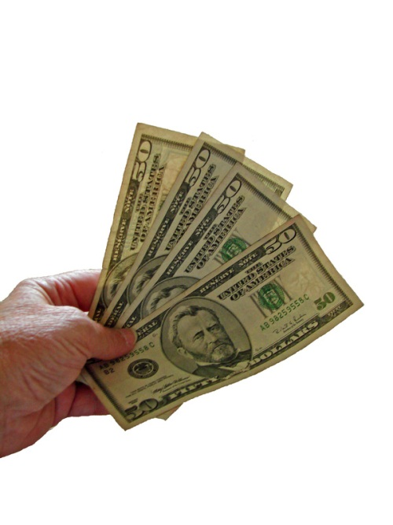
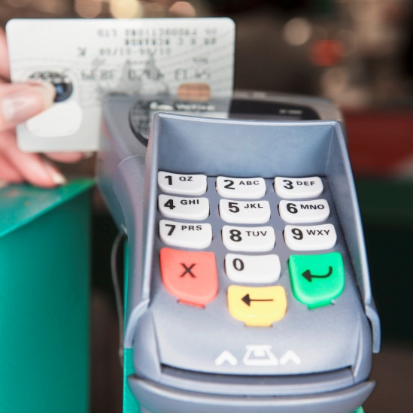
What role does money play in the market?
Money is the mechanism that the market uses to facilitate exchange
Can you rephrase this statement in your own words?
mechanism- the means by which an effect is created
facilitate- to make easier or assist in the progress of

Slide 11
In your own words tell me…
How does money facilitate exchange?

Slide 12
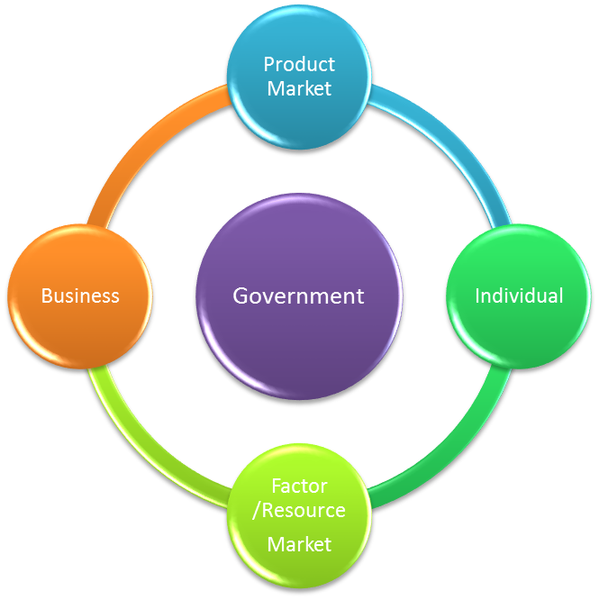
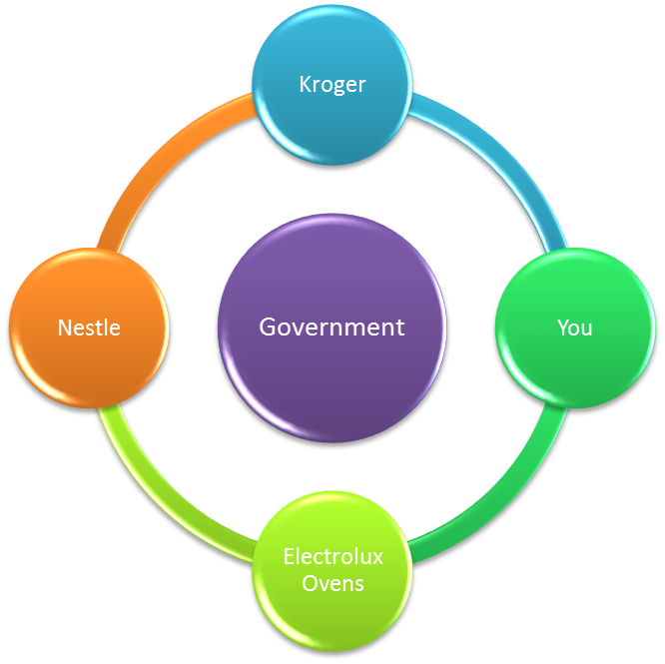




Complete Circular Flow Chart including goods services and money
Products
Goods and Services
Gobstopers
Wonka Candy
$$$
$$$
$$$
$$$
$$$
Wages
$$$
Wages

Slide 13

Draw this chart on your paper
Try to correctly label the Participants on the Chart in 1 minute…
It doesn’t matter where you start, just that participants are in order relative to each other

Slide 14
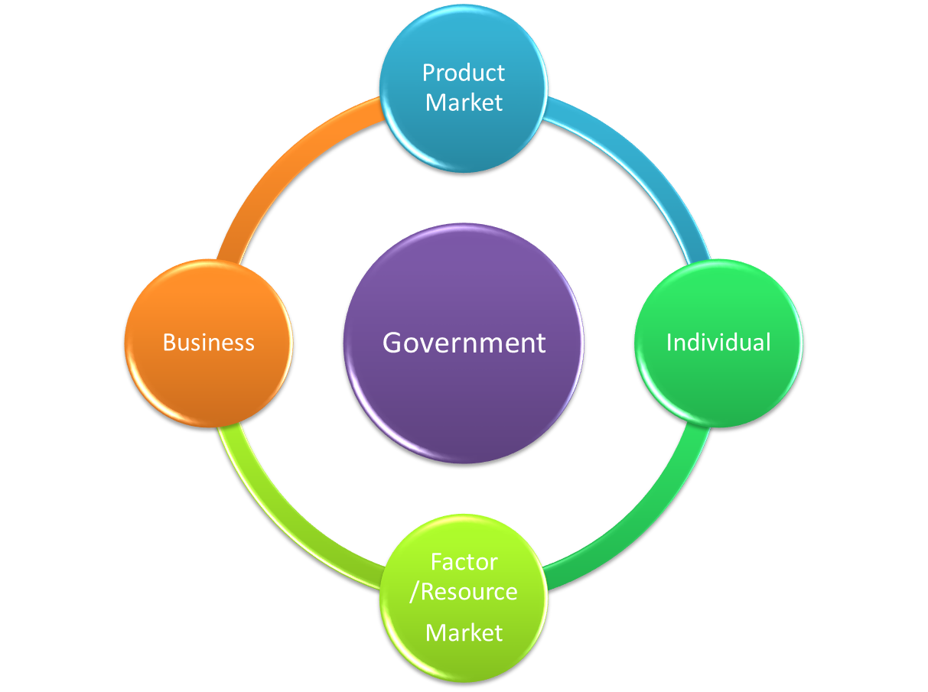
Check your answers

Slide 15
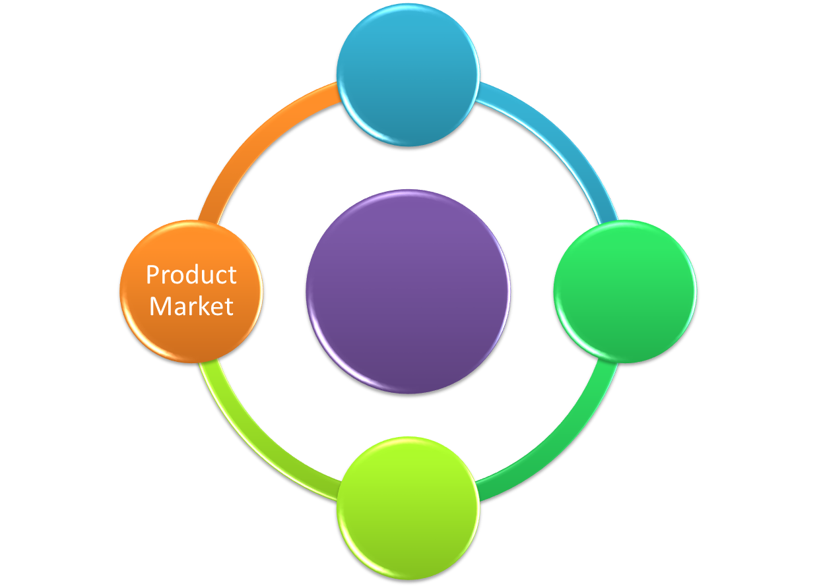
Draw this chart on your paper
Try the Chart again in a different order

Slide 16
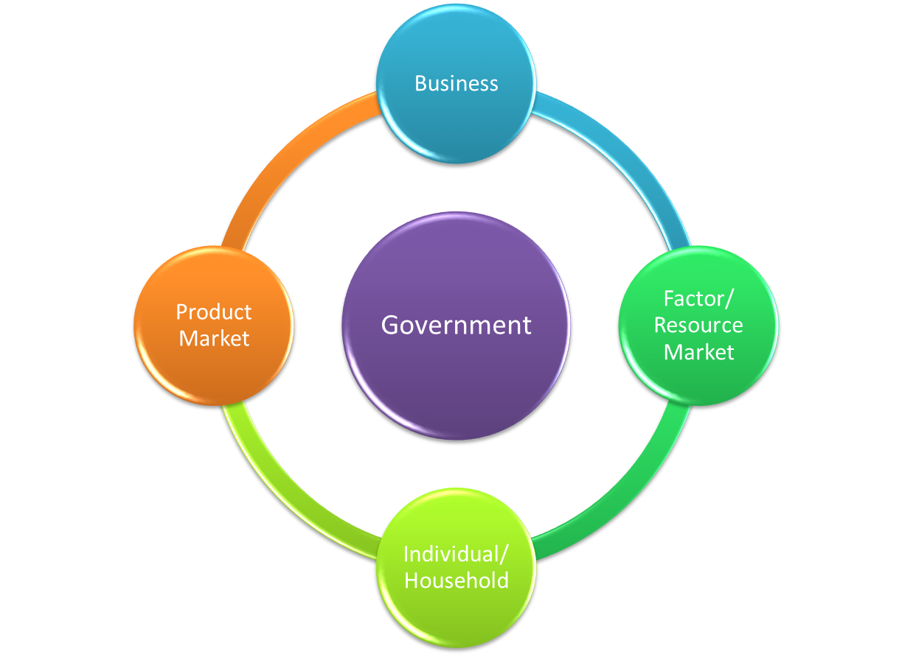
Check your answers

Slide 17


List A-D on your paper
Now complete the chart by including items bought and sold in the market
D
C

Slide 18

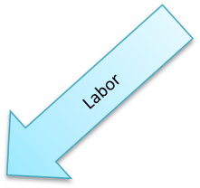
Check your Answers
Products
Goods and Services

Slide 19
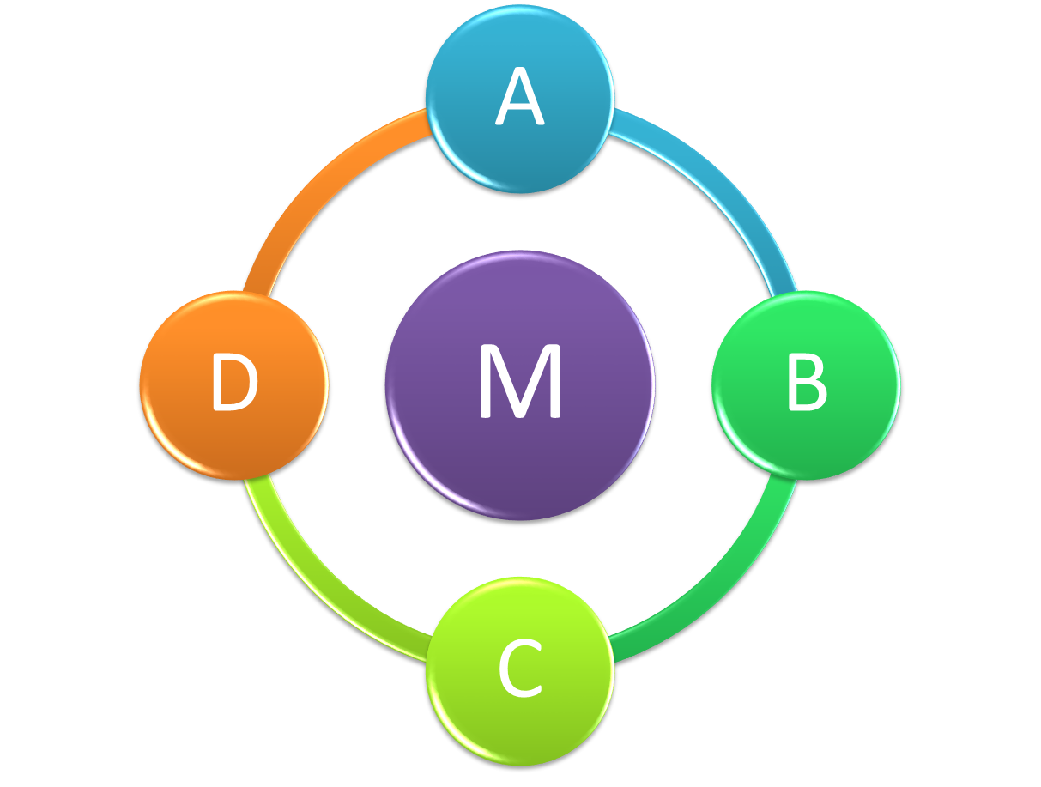


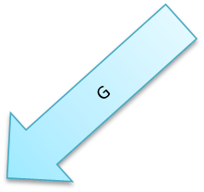
List A-L on your paper
Now complete the chart by including items bought and sold in the market
E
F
I
K
J

Slide 20


Check your Answers
Products
Goods and Services
$$
$$
$$
Wages

Slide 21
You made it to the end of this lesson!! Can you….
Answer these Questions?
When do we engage in voluntary and involuntary exchange in the American economy?
How are households, business, and government interrelated through markets and the flow of money?
What role do I play in the economy?
Define these Terms?
Content Terms
Market
Capital Goods
Productive Resources
Product Market
Factor/Resource Market
Circular Flow Diagram
Academic Terms
Mechanism
Interact
Interdependent
Facilitate
Illustrate
Sample Questions

Slide 22
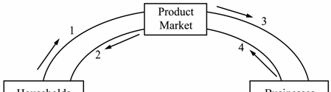
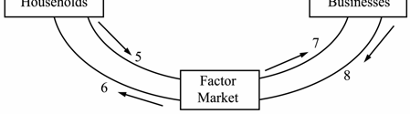
Try these Questions
2. When the U.S. government purchases a submarine from a company, the government has made a major transaction in the
    Factor Market
    Public Market
    Product Market
    Foreign Exchange Market
The flow of goods and services to consumers is illustrated by
  4 to 2
  8 to 6
  2 to 5
  6 to 1

Slide 23
Check your answers
A (this is a question from the released EOCT)
C (this is a question from the released EOCT)

Slide 24
Additional Resources
Economics GPS Frameworks: Unit 3-”Markets: Not just for fleas and stocks”
  https://www.georgiastandards.org/Frameworks/GSO%20Frameworks/Economics%20Unit%203.pdf
Dictionary.com
  http://dictionary.reference.com/
Georgia Department of Education Released EOCT’s and answer keys
  http://www.doe.k12.ga.us/Curriculum-Instruction-and-Assessment/Assessment/Pages/EOCT-Released-Tests.aspx
Georgia Department of Education’s Economics/Business/Free Enterprise EOC Assessment Guide
  http://www.gadoe.org/Curriculum-Instruction-and-Assessment/Assessment/Documents/Milestones/Assessment%20Guides/GM%20Economics%20EOC%20Assessment%20Guide%20081715.pdf
eNotes article on Circular Flow
http://www.enotes.com/circular-flow-reference/circular-flow

