Slide 1
2016 Future Supply Chain
The Consumer Goods Forum in association with Capgemini Global Commerce Initiative
2016 Future SC Report – serving consumers in a sustainable way
  Supply chains have evolved over many decades based on historical trends, but the world has changed and the [collaborative] supply chain must change with it - Unilever
Historically, separate SCs for manufacturing & retail have driven inbuilt inefficiencies - Unilever
We have a duty of care to make our supply chains more efficient & sustainable - Danone
Transparency and visibility are essential - Philips
  The supply chain runs on information
  We need to turn data into information to enable SC decisions & workflow that will drive improvements at store level - PepsiCo
Actionable visibility will drive greater productivity and improved accuracy – P&G
  We need to innovate, collaborate and drive the agenda - Nestle
Source: www.futuresupplychain.com

Slide 2

Conclusions
The information supply chain is as important as the physical distribution of goods
  Consider ‘farm to fork’ and product recalls
Establishing a globally integrated supply chain – comprising a network of hundreds of business partners – is impossible without harmonizing your business processes and implementing recognized international standards for exchanging supply chain information
Pursue opportunities to collaborate horizontally as well as vertically
  Look to ‘gaming’ gain-share theories to overcome people resistance e.g. ‘no player will suffer from collaboration (cost of collaborating is not higher than going it alone)’
Don’t boil the ocean. Build on what already exists and progress iteratively
Having established your standards for integration – use portal technology to publish your standards and grow your business network. Make it easy for people to ‘do the right thing’!

Slide 3
References
2016 Future SC Report – serving consumers in a sustainable way www.futuresupplychain.com
European Supply Chain Horizontal Collaboration Report, eyefortransport , December 2010
“Horizontal Collaboration In The Supply Chain”, Dr. Frans Cruijssen, eyefortransport Horizontal Collaboration in the SC Summit, Brussels, June 2010

Slide 4
Backup Slides

Slide 5
Horizontal collaboration – what is it?
Collaboration is the output of a culture based on trust & openness, where individual requirements are overall met better in concert with others rather than by striving to make it on one’s own capabilities or resources.
“Horizontal collaboration within the supply chain is characterized by a pooling of resources between manufacturers rather than manufacturers collaborating with logistics service providers or 4PLs (vertical collaboration).
Common strategies include consolidation of goods flows, sharing of transport vehicles and network capacity, sharing warehouses, consolidating buying power and back office processes such as finance, administration, customer service, IT, etc.”
European Supply Chain Horizontal Collaboration Report, eyefortransport , December 2010

Slide 6
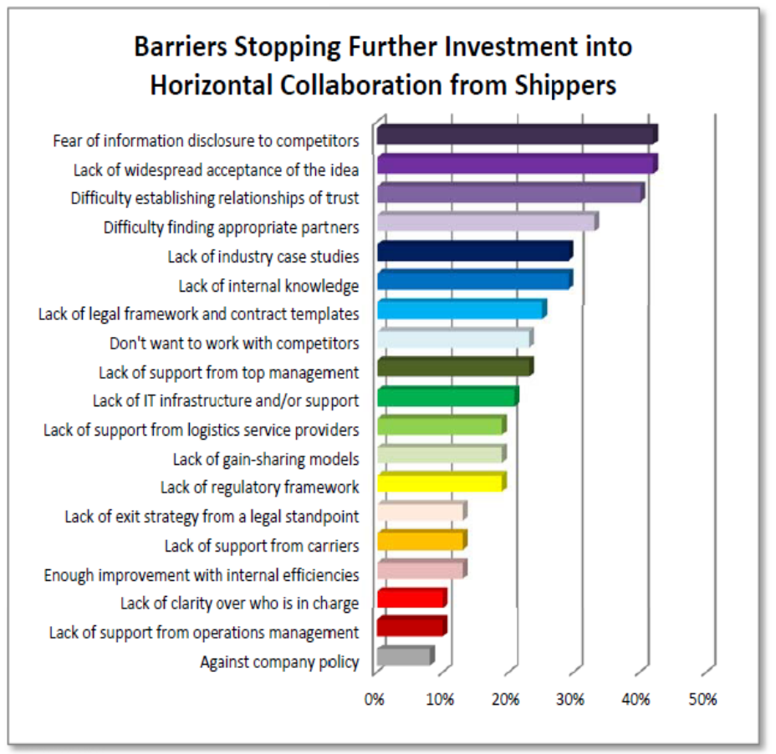

Challenges facing effective horizontal collaboration
Could game theory help address some of these barriers?
1
Co-operative game theory characteristics²
Common interest
Gain from cooperation
Look for a sustainable arrangement
Make sure incentives are right
“Fairness” properties²
Efficiency: | The complete savings of collaboration are distributed
Monotonicity: | If player A adds more value to every coalition than player B, player A will get a higher payoff
Dummy: | A player that adds no value to any coalition, will receive no payoff
Symmetry: | If two players add exactly the same value to every other coalition, they will get the same payoff
Individual fairness: | No player will suffer from collaboration (cost level after collaboration is not higher than individually, i.e. without collaboration)
1) European Supply Chain Horizontal Collaboration Report, eyefortransport, December 2010; “Shippers” = manufacturers or retailers
2) “Horizontal Collaboration In The Supply Chain”, Dr. Frans Cruijssen, eyefortransport Horizontal Collaboration in the SC Summit, Brussels, June 2010

