Slide 1
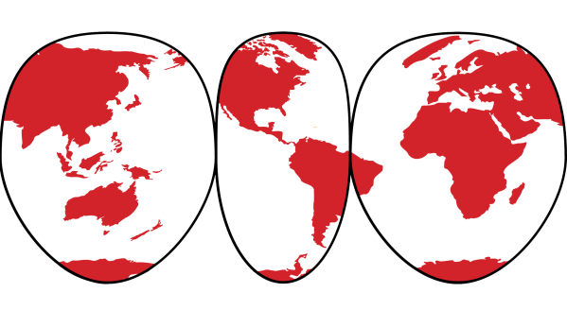
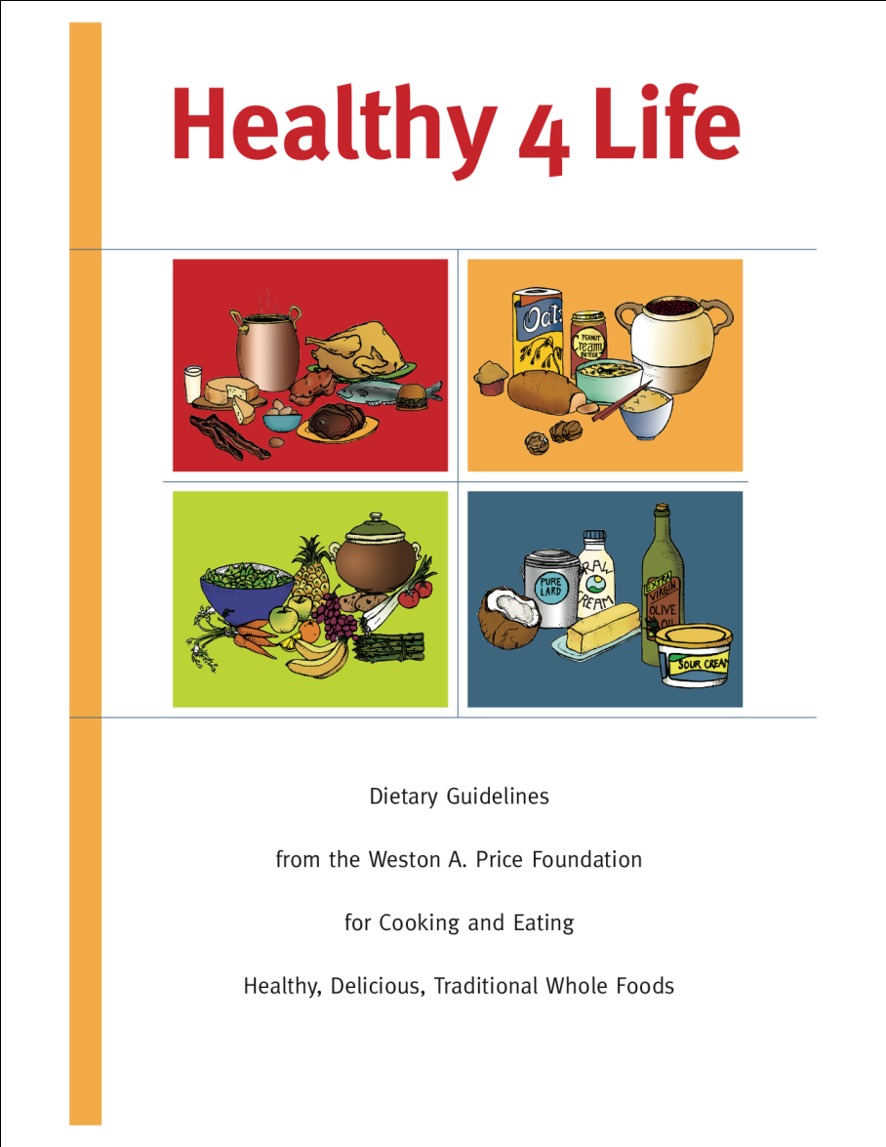
®
THE WESTON A. PRICE FOUNTATION®
Healthy 4 Life
Dietary Guidelines
A Science-Based Alternative to the
USDA Dietary Guidelines
COLORFUL DIETARY GUIDELINES and RECIPE BOOKLET based on
FOUR FOOD GROUPS

Slide 2
®
THE WESTON A. PRICE FOUNTATION®
FLAWS IN THE 2010 DIETARY GUIDELINES
Press Conference
National Press Club
February 14, 2011

Slide 3
®
THE WESTON A. PRICE FOUNTATION®
MAJOR CONCERNS ABOUT THE 2010 GUIDELINES
and the SCHOOL LUNCH PROGRAM
Restriction of saturated fat to less than 7 percent of calories
Restriction of cholesterol to less than 300 mg per day (less than two eggs).
Restriction of sodium to 1500 mg (2/3 tsp salt) per day
Promotion of lowfat milk and lean meat
Use of “meat substitutes” in school lunches
No restriction of refined carbohydrates in school lunches

Slide 4
NO NEED FOR CHOLESTEROL RESTRICTION
In 1937, Columbia University biochemists David Rittenberg & Rudolph Schoenheimer demonstrated that dietary cholesterol had little or no influence on blood cholesterol.
“Cholesterol in food has no affect on cholesterol in blood and we’ve known that all along.” Professor Ancel Keys, American Heart Association board member and father of the low fat diet, who, in retirement, recanted the idea that dietary cholesterol raises blood levels.
Cholesterol-rich foods like eggs, organ meats, meat fats, butter and seafood supply critical nutrients such as choline, arachadonic acid, and vitamins A, D, E and K.

Slide 5
CHOLESTEROL:
THE MOTHER OF ALL HORMONES
ACTH
CHOLESTEROL
Pregnenolone
Corticosterone
Aldosterone
Corticosterone
Progesterone
Pregnenolone
Progesterone
11 Deoxycortisol
Cortisol
REGULATE
MINERAL METABOLISM, GLUCOSE LEVELS,
BLOOD PRESSURE,
HEALING AND STRESS
DHEA
Androstenedione
Estradiol
Testosterone
SEX HORMONES
VITAMIN A IS NEEDED FOR EACH CONVERSION.
TRANS FATS INHIBIT ENZYMES THAT MAKE THESE CONVERSIONS.
Notes:
This chart shows the conversion of cholesterol into all the adrenal cortex hormones. These hormones regulate mineral metabolism and glucose levels in the body. Cortisol is the hormone the body uses for healing and dealing with stress—it’s what I call the ‘chill out’ hormone. And all the sex hormones—testosterone, estrogen and progesterone—are made out of cholesterol.
An important point is that vitamin A found in foods like butter, cod liver oil and liver--all the nutritious foods our government is telling us not to eat--are necessary every step of these conversions. Vitamin A is very important when you’re under a lot of stress or when you’ve injured yourself because then your body can make these hormones very easily. Why do so many people need to take take prednisone today? Because they are not making it themselves--they do not the raw materials, vitamin A and cholesterol, to make their own stress hormones.
Trans fats found in partially hydrogenated vegetable oils (used in margarines, spreads and most processed foods) inhibit the enzymes needed to make this conversion. Mary Enig’s PhD thesis showed that the trans fats interfere with the Cytochrome P450 family of enzymes, which the body uses to make all these conversions. So when you’re substituting margarine for butter and eating lots of processed foods you end up with all sorts of problems with stress, healing, inflammation and reproduction.

Slide 6
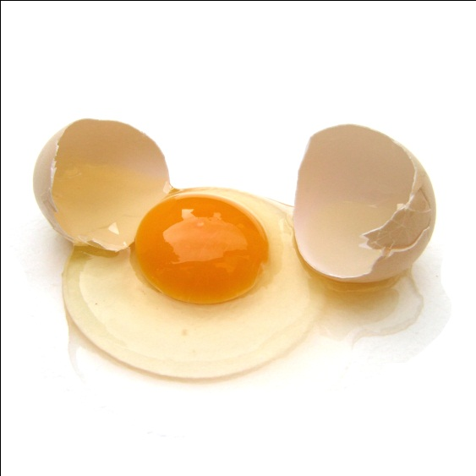
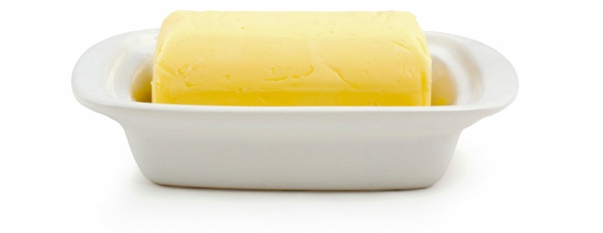
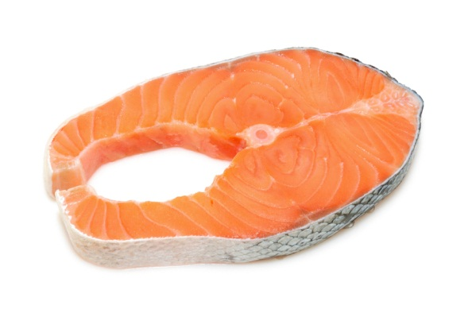
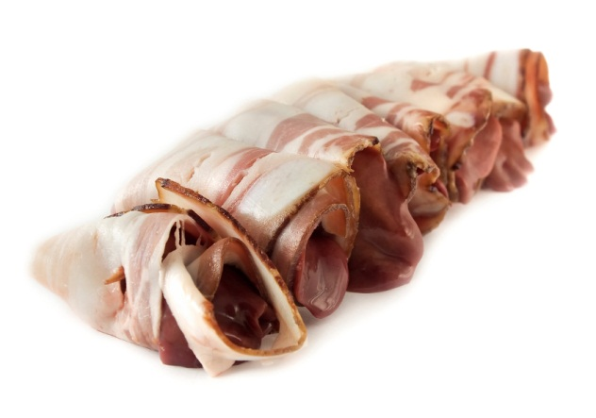
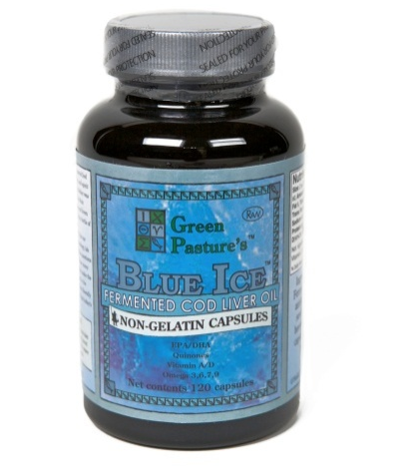
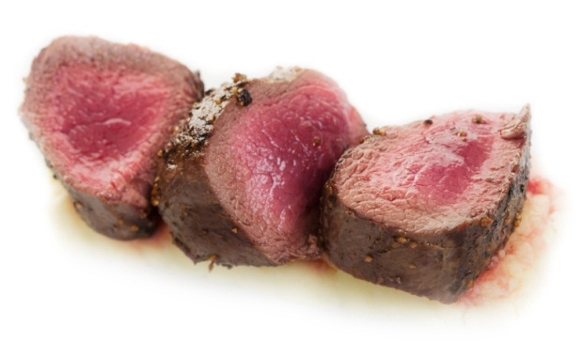
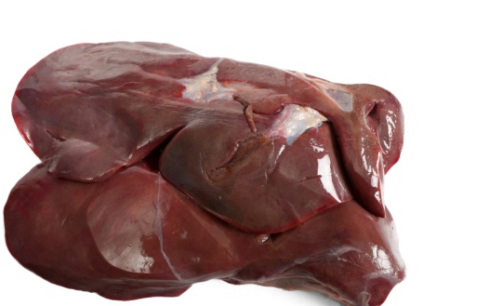
KEY NUTRIENTS FOR BRAIN DEVELOPMENT
VITAMIN A: Cod liver oil; liver, butter and egg yolks from grass-fed animals
VITAMIN D: Cod liver oil; lard, butter and egg yolks from grass-fed animals
VITAMIN K: Butter, egg yolks and organ meats from grass-fed animals
CHOLINE: Liver, egg yolks from grass fed animals
DHA: Cod liver oil, liver, butter, egg yolks
ZINC: Red meat from grass fed animals, shell fish
CHOLESTEROL: Seafood; dairy foods, eggs and meat of grass fed animals

Slide 7
LIVER: NO FOOD HIGHER IN NUTRIENTS
PER 100 G | APPLE | CARROTS | RED MEAT | LIVER
PHOSPHORUS | 6 MG | 31 MG | 140 MG | 476 MG
IRON | .1 MG | .6 MG | 3.3 MG | 8.8 MG
ZINC | .05 MG | .3 MG | 4.4 MG | 4.0 MG
COPPER | .04 MG | .08 MG | .2 MG | 12 MG
VITAMIN B2 | .02 MG | .05 MG | .2 MG | 4.2 MG
VITAMIN A | 0 | 0 | 40 IU | 53,400 IU
VITAMIN C | 7 MG | 6 MG | 0 | 27 MG
VITAMIN B6 | .03 MG | .1 MG | .07 MG | .73 MG
VITAMIN B12 | 0 | 0 | 1.84 MG | 111.3 MG
EAT LIVER FRIED, GRILLED, WITH BACON, IN SAUSAGE, PATE AND LIVERWURST.
Notes:
No food is more nutrient dense than liver, which is a sacred food in many cultures. Plant foods like apples and carrots actually contain very low levels of nutrients. Liver even contains more vitamin C than carrots or apples!
Only zinc is higher in another food than in liver, and that food is red meat. This is an important reason to eat red meat.

Slide 8

WHO’S AFRAID OF SATURATED FAT?
CLOGS ARTERIES
CAUSES CANCER!
INFLAMMATION!
CAUSES MS!
MAKES YOU FAT!
BAD FOR THE LIVER!
HEART ATTACK!
DIABETES!
DON’T WORRY, LISA.
NONE OF THIS IS TRUE!
Notes:
One of the most pernicious modern dietary myths is the myth that saturated fats are bad for us, that they are the villains in the modern diet, causing everything from cancer to heart disease.

Slide 9
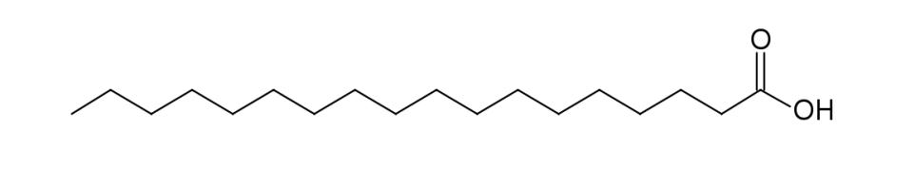
THE MANY ROLES OF SATURATED FAT
CELL MEMBRANES – should be 50% saturated fatty acids.
BONES – Saturated fats help the body put calcium in the bones.
HEART DISEASE – Lower Lp(a), a marker for heart disease.
HEART FUNCTION – Saturated fats are preferred food for the heart.
LIVER – Saturated fats protect the liver from alcohol and other poisons.
LUNGS – Can't function without saturated fats.
KIDNEYS – Can't function without saturated fats.
IMMUNE SYSTEM – Enhanced by saturated fats.
ESSENTIAL FATTY ACIDS – Work together with saturated fats.
DETOXIFICATION – Supports body's detox mechanisms
Notes:
Actually, saturated fats play many important roles in the body chemistry, which is why your body makes saturated fat.
At least 50% of the cell membranes must be saturated fatty acids for your cells to work properly.
Saturated fatty acids are needed for the laying down of calcium in the bones
Saturated fatty acids lower Lp(a), indicating that they protect us against heart disease.
It is well known that saturated fatty acids protect the liver from alcohol and other poisons (tylenol and drugs, pesticides, etc.)
The essential fatty acids work synergistically with saturated fats. Saturated fats help put the essential fatty acids into the tissues where they belong, and keep them there. When you have lots of saturated fats in the diet, you actually only need very small amounts of essential fatty acids.
Saturated fatty acids are the preferred food for the heart, which is why the fats in the cavity of humans and animals is highly saturated.
Finally, the shorter saturated fats have important anti-microbial and immune-stimulating properties.

Slide 10
RECENT STUDIES ON FATS
LOWFAT = FATTER CHILDREN: Swedish study; Children on low fat diets were fatter, consumed more sugar and had higher insulin resistance.
www.ub.gu.se/sok/dissdatabas/detaljvy.xml?id=6979
WHOLE FAT MILK = FERTILITY: Women drinking lowfat milk had fertility problems.
Human Reproduction, online February 28, 2007
WHOLE FAT MILK = LOWER WEIGHT GAIN: Swedish women using cheese and full fat dairy had lower weight gain as they grew older.
American Journal of Clinical Nutrition, 2007;84(6):1481-1488)

Slide 11
THE FAMOUS
FRAMINGHAM HEART STUDY
"In Framingham, Massachusetts, the more saturated fat one ate, the more cholesterol one ate, the more calories one ate, the lower people's serum cholesterol … we found that the people who ate the most cholesterol, ate the most saturated fat, ate the most calories weighed the least and were the most physically active."
WILLIAM CASTELLI, DIRECTOR
THE FRAMINGHAM STUDY
SOURCE: Archives of Internal Medicine, 1992
Notes:
When you look carefully at the studies claiming to show that saturated fats are bad, you find that they actually revealed the opposite. For example, the 40-year Framingham study, used to justify margarine sales, actually found that saturated fats were beneficial.

Slide 12
1965 STUDY ON FATS
PATIENTS WHO HAD ALREADY HAD A
HEART ATTACK WERE DIVIDED INTO 3 GROUPS:
POLYUNSATURATED CORN OIL
MONOUNSATURATED OLIVE OIL
SATURATED ANIMAL FATS
Corn Oil Group had 30% lower cholesterol but only 52% alive after 2 years
Olive Oil Group had 57% alive after 2 years
Animal Fat Group had 75% alive after 2 years
Source: British Medical Journal 1965 1:1531-33
Notes:
Another study on saturated fats, one that you never hear about, was published in the British Medical Journal in 1965. Patients who had already had a heart attack were divided into 3 groups. One group consumed lots of polyunsaturated fatty acids in the form of corn oil. Another group consumed mostly monounsaturated fatty acids in the form of olive oil. The third group consumed mostly saturated animal fats.
After 2 years, the Corn Oil Group had 30% lower cholesterol but only 52% were alive; in the Olive Oil only 57% were alive after 2 years. But in the Animal Fat Group, 75% were alive after 2 years.
Yet if you suffer from a heart attack today, you are told to avoid all animal fats and use polyunsaturated oils!

Slide 13
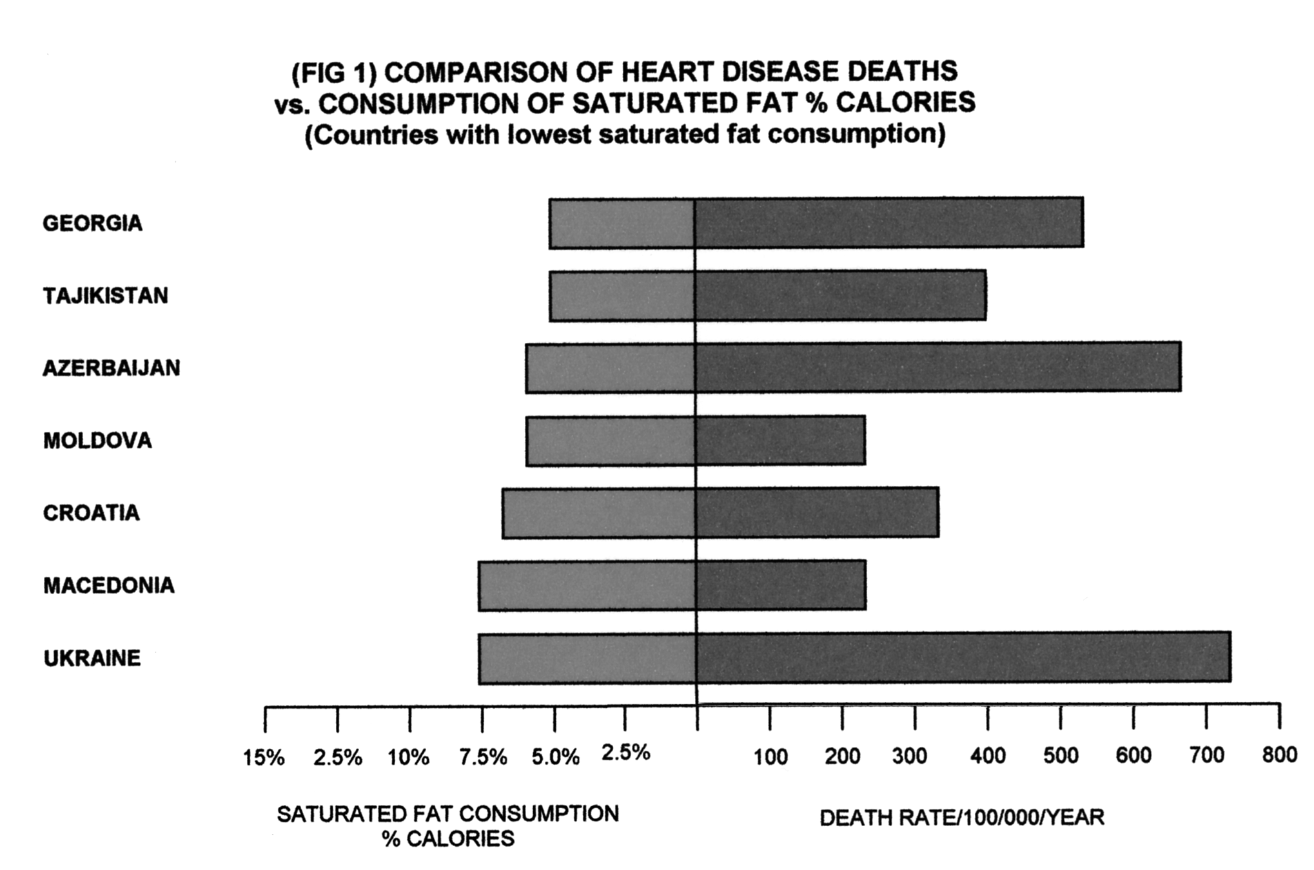
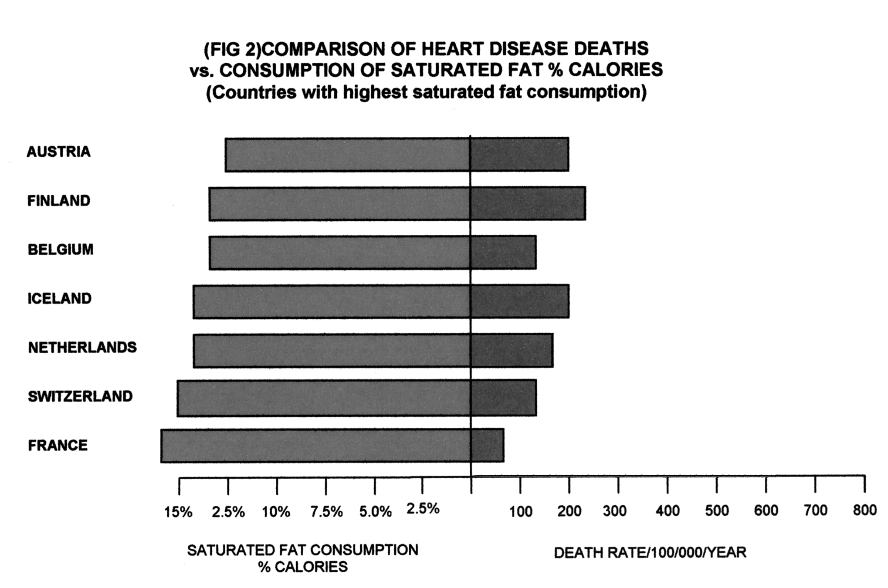
SATURATED FAT AND HEART DISEASE
LOWER RATES OF HEART DISEASE ARE ASSOCIATED WITH HIGHER LEVELS OF SATURATED FAT IN THE DIET.
Notes:
These figures were put together from recent statistics on saturated fat consumption in Europe. As you can see, those countries with the highest consumption of saturated fat have the lowest rates of heart disease and those with the lowest levels of saturated fat have the highest rates of heart disease. France, with the highest consumption of saturated fat in all Europe, has the lowest rate of heart disease. You might call this the European Paradox.

Slide 14


PROBLEMS ASSOCIATED WITH CONSUMPTION
OF POLYUNSATURATED OILS
INCREASED CANCER
INCREASED HEART DISEASE
INCREASED WRINKLES AND PREMATURE AGING
IMMUNE SYSTEM DYSFUNCTION
DISRUPTION OF PROSTAGLANDIN PRODUCTION
DEPRESSED LEARNING ABILITY
LIVER DAMAGE
CEROID STORAGE DISEASE
DAMAGE TO REPRODUCTIVE ORGANS AND THE LUNGS
DIGESTIVE DISORDERS DUE TO POLYMERIZATION
INCREASED LEVELS OF URIC ACID
IMPAIRED GROWTH
LOWERED CHOLESTEROL
Source: Pinckney, The Cholesterol Controversy
Notes:
Many problems have been associated with the consumption of polyunsaturated vegetable oils, from cancer and heart disease to learning disabilities and impaired growth.
Vegetable oils will lower cholesterol, at least temporarily, but our bodies need cholesterol. High cholesterol is only a very weak risk factor for heart disease in men under age 60, but low cholesterol is a marker for cancer, intestinal problems, stroke, depression and even suicide.

Slide 15

DISEASES CAUSED OR EXACERBATED BY HYDROGENATED TRANS FATS
ATHEROSCLEROSIS
HEART DISEASE
CANCER
DEGENERATION OF JOINTS AND TENDONS
OSTEOPOROSIS
DIABETES
AUTOIMMUNE DISEASES
ECZEMA
PSORIASIS
PMS
LOWERED TESTOSTERONE, LOWERED SPERM COUNT
FAILURE TO GROW
LEARNING DISABILITIES
LOW BIRTH WEIGHT BABIES
REDUCED VISUAL ACUITY
REDUCED FAT CONTENT IN MOTHERS' MILK
Notes:
For many years, the industry has claimed that trans fats are harmless, but there is actually a great deal of evidence showing that they contribute to many disease conditions, everything from atherosclerosis to cancer.
Hydrogenated fats contribute to the degeneration of the joints and tendons, which is why so many people need knee and hip replacements these days.
Trans fats interfere with the insulin receptors in your cells, contributing to type-II diabetes. Government advice to use margarine instead of butter has led to an epidemic of type-II diabetes.
When a pregnant woman consumes trans fats, she is more likely to give birth to a low-birth-weight baby. Exposure of the infant to trans fats either in the womb or in the mother’s milk, can interfere with the development of the eyes, resulting in reduced visual acuity.
Finally, trans fatty acids will lower the fat content in mother’s milk, often leading the baby to be fussy (because he is not satisfied) and the mother to give up on nursing. And if she continues, the baby’s development may be compromised.

Slide 16
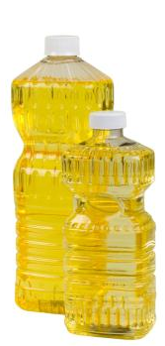
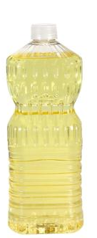
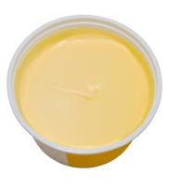
INDUSTRIAL FATS AND OILS
LIQUID POLYUNSATURATED OILS CAUSE UNCONTROLLED REACTIONS IN THE BODY
SOLID PARTIALLY HYDROGENATED OILS INHIBIT REACTIONS IN THE BODY
THE RESULT: BIOCHEMICAL CHAOS
Notes:
The most important first step you can take to improve your health is to remove all industrial fats and oils from your diet!

Slide 17
SATURATED FATS VS. TRANS FATS
 | SATURATED FATS | TRANS FATS
CELL MEMBRANES | Essential for healthy function | Interfere with healthy function
HORMONES | Enhance hormone production | Interfere with hormone production
INFLAMMATION | Suppress | Encourage
HEART DISEASE | Lower Lp(a). Raise "good" cholesterol | Raise Lp(a). Lower "good" cholesterol
OMEGA-3 | Put in tissues and conserve | Reduce levels in tissues
DIABETES | Help insulin receptors | Inhibit insulin receptors
IMMUNE SYSTEM | Enhance | Depress
PROSTAGLANDINS | Encourage production and balance | Depress production; cause imbalances
Notes:
Finally, our government has admitted that trans fats are unsafe at any level. But these spokesmen continue to insist that “trans fats are just as bad as saturated fats.”
However, as you can see from this chart, the saturated fats have the opposite effects compared to the trans fats. The effects of the saturated fats are beneficial while the effects of the trans fats are harmful.

Slide 18
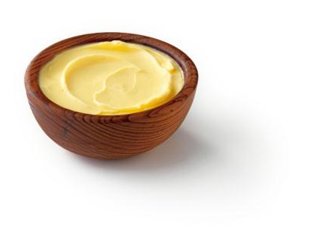
GOOD THINGS IN BUTTER
HIGH LEVELS IN
GRASS-FED BUTTER
Vitamin A
Vitamin D
Vitamin E
Vitamin K
Copper
Zinc
Chromium
Selenium
Iodine
Conjugated Linoleic Acid
CLA
IN ALL BUTTER
Shorter Chain Fatty Acids
Essential Fatty Acids
PERFECT BALANCE
Lecithin
Cholesterol
Glycosphingolipids
Wulzen Factor
DESTROYED BY PASTEURIZATION
Notes:
So switch to butter and profit from the many nutrients in this natural, healthy fat.
Butter contains fat-soluble vitamins. We have discussed the important benefits of vitamins A and D (which will only be in the butter if the cows are on green pasture). But vitamins E and K are also important. Vitamin E protects our cells against free radicals and is essential for normal reproduction; vitamin K is needed for healthy blood and bones.
Butter is a good source of many trace minerals, including copper, zinc, chromium, selenium and iodine.
The combination of vitamin A and iodine makes butter an excellent food for the thyroid gland. In mountainous regions where the soil is deficient in iodine, butter concentrates what little is available (or is provided in salt licks) and helps prevent thyroid problems. Once, after listening to this lecture, a young man told me that his mother grew up in Romania. She was the only one in her village who developed a goiter. She hated butter, never touched it. But everyone else ate plenty of butter.
Butter contains important shorter chain fatty acids and a nice balance of essential fatty acids. It contains lecithin, which helps the body use cholesterol properly, and the Wulzen factor, which helps prevent arthritis. If the cows are on rapidly growing green grass, butter will contain the X Factor. It contains cholesterol, which is a nutrient, and glycosphingolipids, which aid digestion. Finally, if the cows are on green grass, butter will contain CLA, a strong anti-cancer substance.
All of these factors are rather stable and survive pasteurization except the Wulzen factor, which is destroyed by pasteurization. The best butter, of course, is raw butter from cows on green pasture, but if you only have access to pasteurized butter, be sure to get butter from cows that graze on pasture.

Slide 19
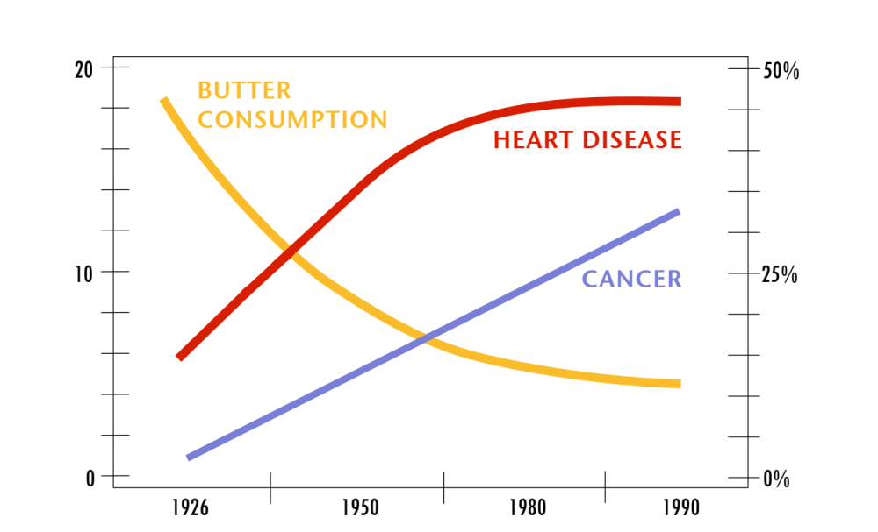
DISEASE TRENDS AND BUTTER CONSUMPTION
POUNDS OF BUTTER | CAPITA | YEAR
% OF CANCER AND HEART DISEASE RELATED DEATHS
Notes:
While butter consumption in the US has plummeted, cancer and heart disease rates have risen dramatically. We do not know all the reasons for these epidemics, but one thing for sure, they are not caused by butter consumption because the trends are going in opposite directions.

Slide 20
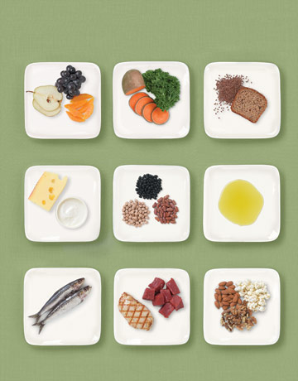
THE PURITANICAL DIET
The virtuous, low-fat, low-salt, high-fiber, impossible diet. Approved by dietitians!

Slide 21

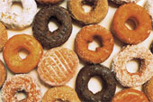




PORNOGRAPHIC FOOD

Slide 22
SUGAR, SUGAR EVERYWHERE!
Flavored milks – “soda in drag”
Canned fruit
Breakfast pastries and cereals
Cookies
Fruit juice
Prepared foods
Federal rules for school meals
place a limit on FAT in meals,
but no limit on SUGAR.

Slide 23
SUGAR IN FLAVORED MILK
per 8 ounces
Product | Sugars
MILK:
Plain Milk 1% Lowfat | 12g
Horizon Organic Milk Reduced Fat Chocolate | 27g
Nestle Nesquik Milk Chocolate Lowfat | 30g
Nestle NesQuik Milk Strawberry | 31g
Organic Valley Chocolate Lowfat Milk | 25g
Hershey’s 2% Chocolate Milk | 29g
SODA:
Coca-Cola Classic | 27g
Sprite | 26g
A & W Root Beer | 31g
JUICE:
Capri Sun Juice Drink Red Berry | 21 g
Apple & Eve 100% Juice Apple | 22g

Slide 24
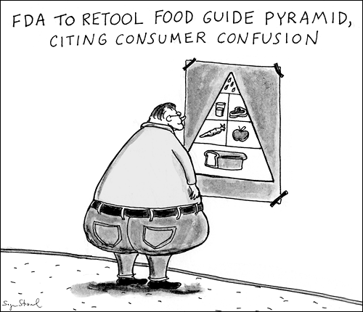

Slide 25
SUMMARY
TRADITIONAL DIETS MAXIMIZED NUTRIENTS WHILE MODERN DIETS MINIMALIZE NUTRIENTS
_{TRADITIONAL DIETS} | _{MODERN DIETS}
FOODS FROM FERTILE SOIL | FOODS FROM DEPLETED SOIL
ORGAN MEATS OVER MUSCLE MEATS | MUSCLE MEATS, FEW ORGANS
ANIMAL FATS | VEGETABLE OILS
ANIMALS ON PASTURE | ANIMALS IN CONFINEMENT
DAIRY PRODUCTS RAW AND/OR FERMENTED | DAIRY PRODUCTS PASTEURIZED
GRAINS AND LEGUMES SOAKED/FERMENTED | GRAINS REFINED, EXTRUDED
BONE BROTHS | MSG, ARTIFICIAL FLAVORINGS
UNREFINED SWEETENERS (HONEY, MAPLE SYRUP) | REFINED SWEETENERS
LACTO-FERMENTED VEGETABLES | CANNED VEGETABLES
LACTO-FERMENTED BEVERAGES | MODERN SOFT DRINKS
UNREFINED SALT | REFINED SALT
NATURAL VITAMINS IN FOODS | SYNTHETIC VITAMINS ADDED
TRADITIONAL COOKING | MICROWAVE, IRRADIATION
TRADITIONAL SEEDS/OPEN POLLINATION | HYBRID SEEDS, GMO SEEDS
Notes:
To summarize, traditional diets maximized nutrients while modern diets minimize nutrients.
[Note to presenter: Leave this on the screen during the break.]

Slide 26
Morton Satin, MSc
Vice President of Science and Research for the Salt Institute

Slide 27
