Slide 1
Managing IP in Public Private Partnerships, Strategic Alliances, Joint Ventures, and M & A
Guriqbal Singh Jaiya
Director, SMEs Division
World Intellectual Property Organization www.wipo.int/sme

Slide 2
Links
http://www.globalforumhealth.org/filesupld/ippph/Taubman.ppt
http://www.wipo.int/uipc/en/partnership/
(User ID: partner06, Password: u15tudy)

Slide 3
Strategic Alliances
Form of cooperative strategy whereby firms combine resources and capabilities to achieve mutually beneficial ends
  Joint ventures – combine assets
  Equity alliances – shareholders in new venture
  Non Equity alliances – contractual agreements
No single theory that provides comprehensive understanding of cooperative strategy
  Four theories are investigated to provide insights into cooperatives as strategic alliances
Notes:
A strategic alliance is a form of cooperative strategy whereby firms combine resources and capabilities to achieve mutually beneficial ends. Alliances may be categorised as: joint ventures where firms combine selected assets to create an independent entity; equity alliances where the partners become shareholders in a new venture and; non-equity alliances, contractual agreements between companies relating to supply, distribution, manufacturing, R&D or any other dimension of the value chain (Hanson, Dowling, Hitt, Ireland and Hoskisson , 2005)
Child and Faulkner (1998) point out that “one looks in vain for a unified theory or approach to provide the basis for understanding cooperative strategy” and list eight bodies of theory that provide “useful, but partial insights” (Page 17). These eight theoretical perspectives are:
Economics:
Market power theory
Transaction cost economics
Agency theory
Increasing returns theory
Game Theory
Strategic Management Theory
Organization Theory
Resource dependence
Organization of alliances
To this list, we might add further contributions from theories of trust and cooperation, leadership, social network theory. Eisenhardt and Schoonhoven (1996), suggest that failure to include social and strategic explanations creates an impoverished view of alliance formation and management.
This paper will focus on the four bodies of theory identified in objective 1

Slide 4
Transaction Cost Economics
TCA traditionally applied to relationships between the firm and its suppliers or customers
Argued that transactions between independent firms are costly and can be reduced through internalising activities
Critical dimensions of transactions are – frequency of occurrence, degree of uncertainty to which they are subject and asset specificity
Balanced investment commitment between parties to the transaction, contracts, or vertical integration seek to limit opportunistic behaviour
More complex a contract becomes the more likely it is that the activities embedded in the contract will be internalised
Notes:
Transaction cost analysis (TCA) has traditionally been applied to relationships between the firm and its suppliers or customers. Coase (1937) argued that market transactions between independent firms are costly, and that vertical integration may be able to reduce these costs by internalising activities, previously carried out by independent firms, within a single firm (Clemons and Row, 1992). Thus, TCA provides a vehicle for determining the boundaries of the firm that minimise the sum of production, distribution and transaction costs (Williamson, 1971).
Transaction costs in inter-firm dealings are those costs related to: information regarding the terms of the transaction; searching for the best price and other conditions of sale; negotiating, monitoring, and enforcing contracts and the cost of managing the risk that the supplier or buyer might not perform as expected. (Barkema, 1993; Rindfleisch and Heide, 1997). According to Williamson (1979) the critical dimensions of transactions are - frequency of occurrence, degree of uncertainty to which they are subject, and asset specificity.
Asset specificity occurs when the firm makes sizable investments in assets specific to ongoing relationships with suppliers or customers (Knoeber, 1989). Once in place these relation-specific assets generate the incentive for opportunistic behaviour. A balanced investment commitment between the parties to the transaction, contracts designed to discourage opportunism, or vertical integration seek to limit such behaviour (Williamson, 1979). However, the effectiveness of any type of contract is limited by bounded rationality, adverse selection, moral hazard and difficulties of monitoring and control (Milgrom and Roberts, 1992)
These contractual issues bring a third cost dimension; the governance costs associated with bureaucratic control in an organization that is vertically integrated by ownership relative to the costs of managing a contractual relationship. The more complex a contract becomes the more likely it is that the activities embedded in the contract will be internalised.
TCA also applies to more complex forms of relationships between firms such as strategic alliances and to relationships within the firm; between the individual owners (shareholders or cooperative members), the owners and the governing board, and the board and management.

Slide 5
TCA and Strategic Alliances
Alliances are formed to partially internalise an exchange to minimise transactions costs that are high relative to production and distribution costs
Argued that TCA focuses on single party cost minimisation while alliances are inherently dyadic relationships
TCA also focuses on appropriation issues that originate from contracting hazards and behavioural uncertainty
Alliance structure tends to be more influenced by considerations relating to managing coordination costs across partners rather than concerns associated with appropriation
Notes:
The transaction cost rationale for the formation of alliances is straight forward. Alliances are formed to partially internalise an exchange because transaction costs are perceived to be high relative to production and distribution costs (Das and Teng, 2000) All the TCA arguments relating to the limitations of contracts and outlined above apply (Gulati, 1998). In addition, alliances that involve sharing information (as is likely in modern alliances) suffer from “the hazard of misappropriation” (Han, 2004) arising from incomplete and vaguely–defined property rights.
Gualti (1998) argues that TCA focuses on single party cost minimisation while alliances are inherently dyadic exchanges. Furthermore alliances are not only about cost minimization but also about maximising the return from the joint venture Concern also stems from the TCA focus on appropriation issues that originate from the presence of contracting hazards and behavioural uncertainty. Gulati and Singh (1998) found alliance structure to be more closely influenced by considerations relating to managing coordination costs across partners rather than concerns associated with appropriation. Moreover the social structure of trusting relationships was found to be distinctive in addressing both coordination cost and appropriation concerns.

Slide 6
Resource Based View
RBV important in the study of inter-organisational relations
RBV argues that resources that valuable, rare, non-substitutable and in combination difficult to imitate are a source of sustained competitive advantage
Resources and competencies include intellectual property (patents and brands), product development capabilities, ability to manage resource heterogeneity
Way resources are combined and utilised can result in competitive advantage
Notes:
In the history of economic thought, the resource-based view (RBV) has its origins in the contributions of Chamberlin (monopolistic competition), Schumpeter (entrepreneurial innovative activity) and Penrose (firms have unique ways of combining resources to generate opportunities for sustained growth) (Chamberlin, 1933; Schumpeter, 1934 ; Penrose, 1959) The RBV argues that resources that are valuable, rare, non-substitutable and, in combination, difficult to imitate are a source of sustained competitive advantage for the firm possessing them. Resources and competencies include intellectual property (such as patents and brands), product development capabilities, and the ability to manage relationships with suppliers and customers leading to the idea of product/service heterogeneity arising from resource heterogeneity. Because different firms have access to different resource bundles and combine resources with varying degrees of effectiveness, profitability of firms within an industry will vary widely (a theory that is well supported by empirical observation)
The existence of sustained resource and product heterogeneity, along with sustained differences in profitability between firms is a direct challenge to the neoclassical theory and is seen by Connor (1991) and Hunt and Morgan (1995) as replacing it as the dominant paradigm (a view that is probably not shared by all economists!).
The RBV also challenges the view of business strategy as managers seeking the best “fit” between the firm and its environment by emphasizing the overriding importance of factors internal to the firm (Barney, 1991)

Slide 7
RBV and Strategic Alliances
Focuses on pooling and using valuable resources
Form of alliance chosen will depend on the nature of the resources held and sought by each partner
Key element is the symmetry of the resource exchange process – firms must have resources to get resources
Alliances have the potential for the development of new idiosyncratic resources which are unique to the alliance
Notes:
In contrast to TCA, which emphasises costs, the RBV focuses on pooling and using valuable resources (Das and Teng, 2000). The market can be considered as a mechanism for trading resources but given that their value to the firm that possesses them lies in their embeddedness, “bundledness” and inimitability, all the limitations of market exchange, as discussed in the TCA literature, become particularly relevant.
The form of alliance chosen will depend on the nature of the resources held and sought by each partner (Das and Teng, 2000; Pangarkar and Klein, 2001) For example, if a firm’s valuable resources are property based and the proposed partner’s resources are knowledge based, the firm will favour an equity joint venture. (Das and Teng, 2000).
A key element in the establishment of an alliance is symmetry in the resource exchange process – “firms must have resources to get resources” (Eisenhardt and Schoonhoven, 1996, page137). This symmetry must continue if the alliance is to be sustained (in a similar way to the TCA view of symmetry in investment in relationship-specific assets)
Alliances have the potential to do more than the simple sharing of resources; they can facilitate the development of new “idiosyncratic resources “which are unique to the alliance and possibly unanticipated at the time of its establishment

Slide 8
Social Networks
Social network theory proposes that economic activity is always embedded in a social context
Importance of social network lies in access to information, emotional and tangible support, status, and a governance mechanism that facilitates trustworthy and predictable behaviour
Notes:
Social Network theory proposes that economic activity is always embedded in a social context and that, for researchers, the social and economic dimensions of a business relationship are likely to be confounded. (Granovetter, 1985; Gulati, 1998). BarNir and Smith argue that the importance of a social network to an individual manager lies in; access to information (for example, about potential alliance partners), emotional and tangible support, status (through association with other network members of perceived high status) and a governance mechanism that facilitates trustworthy and predictable behaviour.

Slide 9
Social Networks and Strategic Alliances
Underlying logic of alliance formation is strategic needs and social opportunities
Social networks facilitate alliance formation by enlarging the circle of potential trustworthy partners
New opportunities for alliances often identified through existing relationships
Positive prior experiences with alliances create a favourable environment for the establishment and maintenance of continuing relationships
Socially embedded relationships engender confidence and trust and a natural deterrent for bad behaviour that will damage reputation
Notes:
Eisenhardt and Schoonhoven (1996) suggest that the underlying logic of alliance formation is strategic needs and social opportunities. Social networks facilitate alliance formation by enlarging the circle of potential trustworthy partners. This is influenced by the size of the top management team, the number of previous employers, and the level of position held with previous employers. (Eisenhardt and Schonhoven, 1996). Gulati (1998) observes that often firms identify new opportunities for alliances through their existing relationships and that the manner and extent to which firms were embedded influenced key decisions such as the frequency with which firms entered alliances, choice of partner, type of contract used and evolution of the alliance over time. Positive prior experiences with an alliance partner (or through the network, the partner’s other alliances) creates a favourable environment for the establishment and maintenance of continuing relationships (Gulati, 1995)
Socially embedded ties within an alliance may also facilitate its continuing performance by engendering confidence and trust, and “a natural deterrent for bad behaviour that will damage reputation” (Gulati, 1998, Page 309)

Slide 10

Trust and Cooperation
Number of definitions of trust however confident expectations and a willingness to be vulnerable are critical components of all definitions
Three perspectives of on trust:
  Calculative – other will do as they say
  Shared cognition – based on length & depth of relationship
  Personal Identity – holding common values
Risk is considered essential for essential for the development of trust
Some form of interdependence is required where the interest of one party cannot be achieved without reliance on another
Cooperation involves proactive behaviour to achieve mutually beneficial outcomes
Cooperation both engenders trust and requires trust to initiate it
Notes:
Trust has been studied from a number of aspects, bringing richness to the understanding of its impact in strategic alliances and cooperative arrangements. However, Rousseau et al. (1998, p394) point that irrespective of the underlying discipline of the authors (psychology to organisational behaviour), confident expectations and a willingness to be vulnerable are critical components of all definitions. Table 2 summarises a number of definitions of trust.
Child and Faulkner (1998), following a number of other authors, identify three perspectives on trust: calculative, “based on the assurance that other people will do as they say because the deterrent for violation is greater than the gains and/or the rewards from preserving trust outweigh any from breaking it “(Page 48); shared cognition – based on the length and depth of the relationship; and personal identity – holding common values. A similar perspective is the distinction between cognition-based trust (broadly corresponding to calculative and shared cognition) and affect-based trust, based on friendship and emotional bonds.
Rousseau et al. (1998, p395) bring together the work of a number of authors and identify the conditions that must exist for trust to arise. Risk is considered essential for the development of trust as it creates an opportunity for it to occur which, in turn, leads to risk taking. Secondly, some form of interdependence is required where the interests of one party cannot be achieved without the reliance on another. These two variables then interact causing variations in the level and form that trust takes, i.e. the nature of risk and trust changes as interdependence increases (Sheppard and Sherman, 1998).
Like trust, cooperation, is defined in various ways. The common thread is that it involves proactive behaviour to achieve mutually beneficial outcomes (Anderson and Narus, 1990; Schroder and Mavondo, 1998). The links between cooperation and trust are that cooperation both engenders trust and requires some degree of trust to initiate it.

Slide 11

Trust and Cooperation in
Strategic Alliances
Development of mutual trust lowers transaction costs by reducing the negative impact of bounded rationality, relationship specific investment and opportunism
Repeated exchange based on trust improves the performance of inter-organisational exchanges
Although argued that trust and control (contract/legal structures) are both needed for confidence on partner cooperation, trust can reduce reliance on contracts and assist in dispute resolution
Notes:
Trust will usually be part of an interrelated bundle of governance devices to ensure the efficient and effective management of their economic transactions with other firms (Alvarez et al, 2003). In a strategic alliance, the development of mutual trust lowers transaction costs by reducing the negative impact of bounded rationality, relationship-specific investment and opportunism (Child and Faulkner, 1998). Whilst there is some difference between economists and sociologists on the impact of trust on cooperation, both argue that repeated exchange based on trust improves the performance of inter-organisational exchanges (Poppo and Zenger, 2002).
Das and Teng (1996) argue that both trust and control are needed to engender a high level of confidence in partner cooperation. Control is achieved through legal structures and contracts. Das and Teng (1996) identify the benefits of trust in strategic alliances which, as well as lowering transaction costs, include inducing desirable behaviour, reducing the need for formal contracts and facilitating dispute resolution.

Slide 12
The FDI Sequence:
Foreign Presence & Foreign Investment
The Firm and its
Competitive Advantage
Greater Foreign Presence
Change
Competitive Advantage
Exploit Existing Competitive
Advantage Abroad
Production at Home:
Exporting
Production Abroad
Licensing
Management Contract
Control Assets
Abroad
Joint Venture
Wholly-Owned
Affiliate
Greater
Foreign
Investment
Greenfield
Investment
Acquisition of a
Foreign Enterprise

Slide 13
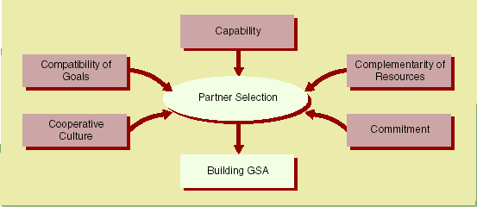
Building Strategic Alliances
The Five-Cs scheme of partner selection

Slide 14
Alliances Come In A Variety Of Forms
Continuum Of Transaction Types
Outsourcing
Corporate Alliances
Traditional M&A
Increasing Partner Commitment
Partial
Partial
Contract
Shared
Partial
Acquisitions
100%
Shared
Acquisitions
Services
Licensing
Resources and
Acquisitions
Controlling
Acquisitions
Resources and
Joint
Non
Joint
Non
-
(Non
-
Equity)
Competencies
-
>50%
Competencies
Ventures
Controlling
Ventures
(Non
Controlling
(Non
-
-
Equity)
Equity)
<=50%
<=50%
Contractual
Collaborative
Increasing Degree of Integration
Source: HLHZ

Slide 15
A Variety Of Types of Equity Alliances
Minority Equity
Solution Joint Ventures
Mazda (33%) & Ford
AIG & Blackstone (7%)
Discovery Com. & Lanet Media (7%)
Prudential Insurance & Kyoei Life (19%)
NBC & Paxon Communications (32%)
Vivendi & Echostar (11%)
DuPont & Pioneer Hi-Bred (17%)
Fuji & Xerox (Fuji/Xerox)
Microsoft & NBC (MSNBC)
Air Canada & Acsion Ind. (Acetek Composites)
Chevron & Texaco (Caltex)
Nestle & Haagen Dazs (Ice Cream Partners)
DuPont & Noranda (Noranda Dupont LLC)
Siemens & Corning (Siecor)
Partial
Acquisitions
Joint
Ventures
Cross Equity
Platform Joint Ventures
Deutsche Telekom (2%) & France Telecom (2%)
GM (6%) & Fiat (20%)
EDS (5%) & Ariba (7%)
Long-Term Credit Bank (3%) & SBC (3%)
AT&T (1%) & Telecom Italia (1%)
British Airways (25%) & AA (25%)
Johnson & Johnson and Merck (Mylanta)
Diageo PLC & Pernod Ricard (Seagram Spirits)
Ameritech & Random House (Worldview)
AOL & Wal-Mart (ShopSmart)
Microsoft & Comcast (AT&T Cable)
BellSouth & Royal KPN (E-Plus)
Source: Public Documents

Slide 16
Business Lifecycle Is A Primary Driver of Business Imperatives
GROWTH BUSINESS LIFECYCLE EXAMPLE
ALPHA TESTING
Start-Up
BETA TESTING
Development
EXPANSION
Early Growth
RAPID
GROWTH
STABILITY & CONSOLIDATION
INNOVATE OR
DECLINE
BUSINESS STAGE
BUSINESS
FOCUS
Technology Feasibility
Economic Feasibility
Market
Acceptance
Market
Penetration
Market Expansion
Milk or Develop New Products & Technologies
Enhance Core Competencies
Access to Capital
Gain Credibility
Management and Process Build-up
Build Market Acceptance
Develop Standards
Market/Sell Value Proposition
Access to Targeted Customer Segments
Create Branding
Establish Service Standards
Enter New Markets
Increase Customer Loyalty
Strengthen Margins
Offer New Service Options
Reduce Cost & Gain Efficiencies
Develop Stream of Innovations
Increase Quality
Expand Globally
Bundle Offering with Others
Build Financing
Service
BUSINESS
IMPERATIVES
Venture Capital Stages
IPO
Going Concern Stages
Sources: BOOZ ALLEN/HLHZ

Slide 17
Risks Vary By Transaction Types
INCREASING CONTROL
High
Price
Risk
High
Governance
Risk
Access assets/
Capabilities
Merge assets/
Of companies
Acquire assets/
Of companies
Corporate-wide
Strategic Alliances
Company
Merger of
Equals
Corporate
Acquisitions
Minority
Stakes
INCREASING SCOPE
Division/SBU
Increasing
Integration
Risk
Mergers of
Divisions/SBUs
As JVs
SBU
Acquisitions
Contractual
Alliances
Assets
Asset
Acquisitions
JVs
Source: McKinsey
Alliances

Slide 18
Due Diligence Questions
From your perspective, what is driving a potential transaction? From theirs?
What core competencies do each party possess? What gaps and weaknesses?
What do you want from them? Them from you?
What combination of assets and competencies must be included in a potential transaction to optimize results?
What must you have from them, at a minimum, to warrant proceeding?
How would these combinations be superior to the status quo? What is the value proposition?
To what extent would this combination be complementary versus cannibalistic?
How would success be defined, measured? In the near-term? In the long-term?
Consider tolerances/requirements for
  Commitment
  Integration
  Independence from the parents

Slide 19
Companies Are Achieving Higher Alliance ROIs Than From Their Core Businesses
ROI
28%
AVERAGE ALLIANCE ROI
(Pre-tax and Pre-Interest)
Emerging &
Middle Market
Firms
Successful
U.S. & European
Alliances
22
Top 20%
Successful European
Alliance Firms
U.S.*
Firms
Asian /European
Firms
16
Fortune 500
Average ROI
0
U.S.
Revenues
$100-$999 Million
Sources: Dr. Pekar, Jr./Booz·Allen & Hamilton/Association for Corporate Growth

Slide 20
Choice of R&D transaction (TCE)
Type of transaction
License
Joint venture
FDI; buy partner
Arm’s length contract
Both parties place assets at risk
Politically risky; potential antitrust problems
Integration
None to full
Uncertainty
Less to more
# of potential partners
Many to few
Complexity
Less complex to more complex
Asset specificity
Less specific to more specific

Slide 21

The eleven modes of cooperation agreements: illustration of their anchor points
Common
Research
Trademark
licence
Engineering
contract
Patent
licence
Consortium
(common
marketing)
Distribution
agreements
Common
purchase
Common
production
Research
contract
Subcontracting
Ways
of...
supplying
producing
marketing
delivering
designing
Know-how transfer
contract
Source: S. Urban, S. Vendemini, CESAG, Strasbourg

Slide 22
Cooperations modes and value chain
Link of the chain
R&D
Logistic
supply
Produc-tion
Marke-ting
Distri-bution
Exchanges of existing knowledge
Organisation of a common research
Setting up of a common project (design, engineering)
Common purchases
Access to the specific resources of the country (raw materials, subventions, capital cost, compared advantages)
Subcontracting agreements
Common manufacturing agreements
Implementation of engineering contracts
Patent license
Production consortium
Trademark licence
Consortium (common marketing)
Joint advertising
Reciprocal distribution agreements (access to existing distribution networks)
Coope-
ration
modes
Services
After sale
Lobbying
Relations
Source: S. Urban, S. Vendemini, CESAG, Strasbourg

Slide 23
Cultural Gap
Entrepreneurial world: secrecy, profit maximization, search for competitive advantage, patents, “time is money”.
University world: broad dissemination of knowledge and research results, independent, guided by scientific curiosity.
Publication vs. patenting

Slide 24
University Vs. Business:
Two Worlds
IP System
as a bridge
Knowledge
Academic
Community
Commercial
World
e.g. SMEs
Collaboration
R&D Funding
Decide what research
Motivated by curiosity
Attract acclaim of peers
Prompt publication
Profitable products
Find new markets
Win competition
Initial secrecy
Decide what research
Motivated by curiosity
Attract acclaim of peers
Prompt publication
Profitable products
Find new markets
Win competition
Initial secrecy

Slide 25
National IP Policy
In the US: Bayh - Dole Act (According to the AUTM, it has led to creation of 260,000 jobs and contributed US$ 40 billion to US economy)
Japan
Germany
China
Brazil
in the Knowledge-driven Economy the university has new functions

Slide 26
University IP Policy
IP Policy for successful commercialization of research results (Win-Win for both)
IP Policy:
  ownership of IP
  disclosure of IP
  licensing, commercialization, and marketing
  distribution of royalty income
  rights and obligations of an inventor and of the institution

Slide 27
University IP Policy
Teaching (Copyright)
Marketing (Inventions, University)
Research (Trade secrets and Patents)
  ownership of IP
  disclosure of IP
  marketing, commercialization and licensing
  distribution of royalty income
  rights and obligations of an inventor and of the institution

Slide 28
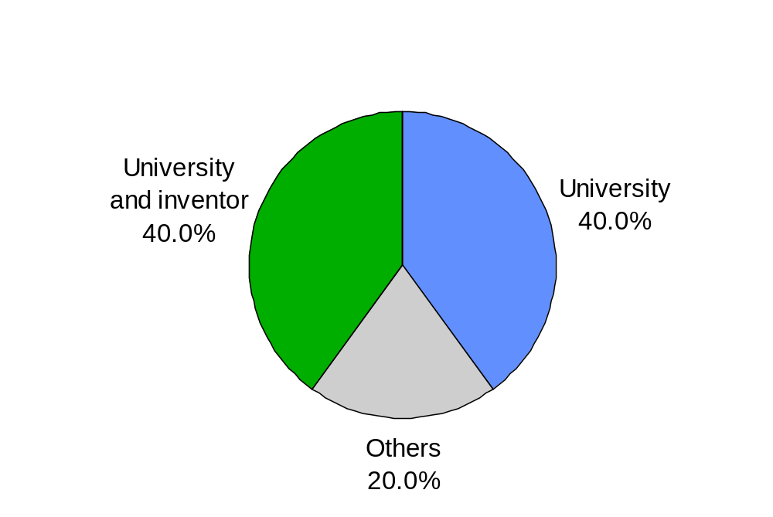
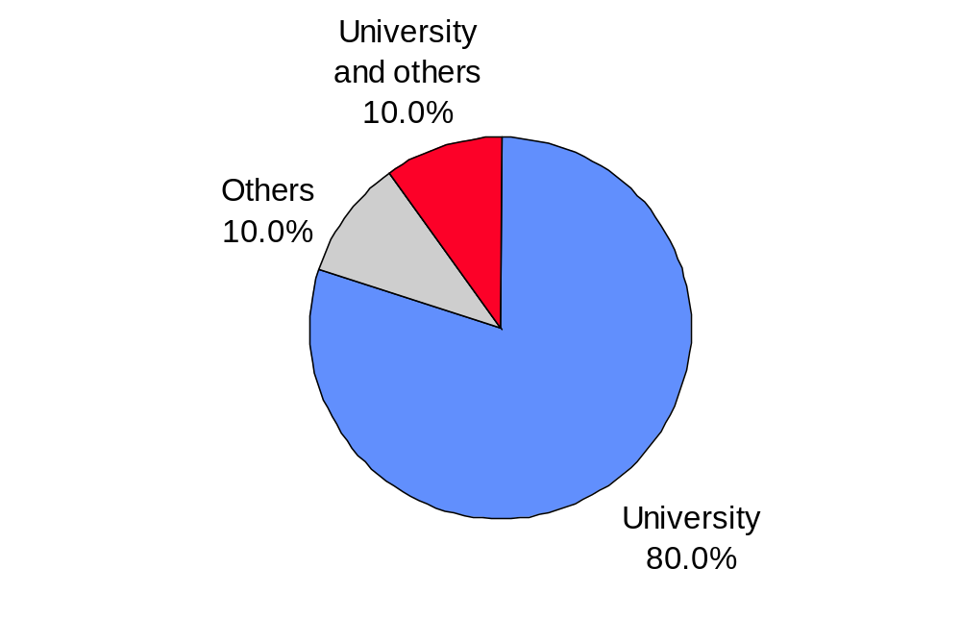
Invention Policies
Ownership of patent rights to technologies developed by faculty, students and staff (Percentage of universities)
North America
Other Countries

Slide 29
What are IP Management Units (IPMUs) (1)
Appropriate institutional structure specifically responsible for:
  managing the commercialization of IP
  facilitating the transfer of technology from universities/R&D centers to industry/business

Slide 30
What are IPMUs (2)
Specific institutional arrangements vary considerably: external and/or internal
  external technology brokers or IP law firms
  office, department, unit or section (IPMU) within a faculty, university or R&D center, managed by and integrated in its overall administration (TLO,TTO, etc)
  common IPMU for a number of Universities
  IPMU may be a limited company
  technology incubators for university spin-offs/start-ups

Slide 31
What are IPMUs (3)
Called by a variety of names, such as:
  Technology Licensing Office (TLO)
  Technology Transfer Unit
  Center for Technology Management
  Innovation Centers
  Industry Liaison Office

Slide 32
Examples:IP Management Unit
Example 1: Stanford University
  Office of Technology Licensing
  Started as pilot program with one staff and three technologies
  Today: 20 staff, 1100 patents currently licensed to companies
  Birth of biotechnology (Cohen Boyer patent)
  Strategy of non-exclusive licensing

Slide 33
Examples:IP Management Unit
Example 2: Technion Israel Institute of Technology
  Technion R&D Foundation for exploitation of university R&D
  Dimotech Ltd. (for university spin-offs)
  Technion Entrepreneurial Incubator Co. Ltd.

Slide 34
Examples:IP Management Unit
  Example 3: By 2000, Brazil had over 180 business incubators
  Some 84% of incubators linked to universities
  Usually strong interaction between incubated businesses and the host universities
  Some 15% of firms that graduated from an incubator have at least one patent. This figure is considerably higher than the average for Brazilian firms.

Slide 35
Examples:IP Management Unit
Example 4: Faculty of Chemistry, Universidad de la Republic of Uruguay
Since 1998 courses on “Development of entrepreneurial capacities” and “Intellectual Property and patents” delivered within the university
Establishment of an incubator
Establishment of a “technology pole” for the joint development of R&D projects.

Slide 36
Importance of IPMUs (1)
(1) Effective and efficient commercialization
structure with responsibility over technology licensing greatly facilitates the proper management of the process of commercialization (in finding and interfacing with industrial and financial partners)
enables inventor/ researcher to focus on the research side of the project
(and less on the related legal/business aspects for which they may not have the appropriate expertise and/or time)

Slide 37
Importance of IPMUs (2)
(2) Awareness and training on IP matters
Sensitizing faculty members and researchers on the importance of identifying, protecting and commercially exploiting their inventions and/or research results
Procedures for disclosing inventions, patenting and management of licensing

Slide 38
Importance of IPMUs (3)
Lack of expertise: Often perceived as one of the major limiting factors in managing the commercialization of IP by universities/R&D centers
“the right mixture of scientists, lawyers and businessmen and a well-organized back-office is the basis for success in technology transfer”
        Bernhard Hertel, Managing Director, Garching Innovation (TTO of the Max-Planck Gesellschaft)
Notes:
TTO: Technology Transfer Organization
Max Planck: Germany' s largest private organization for fundamental research

Slide 39
Challenge of Financing an IPMU
Self-sufficiency: Long-term aim
IPMUs should aim to become self-sufficient and eventually contribute to university funding
In most universities, licensing pays for less than 5% of R&D costs; maximum is 20% at Stanford and Columbia Universities

Slide 40
Challenge of Financing an IPMU
“Technology transfer is a long-term process. A TT office should have the basis to survive at least ten years. It is difficult to predict when you will get your big project. But when it comes you must have the skills to manage it appropriately”
Bernhard Hertel, Garching Innovation: (Germany)

Slide 41
Other Challenges for an IPMU
Elisabeth Ritter do Santos, TT Office, Federal University of Rio Grande du Sur, Brazil:
“The main challenge is striking a balance so that the results achieved by the new functions of universities may strengthen an regenerate the university’s traditional functions.”
Achieving institutional legitimacy
Creating IP Culture: Challenges in changing organizational culture, which may take a lot of time
Early Success: Significant royalty income to gain legitimacy and credibility

Slide 42
Other Challenges for an IPMU
University research covers a huge variety of technical fields. (challenge for TT personnel)
Academic scientists far more independent than industrial researchers. Researcher cooperation and conviction is crucial.
Disclosure. Researchers share information widely. Avoid early disclosure.
Difficult to establish the inventor, especially in cooperative research. Inventorship vs. authorship.

Slide 43
Role of IPMU: Overview
General
Mission statement
University IP Policy
Relevant agreements
Invention disclosures
Determine patentability of inventions
Evaluate commercial potential
Obtain patent protection
Commercialize inventions
Raise awareness and train researchers/inventors on practical IP matters

Slide 44
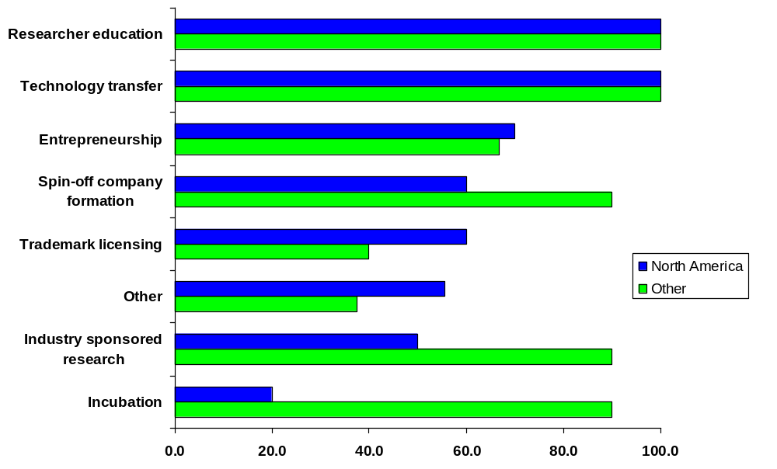
Range of Responsibilities for IPMUs
Percentage of universities whose IPMUs have the
following responsibilities by region

Slide 45
General
Central liaison between the research center / University and industry/business (e.g. SMEs)
Organizing corporate visits to University / research center
Maintaining contact with companies that have potential commercial interest in new technologies
Provide legal assistance and advice to researchers, faculty, administrators and other staff

Slide 46
General
Uncover commercially exploitable ideas
Manage invention disclosures
Evaluate commercial relevance and potential
Provide assessment to determine patentability
Ownership clarification (researcher team, university, outside company, other, together etc)
Responsible for non-disclosure agreements
Responsible for option and license agreements
Responsible for obtaining and managing appropriate IPR protection (patents, trademarks, designs...)

Slide 47
General
Identify and contact appropriate companies to commercialize the technology in return for royalties, license fees and/or research funding.
Licensing IP to appropriate commercial partners
Manage licenses for IP
Negotiate an appropriate agreement which may, in addition to license fees and royalties, include additional research support for the inventor's laboratory

Slide 48
General
Sensitizing researchers on the possibility of commercializing research results
  Evaluating the commercial potential of an invention
  Obtaining patent protection
  Locating suitable commercial development partners
  Negotiating and managing licenses

Slide 49
General
Operational considerations
  Ideally, staff should be skilled in sciences, business and law
  Part of the work is generally outsourced to specialists (e.g. patent agents)
  Disclosure (disclosure forms, early disclosure, non-disclosure agreements, etc.)
  Policy on patenting (every invention, only those with strong market potential, etc.)
  Any cooperation with industry should the subject of a written agreement

Slide 50
Mission statement
Include commercialization in mission statement
  In most universities: not included
  This often impedes execution of joint research projects with private sector
Redirect skills of manpower towards production of innovations, inventions and research findings with commercial potential
  Career development should not depend merely on teaching and basic research (peer reviewed publications)
Notes:
In Jordan: Generally, overall approach of educational institutions emphasizes traditional teaching and research
Redirect skills: In the case of a major project → release temporarily from teaching to permit concentrating on the project

Slide 51
University IP Policy
To safeguard the interests of the university/R&D center in managing collaborative/contract/sponsored research activities
Good IP Policy sets forth transparent guidelines and benchmarks for ownership, protection & commercialization
At the same time, must uphold the core moral values/mission of the institution (dissemination and sharing of knowledge)

Slide 52
University IP Policy
Tailored to specific needs of the institution
Key parts

Slide 53
University IP Policy
Secrecy and Confidentiality
  Identification (ongoing R&D work; laboratory notebooks)
  Contractual obligation (NDA/CA)
  Expected protection measures (email, marking, access limitations)
  Procedures for sharing confidential information (presenting technical papers at seminars; publishing technical or journalistic articles, contracts with third parties, etc)
☹ Some universities: reservations trade secrets ↔ openness in knowledge-sharing
Notes:
Ex: confidential scientific & technical data; commercial info, financial info; negative info. Requirem: secret + comm value + reasonable steps

Slide 54
University IP Policy
Ownership of IPRs
  inventions, CR material, research findings, discoveries, creations, new plant varieties
  generated by students, guest researchers, faculty members, inventors ‘in the course of employment’ or ‘significant use of resources’
  commissioned works
  joint projects
  funded by government; funded by sponsor
  students
  surrender of IP ownership to inventor
Notes:
Univ would normally own any IP that is made, designed, discovered or created by a member of staff, students, guest researchers, etc in the course of their employment and responsibilities or which makes significant use of the institution’s resources (incl funds, facilities, equipment, secretaries) in connection with its development

Slide 55
University IP Policy
Ownership of IP Rights
  A university or R&D institute generally owns any IP made, designed or created by a member of staff or researcher in their course of their employment.
  Sometimes written agreements (e.g. MIT)
  Use of university resources
  Government funded research
  Sponsored research

Slide 56
University IP Policy
Commercialization
  Strategy for marketing, commercializing, licensing of IP
  Distribution of income
    IPMU may expect the costs incurred + some management fees to be refunded
    Inventor may expect fair reward for his contribution
  Rights and obligations of inventor and university/R&D center
Notes:
Income sharing: normally 100% to univ untill all out-of-pocket expenses reimbursed; thereafter, net income shared between inventor and univ

Slide 57
University IP Policy
Disclosure:Need for Balance
    Meeting the needs of researchers for early publication for the sake of their career development
    Preventing “premature disclosure” of potential innovations and research findings, to avoid jeopardizing their patentability and/or commercial exploitation

Slide 58
Relevant Agreements (Examples)
Participation Agreement
Service Agreement
Research agreements
Invention notice / disclosure
Invention ownership agreements
Confidentiality agreements
Option agreements
License or other technology transfer agreement
Agreement to settle disputes, etc.

Slide 59
Relevant Agreements
Participation Agreement
  Confirms acceptance of the Policy by employees, students, guest researchers
  Assigning to the university/R&D center all rights in any IP of which the university/ R&D center may assert ownership
  → means to enforce the Policy
  → before any resources made available!

Slide 60
Relevant Agreements
Service Agreement
  Between university/R&D center and company
  University/R&D center performs certain task
    Evaluation, field testing, clinical trial, etc
  → IP issues: ownership, license, publication, commercialization (income sharing), confidentiality

Slide 61
Relevant Agreements
Material Transfer or Bailment Agreement
  Materials from industry to university/R&D center, or reverse (often biological material)
  Use of original materials; self-replications; modifications
  → IP issues regarding inventions < use of materials: ownership, license, publication, commercialization (income sharing), confidentiality
  → Liability: hazardous materials

Slide 62
Relevant Agreements
Confidentiality Agreement (CA/NDA)
  Separate or integrated in other agreement
  Employees + external partners + visitors
  Bound not to release confidential information, unless expressly permitted
  → protect patentability of invention
  → protect trade value of other technology
  → legal requirement for trade secret protection

Slide 63
Invention Disclosures
Invention Disclosure
  provides information about the inventor, what was invented, circumstances leading to the invention, facts concerning subsequent activities
  first signal that an invention has been made
  basis for determining patentability
  technical information for drafting patent application
  also to report technology that cannot be patented but is protected by other means (e.g. trade secrets or copyright)

Slide 64
Invention Disclosures
Adopt participation agreements or P and CR agreements to govern disclosures
  all researchers should be obliged to disclose all potentially patentable inventions conceived or first put into practice in the course of their institution responsibilities
Encourage to submit disclosures early in the invention development process
  release to the public before patent application is filed may disqualify an invention for patentability

Slide 65
Invention Disclosures
Develop Disclosure Forms
  invention title
  name of inventor
  description of invention*
  sponsorship, if any
  design date and date put into practice
  publication dates, existing or projected, if any
  most relevant technology known to the inventor

Slide 66
Invention Disclosures
*Description of Invention
  Can be brief: explanatory drawing, data, abstracts, summaries may be sufficient
  In sufficient detail to permit a searcher or patent professional to comprehend the invention and assess its patentability
  What is the invention; what does it; why does it appear significant

Slide 67
Invention Disclosures
Protect Disclosures as Trade Secrets
  CA/NDA with members and all outside experts : inform that the information contained in the disclosures is confidential and obligation to keep secret

Slide 68
Determine Patentability
of Inventions
Does it provide a new technical answer to an existing or new technical problem?
Is it possible to make practical use of it?
Does it show an element of novelty? (some new characteristic which is not known in the body of existing knowledge in its technical field - "prior art”) → patent search
Does it show an inventive step? (could not be deduced by a person with average knowledge of the technical field)

Slide 69
Evaluate Industrial
Relevance & Commercial Potential
Does the technology offer a cheaper and/or better way of accomplishing something?
Are there competing technologies available and if so how much better is the invention?
Does it have potential for creating a new market?
How much investment, in both time and money, will be required to bring the invention to the market?

Slide 70
Evaluate Industrial
Relevance & Commercial Potential
if it is decided not to patent/license by the University, then:
→ reassign ownership to inventor
→ retain rights to use the invention for further research and for educational purposes

Slide 71
Raising Funds for Spin-offs/Start-up
Two ways of raising funds
  Debt - loan which the borrower must repay
  Equity - which gives the investor a share of the actual business of the investee and is not automatically repaid by the investee business, but rather relies on the investor ultimately realizing the equity held in the business

Slide 72
Debt Finance
Debt finance is generally ‘secured’ by a charge over the business’ assets. In principle, these assets can be any claims that have reasonably predictable cash flows, or even future receivables that are exclusive.
Securitization of IP assets - a new trend: collateralizing commercial loans and bank financing by granting a security interest in IP is a growing practice, esp. in music, Internet and high technology sectors.

Slide 73
Venture capital
For the venture capitalist, return depends upon future profits.
IP ownership is important to convince investors of the market opportunities open to the enterprise for the commercialization of the products/services in question :
  Patents provide exclusivity for the commercialization of inventions and may be important to convince investors for the commercialization of your product
  A patent is also a proof that the product is innovative.

Slide 74
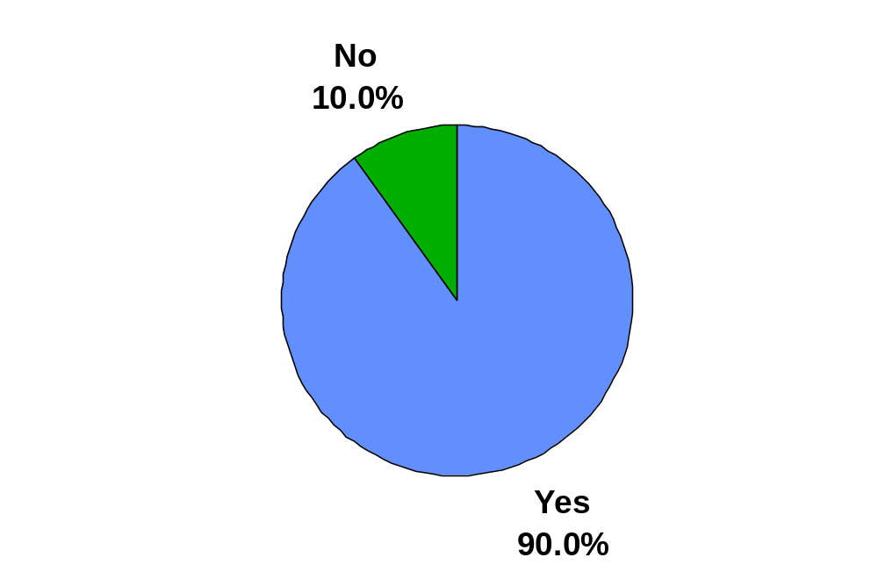
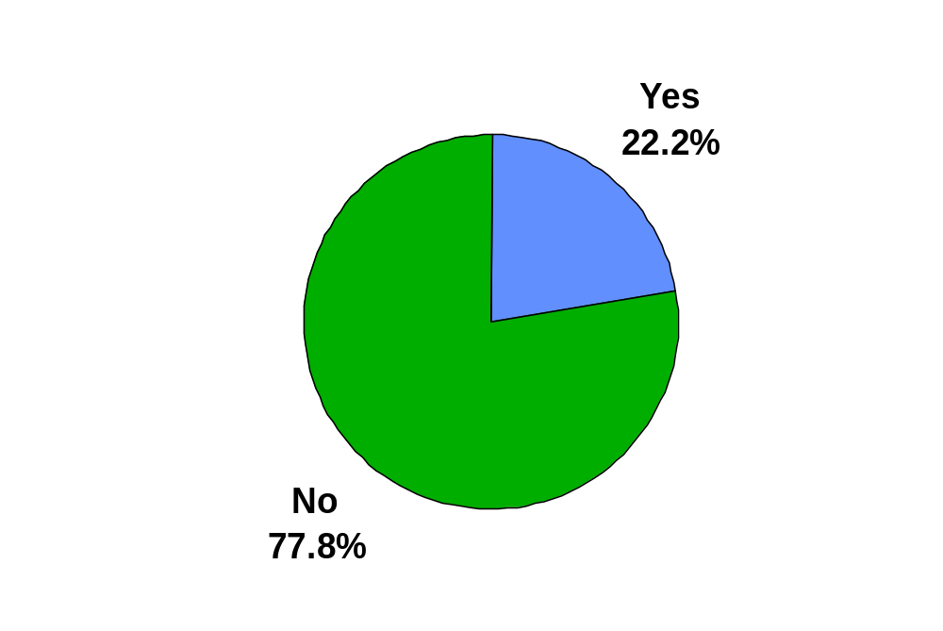
Equity Management Policy
Does university have a an equity management policy for start-up companies receiving technology licensing?
(Percentage of universities)
North America
Other countries

Slide 75
Evaluate industrial
relevance & commercial potential
Will the inventors continue to work on the invention?
What will be the potential pay-off for a company that makes an investment in the development of the invention?
Locate suitable commercial development partners & potential licensees
Estimate costs of patent protection

Slide 76
Academic Entrepreneur
Business Plan: takes stock of the current situation and provides roadmap for the future.
For spin-offs/start-ups, it is crucial for obtaining funds or gaining any credibility with investors, partners, etc.
  Experience of manager
  Description of product/service
  Financial resources (or expected funding)
  Market research (is there a market for it)
  Competitors (why is it special/different) and barriers to entry (e.g. IP of others)
  Marketing strategy,
  Price of product, costs, projections of cash flow

Slide 77
Academic Entrepreneurship
University spin-offs/start-ups
  Depends on willingness of researcher
  Requires entrepreneurial thinking
  Association with business-minded people recommended
  Realistic valuation of the market potential of the product

Slide 78
Academic Entrepreneur
Incubators often provide the ideal setting for university spin-offs/start-ups.
  Controlled environments where failure rate in first years of operations is diminished
  Physical space, infrastructure and access to university facilities
  Access to training
  Access to direct assistance on business planning, licensing negotiations, accounting and legal expertise (free of charge, subsidized or at market rate)

Slide 79
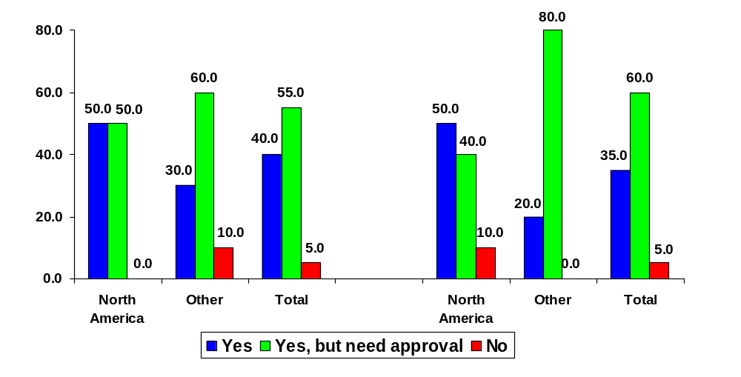
Start-Up Company Policies
Can a tenure-track faculty member serve on board of directors of:
Start-up company to
commercialize invention
Existing companies
Percentage of universities

Slide 80
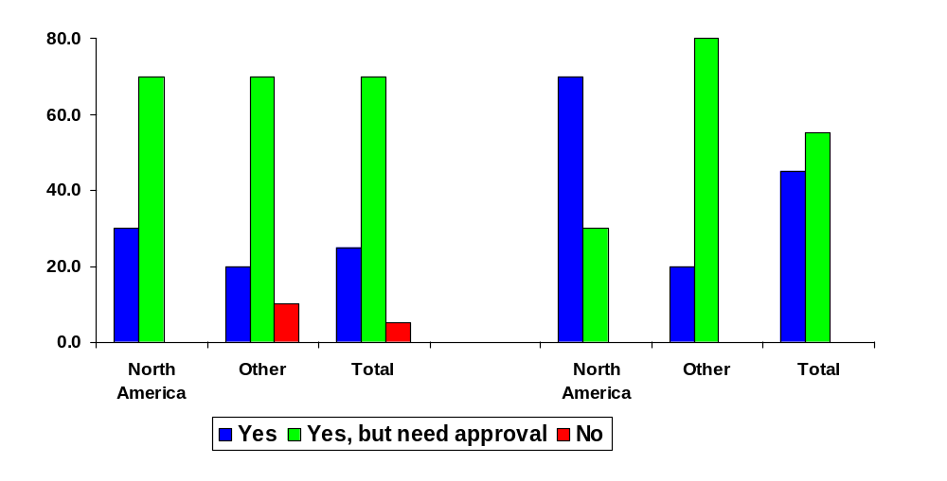
Start-Up Company Policies
Can a tenure-track faculty member:
Take no-pay leave for
involvement in start-up co.
to commercialize invention
Engage in consulting for industry
Percentage of universities

Slide 81
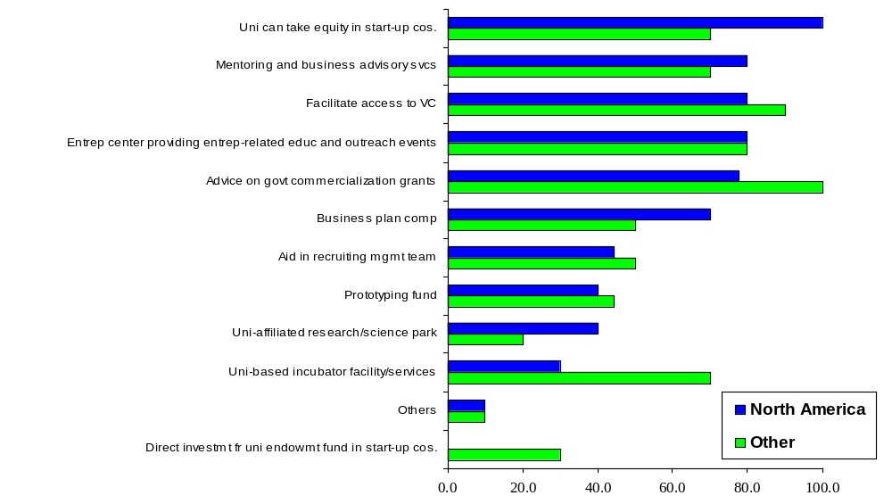
Assistance Provided to Start-Up Companies
(Percentage of universities providing assistance)

Slide 82
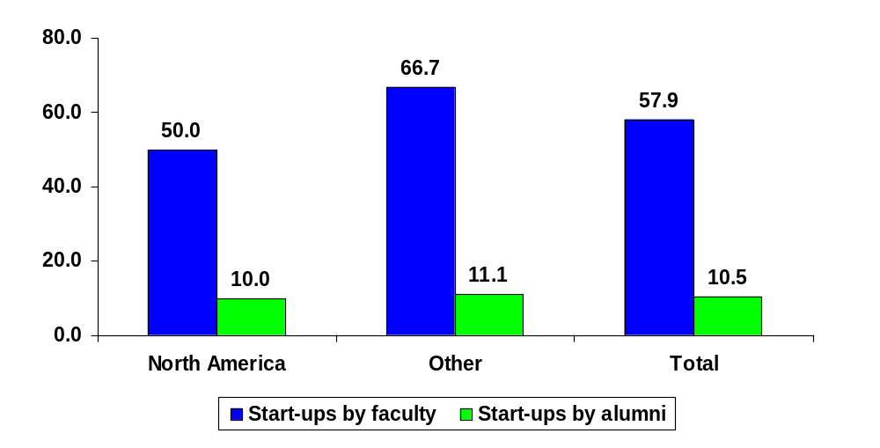
Tracking of Start-up Companies
Does university track number of start-up companies by faculty members/alumni? (Percentage of universities responding ‘yes’)

Slide 83
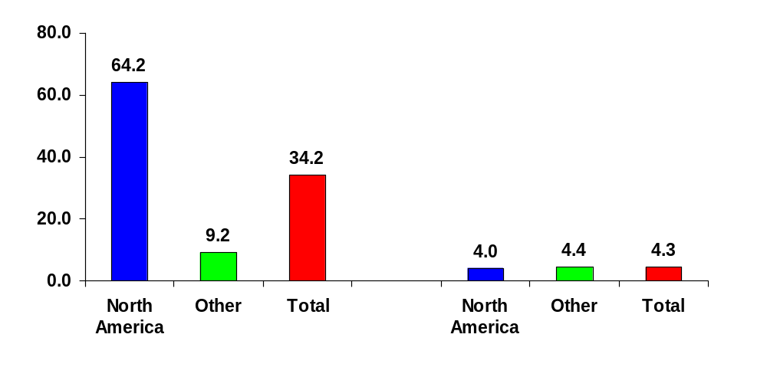
Tracking of Start-Up Companies by Faculty Members
Mean cumulative no. of start-up companies as of end FY2000
(for universities that track start-ups by faculty members only)
With technology licensing
Without technology licensing

Slide 84
Obtain Appropriate
IP Protection
Applications for P, UM, TM, ID, PV
Patents: Scope of patent; where (countries)
Funds
Locate partners for commercialization of IP in domestic and international markets
Notes:
TM may be important where univ owns a company and sells goods & services. Ex Univ of Florida developed an electrolytic thirst quencher for use by its football teams. The formula was patented and acquired value, as did the TM (Gatorade). The P ran out after 17 years but the TM remained in force and continued to produce income for the univ.

Slide 85
Marketing
Crucial issue often neglected by IPMUs
Inventions transferred from laboratory shelves to IPMU shelves
Need for appropriate marketing skills
Websites and other advertisements?
Most successful TT generally takes place between cooperating partners, or through the researcher’s own contacts in industry.

Slide 86
Market Evaluation
Some Important Questions
  Does the technology offer a cheaper and/or better way of accomplishing something?
  Are there competing technologies and if so how much better is the invention?
  How much investment in time and money will be required to bring the invention to the marketplace?
  Does it have the potential for creating the new market?
  What are the potential pay-offs for investing in its development

Slide 87
Commercialize
Inventions, innovations, research findings, trademarks, trade secrets
License agreements
Sale/Assignment
Retain rights
Revenue distribution
Monitoring
Notes:
TM: Gatorade

Slide 88
Licensing
Licensing of the invention to one or more existing companies for the purposes of commercialization
Exclusive or non-exclusive licensing
Developed product: low risk, market is known, focus on manufacturing and marketing
Research result: high risk, far from market, focus on product definition, patent position uncertain, licenses fees low.

Slide 89
University IP Policy
Distribution of Royalty Income
  Royalty income generally shared between institution / department / researcher
  Most universities have a sliding scale. The higher the royalty income the lower the percentage received by the researcher
  In the USA, researchers often choose to allocate income to buy equipment and university provides matching/equal funds

Slide 90
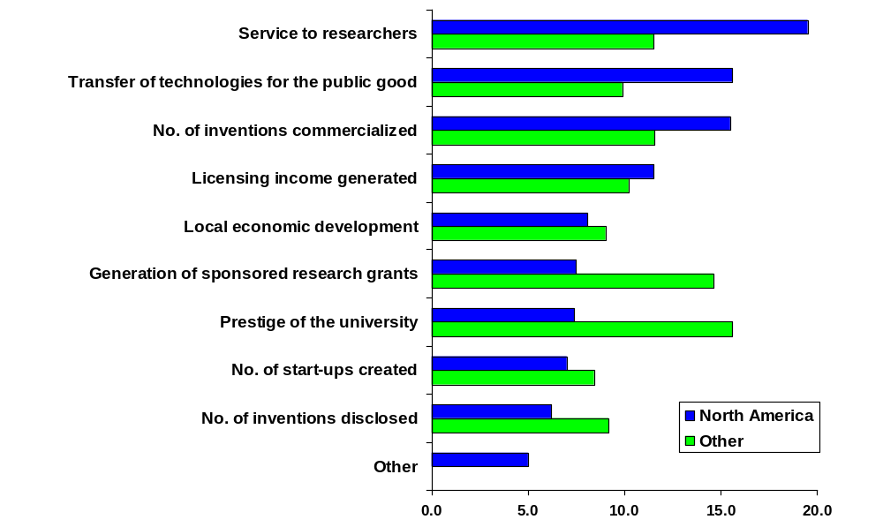
Importance of Technology Transfer Objectives
(Mean score)

Slide 91
Raise Awareness and Training
IP Policy, IP laws, Procedures, Forms
Create awareness of importance of IP
Promote greater use of patent information
Avoid infringement of IPRs of others
Key issues to be kept in mind while negotiating/discussing collaborative project with a company or sponsor
Notes:
P literature: train on how to use P databases

Slide 92
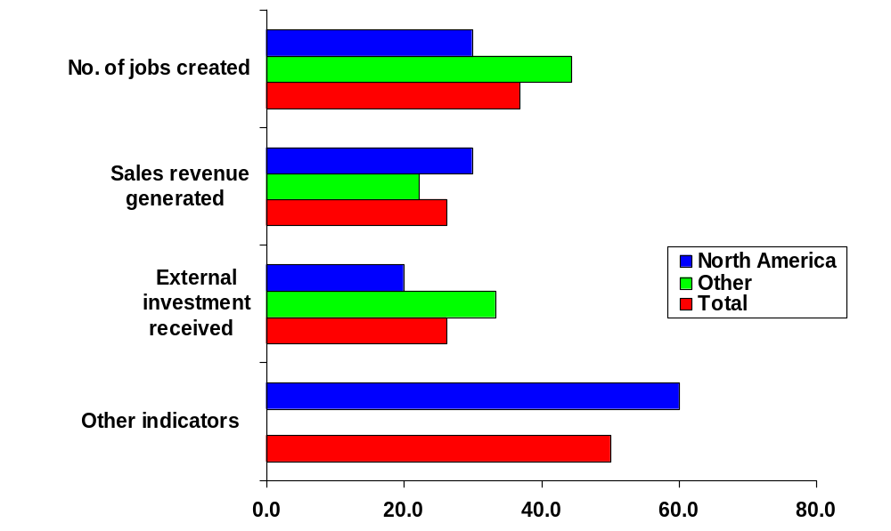
Tracking of Economic Impact/Wealth Creation Indicators of Start-Up Companies with
Technology Licensing from University
(Percentage of universities which track indicator)

Slide 93
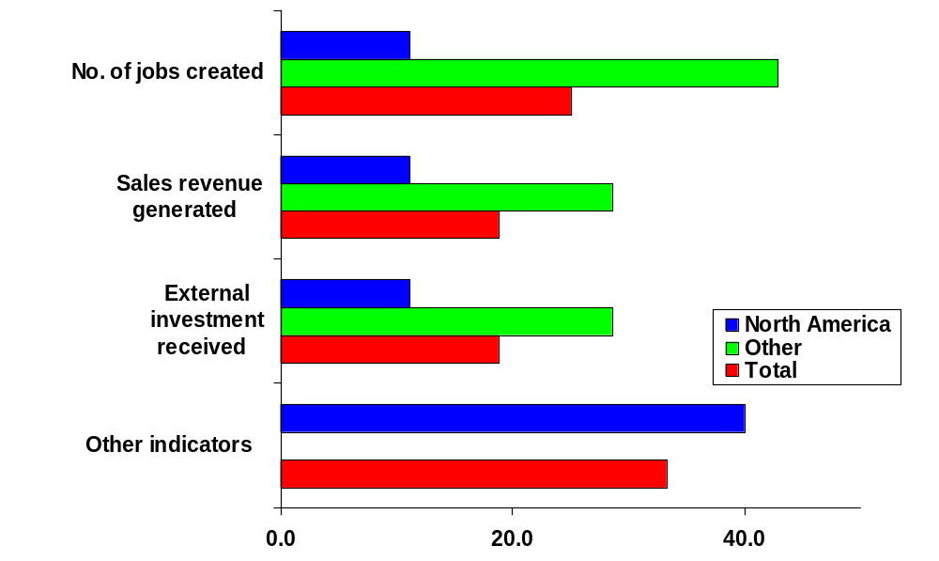
Tracking of Economic Impact/Wealth Creation Indicators of Start-Up Companies without
Technology Licensing from University
(Percentage of universities which track indicator)

Slide 94
Overview of Strategic Partnerships
  What are “Strategic Partnerships”?
  Why enter into Strategic Partnerships?
  Trends in Technology Strategic Partnerships
  Keys to a Successful Partnership
  The Strategic Partnering Process
  Selected Key Issues in Strategic Partnering

Slide 95
What are Strategic Partnerships?
Many Forms
  Joint Ventures (formation of a new company)
  Virtual Alliances – JV without co-locating
  Joint Development Agreements – R&D
  Distribution & Marketing Agreements
  Mergers & Acquisitions
  Pure Equity Investments

Slide 96
Why Enter a Strategic Partnership?
Big Co
Competitive Advantage
Technology /Expertise
Decrease “Time to Market” (make / buy)
Access to Innovation
Prevent Competition (cheaper acquisition)
Small Co
Funding
Credibility/Reputation
Distribution Channel
Market Validation
Critical Mass
BigCo Plans

Slide 97
Trends in Strategic Partnerships
Selectivity
  Longer due diligence
  Corporate governance more important than ever
Partners key to securing financing
  Reference customers
  Expedited path to revenues - key
  Partner strategy in business plan
Increase in foreign/cross-boarder partnerships
Increase in early-stage partnerships
Equity Investment down, but not out

Slide 98
Keys to Successful Strategic Partnerships
Pick the right partner
  – Alliance strategy, rather than strategic alliance
Commitment
  – Management buy-in cited as a top reason for successful partnerships
  – Implementation more difficult than formation
Clear roles and goals

Slide 99
The Strategic Partnering Process
Initial Discussions – NDA
Next Steps – LOI’s & MOU’s
Definitive Agreements
– Equity
– Distribution
– Licensing

Slide 100
Initial Discussions
Non-Disclosure Agreements
– ALWAYS ask partner to sign
– Expect mutuality
– Open the kimono slowly
– Don’t expect complete protection
    If violated, enforceability is very expensive and time consuming (proof: define trade secrets, how disclosed, and clearly confidential at time of disclosure)
    Watch out for residual clauses
    Build trust first, then disclose information

Slide 101
Next Steps – the LOI
Carefully outline details of agreements
– Get professional assistance
    Familiarity with other deals
    Knows key issues and how to draft them
    Clear terms means less time on Definitive Agreement
Not typically binding
– Except confidentiality, and perhaps, fees
Risk of binding LOI is incomplete terms
Careful: can be “binding,” even if not
– Conduct of parties and reliance

Slide 102
Definitive Agreement
Dispute Resolution
Exit Strategy
Equity Issues
Distribution Issues
Licensing Issues

Slide 103
Dispute Resolution
Create incentives to work out issue
– Require management involvement, moving up chain-of-command
– For performance issues, tie to fees or scope
    e.g., exclusive to non-exclusive
– Use outside “neutrals” only after internal system fails to resolve dispute

Slide 104
Exit Strategy
Critical to SmallCo
– Left with people, equipment and facilities can’t support
– Taint of abandonment – difficult to do other deals
CYA – Cover your assets
– Termination for “convenience”
    Notice period
    Cover salaries and/or other expenses
    Buy-out inventory

Slide 105
Exit Strategy
CYA
– Agree up front on who can terminate, and under what circumstances (e.g., partial termination)
– Agree on ownership of IP on termination.
– Agree on continuing obligations.
    Use of TM on completed, but not shipped products.
    Confidentiality.

Slide 106
Exit Strategy
Damage control
– Mutual press release
– Mutual non-disparagement clause
– Equity – take away:
    Board observer rights
    Right of first refusal
    Information rights

Slide 107
Distribution Issues
Audit Rights
– Trust, but verify
– Annual are typical
– Check for injunctive relief or other enforcement rights where distributing
– International partners are difficult to audit
    Use local CPAs

Slide 108
Licensing Issues
Too many issues to cover – definitely use a skilled attorney (see outline of issues)
Scope
– Use, make, distribute, sublicense, reproduce
– Establish with expansion and growth in mind, as well as downside protection if partnership fails
– Field of Use

Slide 109
Licensing Issues
IP Ownership
– Be clear as to who owns what: original technology, improvements, jointly developed IP
– Upgrades vs. Updates (e.g., 1.X, 2.X vs. X.1, X.2)
Territory: Geography and vertical markets
Strategy: Carve up IP, territory and other rights to preserve as much as possible

Slide 110
Licensing Issues
Exclusivity
– Generally, not a good idea – limits value
– Negotiating Ideas:
    Limited term
    Limit to territory or product line
    Require minimum sales or convert to non-exclusive

Slide 111
Licensing Issues
Fees
– Typically royalties based on sales volume (units or % of sales)
– Joint product development – let them pay
– If Licensor:
    Front-end fees
    Incremental fees for new products
    Include “sales” to affiliates and for demo units
    Request minimum volume commitment
    Tiered royalties – front end loaded

Slide 112
What is Offshore Outsourcing?

Slide 113

Outsourcing Offshore
Outsourcing offshore is
relatively complex.
— The interaction of different national business environments in such transnational relationships is a multi-layered process in which diverging legal, economic and social concerns arise.

Slide 114
Can it be defined?
 Outsourcing can be generally ‘defined’ as a means of ...
“… marrying efficiency with innovation, which requires managers to consider the following: time-cycle and cost reduction, levering scale and scope, reduction of resources, partners as role models for change, and reduction of risk”.
Prahalad, C.K. and Ramaswamy, Venkatram (November 2001) “The Collaboration Continuum”.

Slide 115
Outsourcing Offshore
The term outsourcing offshore is used to distinguish the activities that occur when …
…. company A turns over responsibility, in whole or in part, of an in-house business function to company B whose location is outside of company A’s national jurisdiction.

Slide 116
Outsourcing offshore
is used by enterprises to ...
… increase profitability by investing overseas in relatively ‘low-wage’ countries ...
--- such as India, China and Brazil, Eastern Europe, Vietnam, etc.

Slide 117
The prime driver for businesses is ….
…. the ‘savings’, which lead …
… to lower costs while maintaining high quality;
… or to put it another way …
…. to lower costs while maintaining high quality, which ultimately, leads to savings.
… But, in essence it is due to a combination of factors, such as high levels of education and skills appropriate to the tasks outsourced.

Slide 118
Outsourcing offshore is
a valid business strategy ...
… at a time when ...
… information technology and the globalization phenomenon are bringing about increasingly integrated economies and a ‘recovery’ in global trade.
 The key question in this connection is whether or not such outsourcing offshore can be sustained to encourage development also in the so-called ‘low wage’ countries.

Slide 119
TRENDS IN OFFSHORING
Offshoring is here to stay
Outsourcing Industry Growth
38%
26%
CAGR (2001 - 2008)
1.5%
Onshore Outsourcing
& Shared services
Offshore outsourcing
Captive offshoring
USD Billion
2001
2008
Onshore outsourcing + Shared Services
3304
3664
Offshore Outsourcing
17
164
Captive Offshoring
35
182
Offshore outsourcing delivery will show the highest growth
Cost & quality levels are the biggest drivers
Source: Industry Analysts, TCS

Slide 120
The United Nations Conference on Trade and Development (UNCTAD) World Investment Report 2004, in exploring the factors behind the global shift to outsourcing offshore, states that ...
“FDI* plays an important role in offshoring, although this is difficult to quantify owing to the lack of reliable data.
In principle, FDI affects offshoring in two ways:
(i) through captive offshoring, and
(ii) when specialized service providers set up
foreign affiliates to serve foreign clients.
While such investments can create many jobs, they typically do not generate large capital flows. Consequently, they do not account for large shares in the FDI statistics”.
*FDI = Foreign Direct Investment

Slide 121
In which Industries do
Outsourcing Arrangements Occur?

Slide 122
 … Outsourcing arrangements in the manufacturing sector have a long history ….
– i.e. in the apparel, automotive, textile and steel industries (jobbing, maquilla, etc …)
— The practice, termed contract manufacturing or subcontracting*, was and is still used to reduce overall costs.
— Today … traditional contract manufacturing operations have evolved to the ‘contract manufacturing’ of services;
* Subcontracting would include license manufacturing an private label manufacturing.

Slide 123
What can be Outsourced ?
Critical, Non core activities
Likelihood to outsource – moderate today, high tomorrow
Accounting
Supply Chain Mgt
HR/Administration
Claims administration, Billing
Critical, Core activities
Likelihood to outsource – low today, low tomorrow
Core competencies
Managing market image - trademarks
Caring for patients
Find/sell oil and gas
Strategy
Patents and technology
Non Critical, Non core activities
Likelihood to outsource - high today and tomorrow
Landscaping
Cafeteria
Laundry
Source: Gartner Company estimates

Slide 124
Two main groupings of offshore outsourcing:
    Technology services, which includes information technologies (applications hosting, telecommunications (voice and data), logistics, etc.); electronics (semiconductor chips; high-value microprocessors); electronic commerce, etc.
    Business processing outsourcing (BPO), which deals with differentiated activities, such as finance and accounting, procurement and supply, customer contact (customer relations management), human resources, security, etc.

Slide 125
Other outsourced offshore functions...
Medical: drug and product development in the pharmaceutical and biotechnology industries, especially clinical trials and legal services, etc.
Legal: Business, Contracts, IP services, etc.
Business: Advertising, Marketing, Promotions, etc.
Engineering: Architectural, CAD Design, Electronic design, Mechanical, etc.
Graphic design: Banners, Brochures, Business cards, Illustrations, Logos, etc.
Multimedia: Audio, Photography, TV Commercials, Video, etc.
Software: Application development, Database development, Language platforms, etc.
Web design: Flash graphics, site design, website programming, website marketing, etc.
Writing: Copy editing, copy writing, page design, technical writing, translations, web content, etc.
Accounting, Administration, etc...

Slide 126
The Value-chain
and Levels in Outsourcing

Slide 127
Summarising ‘Outsourcing’
Trans-formation
Effectiveness
Efficiency
Value
Business Processes
Intensive
Why?
IT Applications
Extensive
IT Infrastructure
Selective
What?
How?
Source: Jane Linder: Outsourcing for Radical Change, AMACOM, 2004.

Slide 128
The Value-chain
— In the delivery of products and services, different economic actors are mobilized, and each will manage its own value chain.
…. Because there is an independence in the exploitation of upstream and downstream information …
…. there is …..
… a disintegration of the vertical (supply chain) integrated factory which usually leads to the eventual fragmentation of ownership rights.
 Thus, it is imperative for firms to identify the
strengths and weaknesses in each identified
value chain activity.

Slide 129
Economic Globalization
Production Relocation
Outsourcing offshore
Transfer of Know-How
Design
Technology
Production
Process
Trade Secrets
Know-How
Licensing Agreements
Contract
Manufacturing
Market Access
Market Entry
Global Value Chains
Source: “The Magic Pallet” Brochure, Centre for International Studies on development economics

Slide 130
Offshore outsourcing happen at various levels of the value chain
Level 1. …. Labor-intensive unskilled tasks are outsourced.
Level 2. …. the production or manufacture of a component, or the whole product or service, is outsourced.
Level 3. …. technology development is outsourced, including some or all of the associated research and development (R&D) tasks.
Level 4. Some consider outsourcing of marketing functions to be the highest level of outsourcing. It may be done partly (for example, outsourcing of market research) or almost wholly (for example, distribution and sales are outsourced).
…. In practice, there can be various permutations and combinations of the above categories.

Slide 131
Protecting IP Assets and Know-How

Slide 132
So, you’ve decided to outsource a task!
Remember ...
— The benefits of sharing IP assets must outweigh the multiple risks encountered in outsourcing, including the risks linked to the shared IP assets.

Slide 133
Every type of IP asset may be involved at the different levels of outsourcing relationships
– trade secrets,
– trademarks,
– industrial designs,
– patents,
– copyright and related rights

Slide 134
And …
… each type of IP asset will be governed by its own distinct national law…
…. adding further complexity to managing IP assets in offshore outsourcing relationships, especially if there are many partners in different countries.

Slide 135
What are the Risks?
 Risks include the challenges in monitoring and/or dealing effectively with …
- various types of breaches of contract clauses;
- theft or misappropriation of trade secrets;
- misuse or loss of other types of IP rights (resulting in partial loss of control of business);
- poor or inconsistent quality of goods and services (that may affect the reputation or brand image);
- enforcement of IP rights;
- parallel imports and grey-market issues.

Slide 136
An IP due diligence enquiry should be undertaken before finalizing any outsourcing plan to safeguard an enterprise’s IP.

Slide 137
IP Due Diligence Enquiry
(Non-exhaustive list)
 Identify the inventor, creator or author of the IP.
 Determine ownership rights in the identified IP, including joint-ownership issues.
 Identify contracts or other agreements associated with the IP. For example technology transfer or licensing agreements; confidentiality and non-compete agreements.

Slide 138
IP Due Diligence Enquiry, cont’d…
 Identify assigned or licensed IP used by the interested enterprise(s): IP of third parties and/or by employees. Ascertain the rights granted to each party, and detect existing and potential sub-contracting issues.
 Identify existing and/or alleged breaches of contract, infringements, disclosure of confidential information and trade secrets.

Slide 139
IP Due Diligence Enquiry, cont’d…
 Determine jurisdiction and enforcement: applicable laws, enforceability: dispute resolution mechanisms (mediation, arbitration, choice of governing law, applicable jurisdiction).
 Termination, expiration or exit clause of arrangement: Is there an indemnity against infringement?
 Determine other IP related responsibilities: Ongoing maintenance and upgrades to the IP; payments of transfer fees; product liability, IP insurance, etc.

Slide 140
Ownership of IP
Whether the outsourced work is expected to take place domestically or outside the enterprises’ national borders, …
… it is essential to identify, account for and clarify ownership related issues of IP assets improved or created during the relationship.

Slide 141
Ownership of IP
— Several approaches to sharing ownership rights over IP which is improved or created during an outsourcing relationship.
 One approach would be for …
…. the customer to own all IP improved or created during the outsourcing relationship, with the vendor having the possibility of using the IP through a negotiated license agreement.
 Another approach would be for …
…. the vendor (developer) to own all such IP, with the customer (the party having commissioned the task) taking a license through negotiations.

Slide 142
Ownership of IP
 Yet another approach would be for …
…. both the customer and vendor to own jointly the resulting IP.
 Still another approach would be to …
…. apportion ownership of different IP assets, so improved or created, amongst the parties concerned, namely, amongst the vendor, customer and one or more third parties; this is done by a formal agreement based on negotiations guided by each parties’ current and future business needs.

Slide 143
Key questions to pose yourselves:
1. Who owns the IP created by a company’s employees or independent contractors?
-- If it is to belong to the company, then are all such IP assets properly transferred or assigned to the company?
2. Who will own the customized features, improvements, new technology and product in outsourced work?
-- For example, in relation to copyrighted works, such as software, will an improvement or modification result in the creation of co-authorship and resulting joint ownership or will it be treated as an adaptation (also known as a ‘derivative’ work) which would be owned by the party that made the improvement?
3. How does one determine whether ownership will be exclusive to one party or another or held jointly?
4. What entitlements will each party have to exploit jointly created IP?
5. What will happen to customer’s IP when it wants to switch vendors (i.e., transfer rights) or terminate contract?

Slide 144
Confidential Information and Trade Secrets
— A primary concern when outsourcing is the potential partner’s ability to safeguard confidential information of commercial value against …
… accidental, inadvertent or willful misappropriation, misuse, sabotage, loss or theft.
— If the partner cannot be trusted to protect trade secrets, then the risks of outsourcing offshore may far outweigh its potential benefits.
….. Hence, it is crucial to review the integrated security
and/or IP protection program of the
potential outsourcing partner.

Slide 145
IP Concerns in Negotiating Offshore Outsourcing Arrangements
— Offshore outsourcing contractual arrangements can take several forms.
…. Most agreements will include the terms upon which both parties agree to commit their tangible and intangible assets for a mutually beneficial outcome.
— A firm should only start practical business negotiations after being satisfied about a potential partner’s reputation, human, financial and technical resources and compatibility of corporate culture.
— Negotiations should focus on the steps needed for both parties to safeguard and ensure proper use, sharing, licensing, development and improvement of the IP (of both parties) during and after the relationship.
— It should also include any relevant IP assets of third parties.

Slide 146
Third Party IP …
 Third party IP raises intricate concerns in an offshore outsourcing arrangement.
…. The important principle to remember here is for the party outsourcing work (the customer) to review the IP to be outsourced and examine all licensing agreements under which it has licensed third party IP.
….. This step is to ascertain whether or not there are any restrictions on use, limitations on transfers or assignments, or confidentiality provisions.

Slide 147
Negotiating Offshore Outsourcing Arrangements

Slide 148
  IP Essentials for the Contractor (Customer)
  1. Account for all IP and associated know-how (whether registered or not, pending registration, or new (in-development) and fix the limits within which these IP assets are to be made available to the vendor.
  2. Ensure that the contract expressly deals with ownership issues relating to jointly created IP or over IP assets created by the vendor during the outsourcing relationship: Who will have ownership rights of newly created information based on customer’s IP data?
  3. Be aware of any limits on use of licensed third party IP: Can it be sublicensed to a vendor?
  4. Require vendor to take all reasonable measures to protect all licensed IP assets, and especially any confidential information, trade secrets, know-how, etc. disclosed during the relationship.
  5. In ascertaining vendor’s legal responsibilities in relation to outsourced function, make sure that their existing agreements, for example distribution, supply, marketing and research collaborations, do not compromise the IP assets to be shared with them: What would happen if the vendor were to sub-contracts part of the outsourced function to independent contractors, consultants, etc.?
6. Identify the vendor’s other customers: Are they potential competitors? If so, what additional safeguards may be needed to safeguard the IP assets to be shared with the vendor?

Slide 149
        IP Essentials for the Vendor
  1. Account for all IP and associated know-how (whether registered or not, pending registration, or new (in-development) and fix the limits within which these IP assets are to be made available to the relationship. Ensure that the outsourcing agreement includes provisions to protect owned (vendor’s) IP and associated know-how.
  2. Ensure clarity of ownership or joint-ownership of IP assets created or improved during the course of the outsourcing relationship, whether based on customer’s IP data or not; seek the maximum leeway to use any such jointly owned IP assets for other or different outsourced functions with other customers.
  3. Set-up an integrated, well functioning IP protection and security program to safeguard your own and the customer’s confidential information, trade secrets and know-how. Enter confidentiality (non-disclosure) and non-compete agreements where and when appropriate.
  4. Put in place mechanisms to prevent inadvertent ‘mixing’ of proprietary trade secrets with those of the customer.
5. Be aware of any limits on use of licensed third party IP: whether it can be used for the purposes of the current relationship.

