Slide 1

FACIAL EXPRESSION RECOGNISATION SYSTEM USING
CNN ALGORITHM AND Dl
COLLEGE MINOR PROJECT — 5th SEMESTER
UNDER THE GUIDANCE:
MS. ZEBA RUQSHANH
(ASSISTANT PROFESSOR)
PRESENTED BY:
SYED MOAZAM
(160923748131)

Slide 2

ABSTRACT
Facial Expression Recognition (FER) refers to the technology that can automatically detect and interpret facial expressions from images or video frames.
Emotions like happiness, sadness, anger, fear, surprise, and disgust are commonly studied in FER.
Deep Learning is a subset of machine learning that uses neural networks with multiple layers (deep architectures) to learn complex patterns from data.
CNNs are a class of deep neural networks specifically designed for image analysis. They automatically detect spatial hierarchies in visual data.

Slide 3

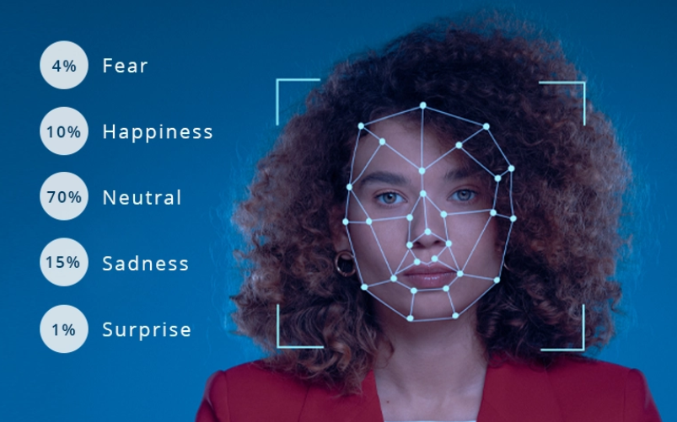
OBJECTIVES
Automate emotion detection by applying image preprocessing and CNN-based feature extraction for accurate facial pattern analysis.
Train and validate a deep learning model to classify a variety of human emotions effectively.
Improve model robustness to handle real-world challenges such as lighting changes, occlusions, and natural expression variations.

Slide 4
EXISTING SYSTEM
Existing facial expression recognition systems primarily use traditional machine learning algorithms with manually extracted features (like LBP, HOG). These systems are limited in accuracy, scalability, and performance under real-world conditions.
Traditional Machine Learning Approaches
Feature Extraction + Classification Pipeline
Basic Neural Networks

Slide 5

DRAWBACKS
REQUIRES LARGE DATASETS: NEEDS EXTENSIVE LABELED FACIAL EXPRESSION DATA FOR ACCURATE TRAINING.
HIGH COMPUTATIONAL POWER: TRAINING CNN MODELS DEMANDS POWERFUL GPUS, WHICH CAN BE COSTLY.
RISK OF OVERFITTING: CNN MODELS MAY OVERFIT WITHOUT PROPER REGULARIZATION AND DATA AUGMENTATION.
REAL-TIME CHALLENGES: LIMITED HARDWARE CAN CAUSE DELAYS IN REAL-TIME EXPRESSION RECOGNITION.
COMPLEX IMPLEMENTATION: DEVELOPING AND TUNING DEEP LEARNING MODELS REQUIRES EXPERTISE.
PRIVACY CONCERNS: USE OF FACIAL DATA RAISES ETHICAL AND PRIVACY ISSUES.

Slide 6

PROPOSED SYSTEM AND
ADVANTAGES
The proposed system combines YOLO (You Only Look Once) for fast and accurate face detection with a CNN-based deep learning model for automatic facial expression recognition, enabling real-time and robust emotion classification.
ADVANTAGES
Automatic Feature Learning
Higher Accuracy
Robust to Variations
Scalable
Potential for Real-Time Processing
Reduced Manual Intervention

Slide 7
SYSTEM REQUIREMENTS
SOFTWARE REQUIREMENTS
Programming Language: Python
Deep Learning Libraries: TensorFlow, Keras, or PyTorch
Image Processing: OpenCV, NumPy
IDE: Jupyter Notebook, VS Code, or PyCharm
HARDWARE REQUIREMENTS
CPU: Multi-core processor (Intel i5 or higher recommended)
GPU: NVIDIA GPU with CUDA support (e.g., GTX 1050 or higher) for faster training
RAM: Minimum 8 GB (16 GB recommended for large datasets)
Storage: Sufficient space for datasets and model checkpoints (at least 50 GB)

Slide 8
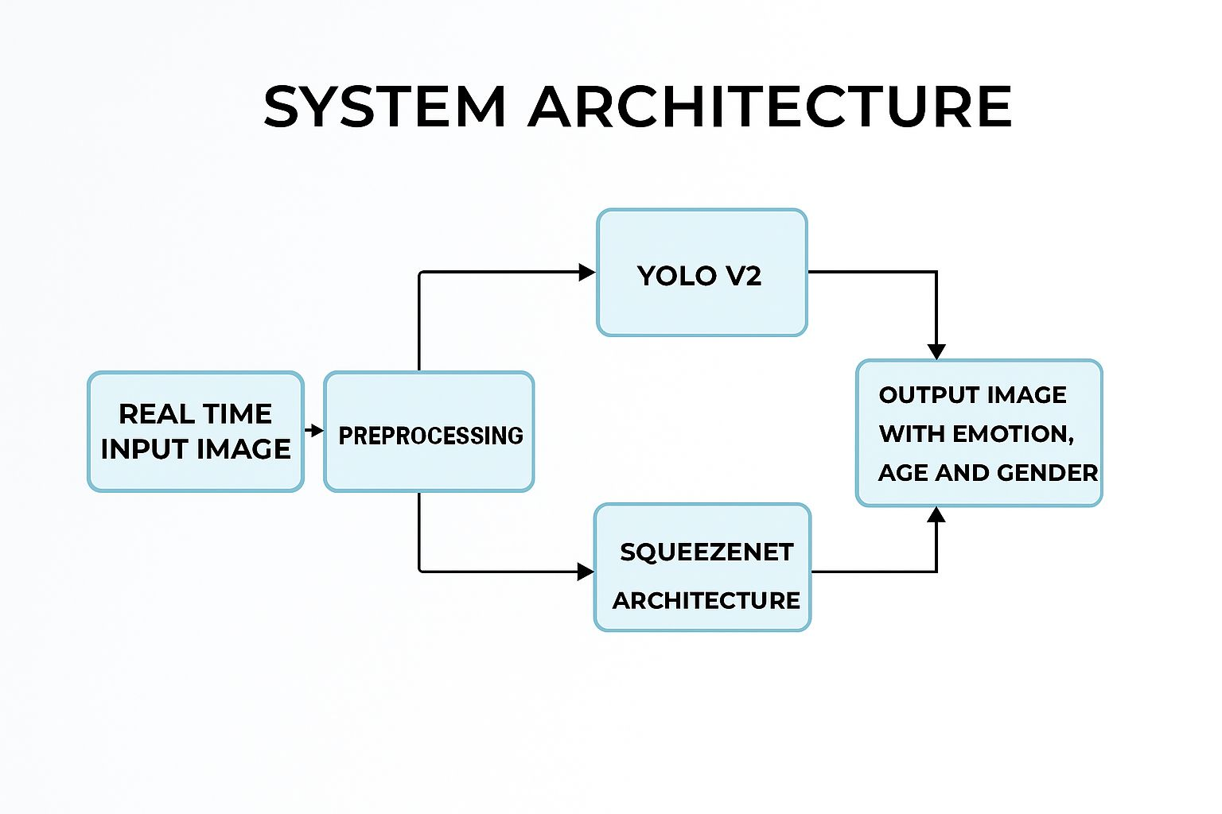

Slide 9
CONCLUSION
Facial Expression Recognition (FER) plays a crucial role in enhancing human-computer interaction, security systems, and healthcare diagnostics.
The use of Convolutional Neural Networks (CNNs) and Deep Learning significantly improves the accuracy and efficiency of emotion detection from facial images.
It successfully classifies key expressions like happiness, sadness, anger, surprise, etc., with promising performance metrics.
The integration of CNNs allows for automatic feature extraction, reducing the need for manual preprocessing.
With further training on larger and more diverse datasets, the system can be made even more robust, real-time, and applicable across various domains.

