Slide 1


KERNEL DENSITY ESTIMATION (KDE)-BASED DEFENCE AGAINST MODEL POISONING IN FEDERATED LEARNING
PRESENTED BY:
SYED MOAZAM (160923748131)
B.E. Computer Science & Engineering (AIML) — 6th Semester Mini Project
Under the Guidance of: Ms. Raheela Tabassum (Assistant Professor)
Lords Institute of Engineering and Technology (UGC Autonomous), Hyderabad

Slide 2

Contents
1. Abstract
2. Objectives
3. Existing System and Drawbacks
4. Literature Survey
5. Proposed System and advantages(includes s/w & h/w requirements)
7. Modules
8. System Architecture
9. Data flow diagram
10. Algorithms Used
11. Output Analysis
12. Conclusion and Future Work
13. References

Slide 3
ABSTRACT
Research Context
Proposed Solution
Key Contribution
Federated Learning (FL) enables collaborative model training across decentralised devices whilst preserving data privacy. However, this distributed architecture introduces vulnerabilities to model poisoning attacks.
We introduce a KDE-based defence mechanism that detects and filters malicious model updates by analysing their density distribution within the parameter space.
The KDE approach provides a statistical foundation for identifying anomalous updates without requiring complete knowledge of client data distributions or extensive computational overhead.

Slide 4
OBJECTIVES
01
02
Investigate Vulnerabilities
Develop KDE Framework
Analyse security weaknesses in standard federated averaging algorithms against model poisoning attacks
Design a kernel density estimation approach for detecting anomalous model parameter updates
03
04
Implement Filtering Mechanism
Evaluate Performance
Create adaptive threshold strategies for rejecting malicious contributions whilst preserving legitimate updates
Validate defence effectiveness across multiple datasets and attack scenarios

Slide 5





EXISTING SYSTEM: FEDERATED LEARNING ARCHITECTURE
Central Server
Aggregates model updates using FedAvg algorithm and broadcasts global model
Client Selection
Randomly selects subset of clients for each training round
Local Training
Clients train on local data and submit model updates
Model Update
Global model improves iteratively through aggregation

Slide 6
CRITICAL DRAWBACKS OF CURRENT SYSTEMS
No Built-in Security
Single Point of Failure
Standard FedAvg assumes honest participants and lacks mechanisms to verify update authenticity or detect malicious behaviour.
A compromised server or malicious client can poison the global model, affecting all participants without detection.
Computational Overhead
False Positives
Existing defence mechanisms like differential privacy or cryptographic verification add significant computational and communication costs.
Statistical methods struggle to distinguish between legitimate model variance and malicious updates, potentially rejecting valid contributions.

Slide 7
LITERATURE SURVEY
Title | Author(s) | Technology / Methodology | Advantages | Drawbacks
LoMar: A Local Defense Against Poisoning Attack on Federated Learning (2022) | X. Li, Z. Qu, et al. | Relative KDE scoring based on client neighborhoods. | Effective against label-flipping; lightweight; high accuracy retention. | Performance may degrade in extremely high-dimensional weight spaces.
Beta Poisoning Attacks: Extensions, Limitations and Defenses (2022) | A. Kara, N. Koprucu, et al. | Gaussian/Epanechnikov KDE + GAN Discriminator. | Comprehensive evaluation of KDE kernels; GAN-based detection of noisy samples. | Defense is primarily focused on linear models; less effective against complex CNNs.
KAFÈ: Kernel Aggregation for FEderated Learning (2024) | P. Qi, D. Chiaro, et al. | KDE-constructed global classification layers. | Addresses non-IID data issues; reduces client drift; low computational overhead. | Requires specific layer-wise weight distribution estimation.
FedRDF: A Robust and Dynamic Aggregation Function (2024) | E. M. Campos, et al. | Fourier Transform + Frequency-domain Density. | No prior knowledge of attacker count needed; handles sophisticated collusive attacks. | Increased mathematical complexity; relies on frequency domain stability.
Adversarial Defense in Cybersecurity: Systematic Review (2025) | Systematic Survey | Statistical Density Analysis + GAN-based filtering. | Provides a unified taxonomy for density-based threat detection. | High-level survey; lacks specific implementation parameters for FL.
KeTS: Kernel-based Trust Segmentation (2025) | A. Gangwal, M. Conti, et al. | Historical Update KDE for trust segmentation. | Outperforms FLTrust by 24% on MNIST; robust against benign outliers. | Higher memory usage due to tracking client update evolution history.
FLAMED: Federated Learning via Aggregating Densities (2025) | W. Briguglio | Multivariate KDE for global model simulation. | Bypasses non-IID drift; ensures high data privacy by never aggregating raw weights. | Scaling multivariate density estimation to millions of parameters is difficult.
A Defense Method Against Multi-Label Poisoning Attacks (2025) | W. Ma, Q. Zhao, et al. | Gap Statistic + K-means + Cluster Compactness (Density). | Defends against multi-target attacks; identifies benign clusters with high precision. | Dependent on the quality of output layer gradient features.
TDF-PAD: Two-step Defense Framework for Poisoning (2025) | IEEE Access (PP) | Interquartile Range (IQR) + Z-score Density Filtering. | Achieves 0% false positive rate on benchmark datasets; very low false rejection. | Step-wise approach may increase latency in massive-scale FL rounds.
Securing FL: A Defense Strategy Against Targeted Attacks (2025) | Discover IoT (2025) | PCA + Anomaly Density Detection. | Effectively isolates malicious updates across vulnerable training rounds. | PCA dimensionality reduction may discard subtle but important model features.

Slide 8
PROPOSED SYSTEMS
Software Requirements
Hardware Requirements
Python 3.8+ with NumPy and SciPy libraries
PyTorch or TensorFlow for FL implementation
Scikit-learn for KDE computation
OpenSSL for secure communications
Matplotlib for visualisation
Central server: 16+ GB RAM, 4+ cores CPU
Client devices: Minimum 4 GB RAM
Network bandwidth: 10 Mbps upload/download
Storage: 50+ GB for model checkpoints
200+
<5%
95%+
Client Devices
False Positive Rate
Detection Accuracy
Scalable to hundreds of participants
Target threshold for legitimate updates
Expected attack identification rate

Slide 9

PROPOSED KDE-BASED DEFENCE SYSTEM
Key Advantages
Statistical Robustness
KDE provides non-parametric density estimation that adapts to complex parameter distributions without distributional assumptions.
Low Overhead
Computational cost scales efficiently with model size, adding minimal latency to the aggregation process.
Adaptive Thresholding
Dynamic threshold calculation based on density scores reduces false positives whilst maintaining attack detection.

Slide 10
MODULES
1. Dimensionality Reduction Module
Transforms high-dimensional model gradients into a lower-dimensional latent space to overcome the "curse of dimensionality" during density estimation.
2. Kernel Selection & Bandwidth Tuning Module
Selects the appropriate mathematical function (e.g., Gaussian) and smoothing parameter to accurately model the distribution of benign client updates.
3. Density Scoring & Probability Mapping Module
Calculates a numerical likelihood score for each client's update based on its position within the estimated global probability distribution.
4. Statistical Outlier Detection Module
Identifies and flags malicious model updates that fall into low-density regions, signaling they are statistical anomalies compared to the honest majority.
5. Robust Aggregator Module
Combines the filtered "clean" updates into a new global model, often weighting them by their density scores to prioritize the most representative contributions.

Slide 11
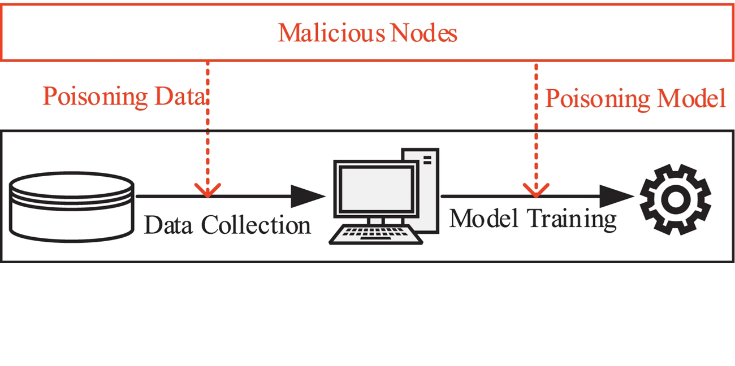
SYSTEM ARCHITECTURE

Slide 12
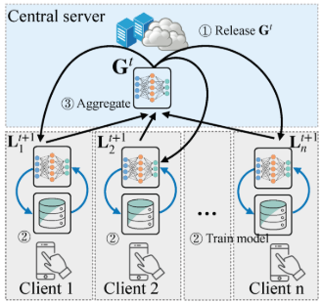
DATAFLOW DIAGRAM

Slide 13
ALGORITHM USED
1. Bandwidth Selection Algorithms
Silverman's Rule of Thumb: Computes a smoothing parameter based on the data's standard deviation to provide a quick, Gaussian-based density baseline.
Sheather-Jones (SJ) Algorithm: Solves a fixed-point equation to find the mathematically optimal bandwidth that minimizes error for non-normal, multi-modal distributions.
Cross-Validation (CV): Uses an iterative "leave-one-out" approach to select the bandwidth that best fits the actual observed client update patterns.
2. Fast Computation & Approximation Algorithms
Fast Multipole Method (FMM): Accelerates density estimation by grouping distant client updates into spatial clusters and approximating their collective influence using Taylor series.
Dual-Tree Recursion: Uses hierarchical data structures like KD-Trees to prune entire groups of distant updates, focusing only on immediate statistical neighbors.
Linear Binning & FFT: Maps updates onto a discrete grid and uses Fast Fourier Transforms to compute density convolutions in near-constant time.
3. Outlier Scoring & Detection Algorithms
Relative Density (LoMar): Compares a client's density score to its local neighborhood average to prevent unique but honest (non-IID) updates from being flagged.
Kernel Density Ratio (KDR): Measures the statistical divergence between the current round's updates and a pre-verified "golden" dataset to identify malicious shifts.

Slide 14
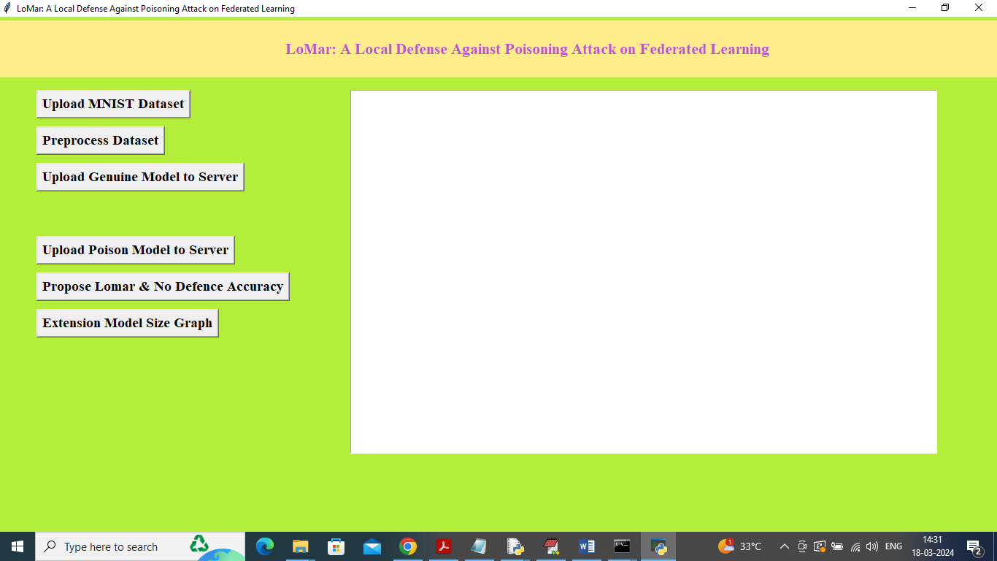
USER VIEW CODE

Slide 15
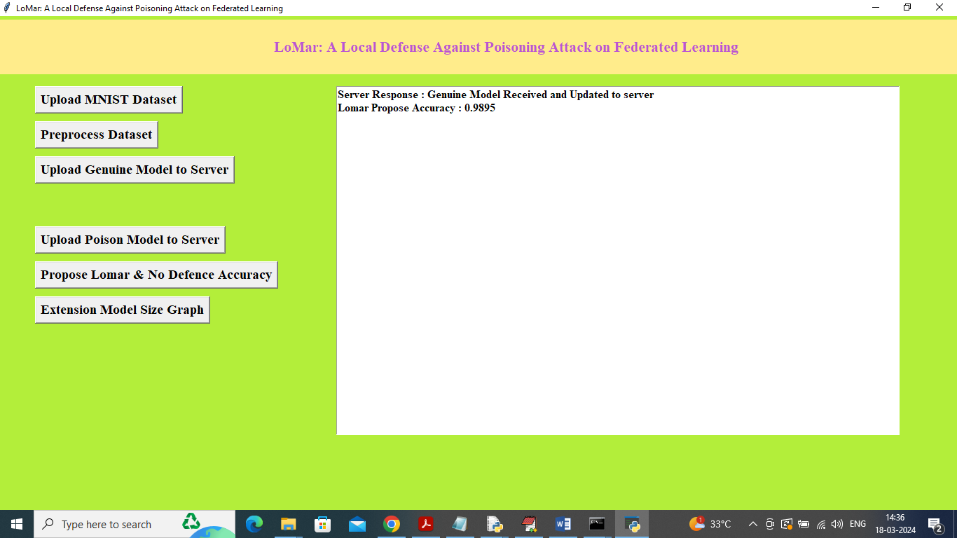
OUTPUT

Slide 16
CONCLUSION
Effective Defence
Practical Implementation
Future Directions
KDE-based filtering significantly reduces model poisoning success rates whilst maintaining model accuracy on legitimate data.
Minimal computational overhead makes the approach deployable in real-world federated learning systems.
Integration with differential privacy and adaptive threshold optimisation for enhanced security guarantees.

Slide 17
REFERENCES
Ahmed, M., Alasad, Q., Yuan, J. S., & Alawad, M. (2024). Re-Evaluating Deep Learning Attacks and Defenses in Cybersecurity Systems. Big Data and Cognitive Computing, 8(12), 191. https://doi.org/10.3390/bdcc8120191 Cited by: 10
Briguglio, W. (2025). An Alternative Approach to Federated Learning for Model Security and Data Privacy. Proceedings of the 11th International Conference on Information Systems Security and Privacy, 291-301. https://doi.org/10.5220/0013237500003899 Cited by: 1
Campos, E. M., Vidal, A. G., Ramos, J. L. H., & Skarmeta, A. (2024). FedRDF: A Robust and Dynamic Aggregation Function against Poisoning Attacks in Federated Learning. arXiv. https://doi.org/10.48550/arxiv.2402.10082 Cited by: 21
Kara, A., Koprucu, N., & Gursoy, M. E. (2022). Beta Poisoning Attacks Against Machine Learning Models: Extensions, Limitations and Defenses. 2022 IEEE 4th International Conference on Trust, Privacy and Security in Intelligent Systems, and Applications (TPS-ISA), 178-187. https://doi.org/10.1109/tps-isa56441.2022.00031 Cited by: 1
Li, X., Qu, Z., Zhao, S., Tang, B., Lu, Z., & Liu, Y. (2022). LoMar: A Local Defense Against Poisoning Attack on Federated Learning. arXiv. https://doi.org/10.48550/arxiv.2201.02873 Cited by: 175
Manzoor, H. U., Shabbir, A., Chen, A., Flynn, D., & Zoha, A. (2024). A Survey of Security Strategies in Federated Learning: Defending Models, Data, and Privacy. Future Internet, 16(10), 374. https://doi.org/10.3390/fi16100374 Cited by: 50

Slide 18

Questions & Discussion
"Security in federated learning requires continuous innovation to stay ahead of evolving attack vectors."

