Slide 1
EMBEDDED SYSTEMS · PROJECT REVIEW
ESP32-Based
Predictive Motor Maintenance
Vibration analysis and anomaly detection for a low-cost embedded IoT solution.
2510030354 – Mohammad Reyhan · 2510030071 – Faizan · 2510030428 – Amaan Shaik

Slide 2


01 · THE PROBLEM
Motor failures are costly because faults hide in plain sight
Unexpected failures increase maintenance cost and production downtime.
Reactive maintenance responds after failure; predictive maintenance looks for warning signals earlier.
Vibration analysis can reveal abnormal motor behavior before serious damage.

Slide 3


02 · THE PROTOTYPE
The prototype turns vibration into an actionable motor signal
A practical monitoring loop, with implementation status kept explicit.
Reactive maintenance
Predictive monitoring
Responds after failure, increasing maintenance cost and production downtime.
Monitors vibration, compares a baseline or threshold, and looks for warning signals earlier.
Display monitoring information and alerts only where the implementation supports them.

Slide 4
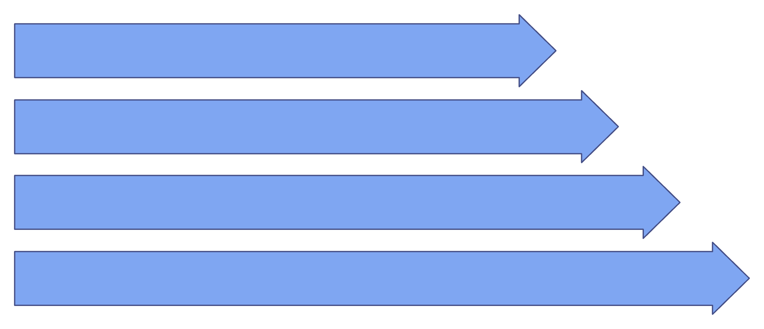
03 · SYSTEM ARCHITECTURE
From motor movement to a condition estimate
Motor Vibration
ADXL335 Sensor
ESP32 ADC
Feature Extraction
A left-to-right signal path from physical vibration to status.

Slide 5
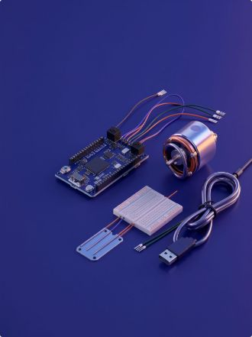
04 · HARDWARE
Six hardware elements support the monitoring loop
Component | Purpose | System role
ESP32 development board | Sensor acquisition and embedded processing | Controller
ADXL335 accelerometer | Three-axis analog vibration measurement | Sensor
Electric motor | Equipment under observation | Observed asset
Wires, breadboard, or connectors | Electrical interconnection | Integration
USB cable and power supply | Programming and power | Support
Optional computer | Serial readings and waveform plots | Visualization

Slide 6
05 · SOFTWARE
IMPLEMENTED CORE
CONDITIONAL / FUTURE
The software stack stays embedded and practical
Embedded and observable
Only when included
ESP32
Arduino IDE
Embedded C/C++
ESP32 ADC
Serial Monitor
Serial Plotter
Wi-Fi, HTTP, MQTT, or a dashboard only if included in the actual build.
Cloud monitoring or machine learning are future enhancement, not part of the current claim.
Keep the current claim grounded in what the prototype actually supports.

Slide 7

06 · DETECTION LOGIC
Threshold-based detection makes the algorithm explainable
This is a transparent rule-based method, not machine learning.
Start
Init Sensor
Read Vibration
Process & Check

Slide 8
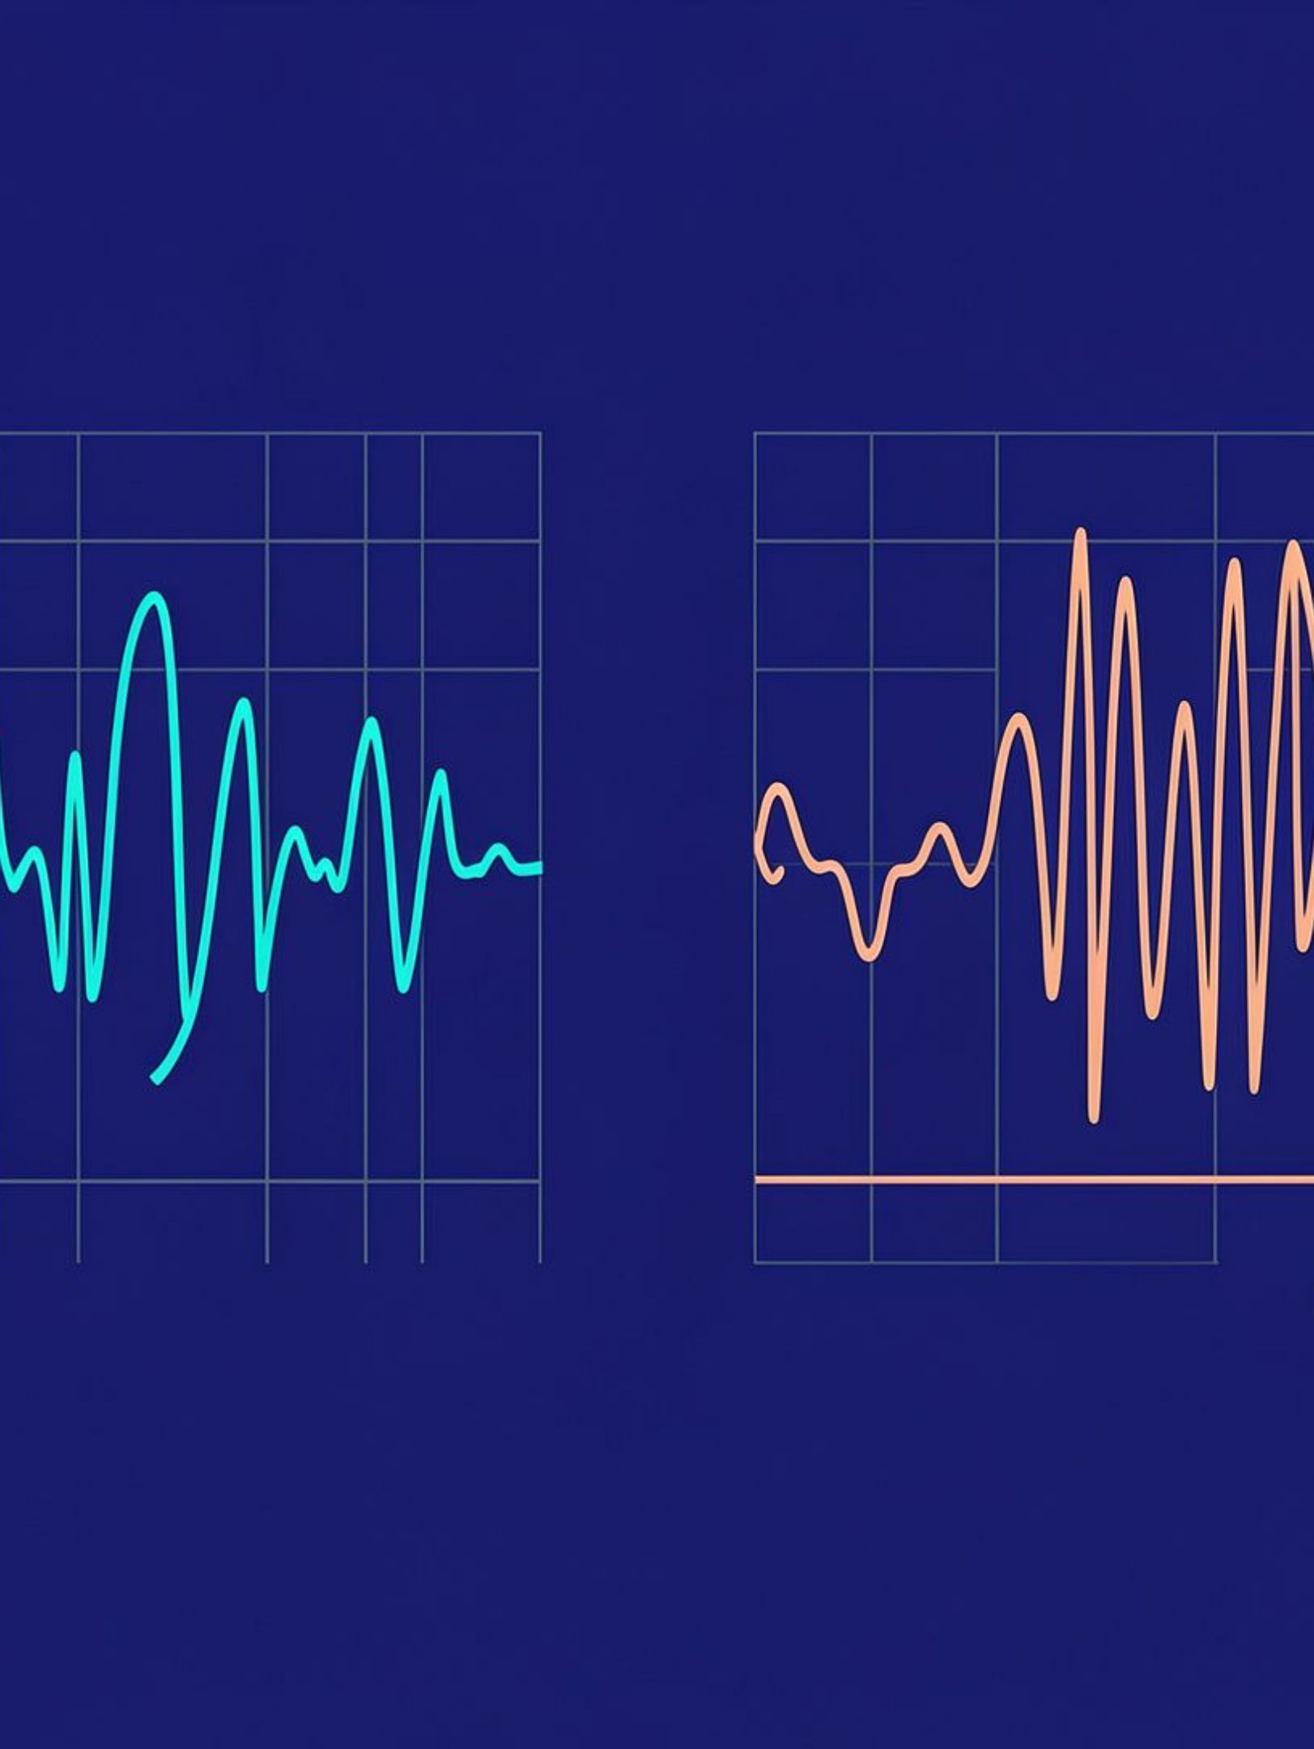
Normal waveform
Abnormal waveform
07 · DEMONSTRATION
Illustrative waveforms, not experimental results.
The demonstration connects the sensor, signal, and status
Secure the vibration sensor to the motor and connect it to the ESP32.
Read analog signals and observe them in the Serial Monitor or Serial Plotter.
Compare normal and abnormal behavior using clearly labeled illustrative waveforms.
Use sample code or pseudocode only where it improves explanation.

Slide 9
08 · EVALUATION
Evaluation should separate evidence from expected value
Category | Evaluation
Evaluate | RMS vibration, peak amplitude, detection rate, false alarms, and response time.
Expected outcome | Detect amplitude changes and threshold exceedances in real time.
Benefits | Earlier fault indication, lower-cost monitoring, and better maintenance planning.
Applications | Motors and pumps, manufacturing equipment, HVAC, conveyors, and industrial automation.
Do not invent accuracy percentages or verified findings.

Slide 10
09 · CLOSING
Predict Today,
Prevent Tomorrow
ESP32 plus vibration sensing provides a practical foundation for motor condition monitoring.
Vibration-based anomaly detection can support preventive maintenance decisions.
Future scope
Temperature sensing, better filtering and feature extraction, wireless dashboards and notifications, condition-specific calibration, and machine-learning extensions.
Thank You · Mohammad Reyhan · Faizan · Amaan Shaik

