Slide 1
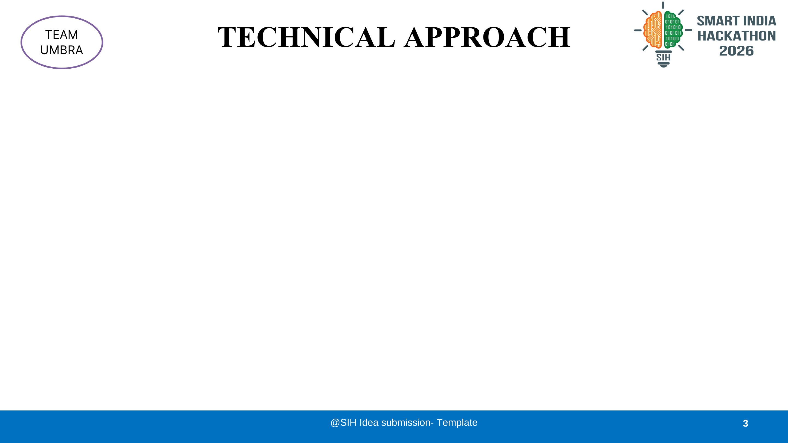
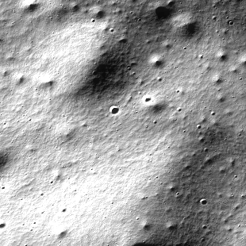
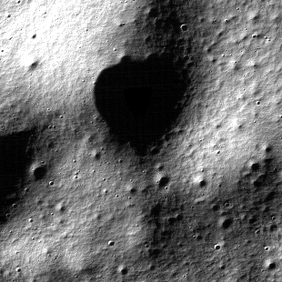
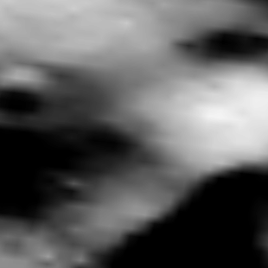
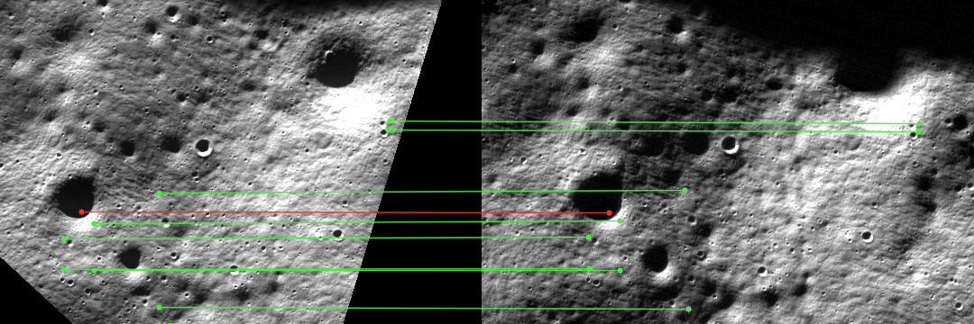
1 SYSTEM ARCHITECTURE
0.25 m → 5 m → 80 m TMC-2 BRIDGES THE 320× GAP
CHANDRAYAAN-2 SOURCES
OHRC
01
↓
02
∩
03
≋
04
⇄
05
✓
0.25–0.30 m/px
INGEST
GEOMETRY
STRUCTURE
TMC-2 BRIDGE
EVIDENCE GATE
TMC-2
PDS4 labels
SPICE pointing
checksums + IDs
Lunar CRS
true footprint ∩
common ROI + DEM
shadow masks
gradients / ridges
selected IIRS bands
OHRC → TMC-2
TMC-2 ← IIRS
bounded search
RANSAC/MAGSAC
held-out + reverse checks
coverage + RMSE / P90
~5 m/px · ortho + DTM
IIRS
REGISTER · ABSTAIN · REJECT
~80 m/px · 256 bands
IIRS LEG: NEXT PHASE
2 IMPLEMENTATION FLOWCHART
3 TECHNOLOGIES
4 REAL DATA CHECKPOINT
01
Acquire
02
Clip overlap
03
Prepare
P4
PDS4 + SPICE
REALPAIR005 · OHRC ↔ TMC-2
XML + browse
science ROI
native polygons
common lunar CRS
masks + pyramids
structural layers
labels · camera geometry
GIS
Shapely + PyProj
polygon intersection · CRS
CV
OpenCV + NumPy
LOCAL RELATIVE REGISTRATION: PASS
06
Save verdict
05
Validate
04
Match
SIFT / AKAZE · RANSAC
878
1.302 px
metrics · transform
manifest + report
RANSAC · hold-out
cycle + coverage
SIFT / AKAZE
reciprocal + ratio
API
FastAPI + JSON
SIFT controls
native TMC RMSE
offline workbench · audits
AKAZE: 410 controls (counts overlap)
FIXED GATE: thresholds stay unchanged. Every accepted point keeps its residual and provenance.
FULL STRIP + ABSOLUTE: ABSTAIN
Notes:
Source template: SIH_26166_UMBRA.pdf, page 3. The top sensor thumbnails are real saved REALPAIR005 candidate browse crops and are not co-registered. The checkpoint figure is a crop of REALPAIR005_science_v1/aligned_middle_evidence/sift_heldout_correspondences.png. Audit REALPAIR005_OHRC_TMC_ALIGNED_MIDDLE_VERIFICATION_V1 accepts local relative OHRC-to-TMC-2 registration in OHRC samples 1000–11000, lines 42000–58000, where camera/DTM support exists. SIFT has 878 accepted controls and 1.302 pixel RMSE on native 5 m TMC-2 ortho pixels; AKAZE has 410 accepted controls, with overlapping physical terrain. The audit explicitly abstains on full-strip registration and absolute 5 m ground accuracy. No TMC-2-to-IIRS image registration is claimed. Details and checksums: data/derived/REALPAIR005_science_v1/ALIGNED_MIDDLE_SCIENTIFIC_VERIFICATION.md and aligned_middle_decision.json.

