Slide 1
CPSC 5240-Project (Part 3)
Air Quality Analysis using Machine Learning Algorithms
Syed Mohammed Tareq
zhd777

Slide 2
Introduction
Environment of our world is under threat.
By measuring the air quality, we can measure the degree of cleanliness of the environment.
Machine learning may help us to analyses and bring meaningful result

Slide 3
Data
Data Source: Data was collected from Kaggle repository
Link: https://www.kaggle.com/datasets/singhakash/air-quality

Slide 4
Data
 | T | TM | Tm | SLP | H | VV | V | VM | PM 2.5
0 | 7.4 | 9.8 | 4.8 | 1017.6 | 93.0 | 0.5 | 4.3 | 9.4 | 219.720833
1 | 7.8 | 12.7 | 4.4 | 1018.5 | 87.0 | 0.6 | 4.4 | 11.1 | 182.187500
2 | 6.7 | 13.4 | 2.4 | 1019.4 | 82.0 | 0.6 | 4.8 | 11.1 | 154.037500
3 | 8.6 | 15.5 | 3.3 | 1018.7 | 72.0 | 0.8 | 8.1 | 20.6 | 223.208333
4 | 12.4 | 20.9 | 4.4 | 1017.3 | 61.0 | 1.3 | 8.7 | 22.2 | 200.645833

Slide 5
Plan
How many features are there ?
Is there any correlation among the features?
Which feature seems to be important?
Which features are proportional to PM 2.5?
Which feature are inversely proportional to PM2.5?
Are there any unnecessary features? If yes, how do you clean those.
Is there any missing value? If yes how do you mitigate those?
How stable the data are? Are there any outliers?
Which type of machine learning approaches will be used and why?
Is there any data loss and how it is tackled?
How do you judge performance of the analysis?

Slide 6
Preprocess
First, it was checked that whether there was any missing value or not and it is found that PM_{2.5} has got one missing value (row number is 184).
Accordingly, it is updated using the code ‘interpolate’. Interpolate is one of the good methods of inferring value using back and forward calculations. From the heat map, it is also visible that there is no zero value
Normalization
Data range is varying from 0 to more than 1000, which need to be normalized for further analysis. So that range of the values are consistent, which will make the statistical analysis easier. It will assist us for fair comparison, between different features. We have used two methods for normalizing the data. One is Lambda Function and another is MinMax Scaler. We have got same result using the both methods [3, 4].

Slide 7
Feature Selection
According to table 2, PM_{2.5} has got good correlation with Tm (67%). Other features like TM, T SLP and VV are correlated with PM_{2.5} with more than 50% value. Thus, most import features can be guessed as T, TM, Tm, VV which can be further confirmed using model.
Feature Selection is the method of reducing the input variable to your model by using only relevant data and getting rid of noise in data. It is the process of automatically choosing relevant features for your machine learning model based on the type of problem you are trying to solve.
Principal Component Analysis (PCA) was utilized for feature selection based on attribute aggregation.

Slide 8
Matrices of PCA For 2 components total variance: 0.8338691291525626 For 3 components total variance: 0.9267355190616648 For 4 components total variance: 0.9602392555156877 For 5 components total variance: 0.9770564443524143 For 6 components total variance: 0.9927145395600608 For 7 components total variance: 0.9982415241024583

Slide 9
Models Used
Decision tree
KNN
Random forest

Slide 10
Result

Slide 11
Models Used
Decision tree

Slide 12
Score Training set score: 0.8109409420137816 Testing set score: 0.69995207352917
Decision tree
Error Mean Squared Error: 2477.5953534636687 Mean Absolute Error: 34.574609317134616 R2 Score: 0.69995207352917

Slide 13
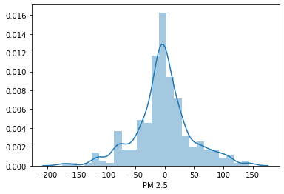
Bell curve

Slide 14
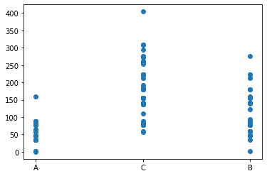

Slide 15
KNN
Most important feature PM2.5 (target is divided into 3 classes A, B, C
Fit into KNN
10-fold CV

Slide 16
K = 2 Mean Accuracy = 74.36% Standard Deviation = 0.066 K = 3 Mean Accuracy = 72.29% Standard Deviation = 0.049 K = 4 Mean Accuracy = 69.36% Standard Deviation = 0.04 K = 5 Mean Accuracy = 70.33% Standard Deviation = 0.03 K = 6 Mean Accuracy = 70.45% Standard Deviation = 0.045

Slide 17
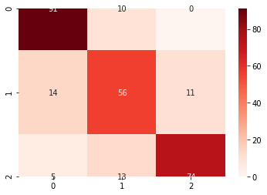
Figure 1: Confusion matrix for KNN

Slide 18
Classification Report: precision recall f1-score support A 0.83 0.90 0.86 101 B 0.71 0.69 0.70 81 C 0.87 0.80 0.84 92 accuracy 0.81 274 macro avg 0.80 0.80 0.80 274 weighted avg 0.81 0.81 0.81 274

Slide 19
Random Forest

Slide 20
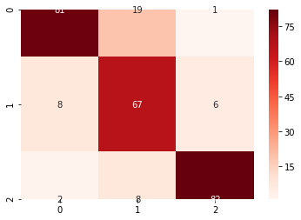
Figure 1: Confusion matrix for random forest

Slide 21
Classification Report: precision recall f1-score support A 0.89 0.80 0.84 101 B 0.71 0.83 0.77 81 C 0.92 0.89 0.91 92 accuracy 0.84 274 macro avg 0.84 0.84 0.84 274 weighted avg 0.85 0.84 0.84 274

Slide 23
Learnings
Model | Accuracy | Remarks
Decision Tree
KNN | 81%
Random Forest | 84 %

Slide 25
Conclusion
Air quality prediction will help researcher to foresee the environmental degradation.
It will give a wakeup call to the decision maker.
Accordingly, we will be able to make the environment livable to the future generation.

Slide 26
References
1. Bhalgat, P., S. Bhoite, and S. Pitare, Air quality prediction using machine learning algorithms. International Journal of Computer Applications Technology and Research, 2019. 8(9): p. 367-390.
2. Iskandaryan, D., F. Ramos, and S. Trilles, Air quality prediction in smart cities using machine learning technologies based on sensor data: a review. Applied Sciences, 2020. 10(7): p. 2401.
3. Madan, T., S. Sagar, and D. Virmani. Air Quality Prediction using Machine Learning Algorithms–A Review. in 2020 2nd International Conference on Advances in Computing, Communication Control and Networking (ICACCCN). 2020. IEEE.

Slide 27
Thank you

