Slide 1

Strength Analysis
ENCH 5910 / ENCH 7997
TMOS AEROGEL
Syed Mohammed Tareq
Department of Computational Science and Engineering

Slide 2

SCOPE
Propanol as Solvent Exchange
95% EtOH as Solvent Exchange

Slide 3
Background
Classical plate theory is used for calculating flexural parameters of an isotropic circular plate
Simply supported circular plate subjected to Centre concentrated or Pont load
Reference:
https://www.internationaljournalssrg.org/IJCE/2015/Volume2-Issue5/IJCE-V2I5P112.pdf

Slide 4
Propanol as solvent exchange

Slide 5
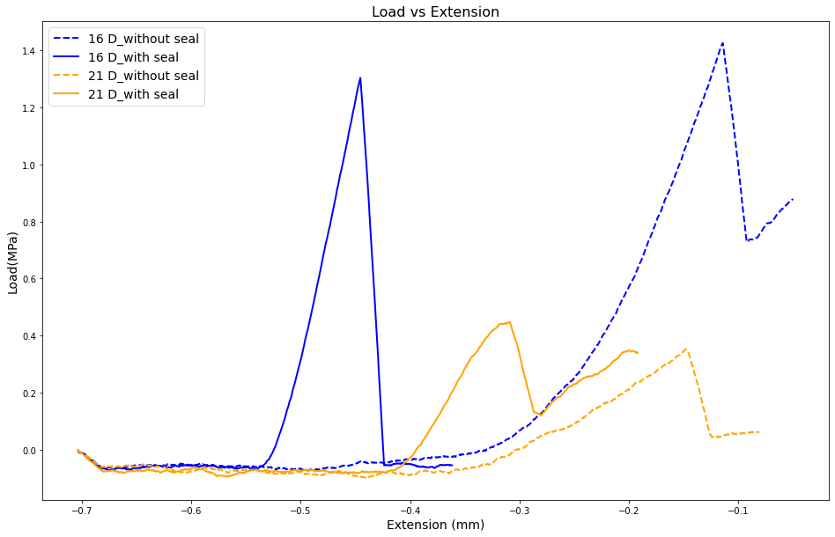
Propanol as solvent exchange
Comments:
Fracture initiation load of sealed sample is more than unsealed one for 21 days sample. It is reverse for 16 days sample.
Unsealed sample can absorb more strain than sealed.
16 days sample can absorb more load than 21 days one

Slide 6
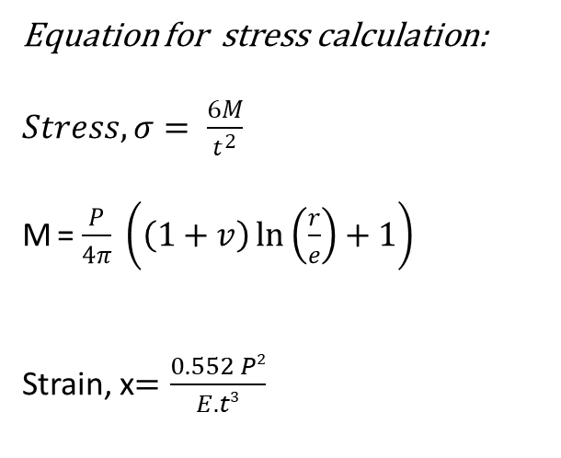
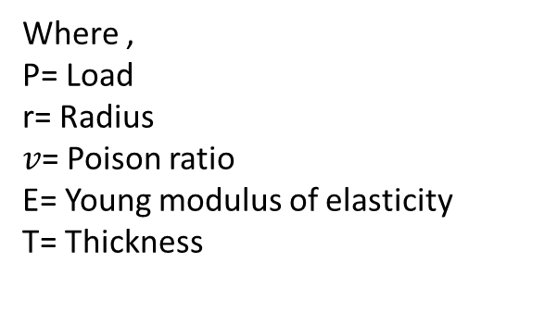
Propanol as solvent exchange
Equation for stress calculation:
$Stress, σ= \frac{6M}{t^{2}}$
M = $\frac{P}{4π} \left(\left(1+v\right)\ln\left(\frac{r}{e}\right)+1\right)$
Strain, x$=\frac{0.552 P2}{E.t3}$
Where ,
P= Load
r= Radius
$v$= Poison ratio
E= Young modulus of elasticity
T= Thickness
https://roymech.org/Useful_Tables/Mechanics/Plates.html

Slide 7
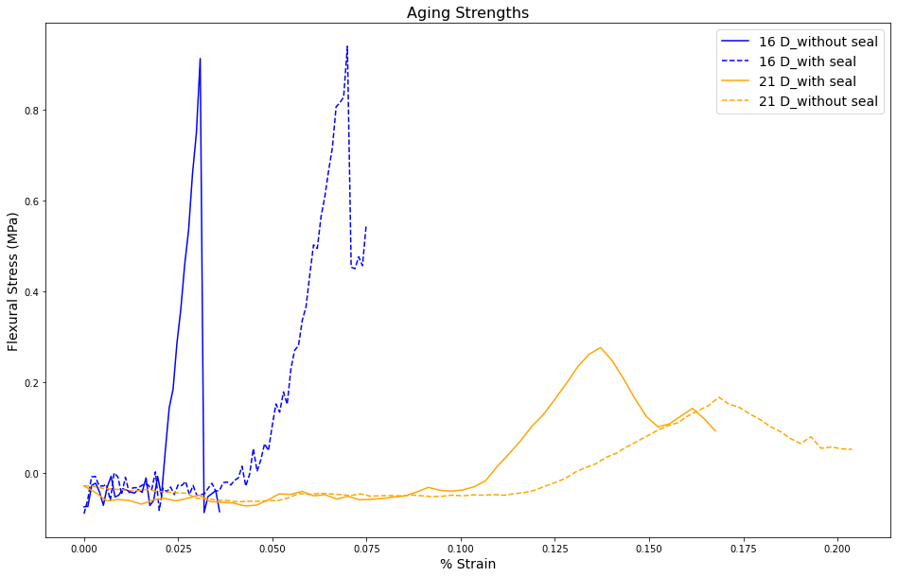


Propanol as Solvent Exchange
Comments:
Max/peak flexural stress for 21 days is higher in case of sealed sample than without seal.
For a certain strain, 16 days flexural stress is higher than 21 days flexural stress.
For 16 days sample, peak flexural stress is more than 21 days sample.
Max/peak flexural stress for 16 days is nearly similar in both sealed and without sealed sample.
Thus, though strength of 16 Days sample > 21 Days sample , but toughness of 21 days sample > 16 Days.
$Stress, σ= \frac{6M}{t^{2}}$
Strain, x$=\frac{0.552 P2}{E.t3}$

Slide 8
95% EtOH as Solvent Exchange

Slide 9
95% EtOH as Solvent Exchange
Samples are released using acetone.
Before solvent exchange samples were washed 3 times with minimum 6 hours submergence.

Slide 10
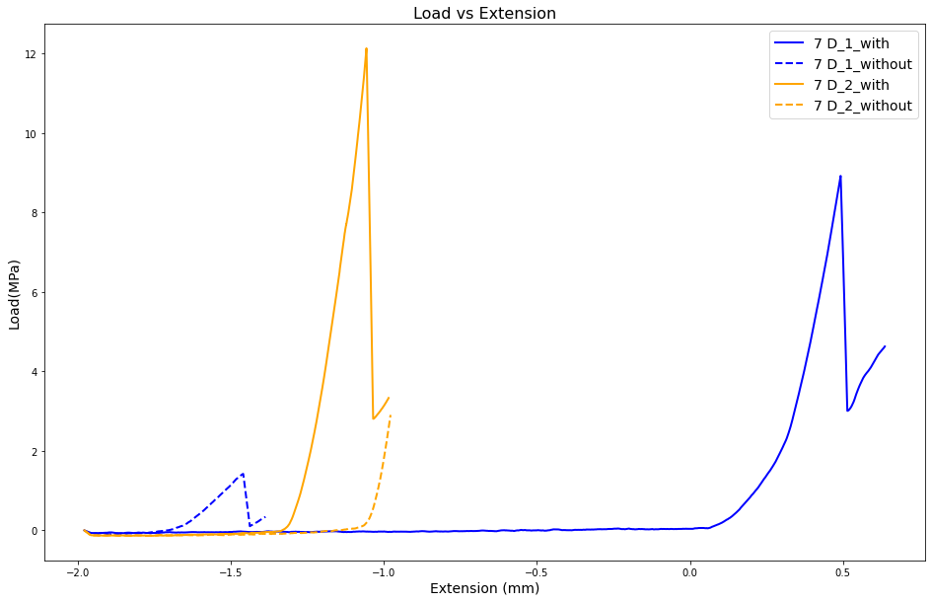
95% EtOH as Solvent Exchange (7 Days)
Comments:
Fracture initiation loads are more for sealed samples than unsealed.
Extension is more in case sealed one for sample 1. But it is reverse for sample 2.

Slide 11
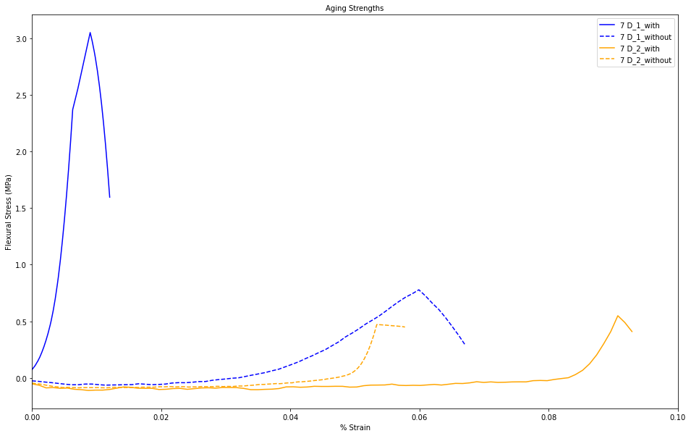
95% EtOH as Solvent Exchange (7 days)
Sample cracked with a load 1.45 N
Comments:
More stress can be absorbed by sealed sample.
% Strain is less in case of sealed sample for sample 1. But for sample 2 it is vice versa

Slide 12
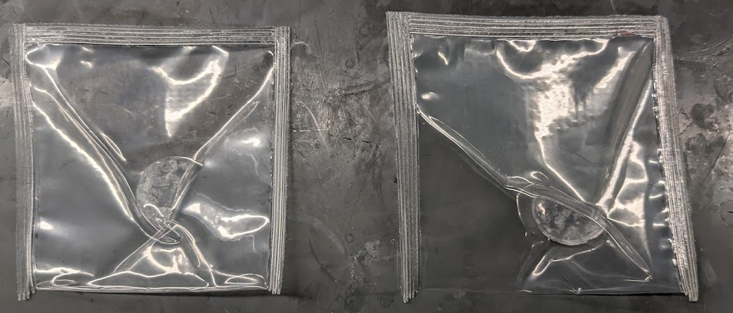
Vacuum sealing with double layer
Sample cracked with a load 1.45 N
Single seal
Double seal
Comments:
Double seal seems to be better sealed. Sample is tightly hold
By strength analysis it be characterized.

Slide 13
Literature Review
Sample cracked with a load 1.45 N
Article #1:
Aesthetic Aerogel Window Design for Sustainable Buildings
Take away.
Monolithic-silica-aerogel were used
Transport of heat through windows account for more than 25% of heating and cooling losses in residential building
It does not have optical clarity of vision glass, due to light scatterings and often have surface imperfections, thus less appealing for glazing applications
Variety of approaches were used to improve the quality, so that they become aesthetically pleasing.
https://www.mdpi.com/2071-1050/14/5/2887

Slide 14
Future Plan
Sample cracked with a load 1.45 N
Vacuum sealing with various options and test the change in strength
Once liquid CO₂ arrives, new set of perfect sample will be made ready using CPD and then strength analysis.

Slide 15
Conclusion
Better result can be found from the samples dried with 100 % EtOH.

