Slide 1

Strength Analysis
ENCH 5910 / ENCH 7997
TMOS AEROGEL
Syed Mohammed Tareq
Department of Computational Science and Engineering

Slide 2

SCOPE
Sample without seal
Sample with Seal, vacuum time 10 secs (Single and Double layer)
Sample with Seal, vacuum time 20 secs (Single and Double layer)
Sample with Seal, vacuum time 40 secs (Single and Double layer)

Slide 3
SCOPE
Load vs Extension

Slide 4
Universal Testing Machine
Schematic Image

Slide 5
Universal Testing Machine
Working principle & Key equations & Applications

Slide 6
Universal Testing Machine
Data examples

Slide 7
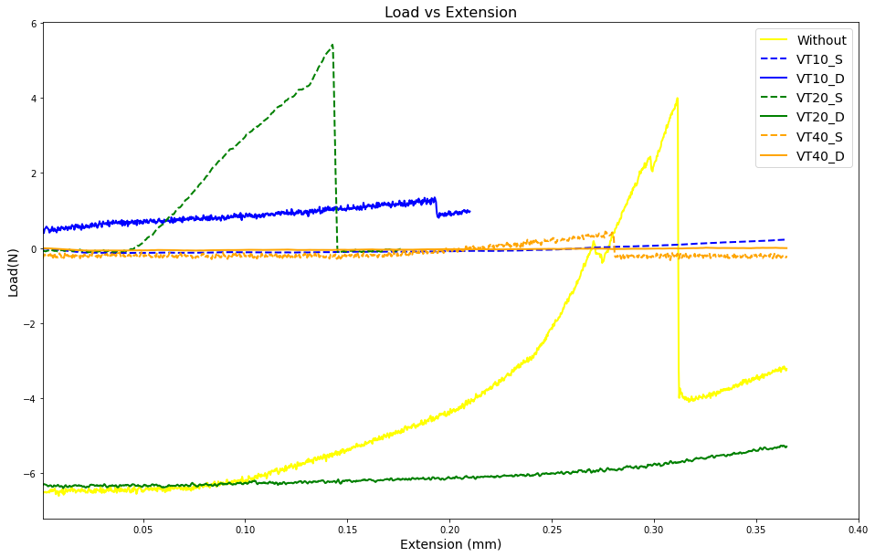
Load vs Extension
Comments:
Load and extension is correlated.
Small load with small strain may give more stress.

Slide 8
Stress vs Strain

Slide 9
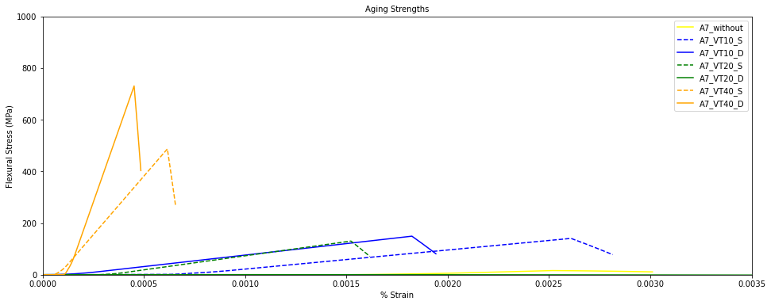
Stress vs Strain
Comments:
Stress with vacuum time (VT) 40 second and double layer seems to be higher.
One sample data of VT20 with Double (D) layer is corrupted.
Value is matching with the article shown below
Key questions
Refs: https://pubs.acs.org/doi/full/10.1021/acs.jpcb.7b03184
Place, side by side to compare

Slide 10
Future Plan
Sample cracked with a load 1.45 N
Vacuum sealing using fresh sample with various options and test the change in strength
Completion of UVvisNIR analysis prior to strength test
Start of manuscript on vacuum aerogel

Slide 11
Conclusion
Better result may be found from the samples dried with 100 % EtOH.

