Slide 1
Digital Signature

Slide 2
What is a digital signature?
Is an electronic signature that can be used to authenticate the identity of the sender of a message or the signer of a document, and possibly to ensure that the original content of the message or document that has been sent is unchanged. Digital signatures are easily transportable, cannot be imitated by someone else, and can be automatically time-stamped. The ability to ensure that the original signed message arrived means that the sender cannot easily repudiate it later.

Slide 3
How it works
The use of digital signatures usually involves two processes, one performed by the signer and the other by the receiver of the digital signature:
Digital signature creation uses a hash result derived from and unique to both the signed message and a given private key. For the hash result to be secure, there must be only a negligible possibility that the same digital signature could be created by the combination of any other message or private key.
Digital signature verification is the process of checking the digital signature by reference to the original message and a given public key, thereby determining whether the digital signature was created for that same message using the private key that corresponds to the referenced public key.

Slide 4
Example
Assume you were going to send the draft of a contract to your lawyer in another town. You want to give your lawyer the assurance that it was unchanged from what you sent and that it is really from you.
You copy-and-paste the contract (it's a short one!) into an e-mail note.
Using special software, you obtain a message hash (mathematical summary) of the contract.
You then use a private key that you have previously obtained from a public-private key authority to encrypt the hash.
The encrypted hash becomes your digital signature of the message. (Note that it will be different each time you send a message.)
At the other end, your lawyer receives the message.
To make sure it's intact and from you, your lawyer makes a hash of the received message.
Your lawyer then uses your public key to decrypt the message hash or summary.
If the hashes match, the received message is valid.

Slide 5
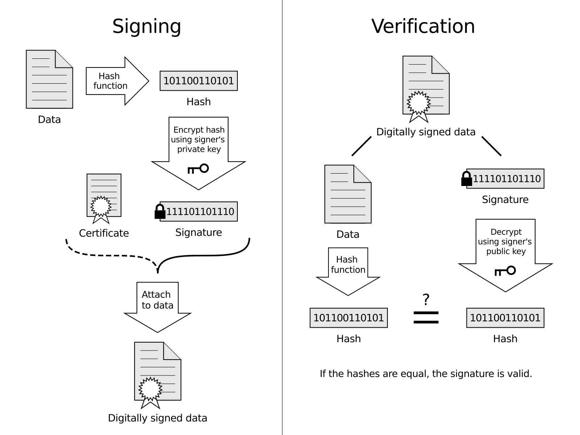
Signing & Verification
Source: Wikipedia

Slide 6
Benefits of digital signatures
These are common reasons for applying a digital signature to communications:
Authentication
Although messages may often include information about the entity sending a message, that information may not be accurate. Digital signatures can be used to authenticate the source of messages. When ownership of a digital signature secret key is bound to a specific user, a valid signature shows that the message was sent by that user. The importance of high confidence in sender authenticity is especially obvious in a financial context. For example, suppose a bank's branch office sends instructions to the central office requesting a change in the balance of an account. If the central office is not convinced that such a message is truly sent from an authorized source, acting on such a request could be a grave mistake.
Integrity
In many scenarios, the sender and receiver of a message may have a need for confidence that the message has not been altered during transmission. Although encryption hides the contents of a message, it may be possible to change an encrypted message without understanding it. (Some encryption algorithms, known as nonmalleable ones, prevent this, but others do not.) However, if a message is digitally signed, any change in the message will invalidate the signature. Furthermore, there is no efficient way to modify a message and its signature to produce a new message with a valid signature, because this is still considered to be computationally infeasible by most cryptographic hash functions.

Slide 7
Drawbacks of digital signatures
Despite their usefulness, digital signatures do not alone solve all the problems we might wish them to.
Non-repudiation
In a cryptographic context, the word repudiation refers to the act of disclaiming responsibility for a message. A message's recipient may insist the sender attach a signature in order to make later repudiation more difficult, since the recipient can show the signed message to a third party (eg, a court) to reinforce a claim as to its signatories and integrity. However, loss of control over a user's private key will mean that all digital signatures using that key, and so ostensibly 'from' that user, are suspect. Nonetheless, a user cannot repudiate a signed message without repudiating their signature key.

Slide 8
Main Questions?
In the digital signature who uses the private key and who uses the public key?
Private key: sender
Public key: receiver
2. What are the benefits of digital signatures?
Authentication and Integrity

