Slide 1
FTP - File Transfer Protocol
TFTP – Trivial FTP

Slide 2
Overview
File Transfer Protocol (RFC 959)
  Why FTP?
  FTP’s connections
  FTP in action
  FTP commands/responses
Trivial File Transfer Protocol (RFC 1350)
  TFTP and TFTP’s message formats
  FTP and TFTP compared

Slide 3
Why do we need a FTP Service?
Purpose: To Transfer files between two computers
Goals of FTP Service
  Promote sharing of files (programs and/or data)
  Encourage indirect/implicit use of remote computers
  Shield users from variations in file storage among hosts
  Transfer data reliably and efficiently

Slide 4




Problems of File Transfer
At first, file transfer may seem simple
Heterogeneous systems use different:
  Operating Systems
  Character Sets
  Naming Conventions
  Directory Structures
  File Structures and Formats
FTP need to address and resolve these problems

Slide 5


FTP’s Connections
2
* Persistent command
and reply connection
* Insulates users from “raw”
FTP commands
client
Non-persistent data
connection
Server is listening on port 21
for connection requests
*Server uses port 20
for data connections
* Routes “raw” FTP commands
* Receives server’s replies
User
Interface
server
User
Protocol
Interpreter
Control
Connection
Server
Protocol
Interpreter
21
User
Data Transfer
Function
Data
Connection
Server
Data Transfer
Function
20

Slide 6
FTP’s Connections – Establishment
2
ftp> open strauss.udel.edu
Connected to strauss.udel.edu
220 strauss FTP server ready.
530 Please login with USER and PASS
client
331 Password req for haggerty.
Password:
User
Interface
230 User haggerty logged in.
ftp>
USER haggerty
PASS mypass
server
User
Protocol
Interpreter
Control
Connection
Server
Protocol
Interpreter
User
Data Transfer
Function
Data
Connection
Server
Data Transfer
Function

Slide 7

2
FTP’s Connections
Data Transfer
client
ls client.txt
-rw-r--r-- haggerty client.txt
User
Interface
226 Closing Data Connection
200 Port Command Sucessful
LIST client.txt
PORT 192,168,100,173,19,137
150 Data Connection will be open shortly
server
User
Protocol
Interpreter
User
Protocol
Interpreter
Server
Protocol
Interpreter
Control
Connection
Server
Protocol
Interpreter
Passive open on
Port 5001
User
Data Transfer
Function
Data
Connection
Server
Data Transfer
Function
Establish Data Connection

Slide 8
2
FTP’s Connections – Connection Closing
bye
client
User
Interface
221 Service Closing
QUIT
server
User
Protocol
Interpreter
Control
Connection
Server
Protocol
Interpreter
User
Data Transfer
Function
Data
Connection
Server
Data Transfer
Function

Slide 9
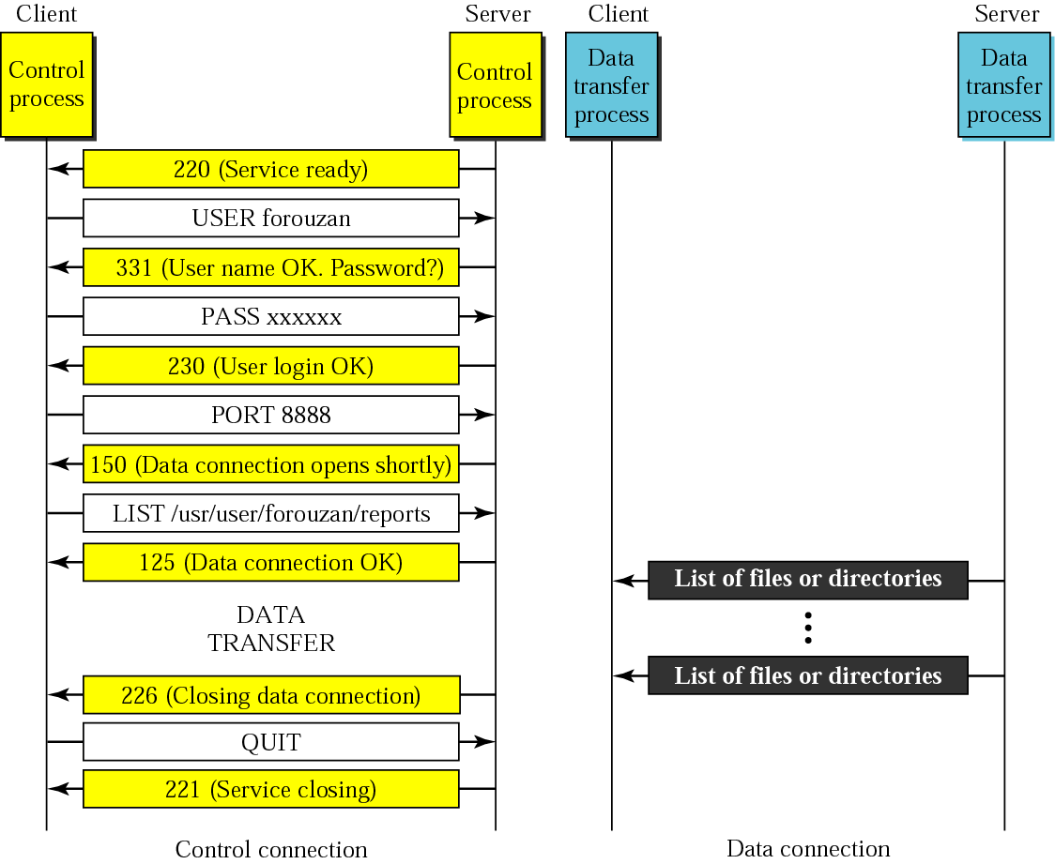
FTP Connections

Slide 10
FTP Connection
Client
Server
ftp> open server
SYN
SYN|ACK
ACK
220 Service Ready
ACK
ftp> USER haggerty
ACK
331 User OK,password?
ACK
ftp> PASS mypass
ACK
230 User login OK
ACK

Slide 11
FTP Data Transfer
Client
Server
PORT 192,168,0,173,19,137
ACK
200 Command Successful
NLST client.txt
ACK
SYN
SYN-ACK
ACK
150 Data Connection will be open shortly
ACK
NAME LIST
FIN
Control connection
FIN-ACK
Data Connection
ACK
226 Closing Data Connection
ACK

Slide 12
FTP Client Commands (issued by user interface)
Command | Description
get filename | Retrieve file from server
mget filename* | Retrieve multiple files from server*
put filename | Copy local file to server
mput filename* | Copy multiple local files to server*
open server | Begin login to server
bye / close / exit | Logoff server
ls / dir | List files in current remote dir on server
lcd | Change local directory
cd | Change remote directory
rhelp / remotehelp | Lists commands the server accepts
* Sent to server as multiple command by User Protocol Interpreter

Slide 13
A-PDU FTP Commands
Command | Description
LIST [filelist ] | List files or directories (ls / dir)
USER username | Send username to server
PASS password | Password on server
PORT h1,h2,h3,h4,p1,p2 | Client IP and port number
RETR filename | Retrieve (get) filename
STOR filename | Store (put) filename
TYPE (ascii, image) | Do nothing (check if server is alive)

Slide 14
Example FTP Responses
120 Service will be ready shortly
200 Command OK
230 User login OK
331 User name OK; password is needed
421 Service not available
530 User not logged in
552 Requested action aborted; exceeded storage allocation

Slide 15
Summary of FTP connections
FTP has 2 connections
  Control (persistent connection)
    Server issues a passive open on well-known 21
    Client uses an ephemeral port to issue active open
    Server ultimately closes control connection
  Data (ephemeral connection)
    Client issues passive open on an ephemeral port
    Client sends this port to server via PORT command
    Server receives the port number and issues active open using its well-known 20 to the received ephemeral port

Slide 16
Data Connection continued
This does not always work…why?
Instead, use PASV command
  Client sends PASV command to server
  Server chooses ephemeral port: passive open
  Server responds with IP, Port in reply (227)
  Client issues active open to server’s port
Ultimately, the data sender closes connection

Slide 17
Trivial FTP (TFTP)
Used only to read and write files from/to a remote server
  Cannot list directories
Useful for bootstrapping diskless systems
  Workstations
  X terminals
Simple and small:
  5 message formats
  Runs on UDP
  Designed to fit in ROM
  Uses a “stop and wait” protocol
  NO BUILT IN SECURITY FEATURES (login)
Notes:
TFTP uses the services of UDP on well known port 69.

Slide 18
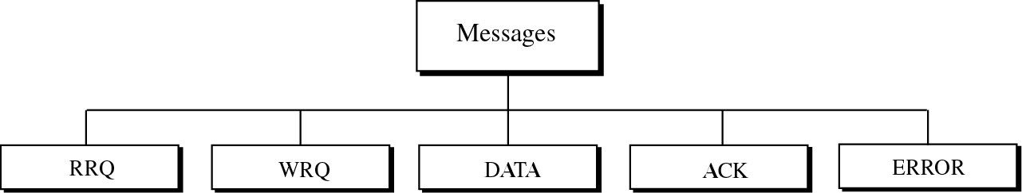
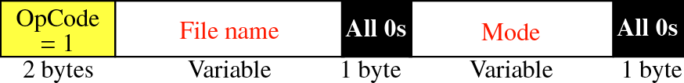
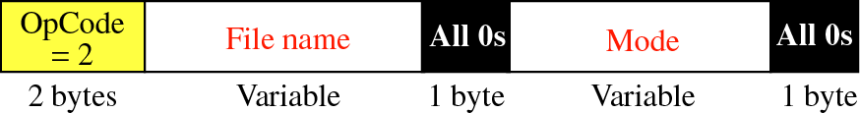
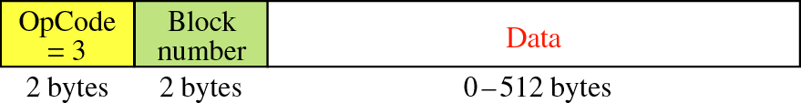
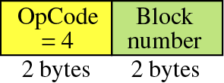
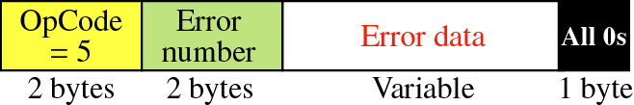
TFTP Message Formats
Notes:
RRQ: client to establish a connection for reading data from the server.
WRQ: write data from the client to the server
DATA: All data bytes are exactly 512 bytes long except the last block which is between 0 and 511 bytes…EOF indicator – if data is in exact multiples of 512, sender must send one extra block of zero bytes. DATA can be in NVT ASCII or octet (binary format)
ACK: Block number is a 2byte field containing the number of the block received

Slide 19
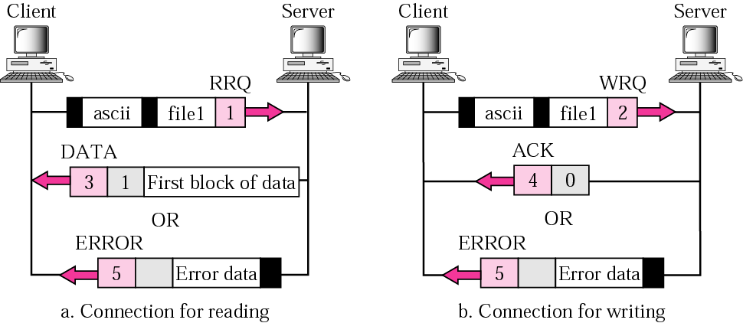
TFTP Connection Establishment

Slide 20
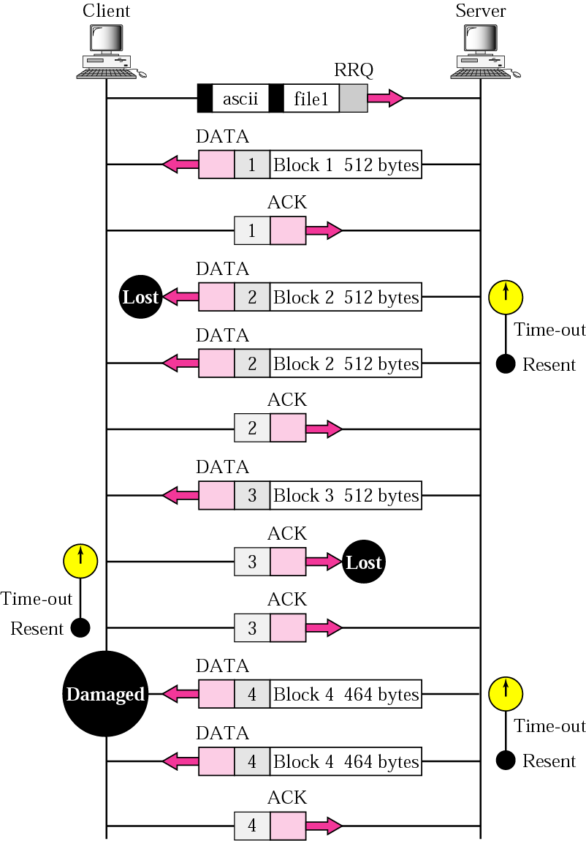
Example TFTP Session

Slide 21
FTP vs. TFTP
FTP provides (minimal) security through login procedure
TFTP has NO login procedure
FTP Provides a reliable service through its use of TCP
TFTP must handle its own retransmissions since it uses UDP
FTP uses two connections
TFTP uses one connection (stop and wait)
FTP provides many commands
TFTP can only read and write files
Slide from William Boyer boyer@cis.udel.edu

