Slide 1
Internet Control Message Protocol

Slide 2
About the Internet
Control Message Protocol
The protocol is used to report problems with delivery of IP datagrams within an IP network.
It can be sued to show when a particular End system is not responding, when an IP network is not reachable, when a node is overloaded, when an error occurs in the IP header information, etc.
The protocol is also frequently used by Internet managers to verify correct operations of End Systems and to check that routers are correctly routing packets to the specified destinations.

Slide 3
About the Internet
Control Message Protocol
ICMP, uses the basic support of IP as if it were a higher level protocol, however, ICMP is actually an integral part of IP, and must be implemented by every IP module.

Slide 4
Purpose of ICMP
The Internet Control Message Protocol is a protocol for the exchange of error messages and other vital information between (Physical) Internet entities such as hosts and routers.

Slide 5
ICMP in the TCP/IP protocol suite
ICMP is a network layer protocol, often it is placed next to the IP protocol.
ICMP Header
ICMP Data Area
IP Header
IP Data Area
Frame Header
Frame Area

Slide 6
ICMP in the TCP/IP protocol suite
ICMP lies just above IP, as ICMP messages are
carried inside IP Packets.
ICMP messages are carried as IP payload, just as
TCP/UDP segments are carried as IP payload
When a host receives an IP packet with ICMP
specified as the upper layer protocol, it de-
multiplexes the packet to ICMP, just as it would
demultiplex a packet to TCP/UDP.

Slide 7
ICMP functions
Announce network errors: such as a host or entire portion of the network being unreachable, due to some type of failure. A TCP or UDP packet directed at a port number with no receiver attached is also reported via ICMP.
When a router begins buffering too many packets, due to an inability to transmit them as fast as they are being received, it will generate ICMP Source Quench messages. Directed at the sender, these messages should cause the rate of packet transmission to be slowed.

Slide 8
ICMP functions
Assist Troubleshooting: ICMP supports an Echo function, which just sends a packet on a round--trip between two hosts. Ping, a common network management tool, is based on this feature. Ping will transmit a series of packets, measuring average round--trip times and computing loss percentages.
Announce Timeouts: If an IP packet's TTL field drops to zero, the router discarding the packet will often generate an ICMP packet announcing this fact. TraceRoute is a tool which maps network routes by sending packets with small TTL values and watching the ICMP timeout announcements.

Slide 9
ICMP Applications
There are two simple and widely used applications which are based on ICMP:
Ping
Traceroute.

Slide 10
ICMP Applications
PING: The ping utility checks whether a host is alive & reachable or not. This is done by sending an ICMP Echo Request packet to the host, and waiting for an ICMP Echo Reply from the host.
TRACE ROUTE: Traceroute is a utility that records the route (the specific gateway computers at each hop) through the Internet between your computer and a specified destination computer. It also calculates and displays the amount of time each hop took.

Slide 11
ICMP Operation

Slide 12
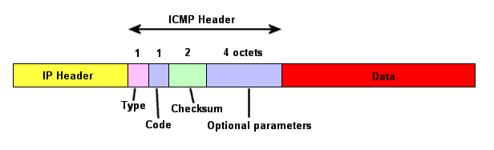
ICMP datagram structure
The ICMP datagram, being an IP datagram, contains the usual IP header. This is followed by an ICMP header which varies slightly between the different types of ICMP message. The general format is shown below:

Slide 13
ICMP Message Types
Type | Message Type | Description
3 | Destination Unreachable | Packet could not be delivered
11 | Time Exceeded | Time to live field hit 0
12 | Parameter Problem | Invalid header field
4 | Source Quench | Choke Packet
5 | Redirect | Teach a router about geography
8 | Echo | Ask a machine if it is alive
0 | Echo Reply | Yes, I am alive
13 | Timestamp Request | Same as Echo request, but with timestamp
14 | Timestamp Reply | Same as Echo reply, but with timestamp

Slide 14
More about Message Types
The DESTINATION UNREACHABLE message is used when the subnet or a router cannot locate the destination.
The TIME EXCEEDED message is sent when a packet is dropped because its counter has reached zero. This event is symptom that packets are looping, that there is enormous congestion, or that the timer values are being set too low.
The PARAMETER PROBLEM message indicates that an illegal value has been detected in a header field. This problem indicates a bug in the sending host’s IP software or possibly in the software of a router transited.
The SOURCE QUENCH message was formerly used to throttle hosts that were sending too many packets. When a host received this message, it was expected to slow down. It is rarely used any more when congestion occurs.

Slide 15
More about Message Types
The REDIRECT MESSAGE is used when a router notices that a packet seems to be routed wrong. It is used by the router to tell the sending host about the probable error.
The ECHO and ECHO REPLY messages are used to see if a given destination is reachable and alive. Upon receiving the ECHO message, the destination is expected to send an ECHO REPLY message back.
The TIMESTAMP REQUEST and TIMESTAMP REPLY messages are similar, except that the arrival time of the message and the departure time of the reply are recorded in the reply. This facility is used to measure network performance.

Slide 16
Code:
The exact meaning of the value contained within this field depends on the message Type. For example, with an ICMP Type 3 message ("Destination unreachable"), a Code value of 0 means "Network unreachable", which implies a router failure. A Code of 1 means "Host unreachable".
Checksum:
The checksum field provides error detection for the ICMP header only and is calculated in the same way as the IP header checksum.
Parameters:
The usage of this field depends on the type of message. For example, Type 3 messages do not use this field, while Type 0 and 8 messages use the field to store an identifier and sequence number.
Data:
Typically, the data is the IP header and first 64 bits of the original datagram, i.e. the one that failed and prompted the ICMP message. Including the first 64 bits of the original datagram allows the ICMP message to be matched to the datagram that caused it.

Slide 17
Destination Unreachable Codes
Code | Definition
0 | Net Unreachable
1 | Host Unreachable
2 | Protocol Unreachable
3 | Port Unreachable
4 | Fragmentation needed & Don’t Fragment was set
5 | Source Route failed
6 | Destination Network Unknown
7 | Destination Host Unknown
8 | Source Host Isolated
9 | Communication Destination Network is Administratively Prohibited
10 | Communication Destination Host is Administratively Prohibited
11 | Destination Network Unreachable for Type of Service
12 | Destination Host Unreachable for Type of Service
13 | Communication Administratively Prohibited
14 | Host Precedence Violation
15 | Precedence Cutoff Violation

Slide 18
Redirect Codes
Code | Definition
0 | Redirect Datagram for the Network (or subnet)
1 | Redirect Datagram for the Host
2 | Redirect Datagram for the Type of Service & Network
3 | Redirect Datagram for the Type of Service & Host
Time Exceeded Codes Parameter Problem Codes
Code | Definition
0 | Time to Live Exceeded in Transit
1 | Fragment Reassembly Time Exceeded
Code | Definition
0 | Pointer Indicates the Error
1 | Missing a Required Option
2 | Bad Length

Slide 19
Testing and
Troubleshooting Sequences for ICMP
ICMP’s most common uses are testing and troubleshooting.
Two of the most well-known utilities, PING and TRACEROUTE, rely on ICMP to perform connectivity tests and path discovery.

Slide 20
Connectivity Testing with PING
The PING utility is actually an ICMP Echo process.
An ICMP Echo Request packet consists of an Ethernet header, IP header, ICMP header, and some undefined data.
This packet is sent to the target host, which echoes back that data, as shown in Figure 4-1.
The ICMP echo request is a connectionless process with no guarantee of delivery.

Slide 21
Connectivity Testing with PING (Contd.)
Most PING utilities send a series of several echo requests to the target in order to obtain an average response time.
These response times are displayed in milliseconds.
These times should be considered a snapshot of the current round-trip time.
The PING utility included with Windows 2000 sends a series of four ICMP echo requests with a one-second ICMP Echo Reply Timeout value

Slide 22
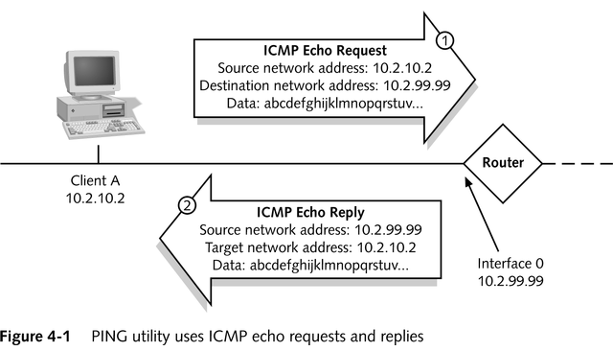
PING Utility Uses ICMP
Echo Requests and Replies

Slide 23
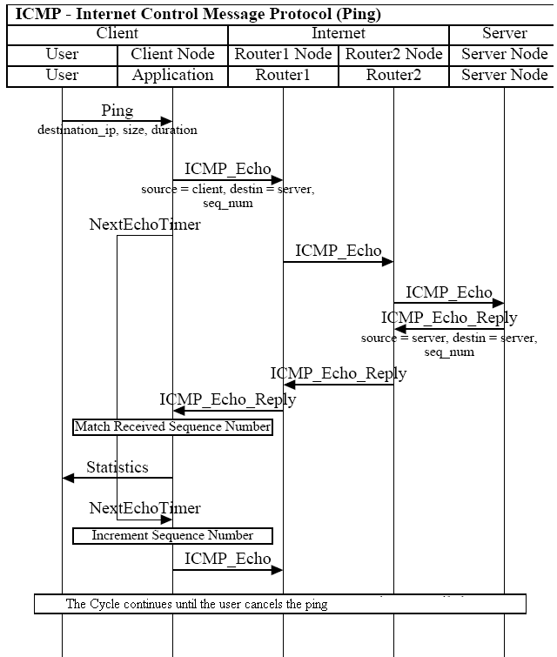
Event Flow Diagram

Slide 24
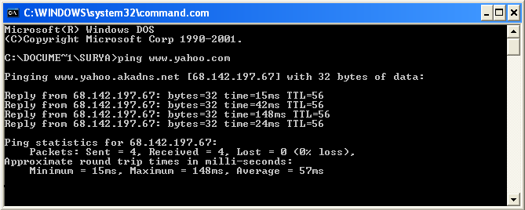
The echo requests consist of 32 bytes of data (an alphabetical pattern)
in a fragmentable IP packet
Ping Utility provides feedback on success and round-trip times
The command-line parameters used with PING can affect the appearance and functionality of ICMP Echo packets.

Slide 25
Path Discovery with TRACEROUTE
The TRACEROUTE utility identifies a path from the sender to the target host using ICMP echo requests and some manipulation of the TTL value in the IP header.
Traceroute starts by sending a UDP datagram to the destination host with the TTL field set to 1. If a router finds a TTL value of 1 or 0, it drops the datagram and sends back an ICMP Time-Exceeded message to the sender.
Traceroute determines the address of the first hop by examining the source address field of the ICMP Time-Exceeded message.

Slide 26
Path Discovery with TRACEROUTE (Contd.)
To identify the next hop, traceroute sends a UDP packet with a TTL value of 2. The first router decrements the TTL field by 1 and sends the datagram to the next router. The second router sees a TTL value of 1, discards the datagram, and returns the Time-Exceeded message to the source. This process continues until the TTL is incremented to a value large enough for the datagram to reach the destination host or until the maximum TTL is reached.
To determine when a datagram reaches its destination, traceroute sets the UDP destination port in the datagram to a very large value that the destination host is unlikely to be using. When a host receives a datagram with an unrecognized port number, it sends an ICMP Port Unreachable error message to the source. The Port Unreachable error message indicates to traceroute that the destination has been reached.

Slide 27
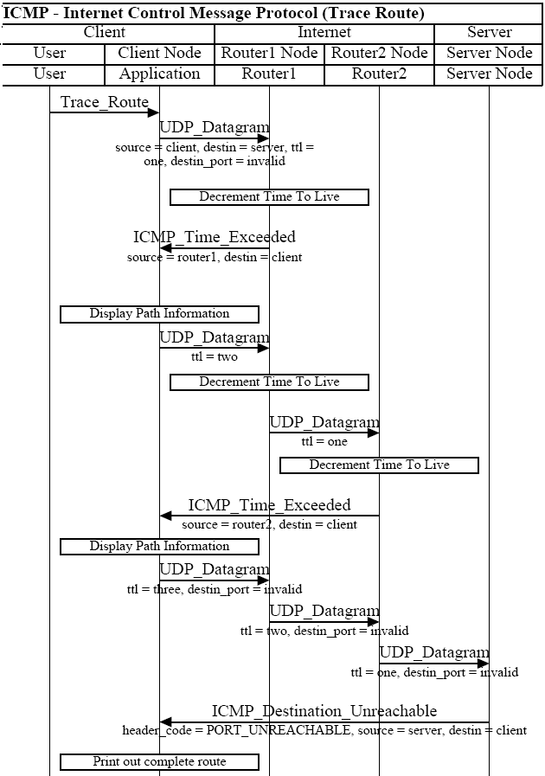
Event Flow Diagram

Slide 28
Problem issues

Slide 29
Problems
ICMP redirect messages can be used to trick routers and hosts acting as routers into using ``false'' routes; these false routes would aid in directing traffic to an attacker's system instead of a legitimate trusted system.
This could in turn lead to an attacker gaining access to systems that normally would not permit connections to the attacker's system or network.

Slide 30
Security Issues

Slide 31
Security Issues with ICMP
You can use ICMP as part of a reconnaissance process to learn about active network addresses and active processes
These reconnaissance processes often precede a network break-in
When hackers decide to infiltrate a network, they typically start with a list of the IP hosts on the network (unless the target is a single known system)

Slide 32
Security Issues for ICMP
An IP host probe process is one method of obtaining a list of the active hosts on a network
The next step in the hack is a port probe
Once hackers know the addresses of the active devices on the network, they can target their next reconnaissance process, the port probe, to those devices
Because many systems do not reply to pings sent to the broadcast address, typical IP host probes are sent unicast to each possible address

Slide 33
Security Issues
  very serious attacks with ICMP and against routing protocols
  Solutions exists but are not applied!
  strict traffic filtering against IP source address spoofing (RFC 2267)
  education of the network managers
  cryptography: key management protocols not generally adopted; standard Public Key Infrastructure (PKI) not yet agreed upon

