Slide 1
TCP/IP

Slide 2
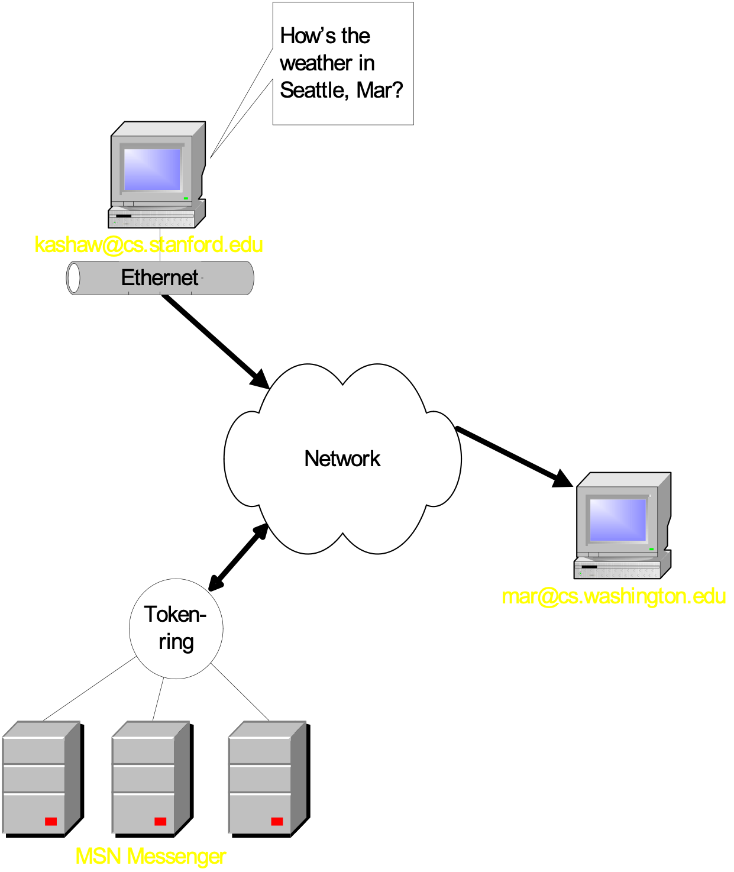
Communicating with Anyone

Slide 3
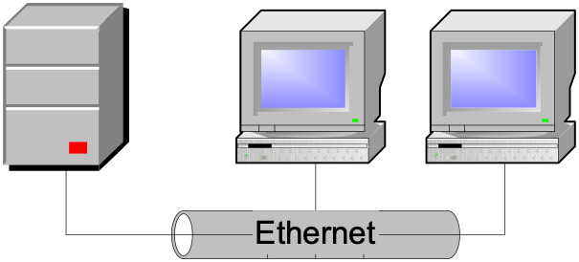
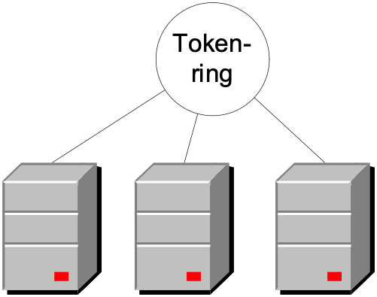
Local Area Network (LAN)
High speed, data network over small region
Few thousand meters
Network technologies:
Ethernet
FDDI(Fiber Distributed Data Interface)
Token ring
Data link layer
Packets routed based on physical address (MAC)
LAN 1
LAN 2

Slide 4
Local Area Network (LAN)
High speed, data network over small region
Few thousand meters
Network technologies:
Ethernet
FDDI
Token ring
Data link layer
Packets routed based on physical address (MAC)
LAN 1
?
LAN 2

Slide 5
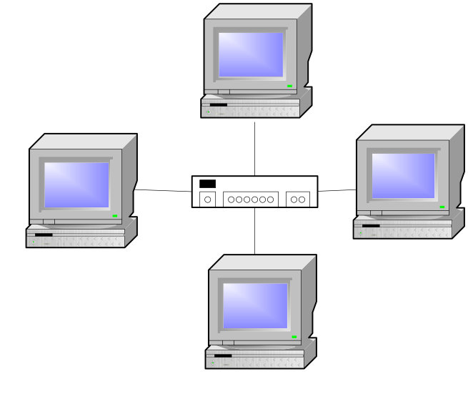
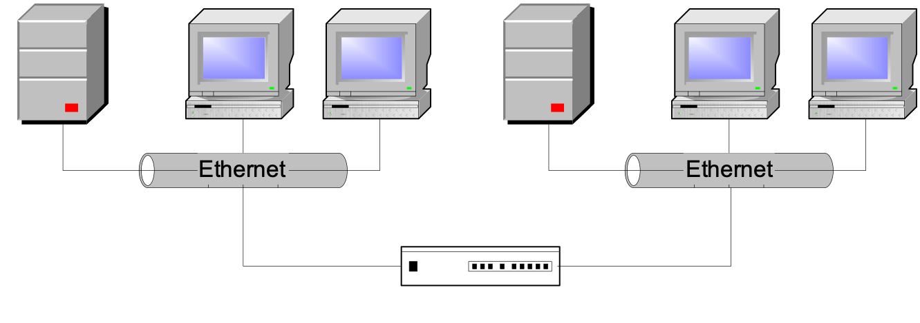
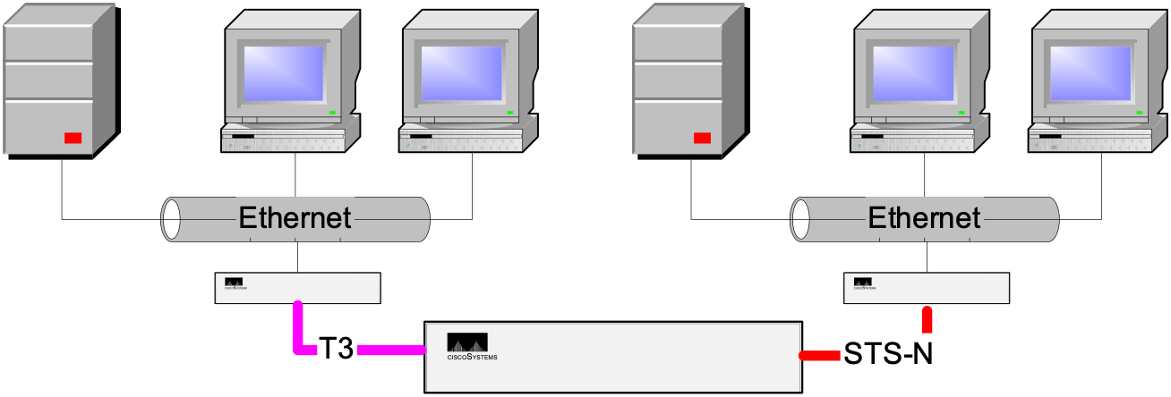
Connecting Below Internet Level
Hub
Center of star topology
In Ethernet, multiport repeater or concentrator
Bridge
Connects 2 networks of same technology – extended LAN
Filters/forwards/floods based on MAC
Link layer - frames
Switch
Connects 2+ networks – packet-switched network
Reduces collisions
Hub
Bridge
Switch

Slide 6
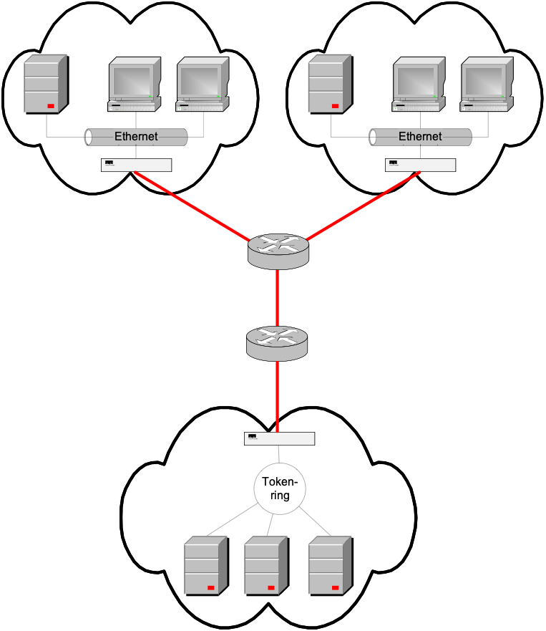
Connecting at the Internet Level
Router
Originally gateway
Forwards packets based on network layer info (IP)
Separate broadcast domains
In each domain, IP packet encapsulated in domain-specific packet
Router

Slide 7
OSI Reference Model for Network Design
Application (Layer 7)
Presentation
Session
Transport
Network
Data Link
Physical (Layer 1)
Notes:
The model divides the functions of a protocol into a series of layers. Each layer has the property that it only uses the functions of the layer below, and only exports functionality to the layer above. A system that implements protocol behaviour consisting of a series of these layers is known as a 'protocol stack' or 'stack'. Protocol stacks can be implemented either in hardware or software, or a mixture of both. Typically, only the lower layers are implemented in hardware, with the higher layers being implemented in software.
Useful, but don’t take it too seriously... because in actuality, we only use a 4 layer model

Slide 8
OSI vs. TCP/IP Stack
Layering: FTP Example
Application
FTP
Application
Presentation
ASCII/Binary
Session
TCP
Transport
Transport
Network
IP
Network
Link
Ethernet
Link
Physical
The 7-layer OSI Model
The 4-layer Internet model

Slide 9
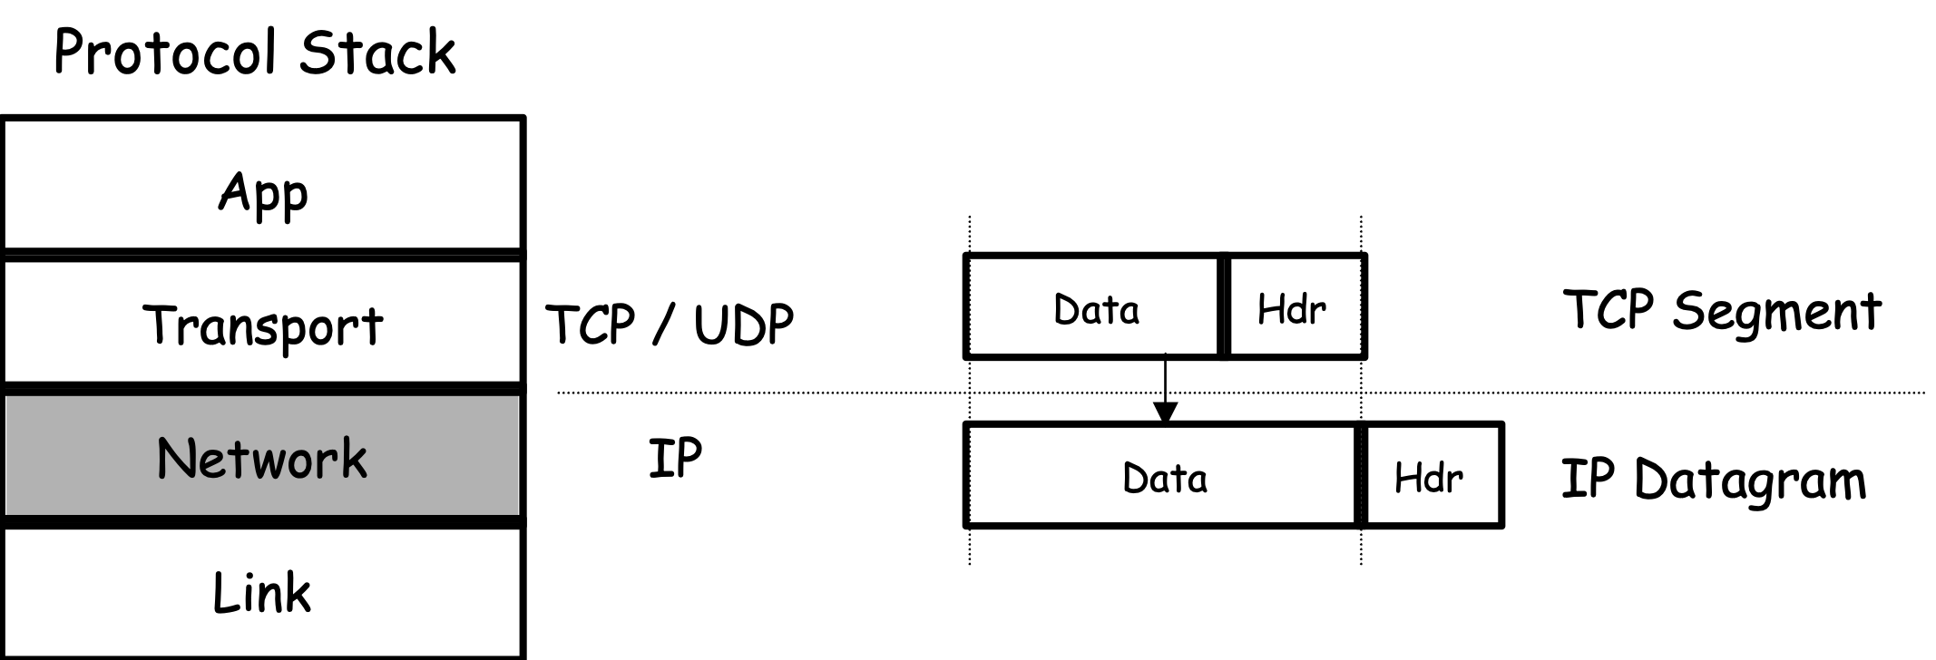
Internet Protocol

Slide 10
IP
Responsible for end to end transmission
Sends data in individual packets
Maximum size of packet is determined by the networks
Fragmented if too large
Unreliable
Packets might be lost, corrupted, duplicated, delivered out of order

Slide 11
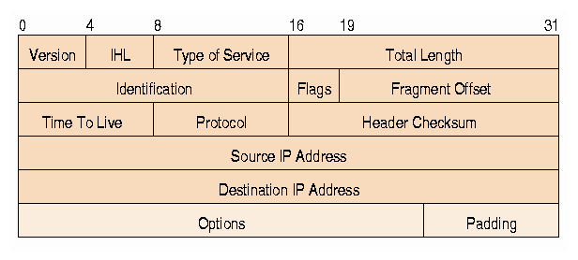
IP Datagram
Header
10101011101010101010010101010100101010100
11010010101010010101111111010000011101111
10100001011101010100110101011110100000101
00100000000010101000011010000111111010101
......... 1011011001010100011001001010110
Data

Slide 12
IPv4 Addressing Overview
Internet address’s architecture
Classes of IP addresses
Subnet mask

Slide 13
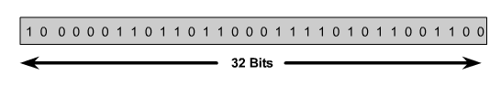

IP Address
An IP address is a 32-bit sequence of 1s and 0s.
To make the IP address easier to use, the address is usually written as four decimal numbers separated by periods.
This way of writing the address is called the dotted decimal format.

Slide 14





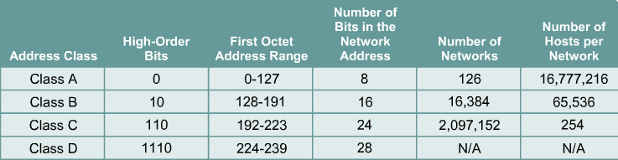
Every IP address has two parts:
Network
Host
IP addresses are divided into classes A,B and C to define large, medium, and small networks.
The Class D address class was created to enable multicasting.
IETF reserves Class E addresses for its own research.

Slide 15
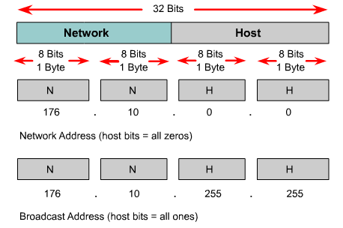
Reserved IP Addresses
Certain host addresses are reserved and cannot be assigned to devices on a network.
An IP address that has binary 0s in all host bit positions is reserved for the network address.
An IP address that has binary 1s in all host bit positions is reserved for the broadcast address.

Slide 16
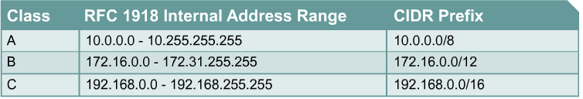
IP Private Addresses
No two machines that connect to a public network can have the same IP address because public IP addresses are global and standardized
Private IP addresses are a solution to the problem of the exhaustion of public IP addresses. Addresses that fall within these ranges are not routed on the Internet backbone:
Connecting a network using private addresses to the Internet requires the usage of NAT

Slide 17
Subnet Mask Address
Determines which part of an IP address is the network field and which part is the host field.
Follow these steps to determine the subnet mask:
1. Express the subnetwork IP address in binary form.
2. Replace the network and subnet portion of the address with all 1s.
3. Replace the host portion of the address with all 0s.
4. Convert the binary expression back to dotted-decimal notation.

Slide 18
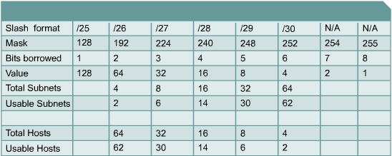
Establishing the Subnet Mask Address
To determine the number of bits to be used, the network designer needs to calculate how many hosts the largest subnetwork requires and the number of subnetworks needed.

Slide 19
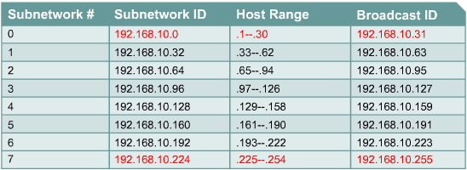
Subnetting example

Slide 20
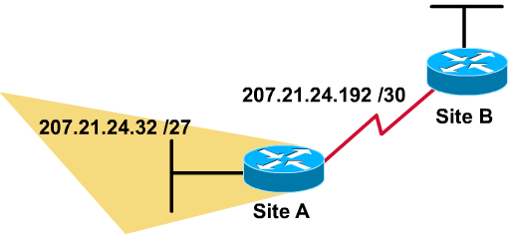
Variable-Length Subnet Mask - VLSM
VLSM allows you to use more than one subnet mask within the same network address space - subnetting a subnet
S | Subnet Add
0 | 207.21.24.0/27
1 | 207.21.24.32/27
2 | 207.21.24.64/27
3 | 207.21.24.96/27
4 | 207.21.24.128/27
5 | 207.21.24.160/27
6 | 207.21.24.192/27
7 | 207.21.24.224/27
Sub-sub | Sub-Subnet Add
Sub 0 | 207.21.24.192/30
Sub 1 | 207.21.24.196/30
……..
Sub 5 | 207.21.24.212/30
Sub 6 | 207.21.24.216/30
Sub 7 | 207.21.24.220/30

Slide 21
Supernetting
Using a bitmask to group multiple classful networks as a single network address.
Same process with route aggregation.
supernetting is most often applied when the aggregated networks are under common administrative control.
In class C network addresses, supernetting can be used so that the addresses appear as a single large network, or supernet

Slide 22
IP Routing
Routers are not omniscient
Next-Hop
Hop-by-Hop
Thus IP makes no guarantees
except to try it’s best (”Best Effort”)
packets may get there out of order, garbled, duplicated
may not get there at all!
Unreliable datagram service

Slide 23
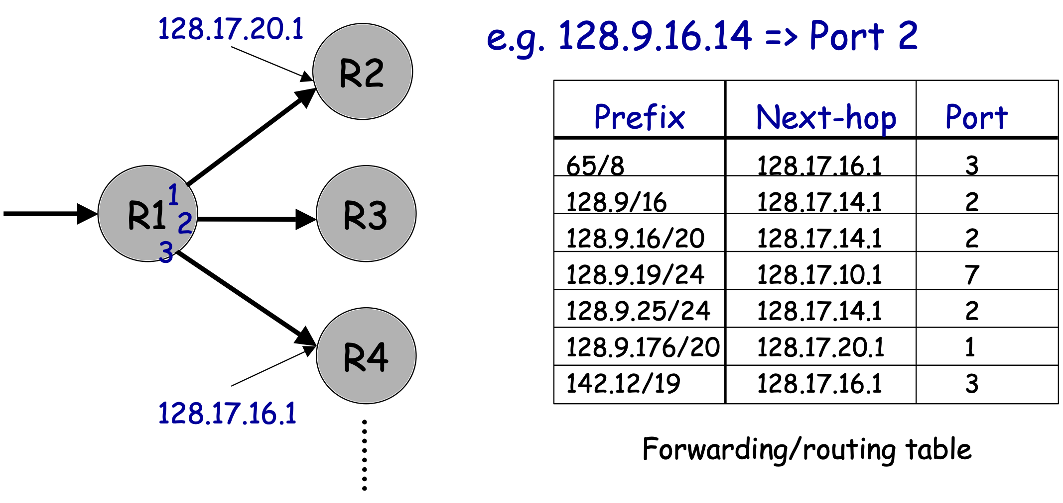
IP Routing Hop-by-Hop
How a Router Forwards Datagrams

Slide 24
Network Programs
host
ping
traceroute
nslookup

Slide 25
Summary of IP
Connectionless/Datagram
Unreliable/Best Effort

Slide 26
Transmission Control Protocol
Notes:
TCP is a protocol that is built on TOP of IP’s basic best-effort datagram service...
TCP interfaces between network layer below and application layer above. For example, FTP uses TCP which sits on IP wich might use the Ethernet...
TCP Packet (or Segment) is just the Data of the IP Packet... which in turn is the data of the Ethernet Packet!
It has these characteristics:

Slide 27
Characteristics
Connection-Oriented
Reliable
Byte-Stream
Flow Control (aka Congestion Control)
Notes:
First, it is connection-oriented, unlike IP.
IP, where each packet is conceptually separate... TCP packets are part of one connection
In Addition, the connection is two-way. Software can write bytes to the connection, and it shows up other side.
Second, it’s End-to-End Reliable
The destination will reassemble and error check packets
Lost, Corrupted packets will be resent by the sender
Third, TCP provides illusion of continuous, byte stream from sender to recipient.
Bytes written 1234 by the sender... will show up 1234 at the receiver
Finally, TCP has Flow Control which means that
Sender wills slow down to a packet rate that the receiver and network can cope with. The way it does this is with ACK packets. Helps to share network capacity between users...

Slide 28
Three Phases
Establish Connection
Data Transfer
Terminate Connection
Notes:
So first, how does it achieve the connection oriented characteristic?
Through these three phases... Every TCP connection goes through these phases:

Slide 29
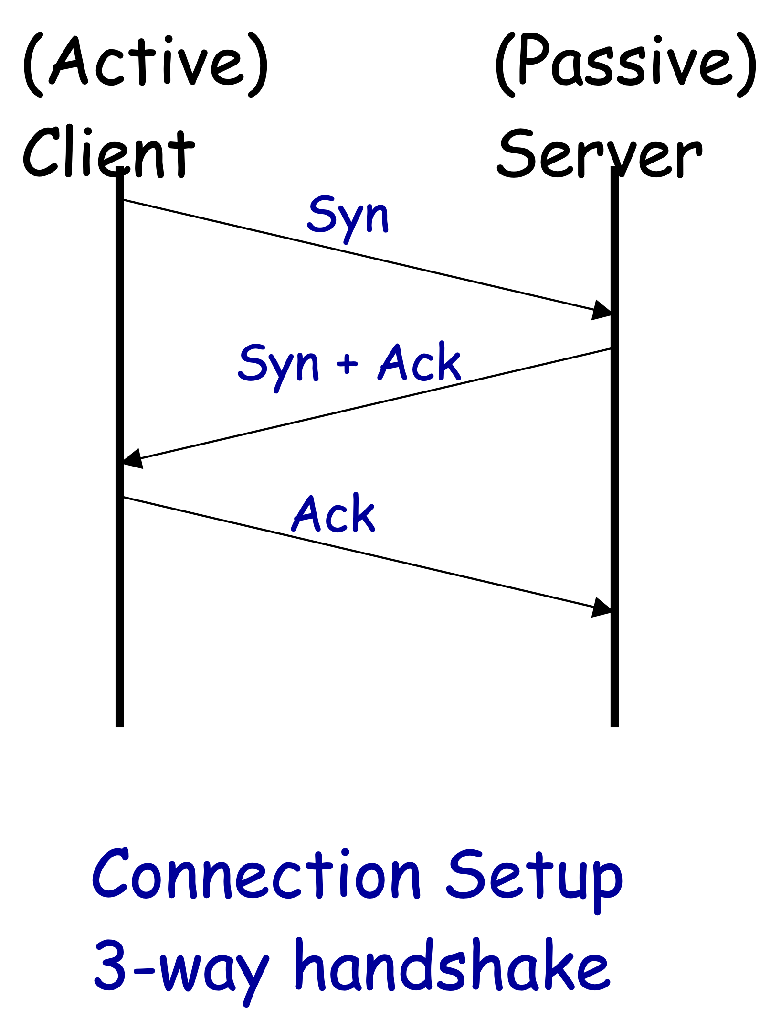
Establishing the Connection

Slide 30
Data Transfer
Host A
Byte 0
Byte 1
Byte 2
Byte 3
Byte 80
Host B
Byte 0
Byte 1
Byte 2
Byte 3
Byte 80
Notes:
Data Transfer has the Byte-Stream characteristic... meaning that bytes written in a certain order on Host A will show up in the same order once put together at host B... how does this work?

Slide 31
Data Transfer
Host A
Byte 0
Byte 1
Byte 2
Byte 3
Byte 80
TCP Data
TCP Data
Host B
Byte 0
Byte 1
Byte 2
Byte 3
Byte 80
Notes:
TCP Segments...
Concept that we’ll talk about later called Sequence Numbers....

Slide 32
Maintaining the “Connection”
IP Data
TCP Data
TCP
Hdr
IP
Hdr
0
15
31
Src
port
Dst port
Sequence #
Src
/dst port numbers
Ack
Sequence #
and IP addresses
HLEN
RSVD
Flags
Window Size
uniquely identify socket
4
6
URG
ACK
PSH
RST
SYN
FIN
Checksum
Urg
Pointer
(TCP Options)
TCP Data

Slide 33
Terminating the Connection
(Active)
(Passive)
Client
Server
Fin
(Data +)
Ack
Fin
Ack
Connection Close/Teardown
2 x 2-way handshake

Slide 34
Connection-Oriented
Reliable
Byte-Stream
Flow Control (aka Congestion Control)

Slide 35
Reliability & Flow Control
Sequence numbers & Acknowledgements (ACKs)
Receiver detects Corrupt, Lost, Duplicated, Out-of-order
Tell sender which packets it has received correctly
Sender can resend
In Flight Window (Window Size)
Sender only has N unacknowledged packets “in
Notes:
Provide Reliability Through Sequence Numbers
Provides Byte-Stream Through Sequence Numbers.... 3 2 4 1, reorganize to 1 2 3 4, and say ACK up until 4...
Provide Flow Control Through Acknowledgement Segments & In Flight Window
If Sender notices slow network/host (lots of packets in flight, few acknowledged)... it will slow down....

Slide 36
Sending a Message
Leland.Stanford.edu
Arachne
.
Berkeley
.edu
Application Layer
Ron
Leslie
Transport Layer
O.S.
Data
Header
Data
Header
O.S.
Network Layer
D
H
D
H
D
H
D
H
D
H
D
H
Link Layer

Slide 37
Connection-Oriented
Reliable
Byte-Stream
Flow Control (aka Congestion Control)
Notes:
In summary, TCP adds all these on top of IP... and hides it from the application via the TCP/IP Protocol Stack....
The key is that each layer is a layer of abstraction. The Application layer doesn’t know how the Transport Layer is implemented.... it only sees that the TCP Transport layer provides these 4 services... The Transport Layer in Turn doesn’t know how the Network layer is implemented... it just knows it provides routing and addressing. And so on and so forth...

Slide 38
UDP
Notes:
Basically allows access to IP functionality without TCP overhead...

Slide 39
User Datagram Protocol (UDP)
Like TCP, in the Transport Layer
Characteristics
Connectionless, Datagram, Unreliable
Adds only application multiplexing/demultiplexing and checksumming to IP
Good for Streaming Media, Real-time Multiplayer Networked Games, VoIP
Notes:
No connection establishment.... packets can show up at any time.... the App has to handle whether you are prepared for the incoming data or not...
Datagram.... means UDP packets are self contained no sequencing like in TCP
Unreliable like IP, no ACKs... no flow control, no automatic retransmission...
Adds checksumming the headers.... to prevent errors... Adds application multiplexing, to send the UDP packet to the correct service. Both TCP and UDP perform this demultiplexing, and they use port numbers to do it....

Slide 40
Summary
IP is the basis of Internetworking
TCP builds on top of IP adds reliable, congestion-controlled, connection-oriented byte-stream.
UDP builds on top of IP allows access to IP functionality

