Slide 1
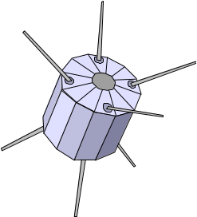
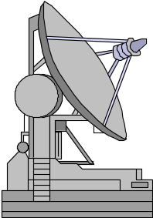
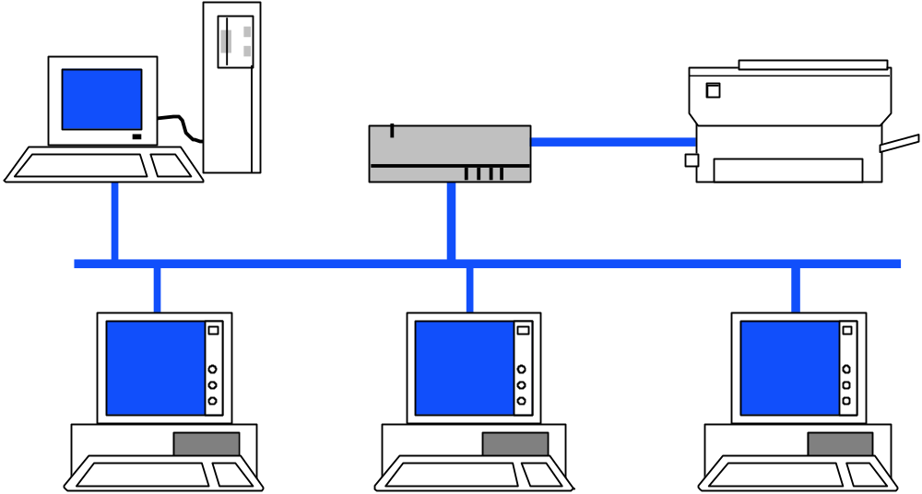
Networking

Slide 2
Network
“ ... communication system for connecting end-systems”
End-systems a.k.a. “hosts”
PCs, workstations
dedicated computers
network components

Slide 3
Multiaccess vs. Point-to-point
Multiaccess means shared medium.
  many end-systems share the same physical communication resources (wire, frequency, ...)
  There must be some arbitration mechanism.
Point-to-point
  only 2 systems involved
  no doubt about where data came from !

Slide 4
Multiaccess
Point-to-point

Slide 5
LAN - Local Area Network
connects computers that are physically close together ( < 1 mile).
  high speed
  multi-access
Technologies:
  Ethernet 10 Mbps, 100Mbps
  Token Ring 16 Mbps
  FDDI 100 Mbps

Slide 6
WAN - Wide Area Network
connects computers that are physically far apart. “long-haul network”.
  typically slower than a LAN.
  typically less reliable than a LAN.
  point-to-point
Technologies:
  telephone lines
  Satellite communications

Slide 7
MAN - Metropolitan Area Network
Larger than a LAN and smaller than a WAN
  - example: campus-wide network
  - multi-access network
Technologies:
  coaxial cable
  microwave

Slide 8

Internetwork
Connection of 2 or more distinct (possibly dissimilar) networks.
Requires some kind of network device to facilitate the connection.
Net A
Net B

Slide 9
OSI Reference Model
Layered model:
  7. Application
  6. Presentation
  5. Session
  4. Transport
  3. Network
  2. Data Link
  1. Physical

Slide 10
The Physical Layer
Responsibility:
  transmission of raw bits over a communication channel.
Issues:
  mechanical and electrical interfaces
  time per bit
  distances

Slide 11
The Data Link Layer -
Data Link Control
Responsibility:
  provide an error-free communication link
Issues:
  framing (dividing data into chunks)
    header & trailer bits
  addressing
10110110101
01100010011
10110000001

Slide 12
The Data Link Layer -
The MAC sublayer
Medium Access Control - needed by mutiaccess communications.
MAC provides DLC with “virtual wires” on multiaccess networks.

Slide 13
The Network Layer
Responsibilities:
  path selection between end-systems (routing).
  subnet flow control.
  translation between different network types.
Issues:
  packet headers
  virtual circuits

Slide 14
The Transport Layer
Responsibilities:
  provides virtual end-to-end links between peer processes.
  fragmentation & reassembly
  end-to-end flow control
Issues:
  headers
  error detection
  reliable communication

Slide 15
The Session Layer
Responsibilities:
  establishes, manages, and terminates sessions between applications.
  service location lookup
Many protocol suites do not include a session layer.

Slide 16
The Presentation Layer
Responsibilities:
  data encryption
  data compression
  data conversion
Many protocol suites do not include a Presentation Layer.

Slide 17
The Application Layer
Responsibities:
  anything not provided by any of the other layers
Issues:
  application level protocols
  appropriate selection of “type of service”

Slide 18
Layering & Headers
Each layer needs to add some control information to the data in order to do it’s job.
This information is typically prepended to the data before being given to lower layers.
Once the lower layers deliver the the data and control information - the peer layer uses the control information.

Slide 19
Headers
Process
DATA
Process
Transport
H
DATA
Transport
Network
H
H
DATA
Network
Data Link
H
H
H
DATA
Data Link

Slide 20
What are the headers?
Physical: no header - just a bunch of bits.
Data Link:
  address of the receiving endpoints
  address of the sending endpoint
  length of the data
  checksum.

Slide 21
Network layer header
protocol suite version
type of service
length of the data
packet identifier
fragment number
time to live
protocol
header checksum
source network address
destination network address

Slide 22
Connecting Networks
Repeater: physical layer
Bridge: data link layer
Router: network layer
Gateway: network layer and above.

Slide 23
Repeater
Copies bits from one network to another
Does not look at any bits
Allows the extension of a network beyond physical length limitations
REPEATER

Slide 24
Bridge
Copies frames from one network to another
Can operate selectively - does not copy all frames (must look at data-link headers).
Extends the network beyond physical length limitations.
BRIDGE

Slide 25
Router
Copies packets from one network to another.
Makes decisions about what route a packet should take (looks at network headers).
ROUTER

Slide 26
Gateway
Operates as a router
Data conversions above the network layer.
Conversions:
  encapsulation - use an intermediate network
  translation - connect different application protocols
  encrpyption - could be done by a gateway

Slide 27
Encapsulation Example
Gateway
Gateway
Provides service connectivity even though intermediate network does not support protocols.

Slide 28
Translation
Gateway
Translate from red protocol to brown protocol

Slide 29
Encryption gateway
Secure Network
Encryption/Decryption
Gateways
Secure Network
?
GW
?
GW
?
Insecure Network

Slide 30
Hardware vs. Software
Repeaters are typically hardware devices.
Bridges can be implemented in hardware or software.
Routers & Gateways are typically implemented in software so that they can be extended to handle new protocols.
Many workstations can operate as routers or gateways.

Slide 31
Byte Ordering
Different computer architectures use different byte ordering to represent multibyte values.
16 bit integer:
Low Byte
Address A
High Byte
High Byte
Address A+1
Low Byte

Slide 32
Byte Ordering
Little-Endian
IBM 80x86
DEC VAX
DEC PDP-11
Big-Endian
IBM 370
Motorola 68000
Sun
Low Byte
High Byte
High Byte
Low Byte
Addr A
Addr A+1
Addr A
Addr A+1

Slide 33
Network Byte Order
Conversion of application-level data is left up to the presentation layer.
But hold on !!! How do lower level layers communicate if they all represent values differently ? (data length fields in headers)
A fixed byte order is used (called network byte order) for all control data.

Slide 34
Multiplexing
“.. to combine many into one”.
Many processes sharing a single network interface.
A single process could use multiple protocols.
More on this when we look at TCP/IP.

Slide 35
Modes of Service
connection-oriented vs. connectionless
sequencing
error-control
flow-control
byte stream vs. message based
full-duplex vs. half-duplex.

Slide 36
Connection-Oriented vs. Connectionless Service
A connection-oriented service includes the establishment of a logical connection between 2 processes.
  establish logical connection
  transfer data
  terminate connection.
Connectionless services involve sending of independent messages.

Slide 37
Sequencing
Sequencing provides support for an order to communications.
A service that includes sequencing requires that messages (or bytes) are received in the same order they are sent.

Slide 38
Error Control
Some services require error detection (it is important to know when a transmission error has occured).
Checksums provide a simple error detection mechanism.
Error control sometimes involves notification and retransmission.

Slide 39
Flow Control
Flow control prevents the sending process from overwhelming the receiving process.
Flow control can be handled a variety of ways - this is one of the major research issues in the development of the next generation of networks (ATM).

Slide 40
Byte Stream vs. Message
Byte stream implies an ordered sequence of bytes with no message boundaries.
Message oriented services provide communication service to chunks of data called datagrams.

Slide 41
Full- vs. Half-Duplex
Full-Duplex services support the transfer of data in both directions.
Half-Duplex services support the transfer of data in a single direction.

Slide 42
End-to-End vs. Hop-toHop
Many service modes/features such as flow control and error control can be done either:
  between endpoints of the communication.
  -or-
  between every 2 nodes on the path between the endpoints.

Slide 43
End-to-End
Process A
Process B

Slide 44
Hop-by-Hop
Process A
Process B

Slide 45
Buffering
Bufferring can provide more efficient communications.
Buffering is most useful for byte stream services.
Process A
Send
Buffer
Recv.
Buffer
Process B

Slide 46
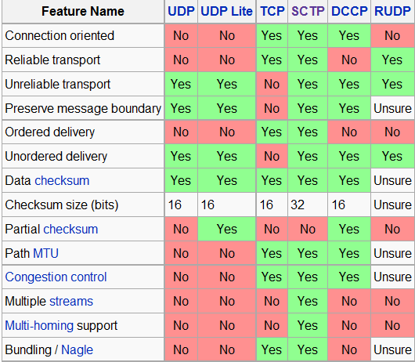
TCP/UDP/SCTP

Slide 47
Addresses
Each communication endpoint must have an address.
Consider 2 processes communicating over an internet:
  the network must be specified
  the host must be specified
  the process must be specified.

Slide 48
Addresses
Physical Layer: no address necessary
Data Link Layer - address must be able to select any host on the network.
Network Layer - address must be able to provide information to enable routing.
Transport Layer - address must identify the destination process.

Slide 49
Broadcasts
Many networks support the notion of sending a message from one host to all other hosts on the network.
A special address called the “broadcast address” is often used.
Some popular network services are based on broadcasting (YP/NIS, rup, rusers )

