Slide 1
Aadhar Masking 2.0
Lipi Singhal , Monika Singh

Slide 2
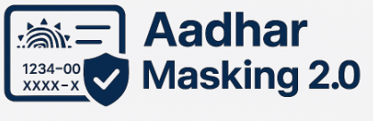
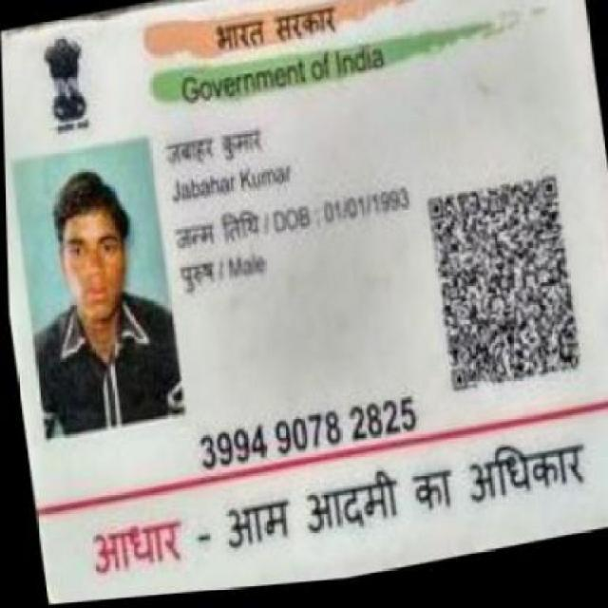
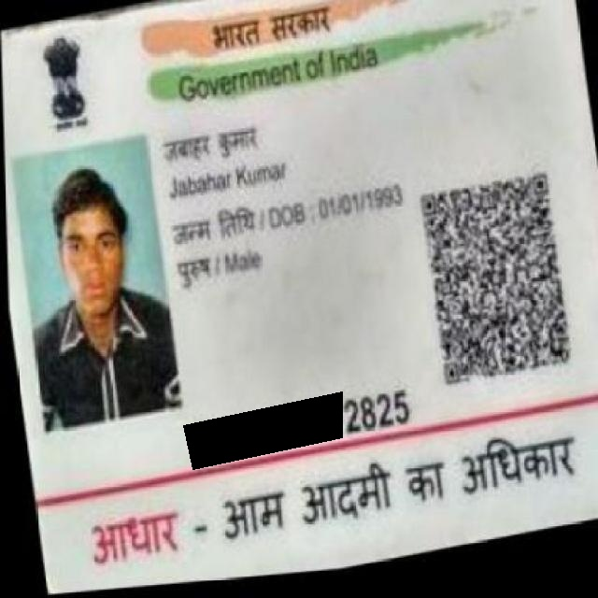

Business
Problem
The company receives on average 1 lakh (approx) documents every day which may have Aadhar numbers in multiple places.
UIDAI has mandated the masking of first 8 digits of Aadhar number.
The previous Aadhaar masking solution lacked robustness against rotated layouts, varied formats, and noisy inputs.
Solution overview
We upgraded the Aadhaar masking system to use FastAPI
with asynchronous methods, YOLOv11-OBB for more accurate detection, and Python 3.13 for better
performance.
This allows efficient, concurrent processing of multiple files at once, even with complex layouts and rotated text.
Approach
The solution uses a computer vision ML model (YOLOv11-obb) to detect Aadhar
numbers in documents for masking. The approach is as follows:
1.Read raw files from directory
2.Batch 20 files together and preprocess them (convert into jpeg)
3.Send the preprocessed batch to the docker container for masking service
4.After masking, convert the masked files back to the original file format.
5.Save masked files, low detction files, and error files in their respective separate
directories.
Output details
Impact
Improved efficiency by 2x.
Masks even at odd angles or harsh lighting.
18% more TIFF, PDF, JPEG likes getting handled.
Works for latest and more diverse Aadhar formats.
Reduced manual masking by 43%.
Yolo INPUT
Final Masked Output

Slide 3
Project Flow
🔹 Project Flow
Accept input files from /data/{current_date}/
Create batches of 20 files for parallel processing
Convert all files to JPEG format for uniform detection
Run YOLOv11-OBB to detect Aadhaar numbers (even at angles)
Apply masking to first 8 digits, keeping last 4 visible
Use log entries to restore masked files to their original format (PDF/TIFF/PNG)
Categorize and move files into: Masked , Manualqc , Error
Save logs for traceability, rollback, and audit support
Challenges
TIFF to JPEG conversion caused quality loss → fixed using Pillow optimization
Low-contrast and blurry text caused detection issues → solved with auto-contrast pre-processing
Rotated Aadhaar numbers → handled using YOLOv11-OBB (Oriented Bounding Box)
Multi-page PDFs were heavy → processed page-by-page and recombined
Input Folder:
data/{Current Data}/ Folder with raw files, PDF, TIFF Files, PNG Files .
Batching (20 Files)
Files groupes into batches of 20 for concurrent processing.
Convert into JPEG
Standardized JPEG conversion using Pillow/OpenCV.
YOLOv11-OBB Detection
Detects Aadhaar numbers, even at angles or rotated positions.
Future Scope
Auto-detect Aadhaar across multiple pages in bulk PDF files using a recursive detection mechanism
Output Classification
Files categorized into: masked , manual_qc , error .
Restore to Original Format
Uses log entries to convert JPEGs back to original format (PDF/TIFF) .
Mask Aadhaar Numbers
First 8 digits masked; last 4 digits preserved for UIDAI compliance.

