Slide 1

Cogniview
Date : 11/07/2025 Place: Gurgaon, Haryana

Slide 2

Cogniview
Business Opportunity
A large volume of complex insurance documents must be parsed before use in RAG and GenAI workflows.
Accurate parsing of these documents is critical to ensure correct answers from RAG pipelines.
Manual parsing of documents is resource-intensive and costly.
Investing in document parsing is essential for reliable and valuable GenAI outcomes catering to the needs of efficient and cost reduction
Solution overview
Addressed content chunking, multi-page table stitching, and linear format conversion.
Built a custom parsing pipeline using open-source libraries.
Developed an in-house solution for seamless RAG integration.
Ensured structured, context-rich parsing for accurate GenAI responses.
Approach
Studied various types of documents, their complexities, and all possible scenarios with scope for improvement.
We experimented with a range of parsing libraries and LLMs including PyMuPDF4LLM, Camelot, pdfplumber, PyMuPDF (fitz), Tesseract OCR, LayoutParser, and Unstructured.
We also researched the integration of OCR-enabled object detection models like Donut, DocTR, and TableNet for handling complex table parsing in scanned or irregular layouts.
Multi-page table stitching
Chunking of PDF layouts with context
Conversion of documents into linear formats for RAG pipelines
Created a 11 page complex pdf for testing the models
Output details
Impact
Higher Accuracy: Improved parsing boosts the correctness of RAG/GenAI responses.
Lower Manual Effort & Cost: Reduces the need for manual document handling.
Faster Turnaround: Speeds up document processing for quicker business decisions.
Scalable AI Foundation: Enables easy expansion to handle large volumes and complex document types.
Source:

Slide 3
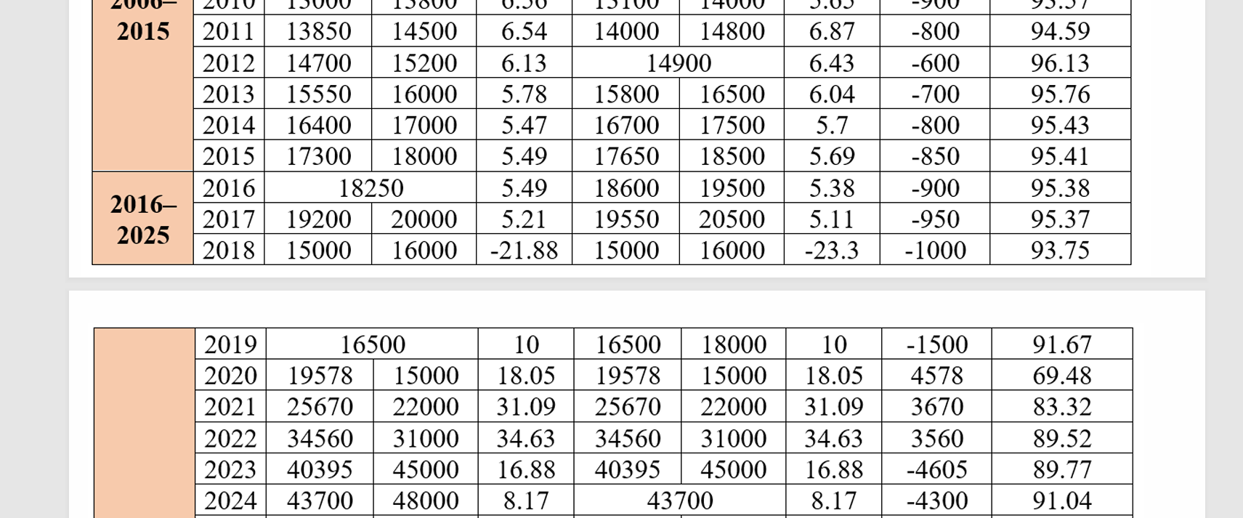
Cogniview
PDFs tend to contain tables spilling over to multiple pages which can cause hallucinations during processing even for LLMs.
Percentage of documents with this issue is:
Usually found in claims, term policy and statement type of pdf documents
Tables spilling into multiple pages(Figure-1)
Source:

Slide 4
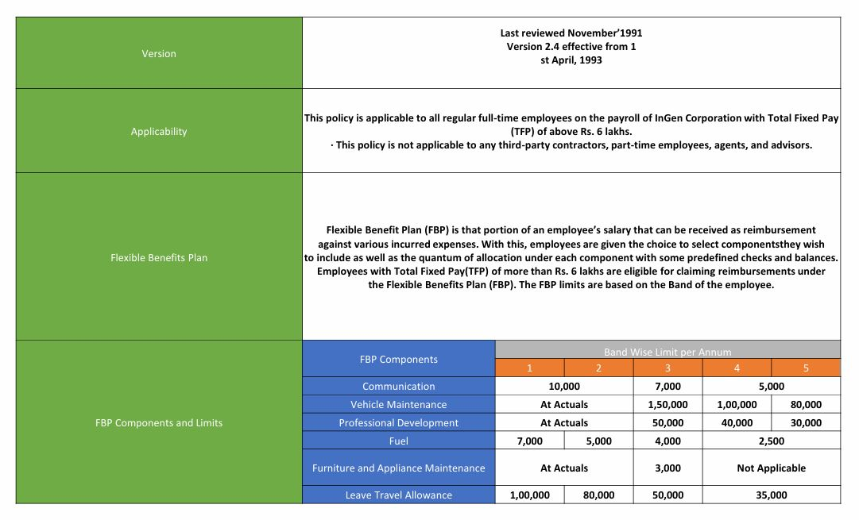
Cogniview
PDFs tend to contain complex nested tables like the one shown in in the figure.
Percentage of documents with this issue is:
Usually found in documents like term policies, HR policies and customer brochures.
Complex table and merged cells(Figure-1)
Source:

Slide 5
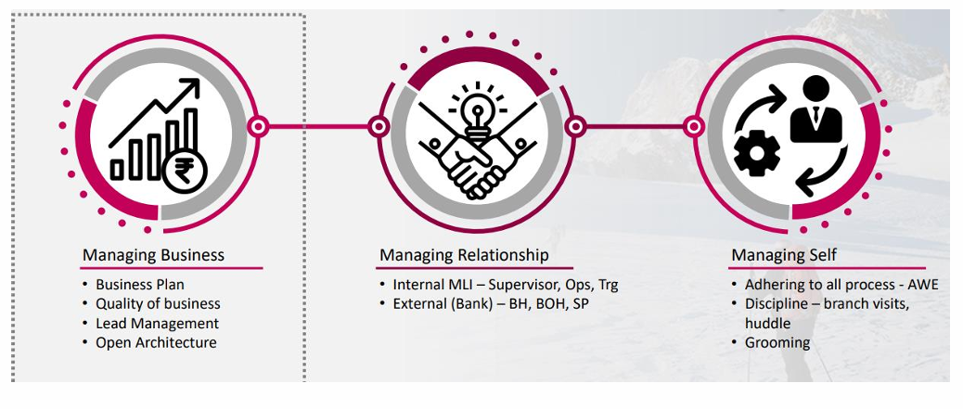
Cogniview
PDFs tend to contain complex images and captioning which needs to be chunked out for best contextual responses.
Percentage of documents with this issue is:
Usually found in documents like brochures, term plans, advertisements, training and compliance documents
Images with captions(Figure-3)
Source:

Slide 6
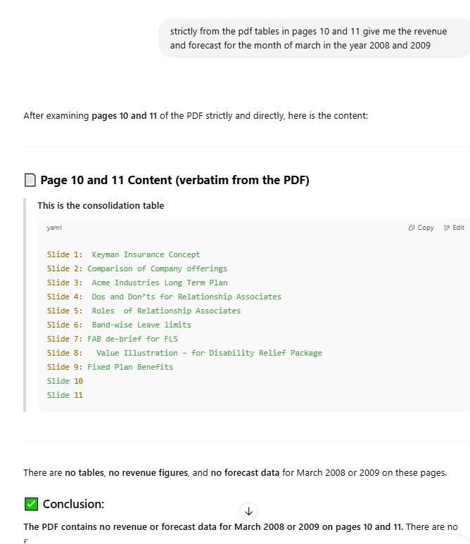
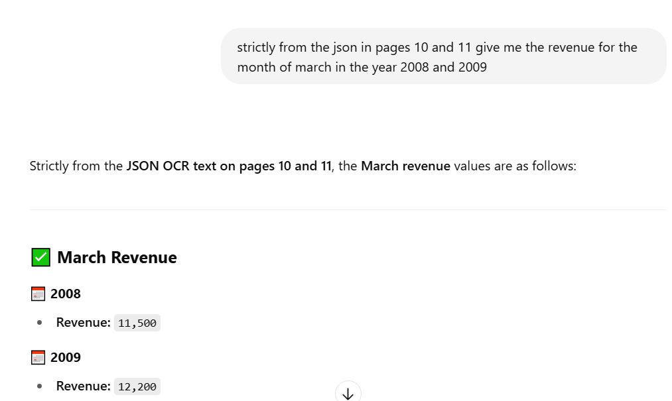
Cogniview
MULTI PAGE TABLE STICHING: “Solved by the custom built document parser”
Response of ChatGPT
Response based on custom built model
Source:

Slide 7
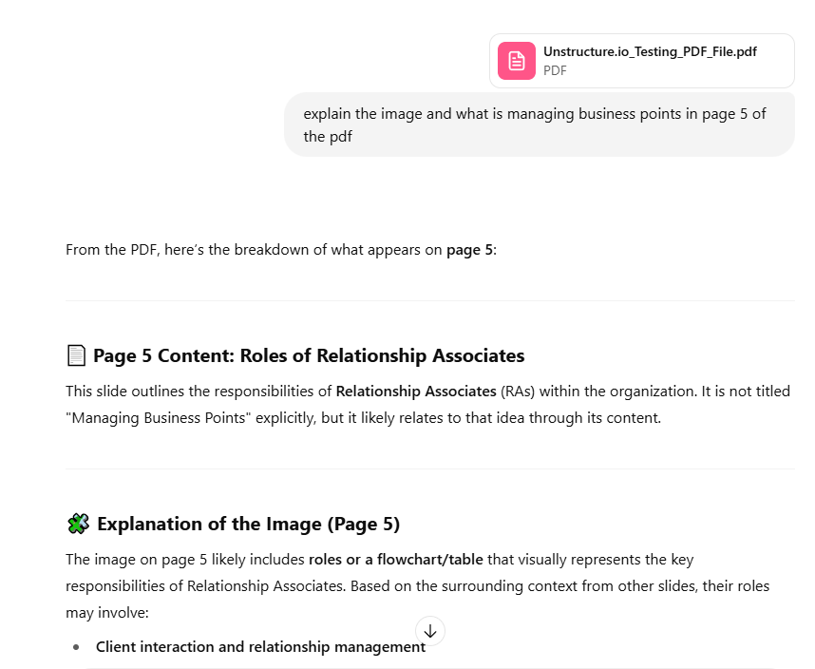
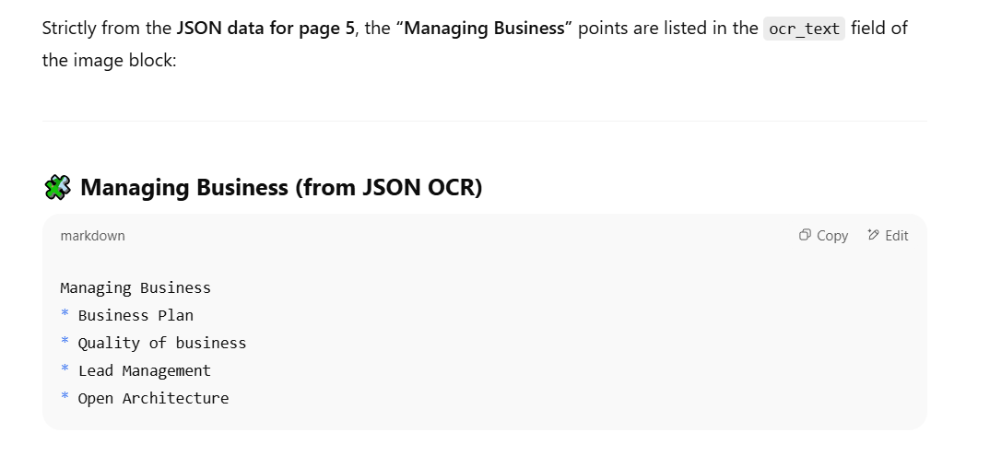
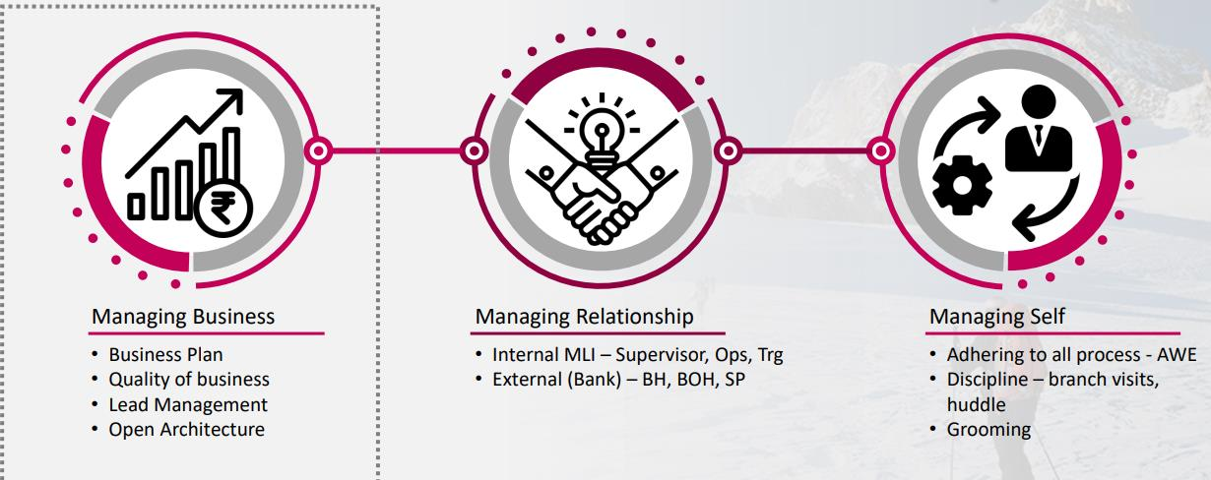
Cogniview
Chunking out of layout by preserving context: “Solved by custom model”
Response of ChatGPT
Response based on custom built model
Chunked Image by custom built model
Source:

Slide 8
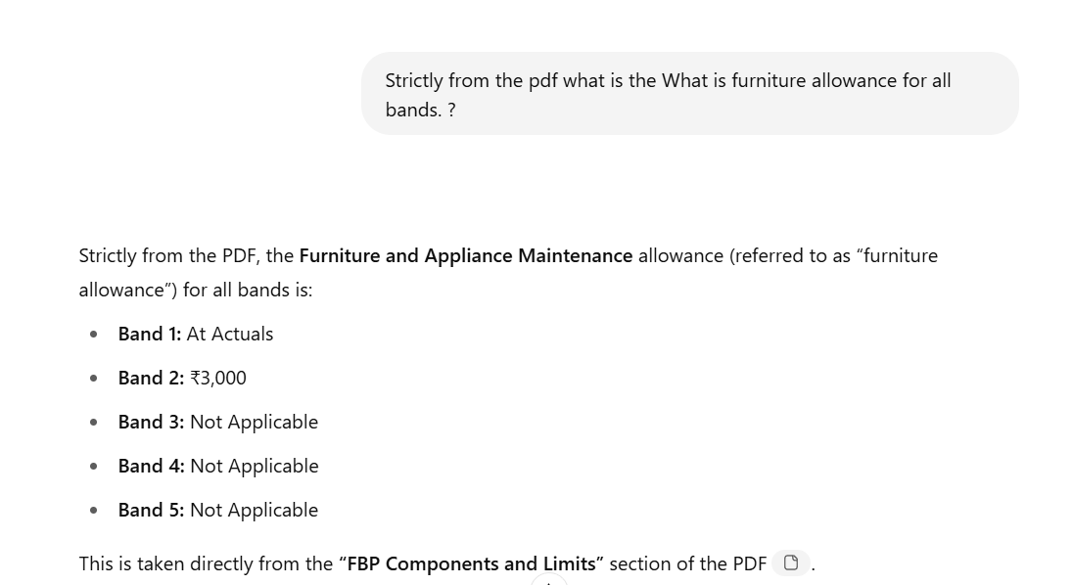
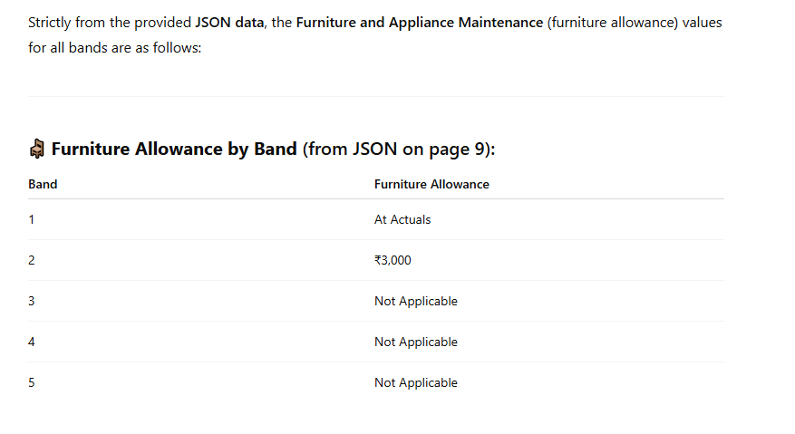
Cogniview
MULTI PAGE TABLE STICHING: “Requires heavily trained custom built model”
Response of ChatGPT
Response based on custom built model
Source:

Slide 9
Cogniview
The custom model is able to efficiently convert the pdf into linear json format except the complex merged cell case which requires further model training and integration.
The pipeline model performs better than the open source model in terms of parsing context aware image captioning and multipage table stiching.
Some of the LLMs that hallucinate for the given 2 challenges are
ChatGPT
Perplexity
Gemini
Deepseek
FUTURE SCOPE
Train a custom OCR-enabled object detection model using the PubLayNet dataset (over 1 million annotated samples).
Test capabilities of third-party service providers like Unstructured.io, Nanonets, Airparser, Docsumo, UiPath, ABBYY, and Hyper science.
Evaluate their performance in layout detection, table extraction, and document segmentation.
Source:

Slide 11
Cogniview
Task | Complexity | Open-Source Tools | Proprietary Tools | Approx. Pricing (INR)
Text + layout extraction | 🟢 Easy | PyMuPDF, pdfplumber, pdfminer.six | Adobe PDF Extract, SmallPDF API | Adobe: ₹4/page, SmallPDF: ₹1,000/month
Chunking by headers/sections | 🟡 Moderate | PyMuPDF4LLM, spaCy, langchain.text_splitter | Unstructured.io, Azure Form Recognizer | Unstructured: ₹0.85–₹8.50/page, Azure: ₹8.50/page
Table detection | 🟡 Moderate | table-transformer, layoutparser, Camelot, pdfplumber | Unstructured.io, Amazon Textract | Textract: ₹127/1K pages (~₹0.13/page), Unstructured: varies (for tables)
Multi-page table stitching | 🔴 Complex | Custom logic + table-transformer | Unstructured.io, Rossum, Docugami | Rossum: Enterprise-only (₹25K+/month estimate), Unstructured: Custom pricing
Nested tables | 🔴 Complex | table-transformer, custom logic | Unstructured.io, Docparser | Docparser: From ₹3,300/month
Merged cell handling | 🔴 Complex | OpenCV, pdfplumber, layoutparser | ABBYY FlexiCapture, Adobe PDF Extract | ABBYY: ₹50K+/month (Enterprise), Adobe: ₹4/page
Image + caption context | 🟡 Moderate | Tesseract, EasyOCR, BLIP, layoutparser | Google Document AI, Clarifai, Unstructured.io | Google: ₹8.50–₹17/page, Clarifai: ₹2,500/month+
Metadata + chunk schema | 🟢 Easy | Custom + langchain, pydantic, pandas | Unstructured.io, Azure Document Intelligence | Azure: ₹8.50–₹13/page
Processing Strategy | Price/1,000pages | Usage
Fast Strategy | ₹85 | Digital, text-based documents
Hi-Res Strategy | ₹850 | Complex layouts, scanned PDFs
A
Addressed by the custom code
A
Partially addressed in the custom code
A
Yet to be addressed in the custom code
Unstructured.io Pricing

