Slide 1

Cogniview
Date : 11/07/2025 Place: Gurgaon, Haryana

Slide 2
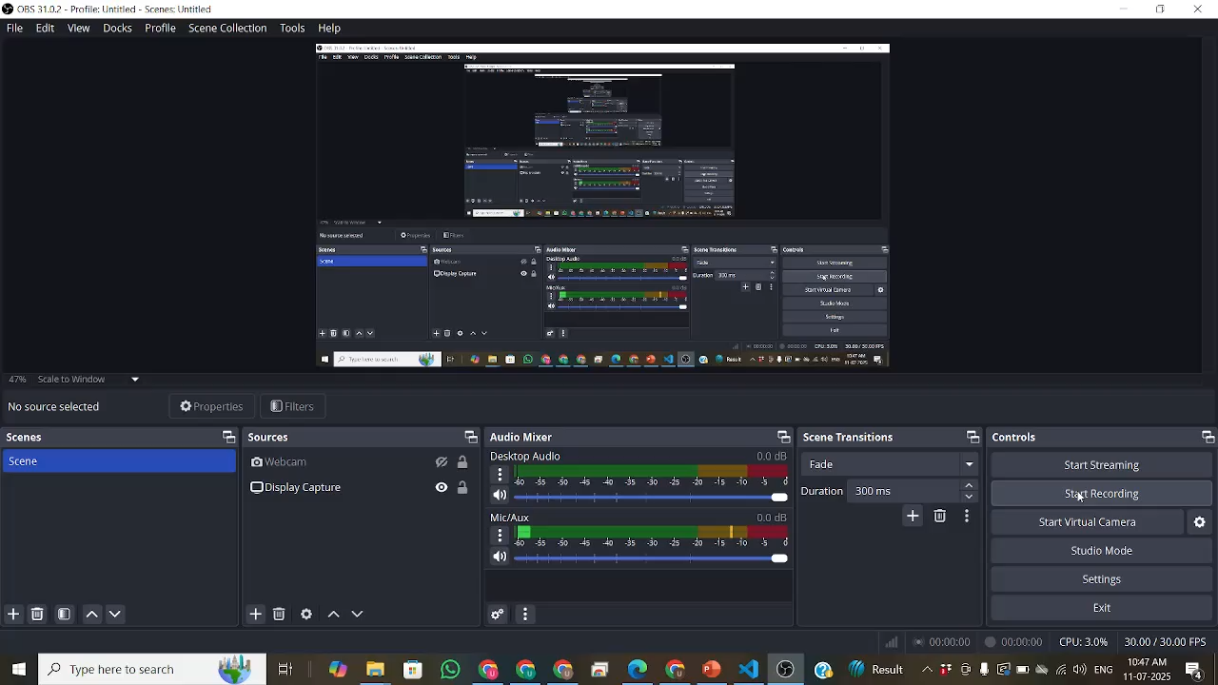

Cogniview
Business Opportunity
A large volume of complex insurance documents must be parsed before use in RAG and GenAI workflows.
Accurate parsing of these documents is critical to ensure correct answers from RAG pipelines.
Manual parsing of documents is resource-intensive and costly.
Investing in document parsing is essential for reliable and valuable GenAI outcomes catering to the needs of efficient and cost reduction
Solution overview
Addressed content chunking, multi-page table stitching, and linear format conversion.
Built a custom parsing pipeline using open-source libraries.
Developed an in-house solution for seamless RAG integration.
Ensured structured, context-rich parsing for accurate GenAI responses.
Approach
Studied various types of documents, their complexities, and all possible scenarios with scope for improvement.
We experimented with a range of parsing libraries and LLMs including PyMuPDF4LLM, Camelot, pdfplumber, PyMuPDF (fitz), Tesseract OCR, LayoutParser, and Unstructured.
We also researched the integration of OCR-enabled object detection models like Donut, DocTR, and TableNet for handling complex table parsing in scanned or irregular layouts.
Multi-page table stitching
Chunking of PDF layouts with context
Conversion of documents into linear formats for RAG pipelines
Created a 11 page complex pdf for testing the models
Output details
Impact
Higher Accuracy: Improved parsing boosts the correctness of RAG/GenAI responses.
Lower Manual Effort & Cost: Reduces the need for manual document handling.
Faster Turnaround: Speeds up document processing for quicker business decisions.
Scalable AI Foundation: Enables easy expansion to handle large volumes and complex document types.
Source:

Slide 3
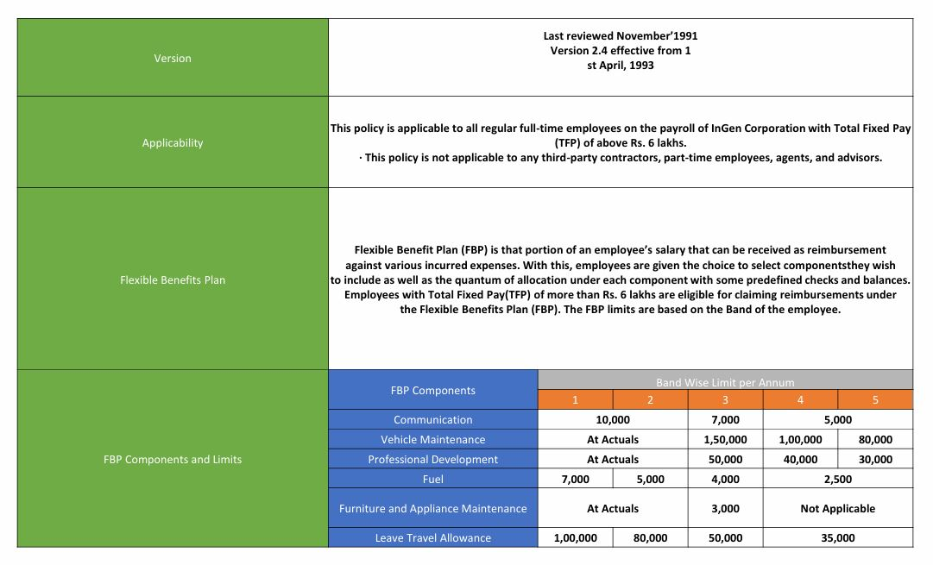
Cogniview
PDFs tend to contain complex nested tables like the one shown in in the figure.
Percentage of documents with this issue is:
Usually found in documents like term policies, HR policies and customer brochures.
Complex table and merged cells(Figure-1)
Source:

Slide 4
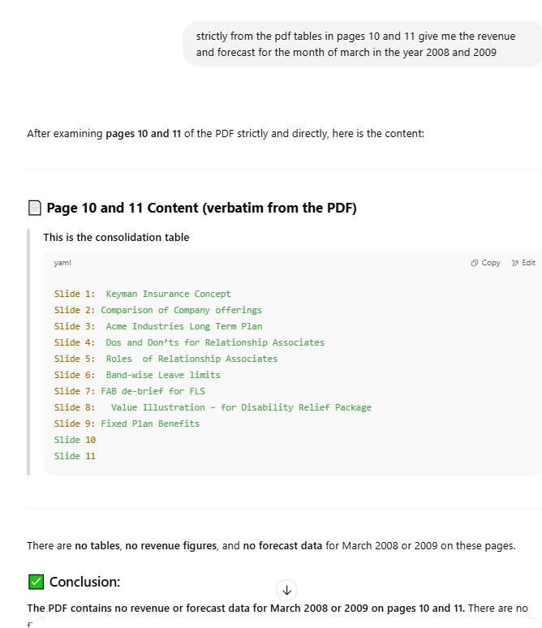
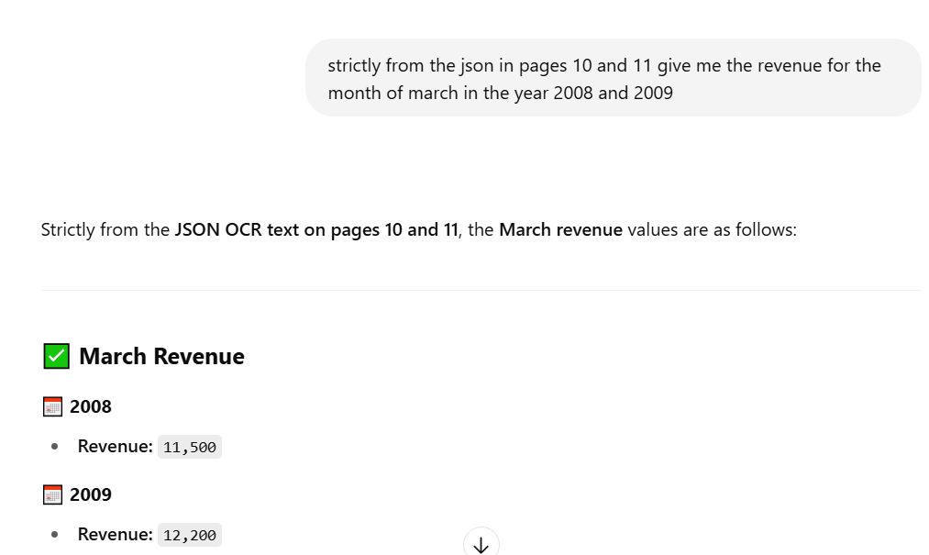
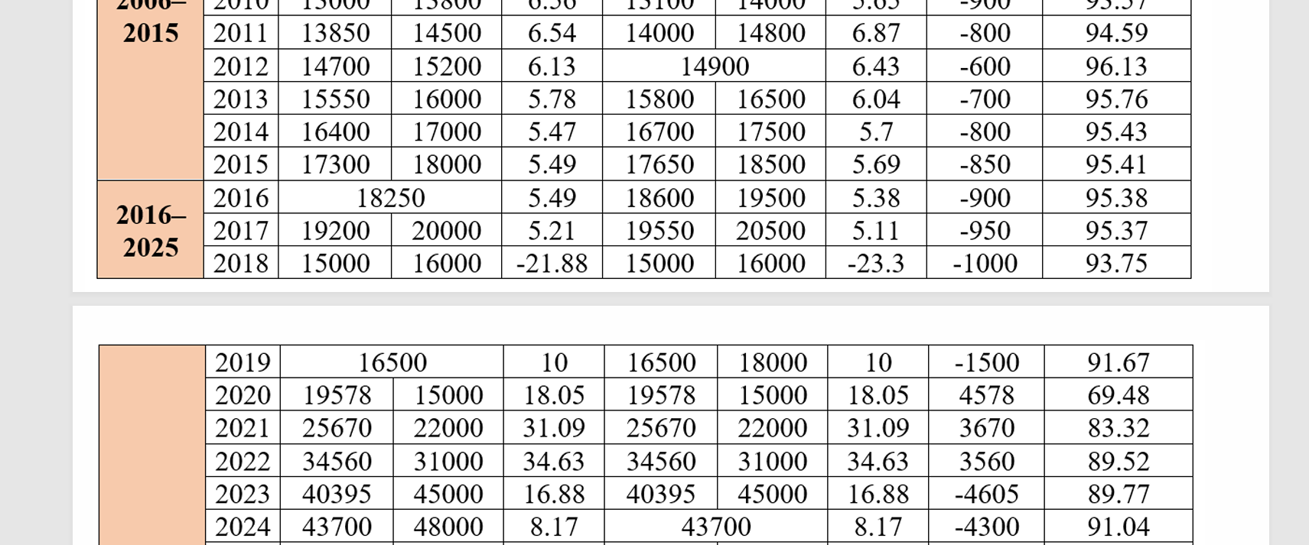
Cogniview
MULTI PAGE TABLE STICHING: “Solved by the custom built document parser”
Response of ChatGPT
Response based on custom built model
Source:

Slide 5
Cogniview
The custom model is able to efficiently convert the pdf into linear json format except the complex merged cell case which requires further model training and integration.
The pipeline model performs better than the open source model in terms of parsing context aware image captioning and multipage table stiching.
Some of the LLMs that hallucinate for the given 2 challenges are
ChatGPT
Perplexity
Gemini
Deepseek
FUTURE SCOPE
Train a custom OCR-enabled object detection model using the PubLayNet dataset (over 1 million annotated samples).
Test capabilities of third-party service providers like Unstructured.io, Nanonets, Airparser, Docsumo, UiPath, ABBYY, and Hyper science.
Evaluate their performance in layout detection, table extraction, and document segmentation.
Source:

Slide 6
Thank You

