Slide 1
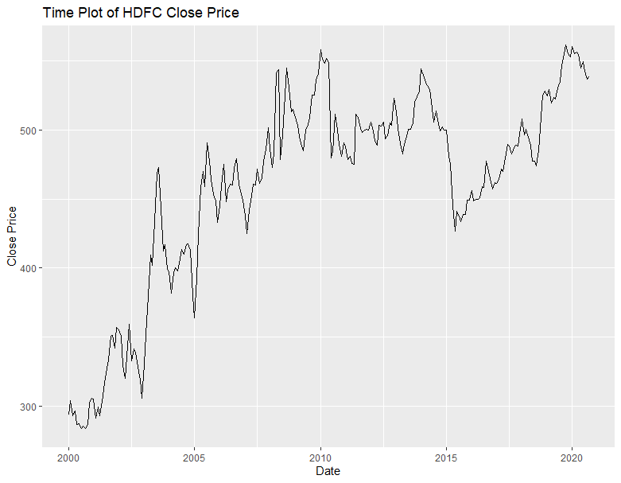
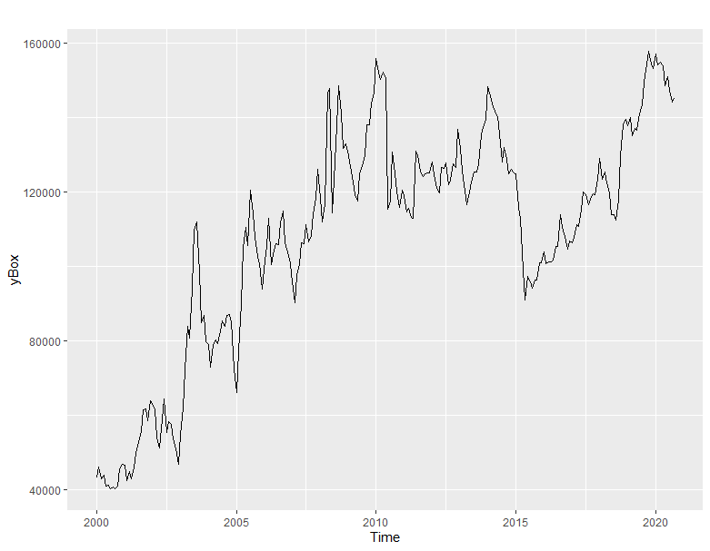
[1] "Best Lambda= 2" [1] "Chi-square (df=1)= 9.93" [1] "p-value= 0.00163"

Slide 2
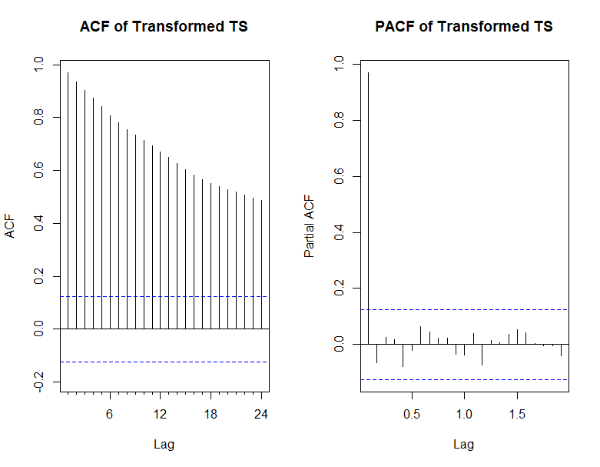
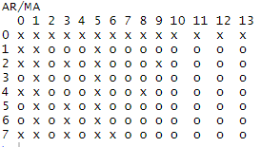
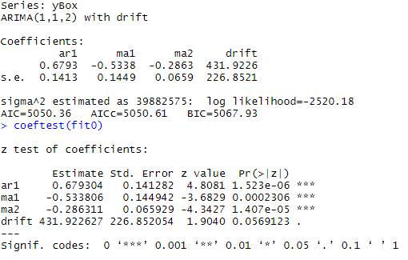

Slide 3
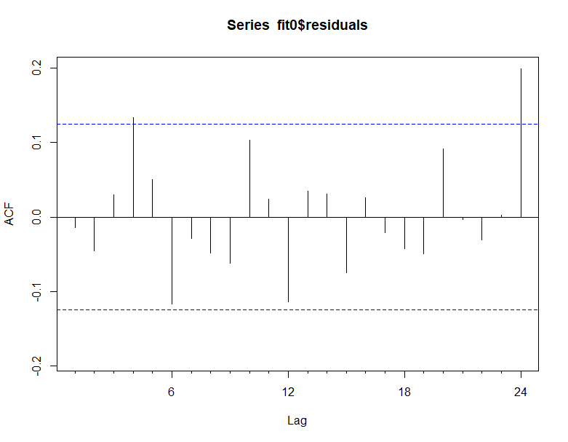
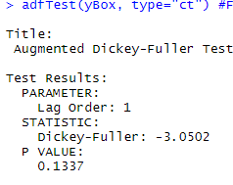

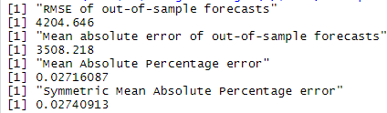


Slide 4
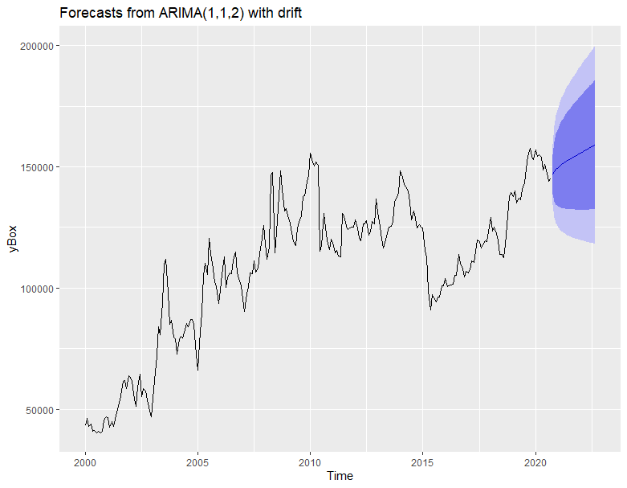
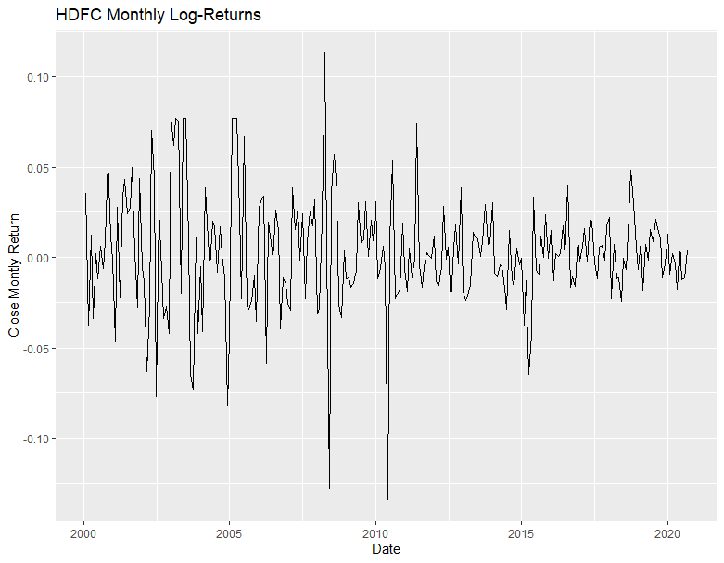

Slide 5
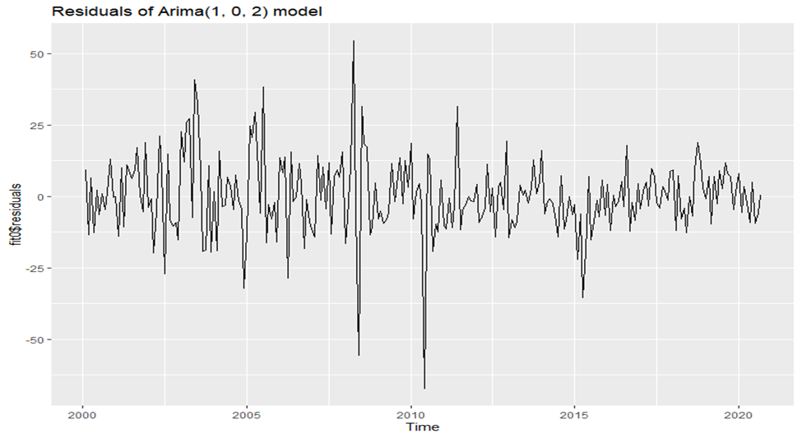
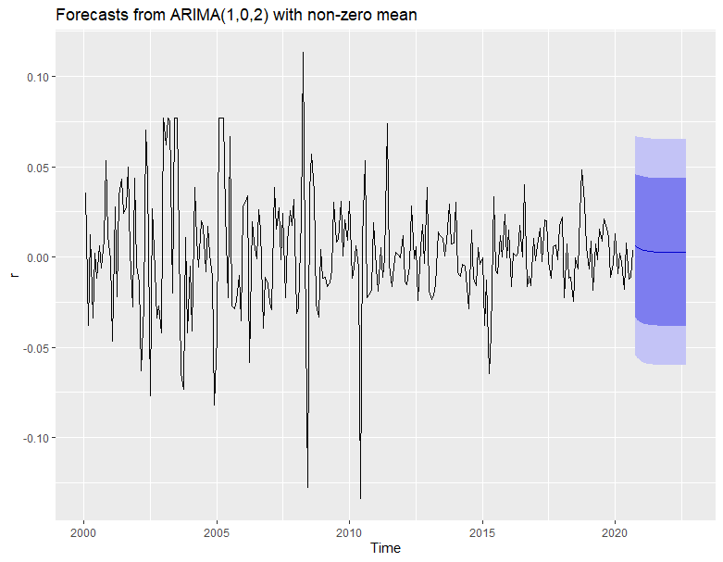
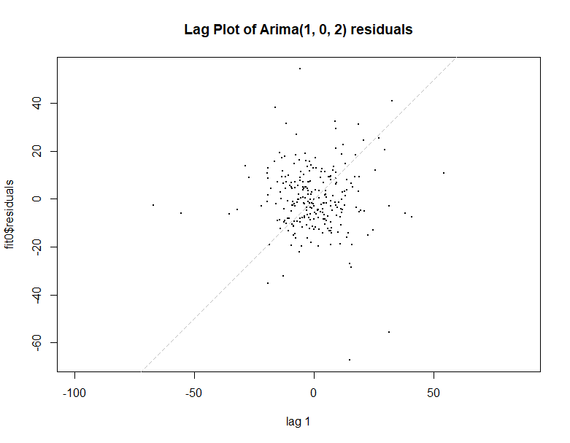

Slide 6
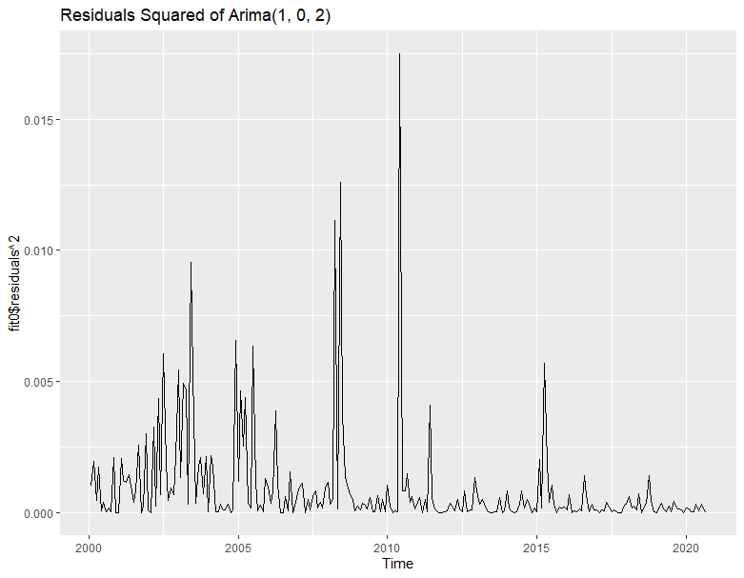
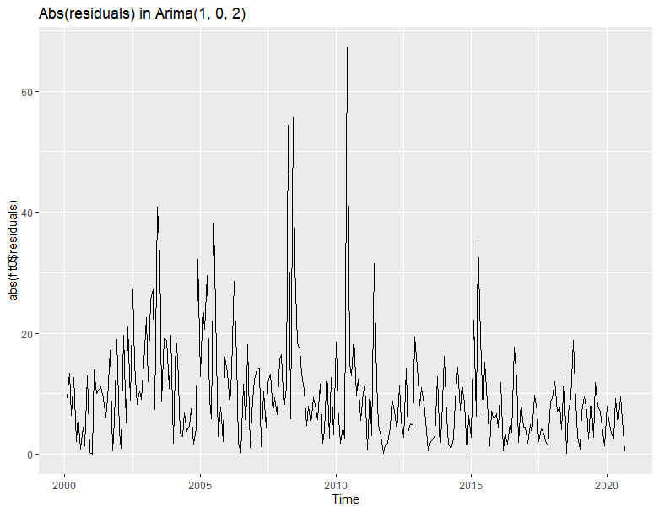
Plot of Volatility of ARIMA(1,0,2) Squared Residuals
Plot of change in Mean of ARIMA(1,0,2) Absolute Residuals

Slide 7
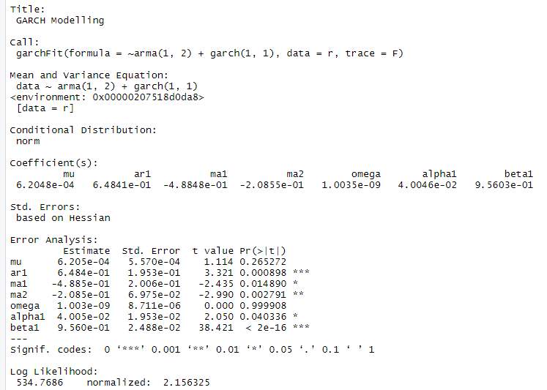
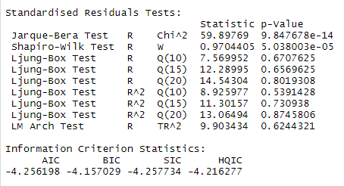
MODEL EQUATION:
return_t = 0.65_v_t-1 – 0.49_a_t-1 - 0.21_a_t-2 + a_t
sigma^2 = 0.04_a^2_t-1 + 0.956_sigma^2_t-1

Slide 8
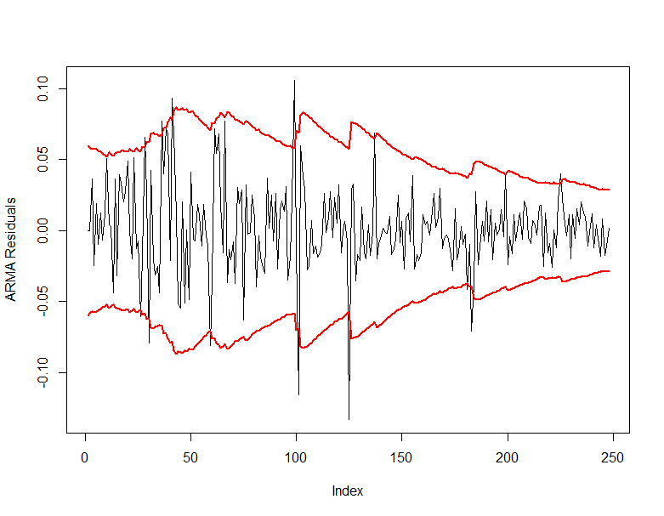
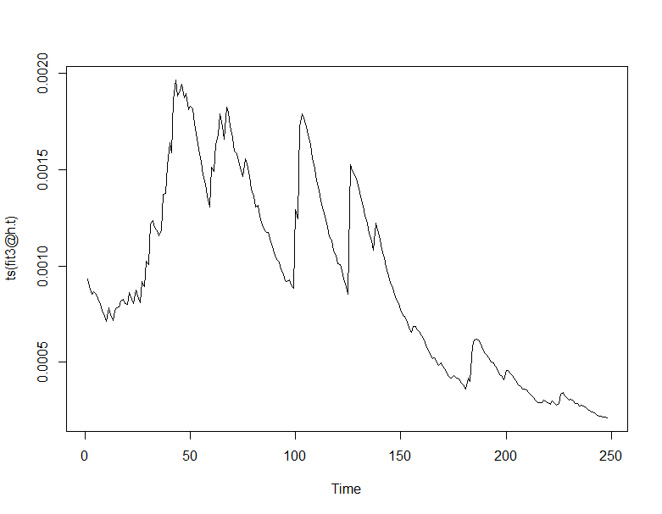
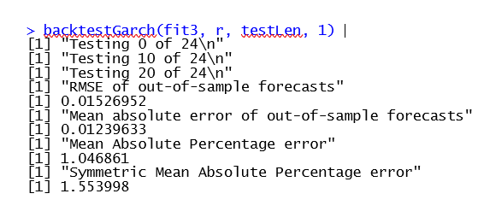
Plot of Garch Fit Residuals with 95% C.I.
Plot of Garch Fit Variance

Slide 9
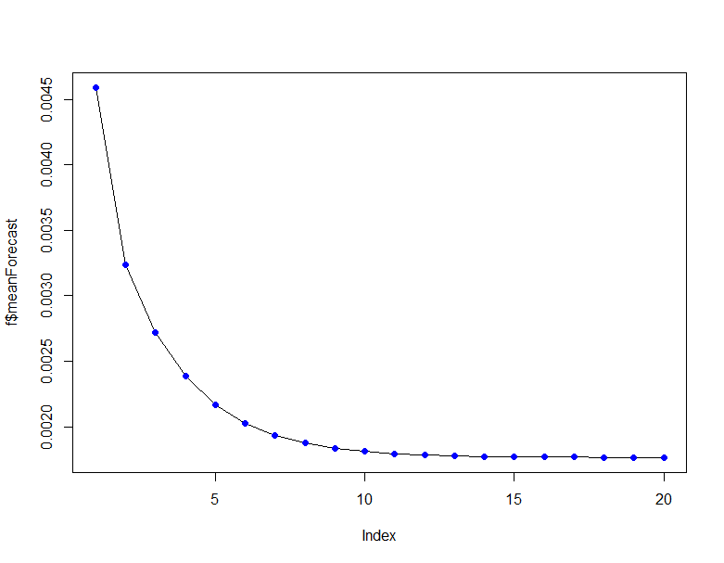
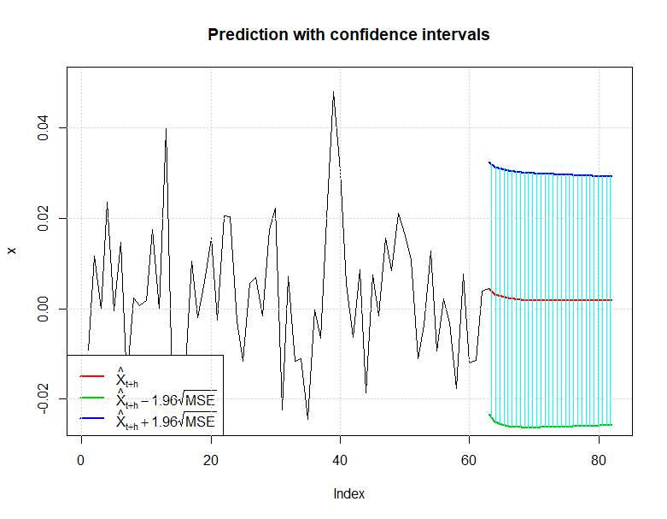
Plot of Garch Fit Mean forecast
Plot of Garch Fit Forecast for the next year

Slide 10
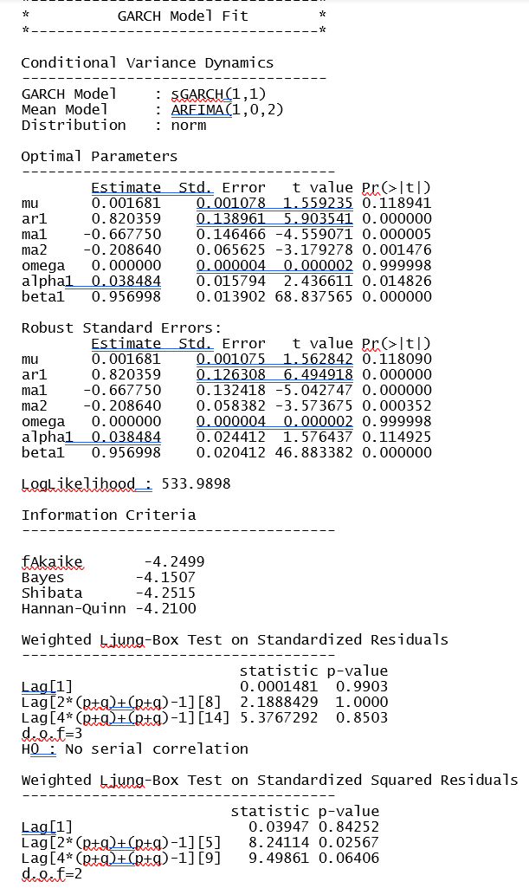
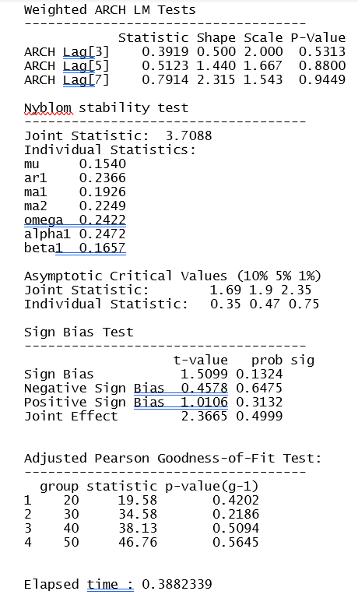
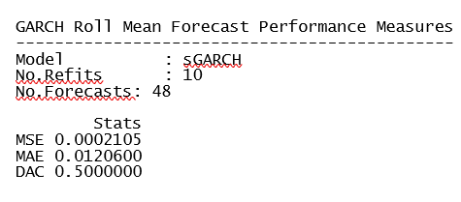
UGARCH MODEL
Model Equation:
return_t = 0.82_v_t-1 – 0.67_a_t-1 - 0.21_a_t-2 + a_t
sigma^2 = 0.039_a^2_t-1 + 0.957_sigma^2_t-1

