Slide 1

RAZOR SYNTAX REFRESHER
Qutub Uddin khan ( software engineer )

Slide 2
The @ syntax template engine
Razor is a mix of C# and html that compiles to C# files.
For using C# syntax you used the @ character.
The razor files have extensions of .cshtml and .razor.
It is used in MVC , Razor Pages , Blazor.
Razor view engine can also be used for custom purposes (that is template writing).
Its is similar to ejs , pug ( also known as jade) , handlebar.js ( nodejs )

Slide 3
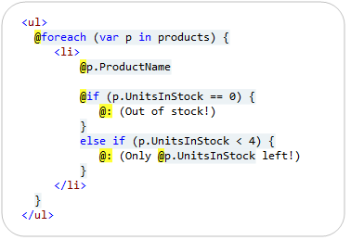
CONCEPTS
C

Slide 4
CONCEPTS
C# Code Support ( local variable , for each , if else , using ) etc.
Razor Specific tokens ( @page , @inject , @model ) etc.
DI Support ( @inject ).
Dedicated import files ( _ViewImport.cshtml )
Routing Support ( tag helper, view components , partial view , html helpers).
Localization and globalization support.
Razor Components.
Model Bindings

Slide 5
WEB ASSEMBLY CONCEPTS
Its is a w3 standard low-level byte code.
It is used as a compilation target.
It allows us to run programming languages other than JavaScript on the browser by compiling it to web assembly.
Currently officially supported languages are:
C / C++ , RUST
It is fast and allow the browser to do performance heavy workload.
It is supported on all modern web browsers.
For example chrome , edge , safari , Firefox and opera.

Slide 6
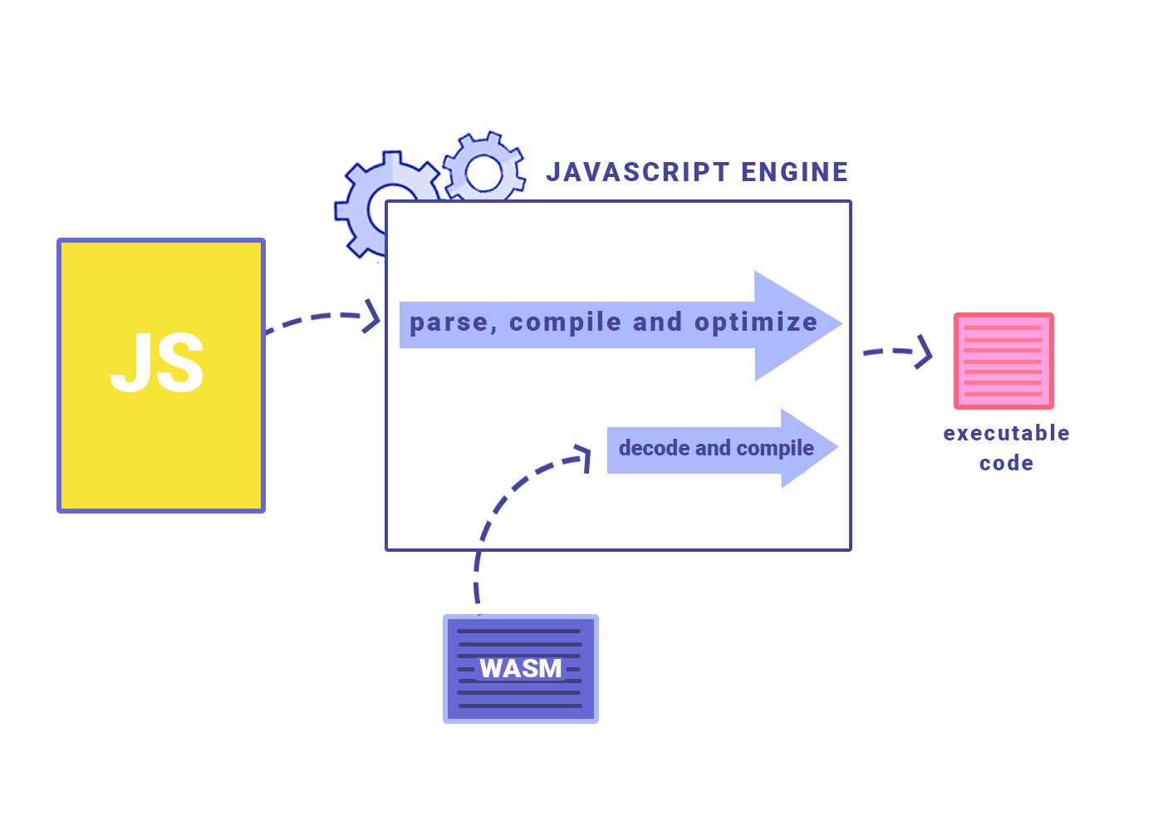

Slide 7
WEB ASSEMBLY FEW FEATURES
JavaScript interop's
Multi threading

Slide 8
Blazor Features
Mutable state management and Context API.
Form Validation and Authentication.
2-Way Data Binding.
VDOM and static-template compilation
Component based application.
Routing
Dependency Support (DI)
Seamless JavaScript Interop
C# programming language.
Code sharing and nugget packages
Razor Component libraries
Browser and VS Debugging
JS Interop

Slide 9
Blazor Supported Libraries
Signal R
EF Core
Others browser Supported (NEwtonSoft,Automapper etc

Slide 10
BLAZOR OTHER FEATURES
Lazy loading.
Native WASM Dependencies
Hot reload.
AOT compilation
Unit testing.
CSS Isolation

Slide 11
BLAZOR OTHER TEMPLATES
Blazor Electron/WebWindow
Blazor Hybrid MAUI
Blazor PWA.
Blazor Mobile Bindings
Blazor Dual Mode

Slide 12
Refferenece https://github.com/syedqutub/Nov2021Blazor

