Slide 1
Numpy
Lingua franca for data exchange
Dr. Noman Islam

Slide 2

Numpy
Numerical Python
Developed in 2005 by Travis Oliphant
Lingua franca for data exchange
ndarray – a n-dimensional array
Fast operations on entire arrays
Reading/writing array data
Linear algebra operations
Travis Oliphant

Slide 3
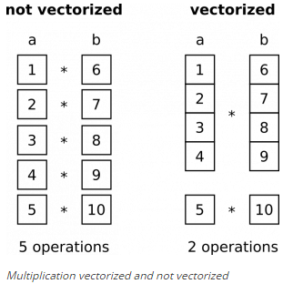
Vectorized operations

Slide 4
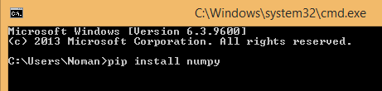
Installation
Prepackaged with Anaconda
Using pip
pip install numpy

Slide 5
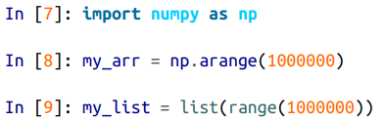
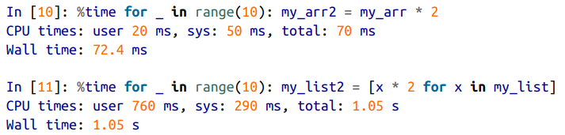
Numpy Vs Python list

Slide 6
nd-array
A fast, flexible container for large datasets in Python
Homogeneous data i.e. all of the elements must be the same type

Slide 7
Creating ndarray
np.array(): convert input data to an ndarray
np.zeros(): produces arrays of 0s
np.ones(): produces arrays of 1s
np.empty(): create new arrays by allocating new memory, but do not populate with any values
np.arange(): like the built-in range but returns an ndarray instead of a list

Slide 8
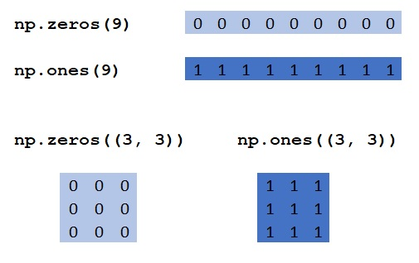
Examples

Slide 9
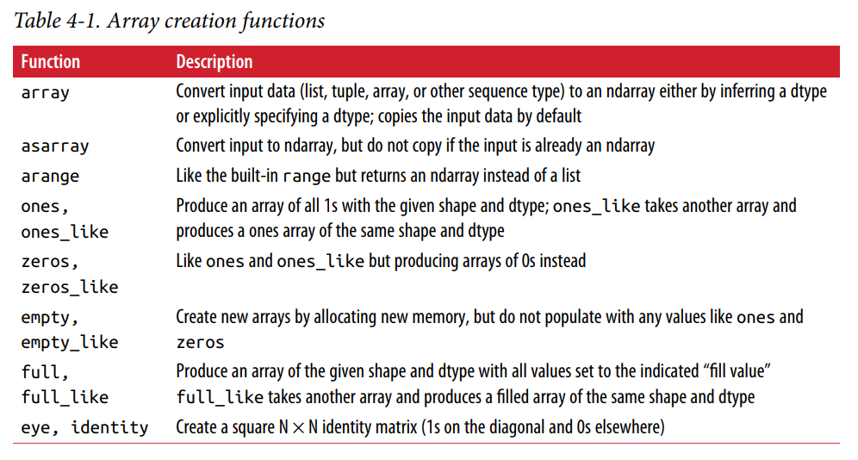
Summary of array creation functions

Slide 10
Attributes of numpy array
shape: a tuple indicating the size of each dimension
dtype: an object describing the data type of the array
ndim: the number of dimensions of the array

Slide 11
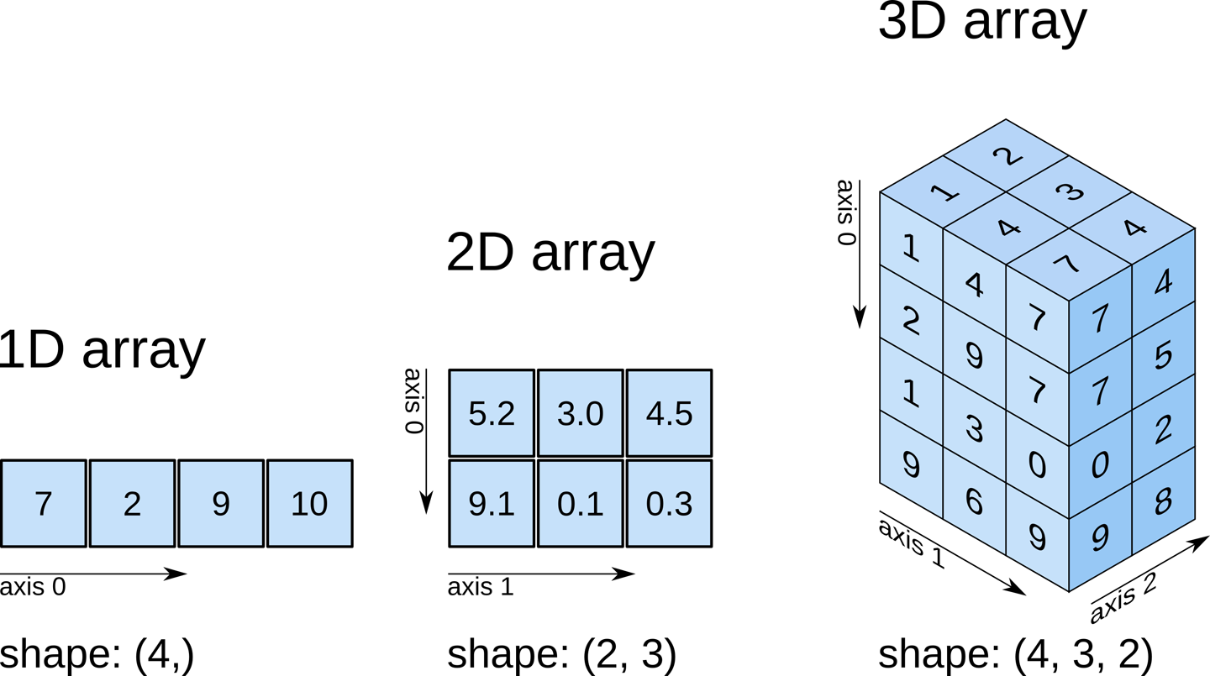
shape attribute

Slide 12
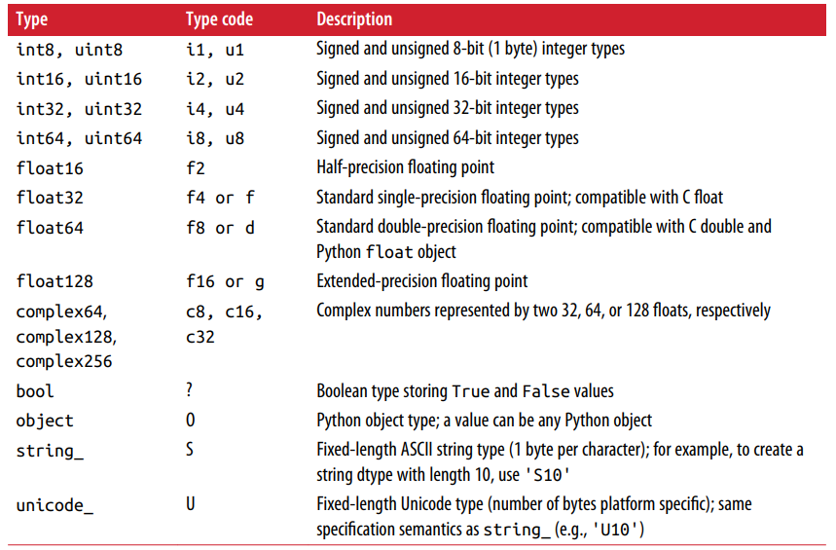
Numpy data types

Slide 13
Vectorization
Express batch operations on data without writing any for loops
Any arithmetic operations between equal-size arrays applies the operation element-wise
Arithmetic operations with scalars propagate the scalar argument to each element in the array
Comparisons between arrays of the same size yield boolean arrays
Operations between differently sized arrays is called broadcasting

Slide 14
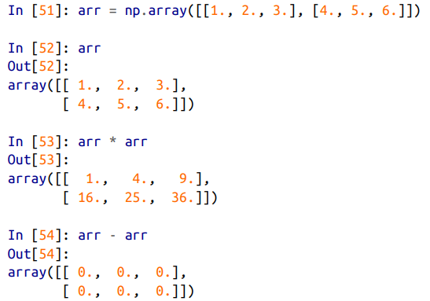
Operations on two matrices

Slide 15
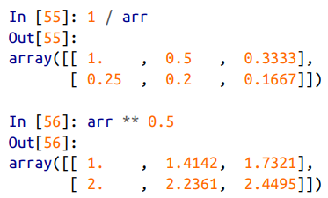
Operations between matrix and scalar

Slide 16
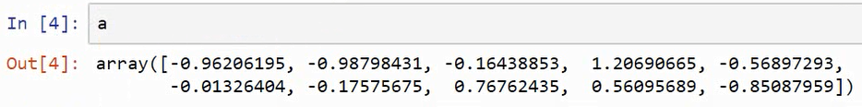
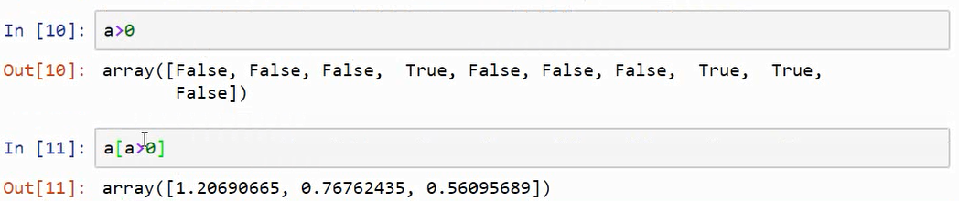
Comparison between matrices

Slide 17
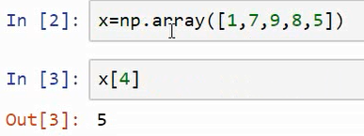
Array indexing

Slide 18
Fancy indexing

Slide 19
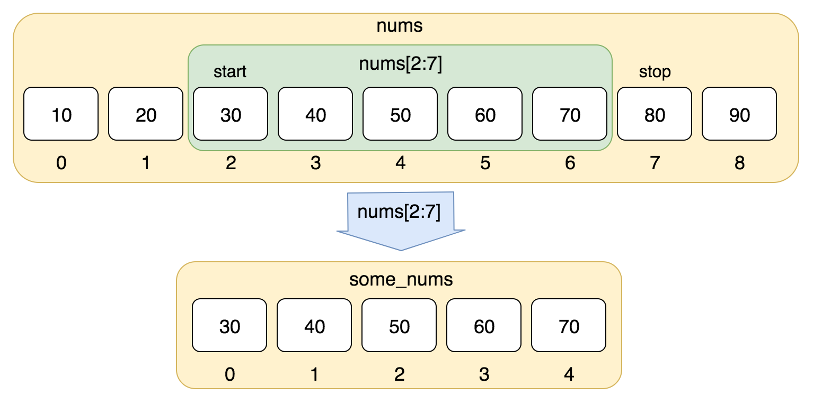
Slicing
Array slices are views on the original array
Format
start: end: step

Slide 20
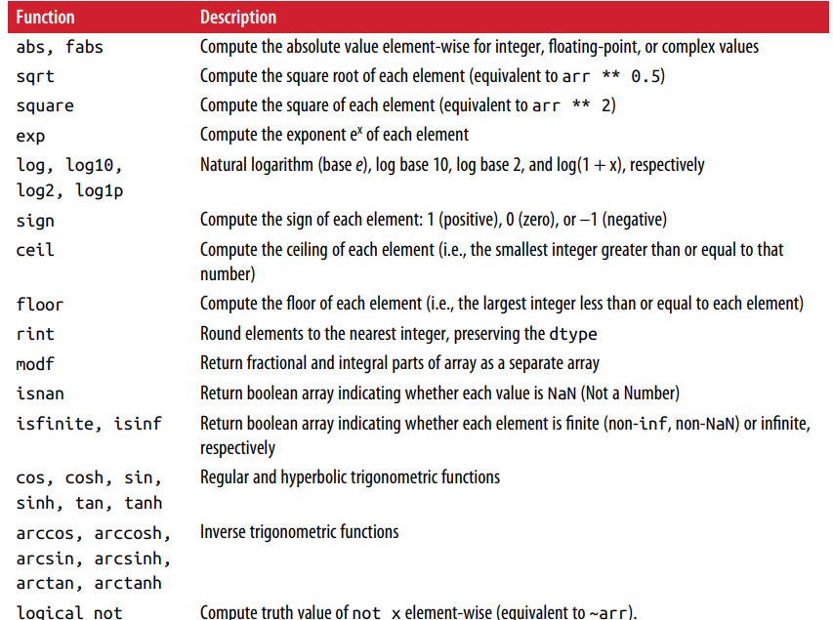
Element-wise array functions

Slide 21
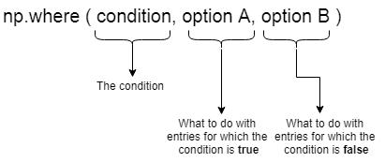
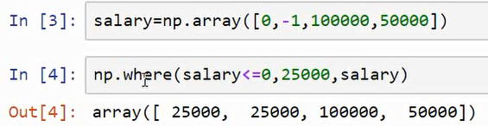
np.where()

Slide 22
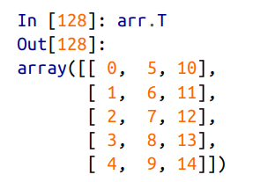
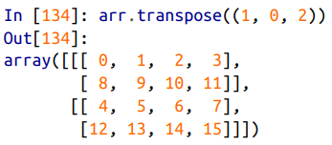
Transpose of a matrix

Slide 23
Mathematical and Statistical Methods
mean(): returns the mean value computed over the array
cumsum(): returns the cumulative sum of array elements
cumprod(): returns the cumulative product of array elements

Slide 24
Methods for boolean arrays
sum(): counting True values in a boolean array
any(): tests whether one or more values in an array is True
all(): checks if every value is True

Slide 25
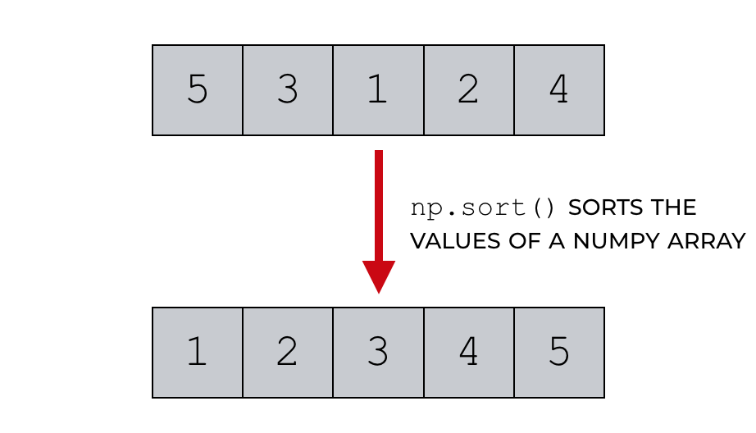
Sorting

Slide 26
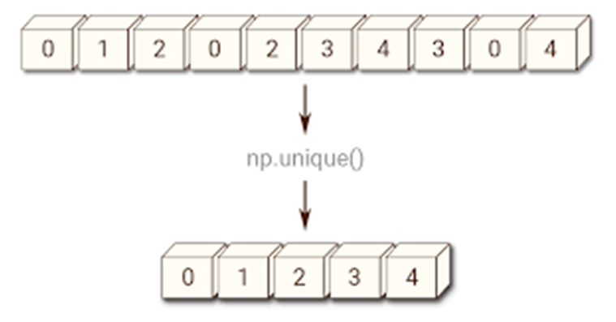
Unique

Slide 27
File Input Output
np.save(filename.npy, array)
np.load(filename.npy)
np.savez(filename.npz,array1,array2)
When loading an .npz file, you get back a dict-like object

Slide 28
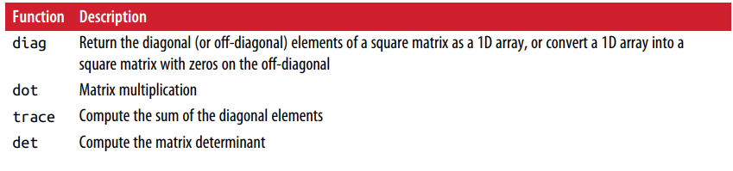
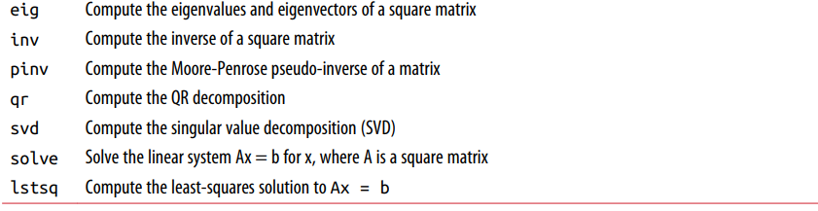
Linear algebra functions

Slide 29
Pseudo-random number generation
normal()
seed()
gamma()
uniform()

Slide 30
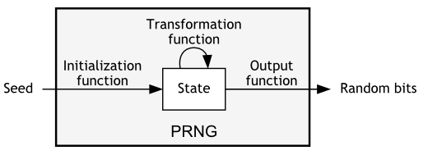
Pseudo random number generator

Slide 31
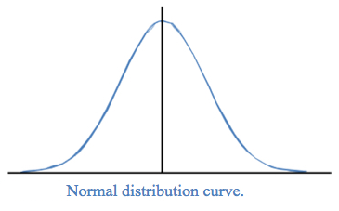

Slide 32
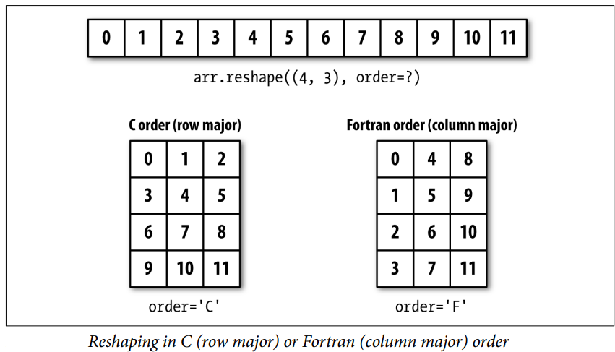
Reshape

Slide 33
Converting to 1D array
flatten()
ravel()

Slide 34
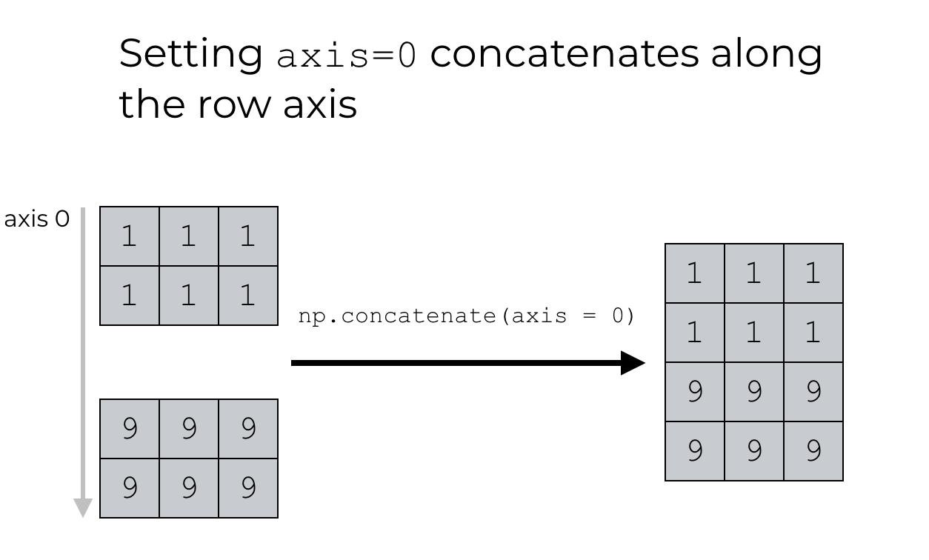
concatenate

Slide 35
Convenience functions
vstack: stack arrays row-wise (along axis 0)
hstack: stack arrays column-wise (along axis 1)
Notes:
Important topic

Slide 36
Stacking helpers
np.r_[arr1, arr2]
np.c_[np.r_[arr1, arr2], arr]

Slide 37
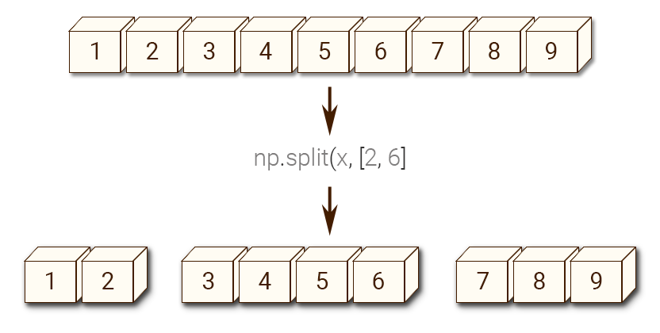
Splitting an array

