Slide 1
NetCopilot
AI-Powered Network Operations Copilot

Slide 2
The Problem
NOC teams spend hours on repetitive CLI checks.
Alerts lack context; tickets lack evidence.
Multi-vendor environments slow response.
Security/compliance blocks public AI tools.

Slide 3
The Solution
Natural-language interface for network operations.
Runs approved tools: CLI, inventory, telemetry, ticketing.
Returns evidence + structured diagnosis.
Deployable on-prem or private cloud.

Slide 4
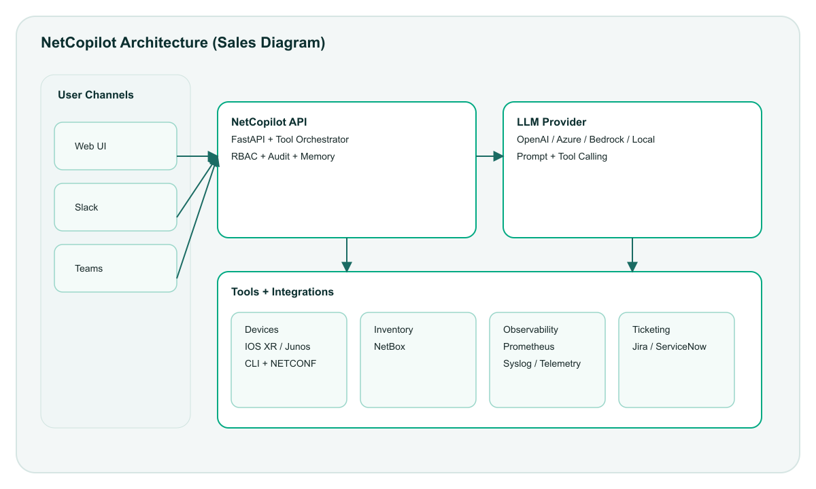
Architecture

Slide 5
Key Use Cases
Interface down / flapping
BGP idle or flapping
ISIS/OSPF neighbors down
CRC errors, drops, MTU mismatch
Routing missing
High CPU / memory
Create or update a ticket with evidence

Slide 6
Demo Workflow
Ask: Check interface health on sandbox-iosxr-1 Gi0/0/0/0
Tools run show commands
NetCopilot returns status, errors, counters, next steps
Optionally creates a Jira ticket

Slide 7
Why It’s Different
Evidence-based answers (not just text).
Multi-vendor tools with guardrails.
Security-first: on-prem or private LLM.
Integrations: Slack/Teams/Jira/NetBox/Prometheus.
RBAC + audit logging.

Slide 8
Deployment Options
On-prem (local or customer-approved LLM).
Private cloud (Azure OpenAI / Bedrock / Vertex).
Hybrid (LLM outside, tools inside).

Slide 9
Business Impact
Faster MTTR
Reduced manual CLI work
Consistent troubleshooting quality
Lower training burden
Audit/compliance ready

Slide 10
Next Steps
2-week POC with 3–5 devices
Integrate inventory + telemetry
Define top 10 playbooks
Review pricing and rollout plan

