Slide 1

Customer 360 and Next Best Action Engine
Built entirely with Snowflake CoCo CLI
Snowflake | Cortex AI | Streamlit | Snowpark
Team Name : Individual
Team Leader Name : Syed Rehan Syed Hamedsaleem
Team Size : 1
Problem Statement : Customer 360 & Next Best Action Engine

Slide 2

Problem Brief
. Problem Brief
Business Problem:
Companies struggle to unify scattered customer data (purchases, interactions, complaints) into a single actionable view. Support and sales teams lack real-time visibility into customer health, leading to missed retention opportunities.
Target User:
Customer success managers, sales reps, and support agents who need instant, data-driven guidance on how to engage each customer.
Pain Point:
Manual analysis across multiple systems is slow and error-prone. This app consolidates all customer signals into one dashboard with AI-generated next best actions and natural-language explanations.
Domain: CRM / Customer Intelligence / Retail & Services

Slide 3
Architecture Diagram
Data Sources: 4 structured tables (Customers, Purchases, Interactions, Complaints) loaded into Snowflake.
Processing: SQL aggregation builds CUSTOMER NBA (unified 360 view with risk scoring and next best action logic) and CUSTOMER_AI_CONTEXT.
AI Layer: Snowflake Cortex AI (Llama 3.1-70B) generates on-demand natural-language explanations for each recommendation.
Frontend: Streamlit in Snowflake app with interactive customer selector, metrics dashboard, risk badges, and AI explanation button.
CoCo CLI Skills Used: sql-author, streamlit (developing-with-streamlit-in-snowflake), Cortex AI functions, Snowpark Python
CUSTOMERS
1,000 rows
PURCHASES
8,000 rows
INTERACTIONS
4,000 rows
COMPLAINTS
1,000 rows
Snowflake
AI Layer: Snowflake Cortex
AI Explanation
Customer NBA
Streamlit in Snowflake
Business-user UI

Slide 4
Impact Statement
Time Saved:
Reduces customer analysis from 15-20 min of manual lookups to instant, one-click insights.
Accuracy:
AI-driven risk scoring and next best action removes subjective guesswork from customer engagement.
Scalability:
Handles 1,000+ customers today; scales to millions with Snowflake compute. Easily extendable to new data sources (web analytics, social, email).
Beyond Demo:
Can integrate with CRM systems, trigger automated outreach, and serve as the foundation for a full customer data platform.

Slide 5
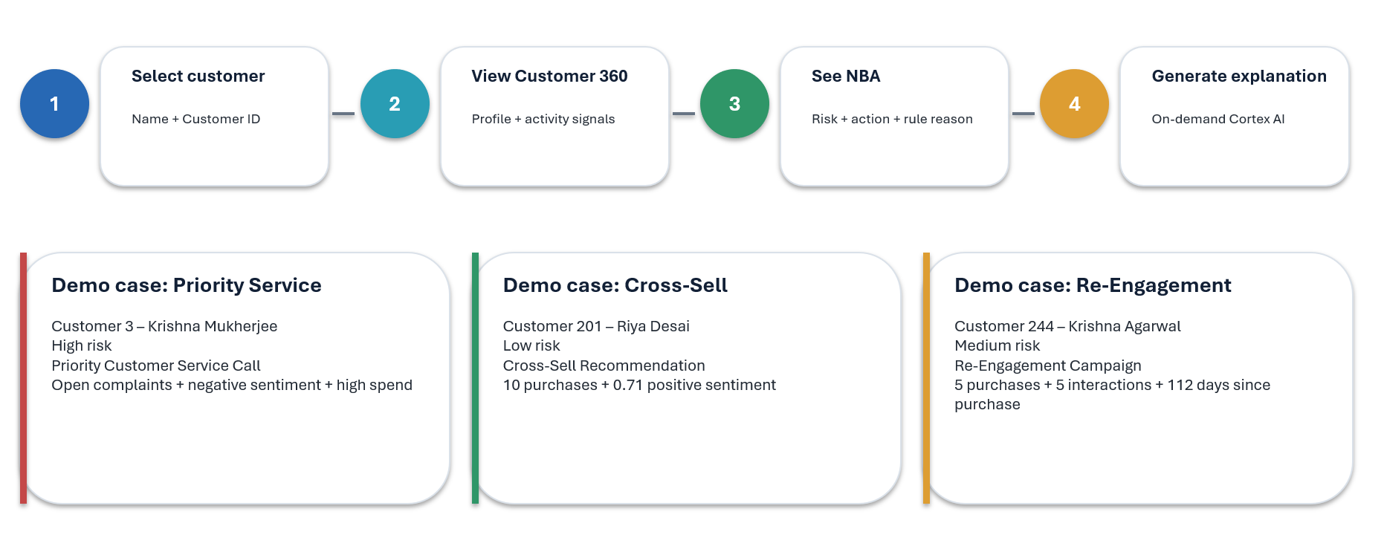
App Workflow and Demo
All source code, configuration, and sample data available in the repository.
GitHub Link: https://github.com/syedrhn0/Customer-360-and-Next-Best-Action-Engine

Slide 6
Tech Stack
Snowflake Data warehouse, compute, and storage
Streamlit-in-Snowflake Interactive web application (deployed via snow CLI)
Snowflake Cortex AI LLM-powered explanations (Llama 3.1-70B)
Snowpark Python Server-side data access within Streamlit
CoCo CLI Project scaffolding, SQL authoring, deployment
Key Features Built with CoCo CLI
1. Database & table creation via sql-author skill
2. Synthetic data generation (1,000 customers, 8,000 purchases, 4,000 interactions, 1,000 complaints)
3. Customer 360 aggregation pipeline (CUSTOMER_NBA table)
4. AI context preparation for Cortex AI (CUSTOMER_AI_CONTEXT table)
5. Streamlit app development with real-time Cortex AI integration
6. One-command deployment to Snowflake (snow streamlit deploy)
Data Model
CUSTOMERS customer_id, customer_name, age, city, customer_since, customer_segment
PURCHASES purchase_id, customer_id, purchase_date, amount, product_category, payment_method
INTERACTIONS interaction_id, customer_id, interaction_date, channel, interaction_type, sentiment_score
COMPLAINTS complaint_id, customer_id, complaint_date, category, status, resolution_date

Slide 7


