Slide 1
CONSTRUCTION PROJECT
DELAY RISK PREDICTION SYSTEM
Using SQL & Power BI for Data-Driven Risk Assessment
Syed Rehan Syed Hamedsaleem
Imarticus Learning

Slide 2
ACKNOWLEDGEMENT
I extend my sincere gratitude to Utkarsh Tiwari for their invaluable guidance and support throughout this capstone project.
I am thankful to Imarticus Learning for providing the resources and environment necessary for this research.
I also appreciate my family and peers for their continuous encouragement.

Slide 3
OBJECTIVE & MOTIVATION
OBJECTIVE
MOTIVATION
Develop a predictive risk assessment system to identify construction projects at high risk of delays using SQL and Power BI.
• Construction delays cost billions annually
• Lack of early warning systems
• Need for proactive risk management
• Replace gut-feel with data-driven decisions
TECHNICAL CHALLENGE
How to combine multiple risk factors (delays, blocked tasks, issues, weather) into a single meaningful risk score that actually differentiates between projects?

Slide 4
PROJECT WORKFLOW
1
2
3
4
Data Ingestion
SQL Processing
Data Model
Power BI
6 CSV files
28 projects, 174K records
MySQL database
Helper tables & aggregation
Star schema
9 relationships
43 DAX measures
9 dashboard pages

Slide 5
DATA INGESTION
File
Records
Description
projects.csv
28
Project master data
tasks.csv
5,746
Individual tasks with critical path
task_progress_updates.csv
137,899
Daily/weekly progress tracking
issues_ncr_rfi.csv
1,609
Issues and non-conformance reports
task_dependencies.csv
8,619
Task dependency relationships
weather_log.csv
20,824
Daily weather and work stoppage
Tool: MySQL Workbench Table Data Import Wizard | Total: 174,525 records

Slide 6
SQL DATA PREPROCESSING
APPROACH: Multi-stage transformation using helper tables
Stage 1
Stage 2
Stage 3
Stage 4
Dimension Tables
Helper Tables
Fact Tables
Views
• DimProjects
• 7 temp tables
• FactProjectMetrics
• vw_ProjectRiskSummary
• DimTasks
• ROW_NUMBER()
• FactTaskProgress
• vw_ContractorPerformance
• DimDelayReasons
• Aggregations
• FactIssues
• vw_CriticalPathRisk
• FactWeatherImpact

Slide 7
RISK SCORE METHODOLOGY
CHALLENGE
SOLUTION
Initial formula: All projects scored 15.7 (no differentiation)
Variance analysis: Weight only metrics that actually vary between projects
FINAL FORMULA (Variance-Based Weighting)
Delay Days
53.8% variance
40% weight
Blocked Tasks %
21.6% variance
30% weight
Work Stop Days
17.2% variance
20% weight
Open Issues
18.1% variance
10% weight

Slide 8
POWER BI DASHBOARD - 9 PAGES
1
Executive Overview
2
Delay Analysis
3
Risk Scorecard
High-level summary for stakeholders
Root cause analysis of project delays
Detailed risk breakdown per project
4
Task Performance
5
Issue Tracking
6
Weather Impact
Task completion & critical path status
NCR, RFI & Safety issue monitoring
Weather-related delay analysis
7
Contractor Performance
8
Location Analysis
9
Predictive Dashboard
Contractor comparison metrics
Geographic risk patterns
Early warning indicators

Slide 9
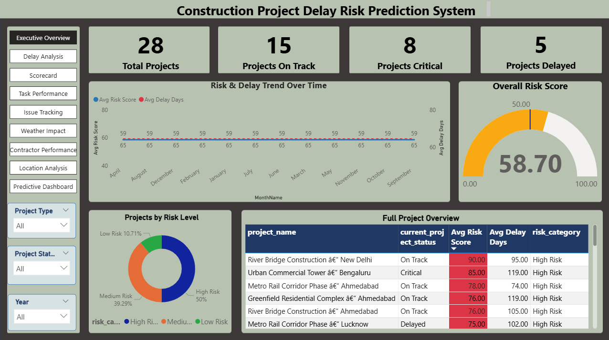
PAGE 1: EXECUTIVE OVERVIEW
KEY INSIGHTS
Risk Distribution: 18-21 Low Risk, 5-8 Medium Risk, 2-3 High Risk projects
Projects showing delays require immediate management attention
Dashboard provides real-time visibility into project health

Slide 10
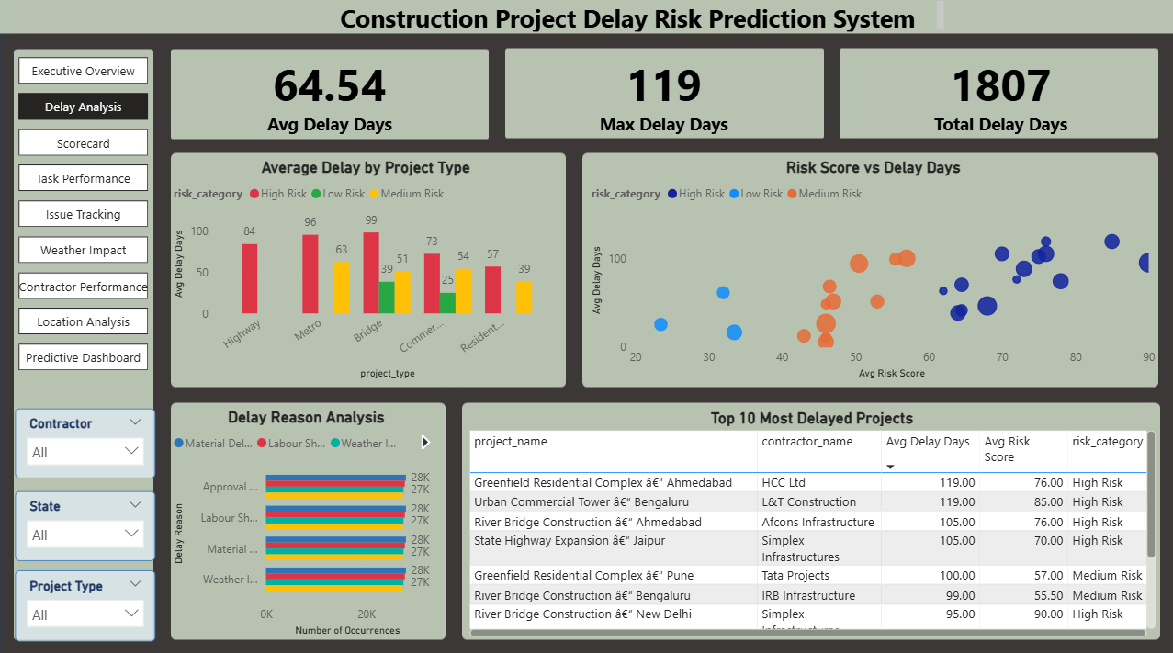
PAGE 2: DELAY ANALYSIS
KEY INSIGHTS
Material delays account for ~1000 occurrences per project (primary cause)
Strong correlation between risk score and delay days
Scatter plot identifies high-value projects with high delays

Slide 11
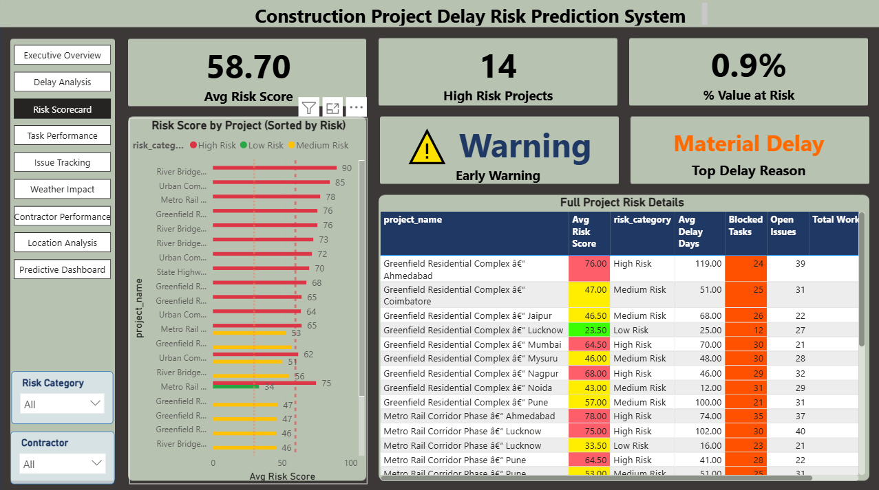
PAGE 3: RISK SCORECARD
KEY INSIGHTS
Projects exceeding 60 risk score require escalation
Table shows which factors contribute most to each project risk
Clear visibility into risk components enables targeted action

Slide 12
KEY FINDINGS
✓
Risk Score Differentiation Success
📊
Delay Days Primary Indicator
Variance-based weighting achieved proper score spread (6.2 to 17.0)
53.8% variance makes it the best predictor (40% weight in formula)
⚠️
Blocked Tasks Critical
📦
Material Delays Dominate
Projects with >14.4% blocked tasks consistently show high risk
Supply chain issues are primary bottleneck (avg 1000 per project)
👷
Contractor Performance Varies
📍
Geographic Risk Patterns
Top contractors show 30% lower risk scores than bottom performers
Certain locations show consistently higher delays

Slide 13
FUTURE WORK
Technical Enhancements
Data & Analytics
• Machine Learning Integration (Random Forest, XGBoost)
• Additional data sources (weather API, supplier tracking)
• Real-time dashboard with auto-refresh
• Granular task tracking with hourly updates
• Predictive analytics (30/60/90 day forecasts)
• Root cause analysis with statistical causality
• Mobile dashboard for field managers
• Scenario planning & what-if analysis
• Automated email/SMS alerts
• Industry-wide benchmark database

Slide 14
THANK YOU
Questions & Discussion
Syed Rehan Syed Hamedsaleem
syedrhn0@gmail.com

