Slide 1

Final Year Project Presentation
Identifying the Best Deployable Machine Learning Model for Malaria and Dengue Diagnosis
A Comparative Benchmarking and Deployment Framework for Low-Resource Healthcare Settings
University of South Asia
Department of Computer Science
2023 - 2027

Slide 2
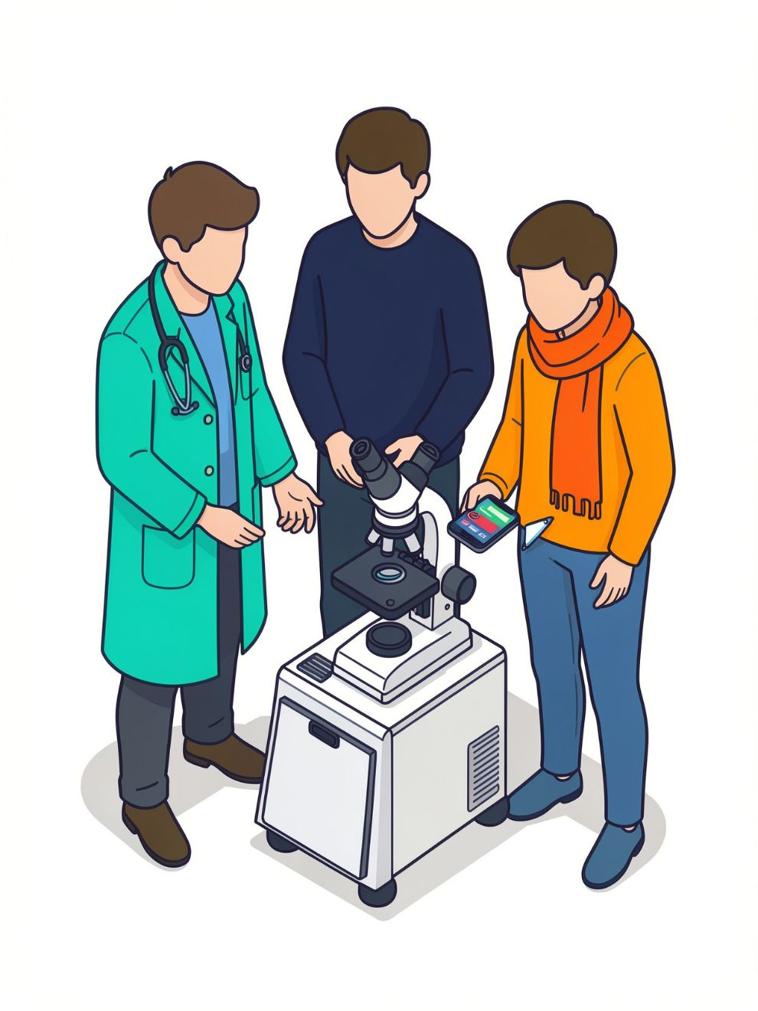


Project Team
Syed Riyyan Hassan (B-29398)
Muhammad Kamran (B-29197)
Muhammad Awais (B-28167)
Supervisor: M. Waqas Ishaq

Slide 3
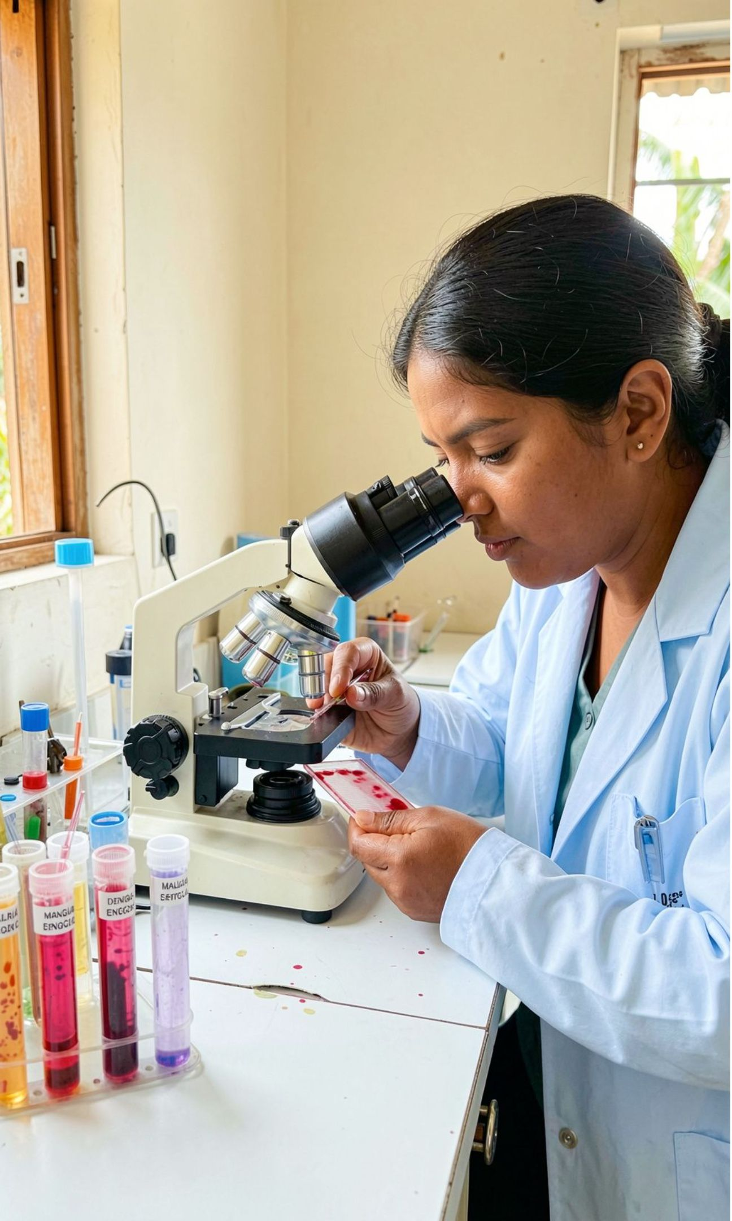
Introduction and Background
Malaria and dengue are endemic in Pakistan and South Asia
Both begin as undifferentiated fever
263 million malaria cases and ~597,000 deaths (WHO, 2023)
14 million+ dengue cases (2024)
Malaria microscopy depends on microscopist skill and workload
Dengue tests (NS1/serology) are often unavailable in small facilities
ML achieves high accuracy on smear images and routine blood values
But studies use different splits and preprocessing, and rarely measure latency, memory, calibration, or explainability

Slide 4
Problem Statement
No standard protocol exists for choosing a deployable model in low-resource settings
Literature is not comparable across studies
Deployment constraints are ignored
Result: model selection defaults to peak accuracy
Peak accuracy can favor models that are:
Slow
Large
Overconfident
Unexplainable
Accuracy alone is the wrong selection
criterion.

Slide 5
Existing Work: Reported Accuracy Benchmarks
Malaria: NIH cell-image
dataset (27,558 images)
Dengue: routine blood values (CBC)
Baseline CNN: ~92–96%
MobileNetV2: ~93.5%
ResNet-50 (transfer learning): ~96%
Xception: >97%
Random Forest: ~84.5% (1,523 patients, Bangladesh)
XGBoost: ~81–87% (same dataset size, different papers)
Random Forest: ~85% (Brazil)
XGBoost / LightGBM: AUC >0.90 (49,679 patients, Puerto Rico)
Accuracy varies widely because every study uses a different dataset, split and preprocessing.

Slide 6
Research Gaps
Results are not comparable: different datasets, splits and preprocessing
Accuracy is reported alone; latency, memory, calibration and explainability are rarely measured
Clinical validation is limited
Dengue models struggle on real febrile patients
No method exists for choosing which model to deploy

Slide 7
Proposed Solution and Novelty
Proposed Solution
Novelty
1
Build one lightweight custom model
per disease
Deployability, not accuracy, as the selection criterion
Benchmark it against 2 established models per disease under one protocol
Clinical sensitivity gate (90% malaria, 85% dengue)
2
3
Score all models on diagnostic and deployment criteria with TOPSIS (Deployability Score)
Ranking-stability testing (weights varied ±10%)
4
Compress the top model per disease and demonstrate it in a prototype
Custom lightweight models designed for low-resource settings

Slide 8


Datasets
Malaria: NIH Malaria
Cell Images
Dengue: Clinical CBC and
Symptom Data
27,558 segmented thin-smear cell images
13,779 parasitized + 13,779 uninfected
From 150 infected and 50 healthy patients
Preprocessing: resize to 224×224, normalize
Split: 70/15/15
Dataset: Dengue Fever Hematological Dataset
Size: 1,523 patients, 13 features
Classes: 1,040 dengue-positive and 481 dengue-negative
Features: platelet count, WBC, haematocrit, neutrophils,
lymphocytes, symptoms
Preprocessing: duplicate removal, imputation, scaling,
SMOTE within training folds only
Validation: repeated stratified 5-fold cross-validation
Infected Not Infected

Slide 9
Candidate Models: 6 Models
Malaria: Cell Images
Dengue: (blood values)
Custom CNN: built by us
(3–4 convolutional layers)
MobileNetV3:
established, designed for mobile
EfficientNet-B0:
established, accuracy/efficiency
balance
Custom MLP (Multi-Layer Perceptron)
built by us
Random Forest:
established, strong tabular baseline
XGBoost:
established, gradient-boosted trees
Why these models?
Small clinics need fast, small models that run offline on a phone or low-end computer.

Slide 10
Project Objectives and Methodology
Objectives
Methodology Pipeline
1. Prepare malaria and dengue datasets under a documented protocol
2. Build one custom model per disease and train 2 established models for comparison
3. Measure diagnostic and deployment metrics for all 6 models
4. Rank with TOPSIS and a sensitivity gate, and test ranking stability
5. Provide Grad-CAM and SHAP explanations with clinician ratings
6. Deploy the selected models in a minimal prototype
Data → Train → Compress → Score → Explain → Statistical Analysis
Metrices: sensitivity, specificity, precision, F1, ROC-AUC, calibration error, robustness, latency, memory, model size
Explainability: Grad-CAM (images) and SHAP (blood values)
Tracking: all experiments logged in MLflow

Slide 11
Requirements and System Architecture
MalDen-Deploy: Four-Layer Architecture
Presentation: web dashboard and Android app
Functional Requirements
1
Enter lab values and symptoms, or upload a smear image
Receive a prediction, confidence level, risk flag, and explanation
Store all predictions for later review
Application: API (authentication, predictions, benchmarks, explanations)
2
AI/ML: optimised models, compression tools, scoring engine
3
Non-Functional Requirements
Data: PostgreSQL, object storage, MLflow model registry
4
Offline capability on Android
Low latency and small model size
Decision support only

Slide 12

Scope and Limitations
In Scope
Risks and Mitigation
Benchmarking for two tasks (malaria and dengue)
Model selection and compression
Explainability
Prototype
Small dengue data → repeated cross-validation and external validation
Quantisation accuracy loss → full-precision fallback
Compute limits → university GPUs or Colab
Ethics → anonymised data, ethics approval, decision support only
Out of Scope
Final diagnosis or treatment advice
New laboratory hardware
Clinical trials and regulatory approval

Slide 13


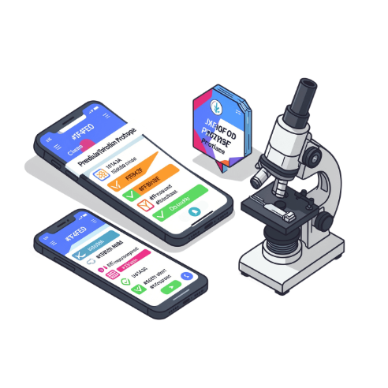



Expected Outcomes and Deliverables
A repeatable benchmark of 6 models
A data-backed recommendation of the best deployable model per disease
Compressed models with a measured size, speed, and accuracy trade-off
A working prototype: MalDen-Deploy
One custom model per disease, compared against established models
A framework reusable for other diseases

Slide 14
Project Timeline and Work Plan
Approximately 8 months, with overlapping phases
Literature Review and Requirements
Malaria Model Benchmark
Compression and Deployability Scoring
Integration and Testing
Data Collection and Preprocessing
Dengue Model Benchmark
Application Development
Documentation and Final Defence

Slide 15
Conclusion, References and Q&A
Key Takeaway: The best model is not the most accurate. It is the most deployable.
References:
WHO, World Malaria Report 2024
Haider N. et al., Global dengue epidemic 2024, Int. J. Infect. Dis., 2025
Rajaraman S. et al., PeerJ 6:e4568, 2018 (NIH malaria dataset)
Vu D.M. et al., Dengue detection in Kenyan febrile children, PLOS Glob. Public Health, 2023
Hwang & Yoon, Multiple Attribute Decision Making (TOPSIS), 1981
Dataset Links:
Malaria Dataset (https://www.kaggle.com/datasets/iarunava/cell-images-for-detecting-malaria)
Dengue Dataset (https://data.mendeley.com/datasets/6fsrsk3mb8)

