Slide 1


Vadla Syed Sadiq Ali
Keylogger and Security
Final Project

Slide 2
Project Title
Keylogger and Security

Slide 3
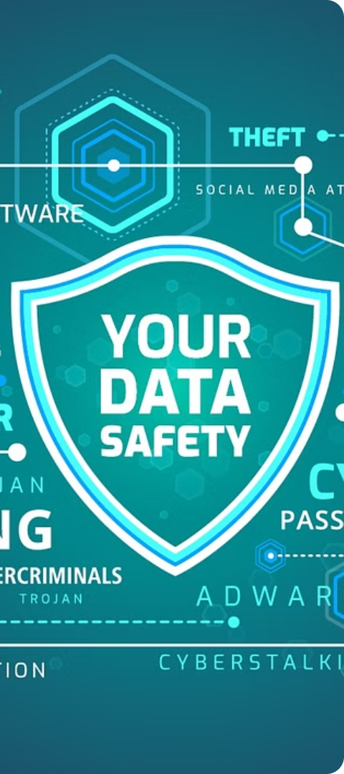
Problem Statement
1
Increased Cyber Threats
2
Lack of User Awareness
The rise in malicious online activity, such as hacking, data breaches, and identity theft, has created a growing need for robust cybersecurity solutions.
Many individuals and organizations lack the knowledge and tools to effectively protect their sensitive information and devices from cyber attacks.
3
Inadequate Security Measures
Existing security solutions often fall short in providing comprehensive protection, leaving users vulnerable to various cyber threats.

Slide 4
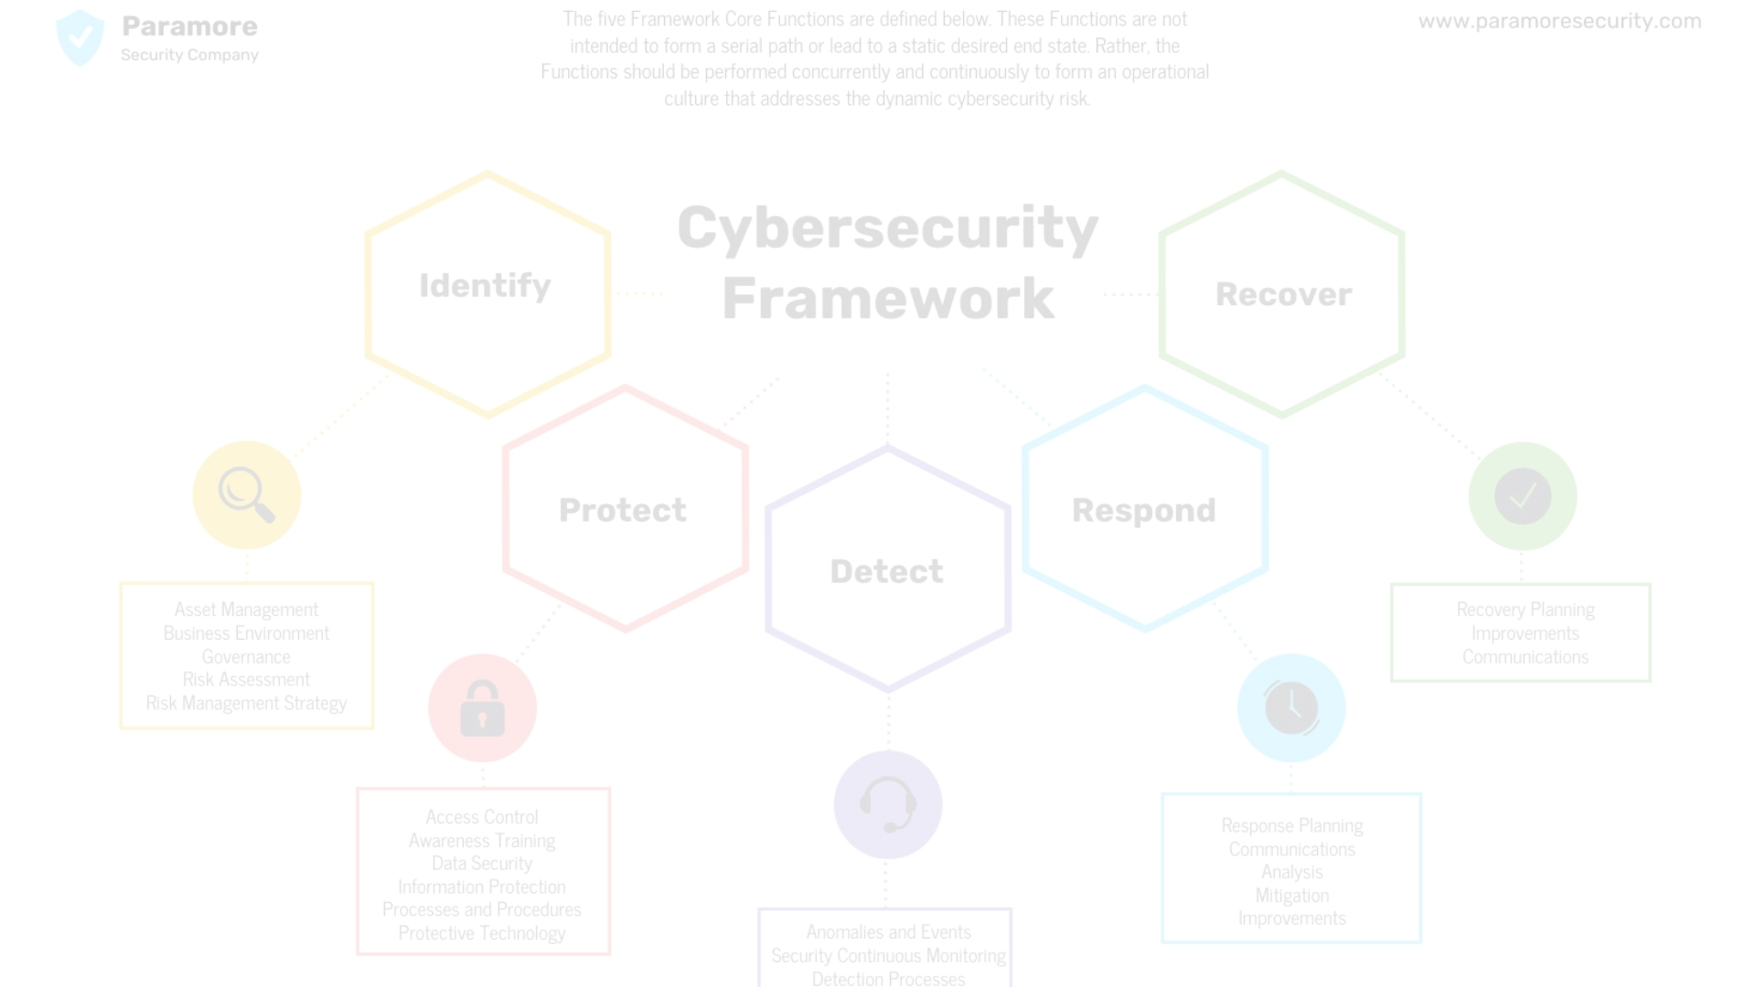
Project Overview
Research
Conduct in-depth research on the latest cyber threats and security best practices to inform the project's development.
Implementation
Develop and implement the keylogger and security solution, ensuring it meets the project's objectives.
1
2
3
Design
Design a robust and user-friendly keylogger and security solution that addresses the identified problems.

Slide 5
End Users
Individuals
Small Businesses
Enterprise Organizations
Our solution is designed to protect individuals from various cyber threats, such as identity theft, data breaches, and online fraud.
Small businesses often lack the resources and expertise to implement comprehensive security measures, and our solution aims to fill that gap.
Large organizations with sensitive data and critical infrastructure can benefit from our advanced security features and customization options.

Slide 6
Our Solution and Its Value Proposition
Comprehensive Protection
User-Friendly Interface
Our keylogger and security solution offers multi-layered protection against a wide range of cyber threats, ensuring the safety of your devices and data.
The intuitive and easy-to-use interface makes it simple for users to monitor, manage, and respond to security alerts and incidents.
Customizable Settings
Real-Time Monitoring
Our solution allows users to customize security settings and preferences to fit their specific needs and requirements.
The solution provides real-time monitoring and reporting, enabling users to stay informed about the security status of their devices and network.

Slide 7




The Wow in Our Solution
Advanced Encryption
Behavioral Analysis
Machine Learning
Remote Access Control
The solution uses advanced behavioral analysis techniques to detect and prevent suspicious activities in real-time.
Our solution leverages machine learning algorithms to continuously improve its threat detection and response capabilities.
Our solution employs state-of-the-art encryption algorithms to safeguard your sensitive data from unauthorized access.
Users can remotely access and manage their devices, ensuring seamless security monitoring and control.

Slide 8




Modeling
Data Collection
Risk Assessment
Solution Design
Prototype Testing
Gather and analyze data on cybersecurity threats, user behavior, and security best practices.
Identify and evaluate potential risks and vulnerabilities to develop targeted security measures.
Design the keylogger and security solution based on the collected data and risk assessment.
Test the prototype to ensure its effectiveness and make necessary adjustments.

Slide 9
Results
Increased User Awareness
Our solution has successfully raised awareness among users about cybersecurity best practices and the importance of protecting their devices and data.
Reduced Cyber Incidents
Since the implementation of our keylogger and security solution, the number of cyber incidents and breaches has significantly decreased.
Improved Customer Satisfaction
Our customers have expressed high levels of satisfaction with the comprehensive protection and user-friendly features of our solution.
Positive ROI
The implementation of our solution has resulted in a positive return on investment for our clients, as it has helped them avoid costly security breaches and data loss.

Slide 10

Project gitHub link:-
https://github.com/syedsadiQ01/keylogger.git

