Slide 1
Vehicle Movement Analysis and Insight Generation in a College Campus using Edge AI

Slide 2
Problem Statement
The movement of vehicles within a college campus can significantly impact safety, traffic flow, and overall campus operations. The objective of this project is to analyse vehicle movement and generate insights using Edge AI to help manage vehicle traffic more efficiently, enhance security, and improve the overall campus experience.

Slide 3
Unique Idea Brief (Solution)
Efficient management of vehicle traffic within a college campus is crucial for ensuring safety, optimizing traffic flow, and enhancing overall campus operations. With the rapid advancement of technology, Edge AI provides a powerful tool to monitor, analyze, and manage vehicle movements in real-time. By leveraging computer vision, OCR, and data analytics, this project aims to provide a comprehensive solution for vehicle movement analysis and insight generation.

Slide 4
Features Offered
Enhance Campus Safety:
Use OCR to detect and recognize vehicle number plates.
Cross-check detected number plates against a pre-registered database.
Provide immediate alerts for unauthorized vehicles attempting to enter.
Optimize Traffic Flow:
Dynamically assign available parking slots to entering vehicles.
Track and update the status of each parking slot in real-time.
Prevent entry when all parking slots are occupied, avoiding congestion.
Efficient Parking Management:
Log entry and exit times of vehicles to keep track of parking duration.
Maintain a real-time status of each parking slot, indicating whether it is occupied or available.

Slide 5
Features Offered
4 . Real-Time Monitoring and Alerts:
Display real-time status of vehicles on entry, including visual overlays and audio alerts.
Generate real-time notifications for unauthorized entries and full parking conditions.
Ensure real-time updates of the parking status on a centralized platform.
5. Comprehensive Logging and Reporting:
Record detailed logs of each vehicle's entry and exit, including timestamps and duration.
Provide visual representations, such as charts and graphs, to highlight parking slot status and trends.
6. Data-Driven Decision Making:
Analyze logs and reports to identify peak hours, frequently used slots, and potential improvements.
Use insights to optimize parking slot allocation and campus traffic regulations.

Slide 6
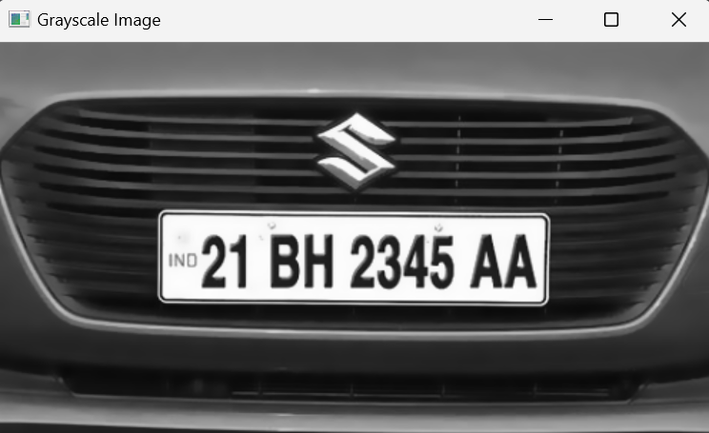
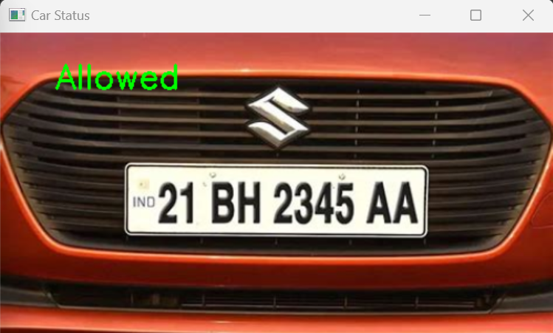
Processflow
1. Vehicle Detection
Image Processing:
The code processes images from the specified directory to detect vehicle number plates.
Contours are used to identify the number plate regions in the images.
Optical Character Recognition (OCR) with Tesseract extracts text from the identified number plate regions.
Registration Check:
The extracted number plate text is checked against a database (text file) to verify if the vehicle is registered.

Slide 7
Processflow
2. Status Logging
Entry and Exit Logging:
For registered vehicles, the code logs entry and exit times into an Excel file.
Each vehicle's status (inside or outside) and the duration of its stay are calculated and recorded.
Slot Management:
The code assigns parking slots to vehicles and updates the slot information in the Excel file.
Duration Calculation:
The duration of each vehicle's stay on the campus is calculated as the difference between entry and exit times.
The calculated duration is formatted into "days, hours, minutes".

Slide 8
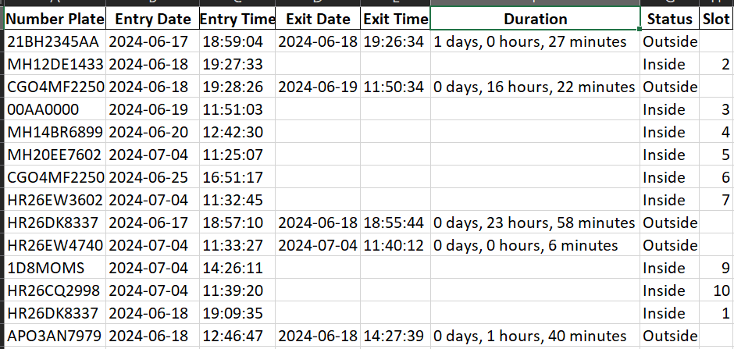
Excel records

Slide 9
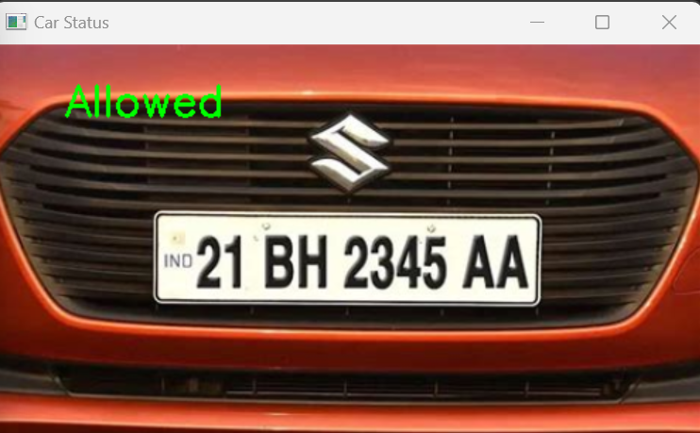
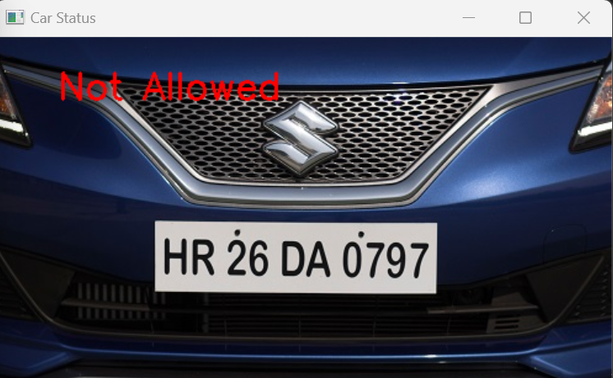
Processflow
3. Alerts and Notifications
Sound Alerts:
A beep sound is played for registered vehicles to alert their detection.
Visual Alerts:
Images of vehicles are displayed with either "Allowed" or
"Not Allowed" text based on registration status.
If the vehicle is not registered, it is marked as "Not Allowed".

Slide 10
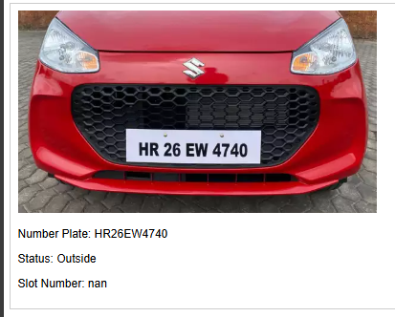
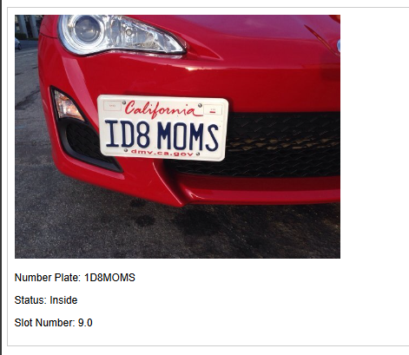
Processflow
4. Visualization
HTML Report Generation:
An HTML page is dynamically generated to visualize the status of all detected vehicles.
The HTML page includes:
Images of vehicles, Number plate information, Status (Inside/Outside), Slot number.

Slide 11
Technologies used
1. Image Processing and Optical Character Recognition (OCR)
OpenCV (cv2): Used for image processing tasks such as reading images, resizing, converting to grayscale, noise reduction, edge detection, and contour finding.
cv2.imread(), cv2.resize(), cv2.cvtColor(), cv2.bilateralFilter(), cv2.Canny(), cv2.findContours(), cv2.arcLength(), cv2.approxPolyDP(), cv2.boundingRect(), cv2.putText(), cv2.imshow(), cv2.waitKey(), cv2.destroyAllWindows()
Imutils: Used for resizing the image.
imutils.resize()
Pytesseract: Used for Optical Character Recognition (OCR) to extract text (license plate numbers) from images.
pytesseract.image_to_string()

Slide 12
Technologies used
2. Data Storage and Manipulation
Pandas: Used for reading and writing data to Excel files and for manipulating data frames.
pd.read_excel(), pd.concat(), pd.DataFrame()
Openpyxl: Used for working with Excel files, including reading and writing data.
load_workbook(), wb.save(), ws.append()
OS module: Used for file and directory operations such as listing files, checking file existence, and getting file modification times.
os.listdir(), os.path.exists(), os.path.isfile(), os.path.getmtime(), os.path.join()
Datetime module: Used for handling date and time operations, including formatting and calculating durations.
datetime.fromtimestamp(), datetime.strptime(), datetime.timedelta()

Slide 13
Technologies used
3. User Alerts
Winsound: Used to play a beep sound as an alert when a registered vehicle is detected.
winsound.Beep()
4. HTML Generation
String manipulation and file writing: The code dynamically generates HTML content and writes it to an HTML file to display vehicle status, including the image of the vehicle, its number plate, status, and slot number.

Slide 14
Technologies used
5. Functions
check_if_string_in_file(file_name, string_to_search): Checks if a specific string (number plate) exists in a text file (database).
process_image(image_path): Processes an image to detect the number plate.
format_duration(duration): Formats a duration into "days, hours, minutes".
get_next_available_slot(df): Determines the next available parking slot.
update_excel(entry_data, exit_data=None): Updates or adds data to the Excel file, managing vehicle entry and exit records.

Slide 15
Team members and contribution
Syed Safiya : Visualization,database& part of image processing
C.Yeswanth kumar : Pattern, dataset & part of image processing
PAPEPALLI PURUSHOTHAM REDDY : Vehicle Movement Analysis & HTML Generation

Slide 16
Conclusion
• Effective Vehicle Detection and OCR:
The system successfully detects vehicle number plates from images using OpenCV for image processing and Tesseract for Optical Character Recognition (OCR).
The detection accuracy is high for clear and well-captured images.
• Registration Verification:
Number plates are verified against a predefined database to check if the vehicle is registered.
Registered vehicles are allowed entry, while unregistered vehicles are flagged as not allowed.
• Efficient Logging:
Entry and exit times of vehicles are logged in an Excel file.
The system calculates and records the duration of each vehicle’s stay on the campus
)

Slide 17
Conclusion
• Real-time Alerts:
The system provides immediate visual and audio alerts for registered vehicles.
"Allowed" or "Not Allowed" labels are displayed on the images of the vehicles based on their registration status.
• Comprehensive Visualization:
An HTML report is generated to visualize the status of all detected vehicles.
The report includes images of vehicles, their number plate information, status, and assigned slot numbers.

