Slide 1
Ch. 5: Support Vector Machines
Stephen Marsland, Machine Learning: An Algorithmic Perspective. CRC 2009
Based on slides by
Pierre Dönnes and Ron Meir
Modified by Longin Jan Latecki, Temple University

Slide 2
Outline
What do we mean with classification, why is it useful
Machine learning- basic concept
Support Vector Machines (SVM)
  Linear SVM – basic terminology and some formulas
  Non-linear SVM – the Kernel trick
An example: Predicting protein subcellular location with SVM
Performance measurments

Slide 3
Classification
Everyday, all the time we classify things.
Eg crossing the street:
  Is there a car coming?
  At what speed?
  How far is it to the other side?
  Classification: Safe to walk or not!!!

Slide 4



Decision tree learning
IF (Outlook = Sunny) ^ (Humidity = High)
THEN PlayTennis =NO
IF (Outlook = Sunny)^ (Humidity = Normal)
THEN PlayTennis = YES
Training examples:
Day Outlook Temp. Humidity Wind PlayTennis
D1 Sunny Hot High Weak No
D2 Overcast Hot High Strong Yes ……
Outlook
Sunny
Overcast
Rain
Humidity
Yes
Wind
High
Normal
Strong
Weak
No
Yes
No
Yes

Slide 5
Classification tasks
Learning Task
  Given: Expression profiles of leukemia patients and healthy persons.
  Compute: A model distinguishing if a person has leukemia from expression data.
Classification Task
  Given: Expression profile of a new patient + a learned model
  Determine: If a patient has leukemia or not.

Slide 6
Problems in classifying data
Often high dimension of data.
Hard to put up simple rules.
Amount of data.
Need automated ways to deal with the data.
Use computers – data processing, statistical analysis, try to learn patterns from the data (Machine Learning)

Slide 7
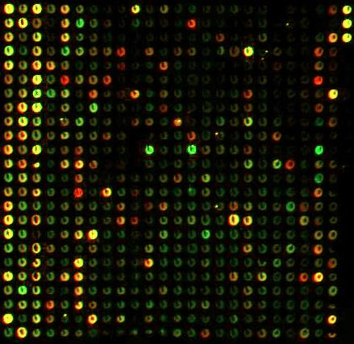
Black box view of
Machine Learning
Test-data
Training data
Model
Model
Magic black box
(learning machine)
Prediction = cancer or not
Training data: -Expression patterns of some cancer +
expression data from healty person
Model: - The model can distinguish between healty
and sick persons. Can be used for prediction.

Slide 8
Tennis example 2
Temperature
Humidity
= play tennis
= do not play tennis

Slide 9
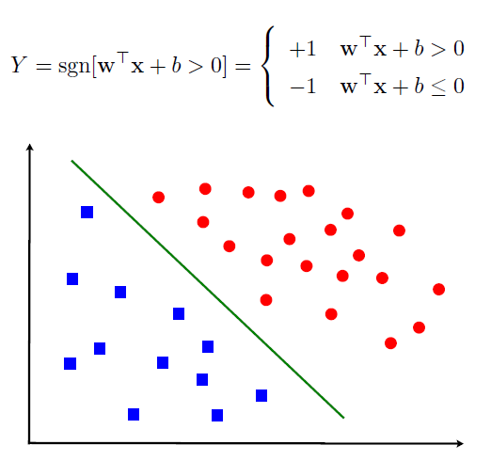
Linearly Separable Classes

Slide 10
Linear Support Vector Machines
Data: <x_{i},y_{i}>, i=1,..,l
x_{i} ∈ R^{d}
y_{i} ∈ {-1,+1}
x2
=+1
=-1
x1

Slide 11
Linear SVM 2
Data: <x_{i},y_{i}>, i=1,..,l
x_{i} ∈ R^{d}
y_{i} ∈ {-1,+1}
f(x)
=-1
=+1
All hyperplanes in R^{d} are parameterized by a vector (w) and a constant b.
Can be expressed as w•x+b=0 (remember the equation for a hyperplane
from algebra!)
Our aim is to find such a hyperplane f(x)=sign(w•x+b), that
correctly classify our data.

Slide 12
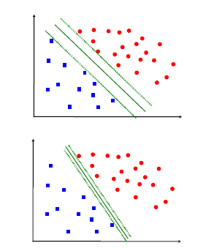
Selection of a Good Hyper-Plane
Objective: Select a `good' hyper-plane using
only the data!
Intuition:
(Vapnik 1965) - assuming linear separability
(i) Separate the data
(ii) Place hyper-plane `far' from data

Slide 13
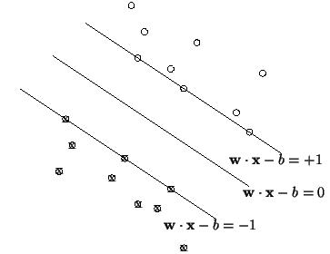

Definitions
Define the hyperplane H such that:
x_{i}•w+b ≥ +1 when y_{i} =+1
x_{i}•w+b ≤ -1 when y_{i} =-1
H1
H1 and H2 are the planes:
H1: x_{i}•w+b = +1
H2: x_{i}•w+b = -1
The points on the planes H1 and H2 are the Support Vectors:
H2
d⁺
d⁻
H
d+ = the shortest distance to the closest positive point
d- = the shortest distance to the closest negative point
The margin of a separating hyperplane is d⁺ + d⁻.

Slide 14
Maximizing the margin
We want a classifier with as big margin as possible.
H1
H
H2
Recall the distance from a point(x₀,y₀) to a line:
Ax+By+c = 0 is|A x₀ +B y₀ +c|/sqrt(A²+B²)
d+
d-
The distance between H and H1 is:
|w•x+b|/||w||=1/||w||
The distance between H1 and H2 is: 2/||w||
In order to maximize the margin, we need to minimize ||w||. With the
condition that there are no datapoints between H1 and H2:
x_{i}•w+b ≥ +1 when y_{i} =+1
x_{i}•w+b ≤ -1 when y_{i} =-1 Can be combined into y_{i}(x_{i}•w) ≥ 1

Slide 15
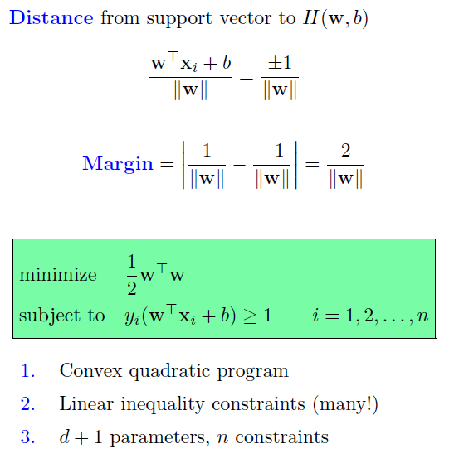
Optimization Problem

Slide 16
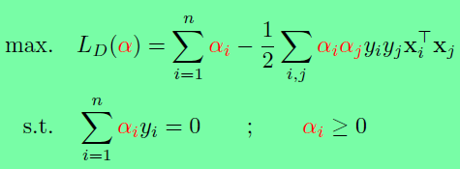
The Lagrangian trick
Reformulate the optimization problem:
A ”trick” often used in optimization is to do an Lagrangian
formulation of the problem.The constraints will be replaced
by constraints on the Lagrangian multipliers and the training
data will only occur as dot products.
What we need to see: x_{i}and x_{j} (input vectors) appear only in the form
of dot product – we will soon see why that is important.

Slide 17
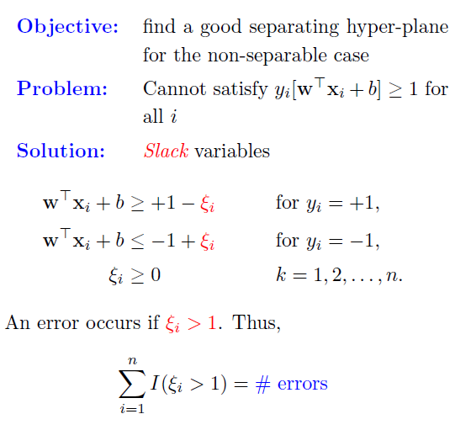
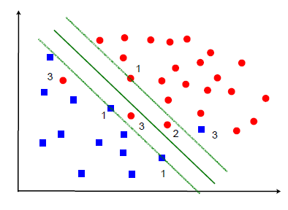
Non-Separable Case

Slide 18
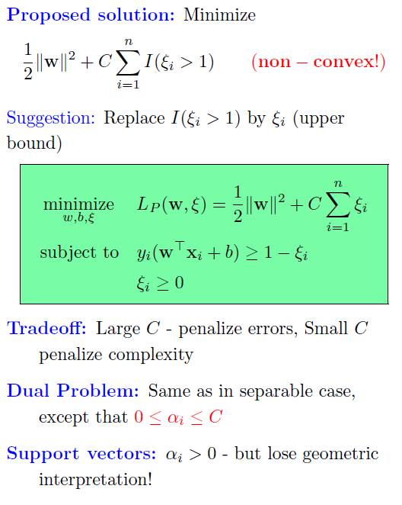
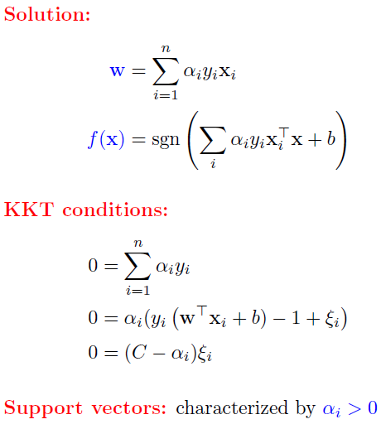

Slide 19
Problems with linear SVM
=-1
=+1
What if the decison function is not a linear?

Slide 20
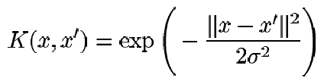
Non-linear SVM 1
The Kernel trick
Imagine a function φ that maps the data into another space:
φ=R^{d}→Η
R^{d}
Η
=-1
=+1
φ
=-1
=+1
Remember the function we want to optimize: L_{D} = ∑α_{i} – ½∑α_{i}α_{j}y_{i}y_{j}x_{i}•x_{j},
x_{i} and x_{j} as a dot product. We will have φ(x_{i}) • φ(x_{j}) in the non-linear case.
If there is a ”kernel function” K such as K(x_{i},x_{j}) = φ(x_{i}) • φ(x_{j}), we
do not need to know φ explicitly. One example:

Slide 21
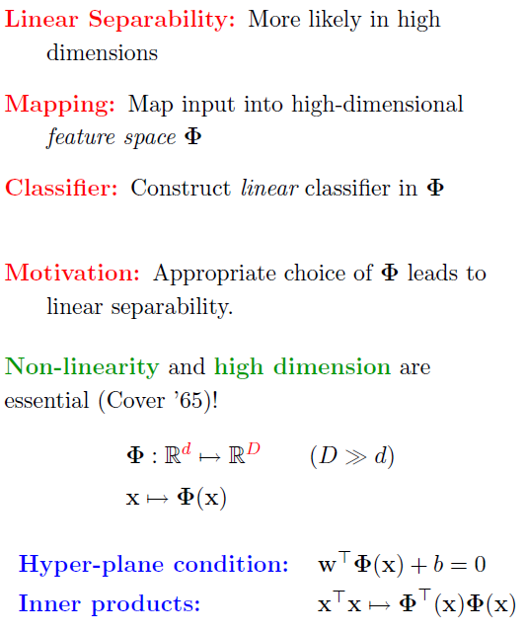

Slide 22
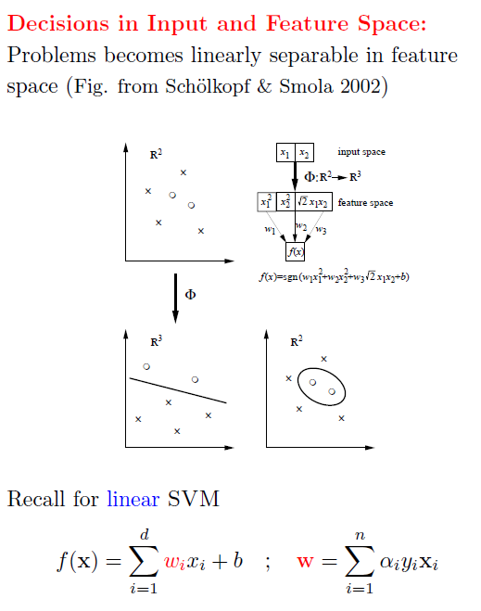

Slide 23
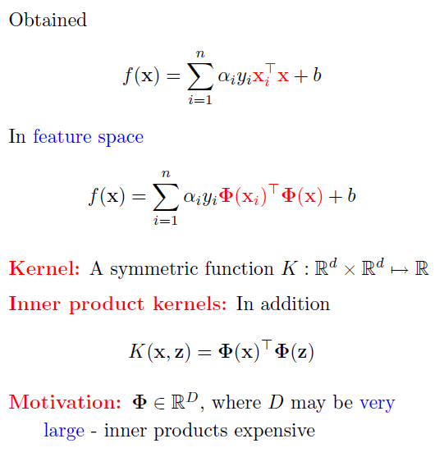

Slide 24
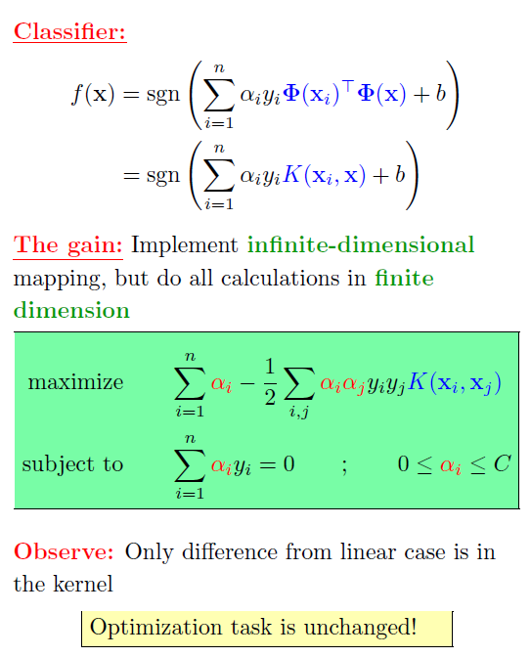

Slide 25
Homework
XOR example (Section 5.2.1)
Problem 5.3, p 131

