Slide 1
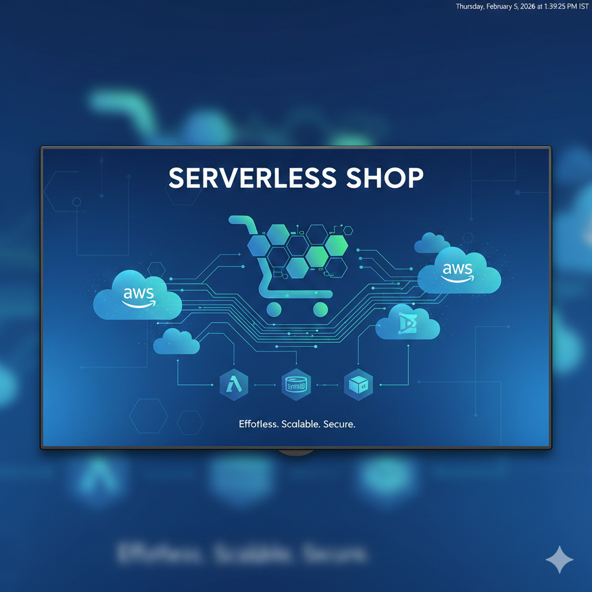
Serverless Shopping Website

Slide 2
Project Overview
Serverless Shopping Website
Built using AWS services
Scalable & cost-effective

Slide 3
SDLC Model
Requirement Analysis
Design
Development
Testing
Deployment
Maintenance

Slide 4
Architecture Design
• HTML, CSS, JavaScript
• Python Lambda Functions
• REST APIs
• S3 – Frontend Hosting
• API Gateway – API Management
• Lambda – Business Logic
• DynamoDB – Database

Slide 5
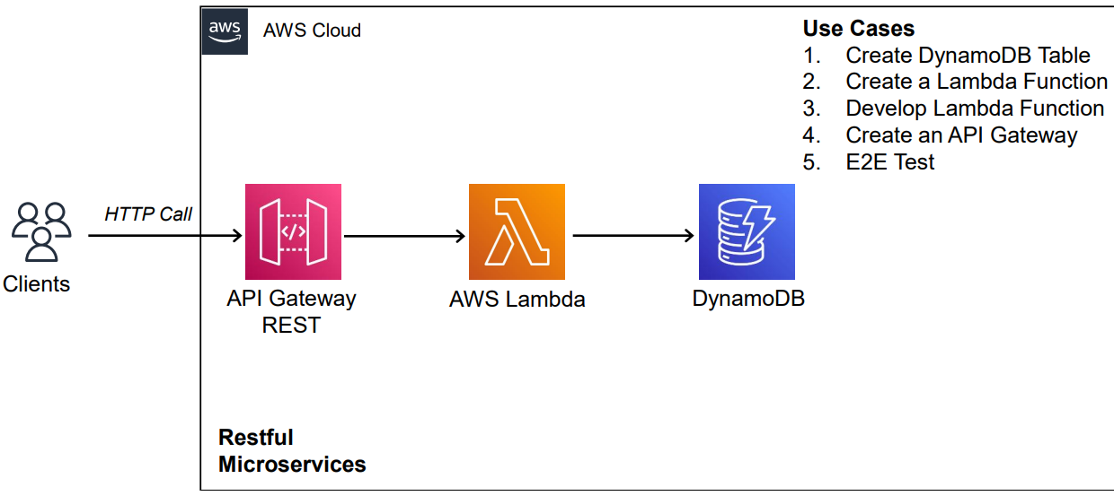
Architecture Flow
User → S3 → API Gateway → Lambda → DynamoDB

Slide 6
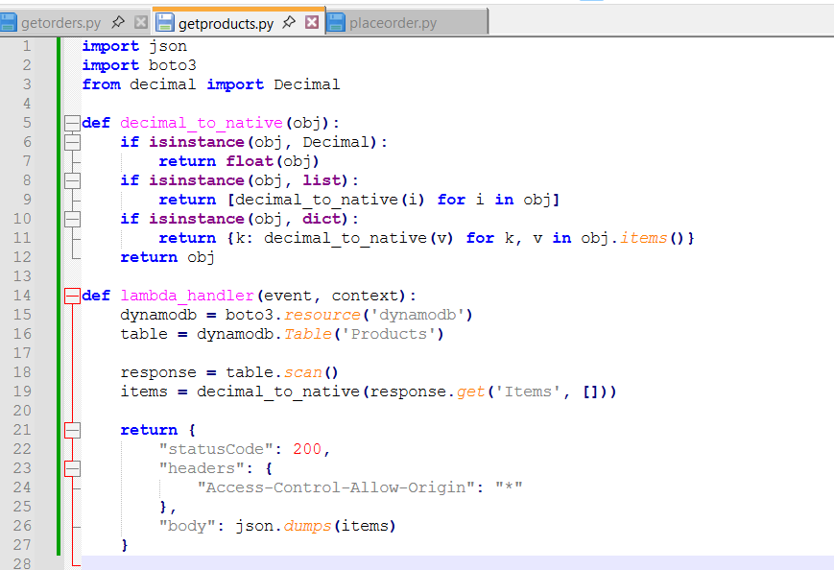
Implementation

Slide 7
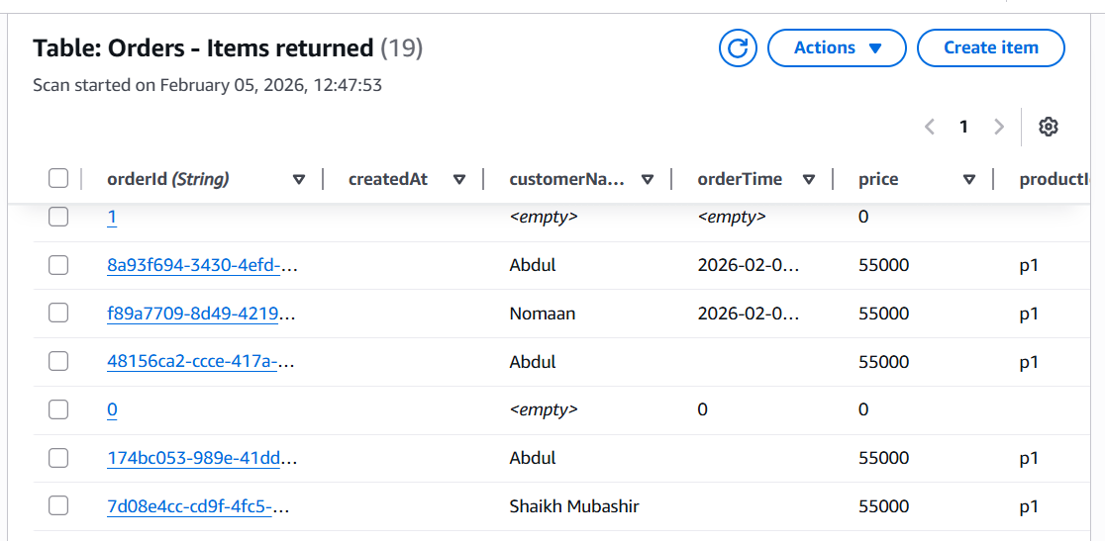
Data in DynamoDB

Slide 8
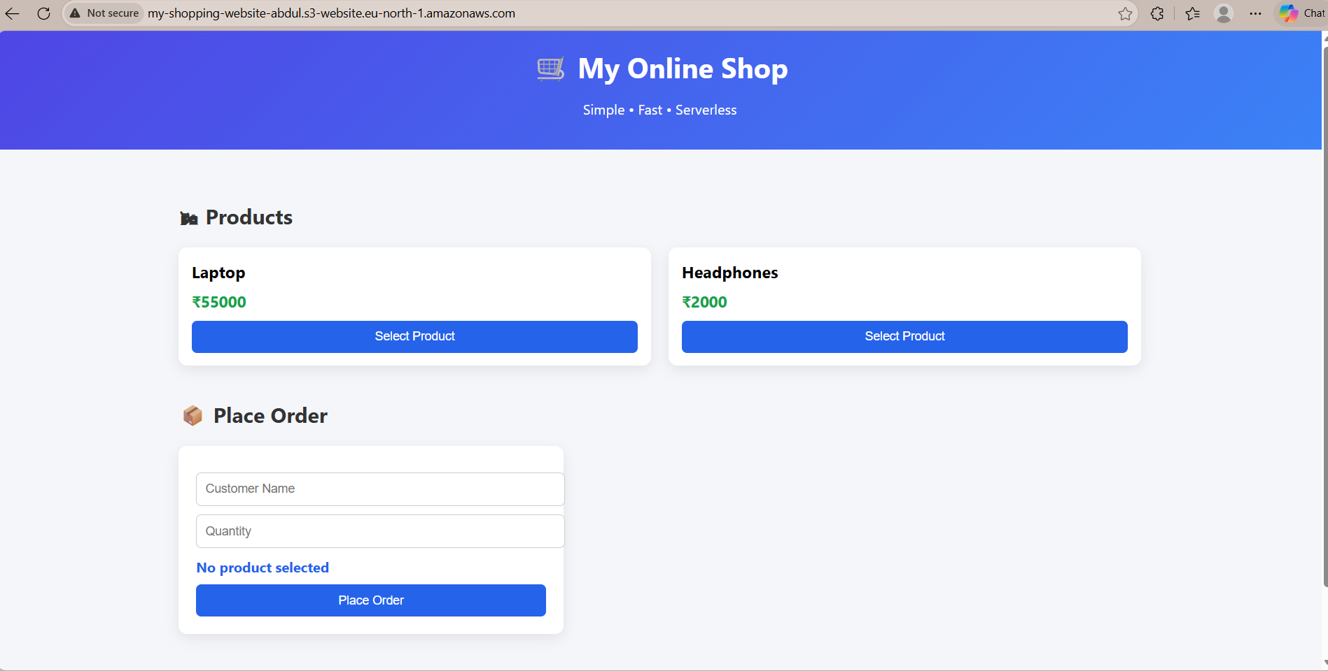
Screenshots

Slide 9
Security
• IAM Roles & Policies
• CORS Configuration

Slide 10
Benefits
• No server management
• Auto-scaling
• Cost efficient

Slide 11
Conclusion
Serverless architecture simplifies deployment and scaling
The url-webhosting : My Online Shop

