Slide 1
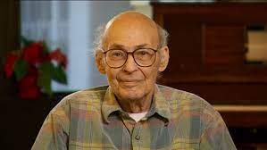

Slide 2
APTECH
The quick brown fox jumps over the lazy dog. The quick brown fox jumps over the lazy dog. The quick brown fox jumps over the lazy dog. The quick brown fox jumps over the lazy dog. The quick brown fox jumps over the lazy dog.
CUMPUTER
The quick brown fox jumps over the lazy dog. The quick brown fox jumps over the lazy dog. The quick brown fox jumps over the lazy dog. The quick brown fox jumps over the lazy dog. The quick brown fox jumps over the lazy dog.
OFFICE WORK
The quick brown fox jumps over the lazy dog. The quick brown fox jumps over the lazy dog. The quick brown fox jumps over the lazy dog. The quick brown fox jumps over the lazy dog. The quick brown fox jumps over the lazy dog.

