Slide 1

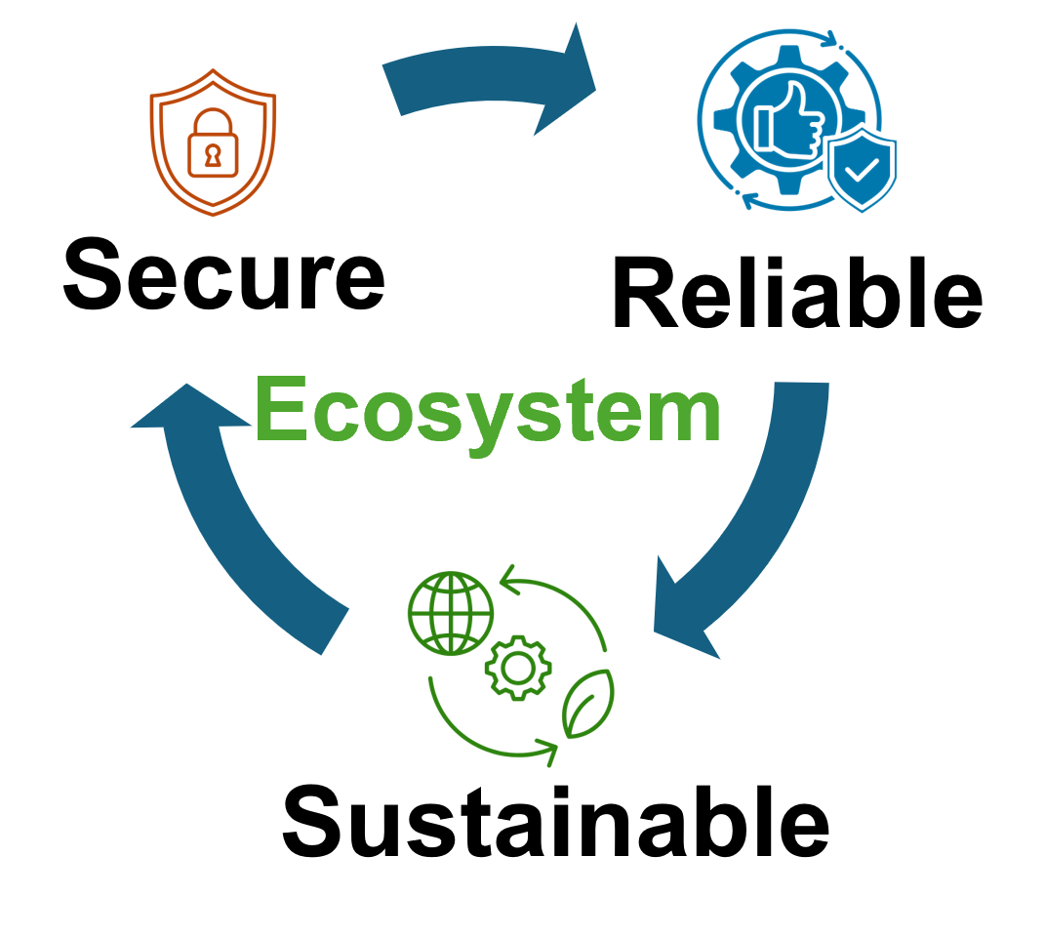


Quantum Crosstalk Mitigation in Multi-Tenant Computing
Presented By,
Syed Emad Uddin Shubha
CS Grad Student, LSU

Slide 2
Crosstalk in Quantum Hardware
Crosstalk = Unintended interaction between qubits.
Causes correlated errors, breaks local noise assumption.
Sources:
Always-on ZZ interactions (superconducting qubits)
Residual XX from Molmer–Sorensen gates (trapped ions)
Frequency crowding, pulse overlap.

Slide 3
Why Crosstalk Matters
Degrades fidelity (up to 20× error in CNOTs)
Violates assumptions in QEC
Interferes with parallelism and scheduling
In MTC, someone can abuse scheduling and degrade one’s performance.
Maybe some information leakage is possible.

Slide 4
Quantum Crosstalk Mitigation
General Methods
Gate Reordering
Cycle-Aware Scheduling (CYCO)
Multi-Tenant Systems
Qubit Allocation Optimization using RL
Employing Spectator Qubits
More possible solutions:
Quantum Differential Privacy
Probabilistic Error Cancellation

Slide 5
Gate Reordering Based on Commutativity
Exploit commutativity of quantum gates (e.g., CNOTs, SWAPs).
Reorder instructions to avoid simultaneous execution of high-crosstalk gates.
3. Uses bidirectional algorithm:
Forward pass → look ahead for interference
Backward pass → adjust past gates
4. Avoids serialization → retains parallelism
5. Up to 18% fidelity gain on average over naive scheduling

Slide 6
Cycle-Aware ZZ Crosstalk Mitigation (CYCO)
* Problem with naive schedulers:
Insert barriers to isolate gates → hurts parallelism
Ignores gate duration and quantum clock cycles
CYCO Approach:
Models active-qubit interference and cross-qubit interference
Schedules gates in cycle windows using new data structure: TDDG (Time and Distance Dependency Graph)
Dynamically inserts/removes barriers
Result: Up to 37% reduction in program cycles, maintains fidelity on IBMQ-Brisbane & Google Bristlecone

