Slide 1

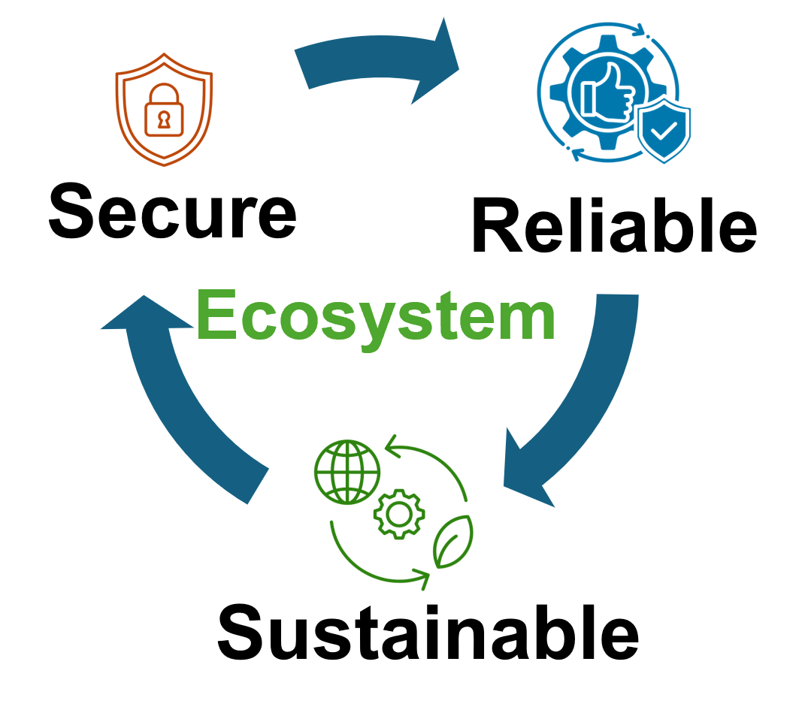


Multi-Tenant Computing in Trapped Ion Quantum Processor
Presented By,
Syed Emad Uddin Shubha
CS Grad Student, LSU
Date: April 23, 2025

Slide 2
Basics of Ion Trap Quantum Computing
- Qubits stored in internal electronic states of ions (e.g., Ca+, Yb+)
- Ions confined in Paul traps using RF and DC fields
- Quantized harmonic motion (shared motional modes)
- Gates:
- Single-Qubit: Laser-driven transitions
- Two-Qubit: Entanglement via shared motional modes (Mølmer–Sørensen gate)
- Readout via state-dependent fluorescence

Slide 3
Unique Strengths of Trapped Ion QC
- Long coherence times (T2 > seconds)
- High gate fidelity (> 99.9%)
- All-to-All connectivity via global motion
- Identical, natural qubits
- Flexible qubit types: Optical, hyperfine, Zeeman

Slide 4
Challenges vs Superconducting Chips
Aspect | Trapped Ion QC | Superconducting QC
Gate Speed | Slow (~10-100 µs) | Fast (~10-100 ns)
Scalability | Harder (trap crowding) | Easier (chip-based)
Connectivity | All-to-All | Nearest-Neighbor
Crosstalk | Global (via motion) | Local (via wires)
Control | Lasers | Microwaves
Example | IonQ, Quantinuum, Sandia National Lab | IBM, Google, Rigetti

Slide 5
MTC Challenges in Trapped Ion QC
MTC: Multiple users share the same quantum hardware simultaneously
Goal: Efficient use of limited quantum resources
Risk: Interference between user programs due to shared resources
*** Challenges in Trapped Ion Processor:
- Shared motional modes link all qubits
- Ion shuttling causes heating, reducing fidelity
- Crosstalk via global interactions
- Long gate times amplify interference
- Spectral crowding complicates isolation

Slide 6
Shuttle-Exploiting Attacks
- Malicious programs induce excessive shuttling
- Victim programs lose fidelity without direct interaction
- Effects:
- Up to 63x fidelity reduction
- Longer programs more vulnerable
- Attack Types:
1. Systematic (needs hardware knowledge)
2. Randomized (trial-based)

Slide 7
Solutions to Shuttle-Based MTC Attacks
1. Random Mapping: Prevent predictable trap allocation
2. Dummy Qubits: Block adversarial access
3. Shuttle Caps: Limit shuttling per program
4. Enhanced Scheduling: Avoid shared heating zones

Slide 8
Future Research Directions
- Real-time dynamic error mitigation
- Privacy-preserving quantum execution protocols
- Scalable modular traps to reduce global coupling
- Quantum security models tailored for ion traps

