Slide 1

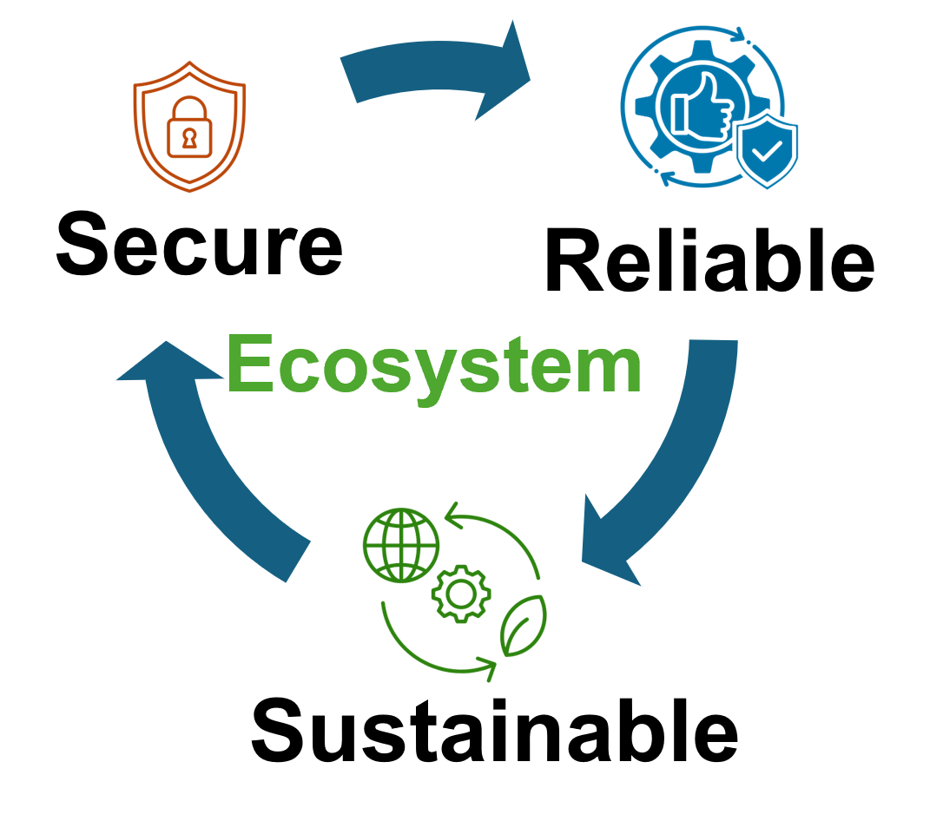


Quantum Crosstalk Mitigation in Multi-Tenant Computing
Presented By,
Syed Emad Uddin Shubha
CS Grad Student, LSU

Slide 2
Crosstalk in Quantum Hardware
Crosstalk = Unintended interaction between qubits.
Causes correlated errors, breaks local noise assumption.
Sources:
Always-on ZZ interactions (superconducting qubits)
Residual XX from Molmer–Sorensen gates (trapped ions)
Frequency crowding, pulse overlap.

Slide 3
Why Crosstalk Matters
Degrades fidelity (up to 20× error in CNOTs)
Violates assumptions in QEC
Interferes with parallelism and scheduling
In MTC, someone can abuse scheduling and degrade one’s performance.
Maybe some information leakage is possible.

Slide 4
Quantum Crosstalk Mitigation
General Methods
Gate Reordering
Cycle-Aware Scheduling (CYCO)
Multi-Tenant Systems
Qubit Allocation Optimization using RL
Employing Spectator Qubits
More possible solutions:
Quantum Differential Privacy
Probabilistic Error Cancellation

Slide 5
Gate Reordering Based on Commutativity
Exploit commutativity of quantum gates (e.g., CNOTs, SWAPs).
Reorder instructions to avoid simultaneous execution of high-crosstalk gates.
3. Uses bidirectional algorithm:
Forward pass → look ahead for interference
Backward pass → adjust past gates
4. Avoids serialization → retains parallelism
5. Up to 18% fidelity gain on average over naive scheduling

Slide 6
Cycle-Aware ZZ Crosstalk Mitigation (CYCO)
* Problem with naive schedulers:
Insert barriers to isolate gates → hurts parallelism
Ignores gate duration and quantum clock cycles
CYCO Approach:
Models active-qubit interference and cross-qubit interference
Schedules gates in cycle windows using new data structure: TDDG (Time and Distance Dependency Graph)
Dynamically inserts/removes barriers
Result: Up to 37% reduction in program cycles, maintains fidelity on IBMQ-Brisbane & Google Bristlecone

Slide 7
RL-Based Qubit Allocation for MTC
In quantum networks (or shared QPUs), qubit reuse creates resource contention + dynamic crosstalk patterns. Hence:
Model as MDP → Optimize expected fidelity + waiting time
Combine Reinforcement Learning with Active Learning to reduce training cost
Learns to dynamically allocate qubits based on:
Fidelity maps, Wait time, Resource occupancy
Impact:19.2% better path maturity & 23.5ms lower average waiting time

Slide 8
Spectator Qubits for Real-Time Calibration
Errors drift over time, frequent recalibration interrupts computations. Hence:
Reserve spectator qubits to monitor coherent errors (e.g., magnetic field drift, crosstalk)
Use this info to adapt control strategies (e.g., over-rotation angle)
Fisher Information and Cramér–Rao bound determine how fast spectator qubits can estimate error parameters.

Slide 9
Quantum Differential Privacy (QDP)
Treat crosstalk as a leaky quantum channel
Use hockey-stick divergence to bound distinguishability from neighboring inputs
Helps design:
Privacy-aware schedulers
Leakage-tolerant QEC schemes
Noise shaping for privacy

Slide 10
Probabilistic Error Cancellation (PEC)
PEC is a zero-noise extrapolation technique.
Model crosstalk-affected gate as a noisy channel.
Decompose into ideal + error operations, sampled via quasi-probabilities.
It uses Gate Set Tomography (GST) to learn how each gate deviates from the ideal.
GST process can be extended to include correlated gate pairs.

Slide 11
Research Ideas
We might combine these ideas but still need a better way to proceed.
References:
https://github.com/syedshubha/CrosstalkMTC

