Slide 1

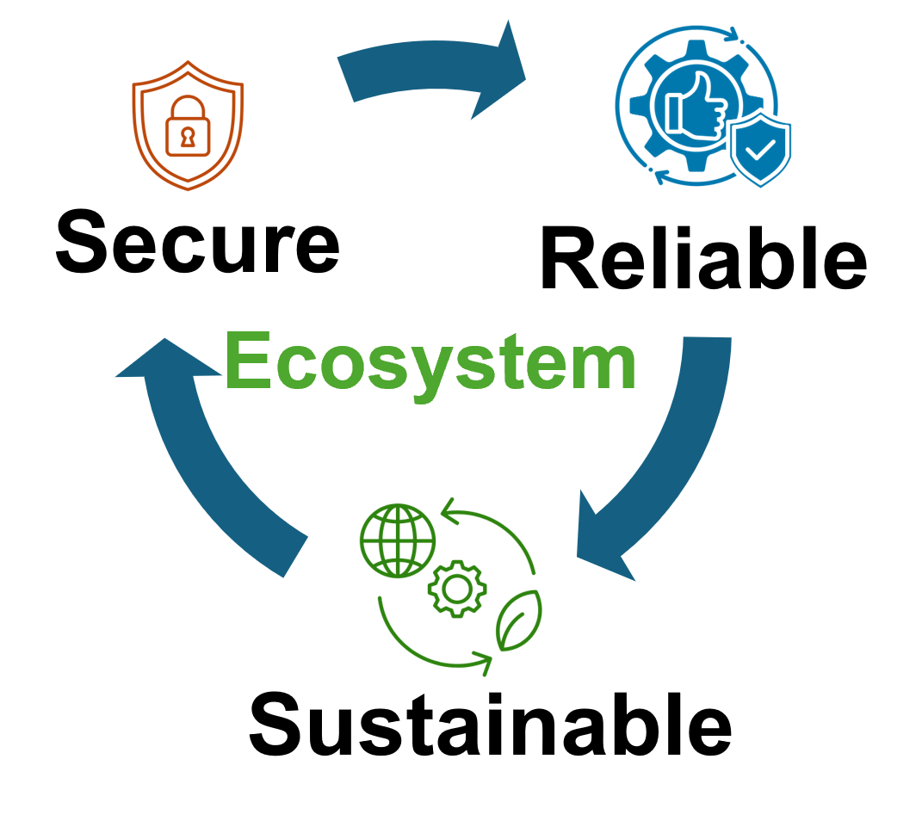


FPGA-Based Quantum Control and Bit-Flip Resilience
Presented By,
Syed Emad Uddin Shubha
CS Grad Student, LSU
Date: April 22, 2025

Slide 2
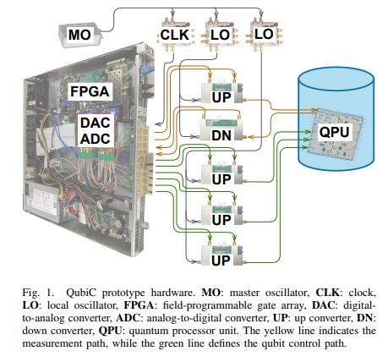
QubiC 1.0 Overview
FPGA-based (pulse level) control system for superconducting qubits.
Focused on generating static pulse-level instructions.
Waveforms: pre-defined envelopes stored in FPGA BRAM, modulated using CORDIC-based DSP.
Modular full-stack (Hardware, Gateware, Software).
Lacks mid-circuit measurement, real-time adaptability.
Suitable for small-scale, static quantum circuits.

Slide 3
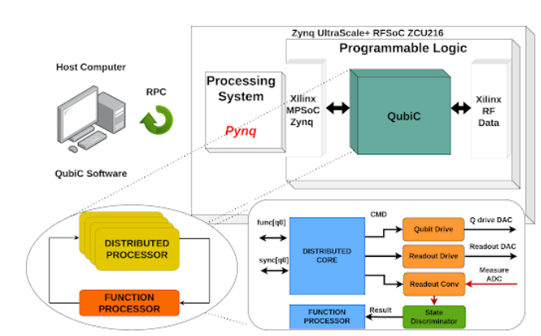
QubiC 2.0 Overview
• Supports adaptive, real-time control and feedback.
• Parameterized waveform updates: amplitude, phase, frequency.
• Distributed processing: one processor per qubit, enabling scalability and low-latency.
• Multi-FPGA synchronization for large quantum processors.
• Enables fast reset and conditional quantum operations.

Slide 4
Comparison of QubiC 1.0 and 2.0
Qubic 1.0 | Qubic 2.0
Pre-stored, static waveforms, fixed modulation parameters, no feedback capability | Reusable pulse envelopes with dynamic parameter updates and Real-time control.
Single FPGA focus | Multi-FPGA synchronized systems.
No mid-circuit measurement or conditional logic. | Supports fast reset, mid-circuit conditional operations.
Suitable for static cases: Gate Calibration, State preparation and Readout. | Suitable for Dynamic cases, like Randomized compiling, Quantum Error Correction
Developed and tested at LBNL | Tested at LBNL too but can be deployed in large-scale superconducting qubit platforms.

Slide 5
Hardware, Firmware & Software Comparison
 | Qubic 1.0 | Qubic 2.0
Hardware | FPGA: Xilinx VC707 board. DAC/ADC: FMC120. External RF Mixer & LO Module. | FPGA: Xilinx ZCU216 RFSoC. Integrated DAC/ADC (RFSoC). Custom Analog Front-End (AFE) board for signal conditioning. Multi-FPGA synchronization with sub-2 ps jitter.
Firmware | CORDIC-based DSP Static pulse generation Waveforms stored in BRAM, pre-loaded. | Distributed processors (1 per qubit) for real-time control. Parameterized waveforms, dynamically updated during execution. Mid-circuit measurement, fast reset, conditional logic.
Software | Basic Python interface. Static Pulse compiler | Python stack with PYNQ framework on Zynq ARM core. Pulse compiler supports control flow (if/else, loops).

Slide 6
Bit-Flip Error Study: Motivation
• FPGA BRAMs are vulnerable to bit-flip errors (EMI, power noise, aging, attacks).
• QubiC 1.0 & QubiC 2.0 both default to floating-point storage for waveform data in BRAM.
Control electronics errors propagate to qubit operations, reducing fidelity.
Need to quantify impact of bit-flips and explore robust data representations.

Slide 7
Bit-Flip Error Study: Methodology and Findings
Simulated bit-flips (Qiskit for pulse-level simulation) in amplitude/phase data using IBM Fake Backends (FakeValencia, FakeManila, FakeLima).
Measured impact using Total Variation Distance (TVD) between ideal and faulted circuits: TVD quantifies the difference in output distributions, reflecting control fidelity.
Focused on real part, imaginary part, and phase sensitivity.
Findings:
• Floating-point: Exponent/mantissa flips → severe errors (TVD ↑ ~200%).
• Fixed-point: More resilient (TVD < 25% beyond bit 5).
• Real part of amplitude most critical; imaginary & phase less sensitive.

Slide 8
Recommendations and Limitations
Recommendations:
Shift to fixed-point storage for pulse data in FPGA.
• Implement error detection and correction (EDAC) in memory handling.
• Design for robust control under varying environmental conditions.
Limitation:
No real error correction (ECC/Hamming) implemented, only discussed.
Focus on single bit-flips, not multi-bit or real hardware testing. Future work could involve testing multi-bit flip scenarios.

Slide 9
Does Qubic 2.0 address Bit Flip Issue?
• QubiC 2.0 improves control adaptability but assumes reliable memory.
• Floating-point vulnerability identified in bit-flip paper remains unaddressed.
• Fixed-point suggested in paper; QubiC 2.0 can benefit but does not enforce it.
• ECC or Hamming codes not implemented in QubiC 2.0 memory handling (but can be implemented).
While QubiC 2.0 excels in control adaptability, hardware-level resilience remains an open design consideration.

Slide 10
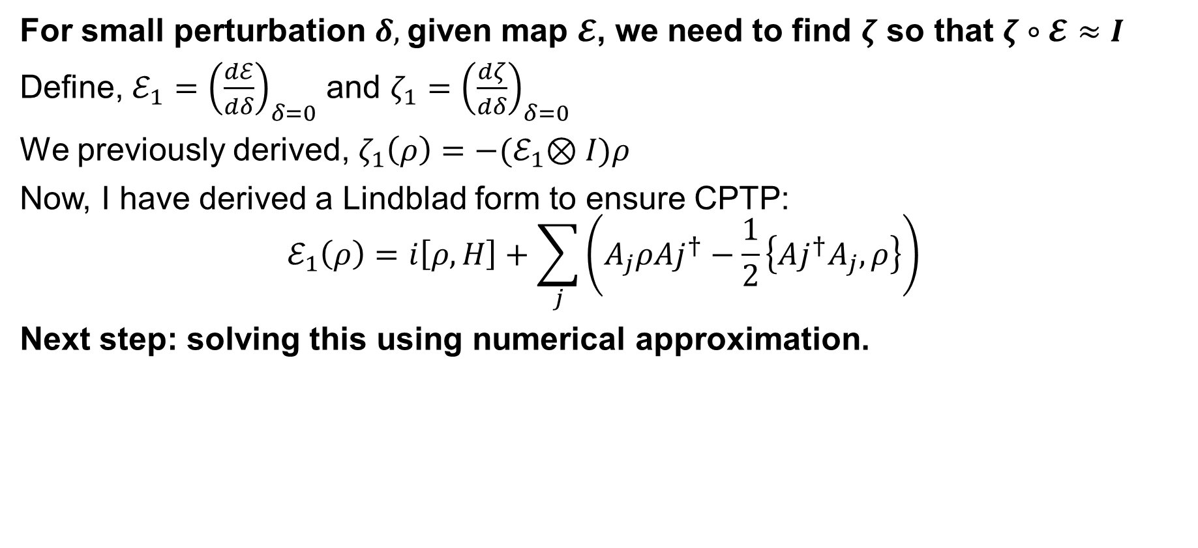
Results Regarding Adaptive Purification
For small perturbation $δ,$given map $𝓔$, we need to find $ζ$ so that $ζ∘𝓔≈I$
Define, $ℰ_{1}={\left(\frac{dℰ}{dδ}\right)}_{δ=0}$ and $ζ_{1}={\left(\frac{dζ}{dδ}\right)}_{δ=0}$
We previously derived, $ζ_{1}\left(ρ\right)=−{(ℰ}_{1}⊗I)ρ$
Now, I have derived a Lindblad form to ensure CPTP:
$$ℰ_{1}\left(ρ\right)=i\left[ρ,H\right]+\sum_{j}{\left(A_{j}ρAj^{†}−\frac{1}{2}\left\{Aj^{†}A_{j}, ρ\right\}\right)}$$
Next step: solving this using numerical approximation.

