Slide 1



Impact of Qubit Mapping and Connectivity on Quantum Machine Learning Output by Syed Emad Uddin Shubha 8 January, 2025

Slide 2
Qubit Mapping in QML
QML algorithms, such as those used for classification, regression, and quantum neural networks, rely on quantum circuits to perform computations.
The efficiency and accuracy of these algorithms depend not only on the quantum gates but also on how logical qubits are mapped to physical qubits on the quantum device.
Qubit mapping refers to assigning quantum circuit qubits to physical qubits on a quantum processor, ensuring that qubits which need to interact are connected, or minimizing swap operations if they are not directly connected.
Paper references:
https://ieeexplore.ieee.org/stamp/stamp.jsp?tp=&arnumber=8382253
https://arxiv.org/pdf/2310.09826

Slide 3
Solving the Mapping Problem: Cirq & PennyLane
Cirq and PennyLane both automate the qubit mapping process, making it easier for developers to focus on the quantum algorithm without manually optimizing the mapping.
Cirq (from Google) offers tools like cirq.optimize_for and cirq.routing which can find the most efficient way to map logical qubits to physical qubits based on the connectivity of the quantum hardware.
PennyLane (from Xanadu), while more focused on hybrid quantum-classical workflows, also integrates tools for mapping qubits efficiently when running on various quantum hardware backends (including those from IBM, Google, and others). It uses optimization algorithms to reduce the number of swap operations required.

Slide 4
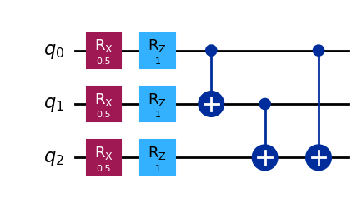
QNN Example
The code can be found here:
https://colab.research.google.com/drive/134NdNGrTGoZmY2_ZEBXm6Weleu3o05w3?usp=sharing

Slide 5
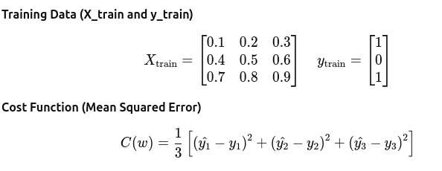
The cost function

Slide 6
Swap Penalty and Its Impact on Qubit Mapping
Swap penalty refers to the additional cost (in terms of quantum operations) introduced when qubits that need to interact are not directly connected in the quantum hardware’s topology.
In other words, the swap penalty increases when qubits that should interact must be swapped because they're not adjacent or connected directly.
Let's assume a linear chain of physical qubits: 0 -- 1 – 2
The swap penalty increases based on how far apart two qubits are in the physical topology when they need to interact. If qubits are not directly connected, the system must perform SWAP operations to facilitate interactions.
The swap_penalty() function computes the penalty by checking the distance between qubits in the given mapping.

Slide 7
Swap Penalty Calculation
Different logical-to-physical qubit mappings lead to different swap penalties because of the physical connectivity. Here are three possible mappings:
Mapping 1: Logical qubit 0 → Physical qubit 0, Logical qubit 1 → Physical qubit 1, Logical qubit 2 → Physical qubit 2 (Consecutive mapping).
Mapping 2: Logical qubit 0 → Physical qubit 1, Logical qubit 1 → Physical qubit 2, Logical qubit 2 → Physical qubit 0 (Non-consecutive mapping).
Mapping 3: Logical qubit 0 → Physical qubit 2, Logical qubit 1 → Physical qubit 0, Logical qubit 2 → Physical qubit 1 (Non-consecutive mapping).
The swap penalty will be zero or minimal for Mapping 1 because qubits are adjacent.
Mappings 2 and 3 will likely have higher swap penalties due to the non-local interactions (i.e., qubits that should interact are far apart and need swaps).

Slide 8
Minimizing the Cost Function for QML
Mapping | Description | Cost Function Value (MSE)
Mapping 1 | Logical 0 → 0, Logical 1 → 1, Logical 2 → 2 | 1.2266
Mapping 2 | Logical 0 → 1, Logical 1 → 2, Logical 2 → 0 | 2.2266
Mapping 3 | Logical 0 → 2, Logical 1 → 0, Logical 2 → 1 | 2.2266
Mapping 1 has the lowest cost, meaning this mapping leads to the best performance in terms of minimizing the cost function (MSE).
Mappings 2 and 3 show a higher cost, indicating that the prediction errors are larger, possibly due to non-local qubit interactions that increase the swap penalty.
Please refer to the full code here:
https://colab.research.google.com/drive/134NdNGrTGoZmY2_ZEBXm6Weleu3o05w3?usp=sharing

Slide 9
Future Plan
Understanding how CNN can be modeled using QAOA.
Understanding some QML techniques.
Finding research scopes of QML.
Thank you!

