Slide 1

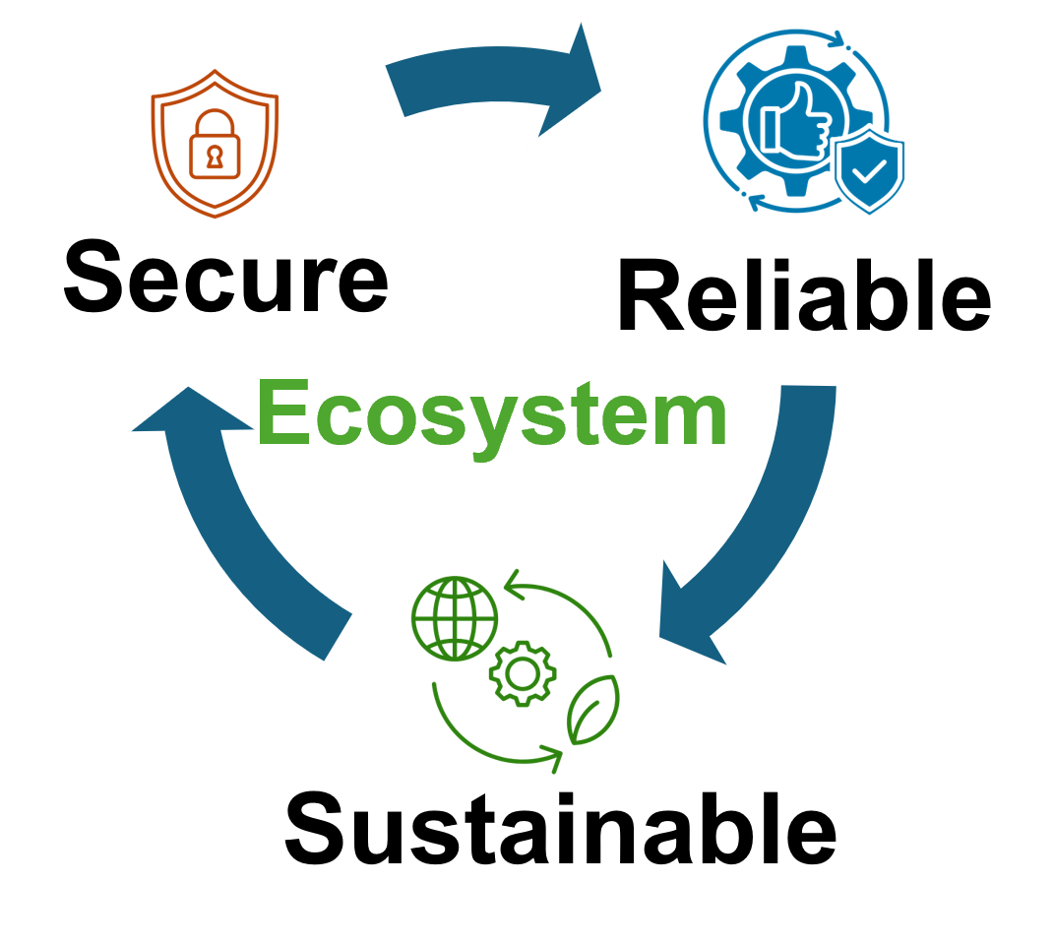


29th April 2025
Syed Emad Uddin Shubha
CS Graduate Student, Louisiana State University

Slide 2
Context Switching - Motivation
Context Switching for Secure Multi-programming of Near-Term Quantum Computers
Quantum processors are increasingly shared among multiple users.
Context: Which users’ job are currently executed together.
Crosstalk between concurrent quantum programs can degrade fidelity.
Attackers can exploit crosstalk without hardware knowledge (Zero Knowledge Tampering Attack - ZKTA).

Slide 3
Context Switching - Summary
What they did:
Proposed QONTEXTS: randomized context switching among co-running programs.
Statistical modeling of attack success probability.
Detection of anomalies using Hellinger distance.
Tools:
They assumed superconducting hardware.
Provided numerical simulations.

Slide 4
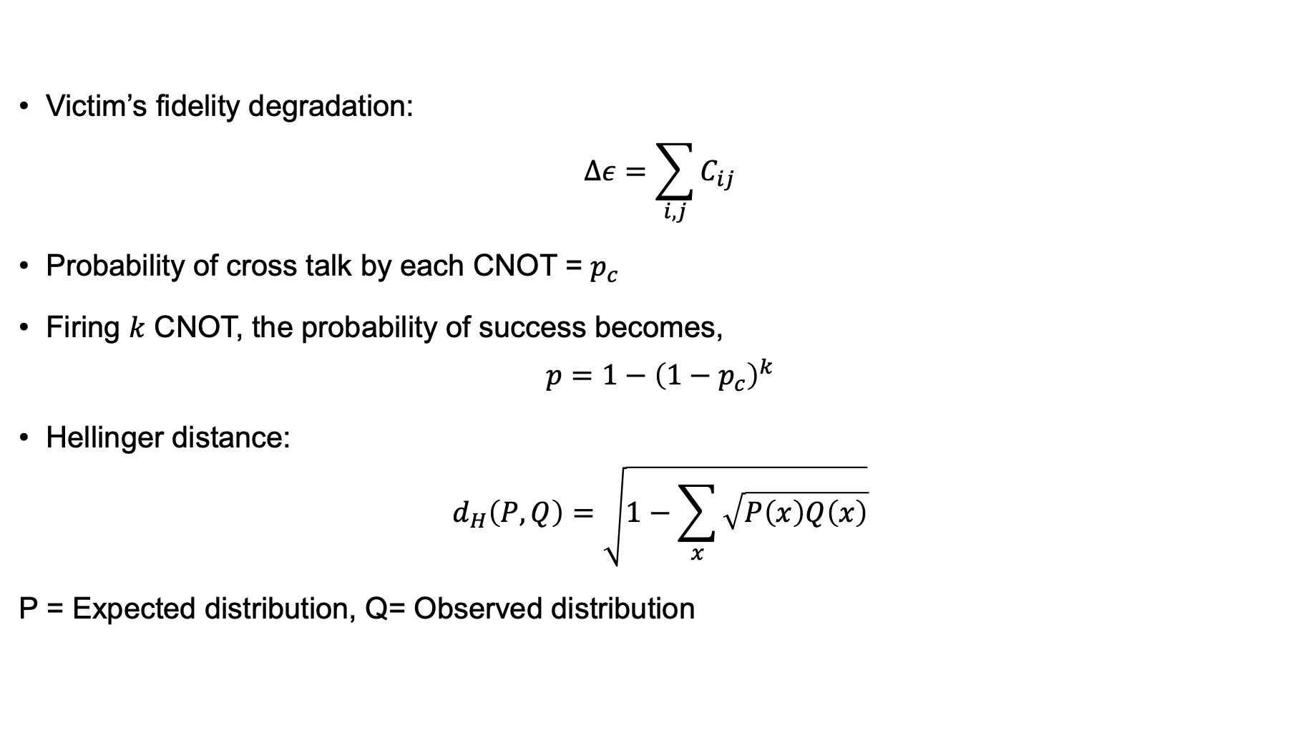
Context Switching - Modelling
Victim’s fidelity degradation:
$$Δε=\sum_{i,j}{C_{ij}}$$
Probability of cross talk by each CNOT = $p_{c}$
Firing $k$ CNOT, the probability of success becomes,
$$p=1−{\left(1−p_{c}\right)}^{k}$$
Hellinger distance:
$$d_{H}\left(P,Q\right)=\sqrt{1−\sum_{x}{\sqrt{P\left(x\right)Q\left(x\right)}}}$$
P = Expected distribution, Q= Observed distribution

Slide 5

Context Switching - Limitations
Author assumed $k$ could be chosen as large as possible. – But no! This is an unrealistic attacker model, ignores qubit allocation and concurrency constraints.
Not everyone knows the intended distribution, thus Hellinger Distance may not work.
Similar attacks (i.e., SWAP injection) has been previously studied. This problem is less severe and easily manageable by proper qubit allocation and intelligent transpiler.

Slide 6
Guess, SWAP, Repeat - Motivation
Guess, SWAP, Repeat — Capturing Quantum Snapshots in Classical Memory
Capture quantum snapshots without full state tomography.
Enable non-destructive learning of unknown quantum states.
Reduce resource requirements for state reconstruction.

Slide 7
Guess, SWAP, Repeat – Summary
What They Did:
Used SWAP test fidelity as feedback for ML models.
Applied gradient descent and evolutionary algorithms.
Built ensemble of guessed states through optimization.
Method:
SWAP Test to estimate fidelity.
Machine learning optimization over parameter space.
Multiple shots for ensemble averaging.

Slide 8
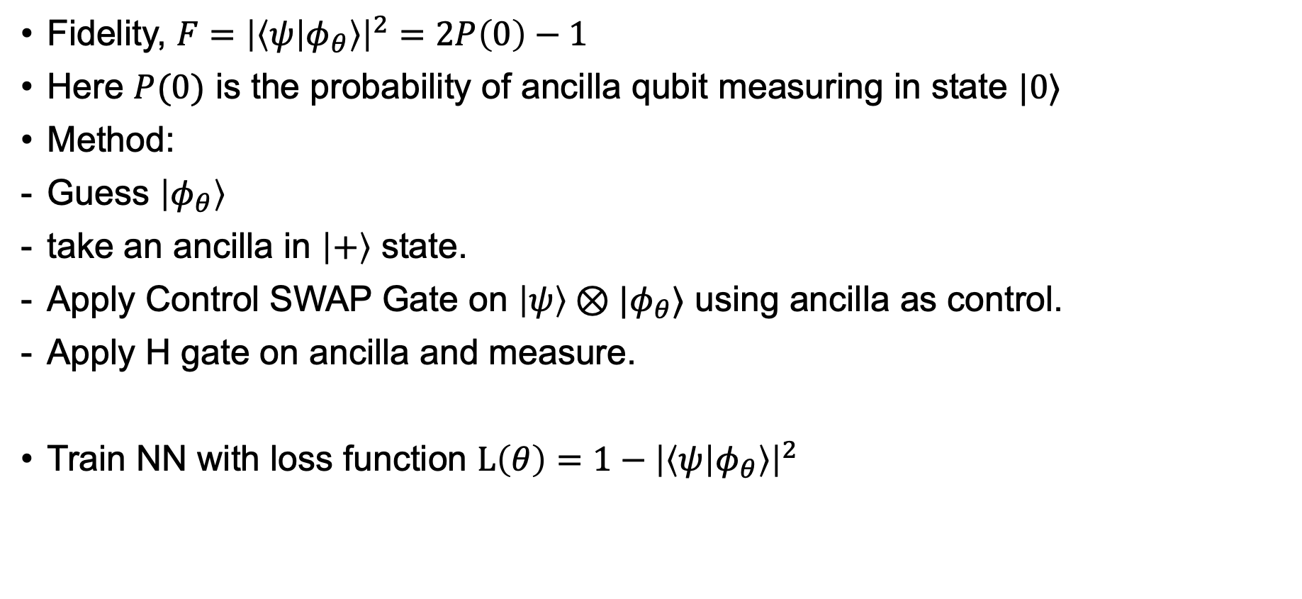
Guess, SWAP, Repeat – Modelling
Fidelity, $F={\left|\left\langle ψ | φ_{θ}\right\rangle \right|}^{2}=2P\left(0\right)−1$
Here $P(0)$ is the probability of ancilla qubit measuring in state $|0⟩$
Method:
Guess $\left|φ_{θ}\right\rangle$
take an ancilla in $\left|+\right\rangle$ state.
Apply Control SWAP Gate on $\left|ψ\right\rangle ⊗|φ_{θ}⟩$ using ancilla as control.
Apply H gate on ancilla and measure.
Train NN with loss function $L\left(θ\right)=1−{\left|\left\langle ψ | φ_{θ}\right\rangle \right|}^{2}$

Slide 9
Guess, SWAP, Repeat – Limitation
Requires fresh copies per SWAP test, destructive in ensemble.
Scales poorly: exponential copies needed for multi-qubit states.
Did not compare against Direct Fidelity Estimation or Shadow Tomography.
Optimization faces barren plateau problems.

Slide 10
Trojan Attack on BB84 - Motivation
Imperfect preparation and Trojan attack on the
phase modulator in the decoy-state BB84 protocol
Analyze Trojan horse attacks targeting Alice's phase modulator (PM).
Model realistic leakage in QKD settings.
Preserve security in imperfect device scenarios.

Slide 11
Trojan Attack on BB84 - Summary
Decoy-State BB84: varying pulse intensities to detect photon number splitting attacks.
Device-Independent QKD (DI-QKD): security based on Bell violation, no device trust needed.
Homodyne/heterodyne detection models for Eve's measurements.
What they did:
Modeled Trojan attack with arbitrary probe states.
Introduced effective worst-case emission model.
Applied finite-key analysis using Chernoff bounds.

Slide 12
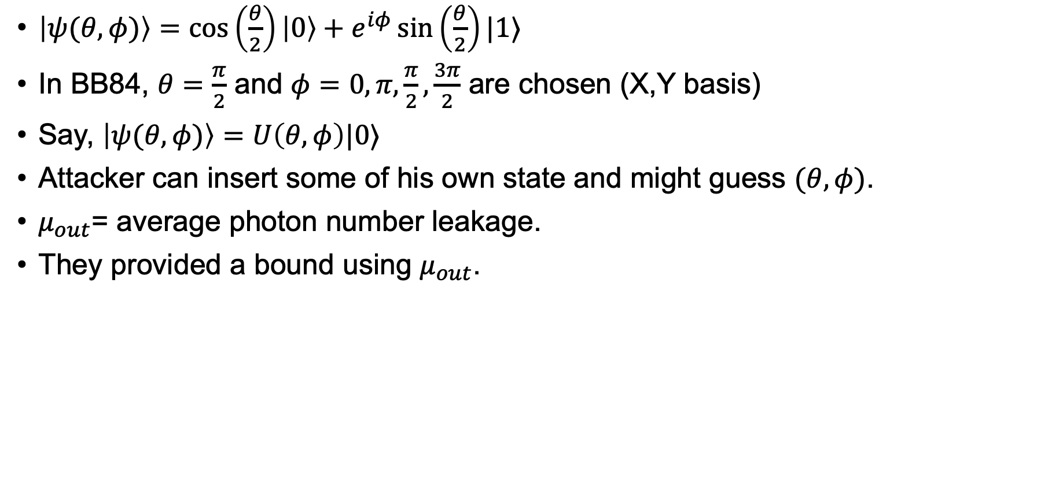
Trojan Attack on BB84 - Modelling
$\left|ψ(θ,φ)\right\rangle =\cos\left(\frac{θ}{2}\right)\left|0\right\rangle +e^{iφ}\sin\left(\frac{θ}{2}\right)|1⟩$
In BB84, $θ=\frac{π}{2}$ and $φ=0,π,\frac{π}{2},\frac{3π}{2}$ are chosen (X,Y basis)
Say, $\left|ψ(θ,φ)\right\rangle =U\left(θ,φ\right)|0⟩$
Attacker can insert some of his own state and might guess $(θ,φ)$.
$μ_{out}$= average photon number leakage.
They provided a bound using $μ_{out}$.

Slide 13
Trojan Attack on BB84 - Limitation
Assumes very small leakage: relies on perfect isolators/filters.
Passive protections might be insufficient against stronger attacks.
Decoy states defend PNS attacks, not Trojan probing directly.
DI-QKD would fundamentally solve the issue but is currently impractical.

Slide 14
Future Plan
Context Switching: Designing an efficient compiler so that the number of CNOT can never cross a certain value. Now what we need to look for is, if someone can take advantage of circuit ‘barrier’ in their code. We also need to know if such compiler already exist or not.
Tomography: Gotta read Shadow Tomography paper.
Device Independent Quantum Key Distribution, if Non-Contextual Inequalities can be used. But we need a solid usage of DI-QKD in security.

Slide 15
People and Conferences to follow
Robert Huang: https://hsinyuan-huang.github.io
Scott Aaronson: https://www.scottaaronson.com
Ewin Tang: https://ewintang.com
QIP:
QIP doesn't publish proceedings; it showcases impactful research (potentially already published elsewhere) and authors retain rights to publish later. Presenting at QIP (as talk or poster) is about sharing significant findings with experts, not formal QIP publication.
Here are some good conference for quantum computing: https://quantumpositioned.com/best-quantum-computing-conferences/

