Slide 1

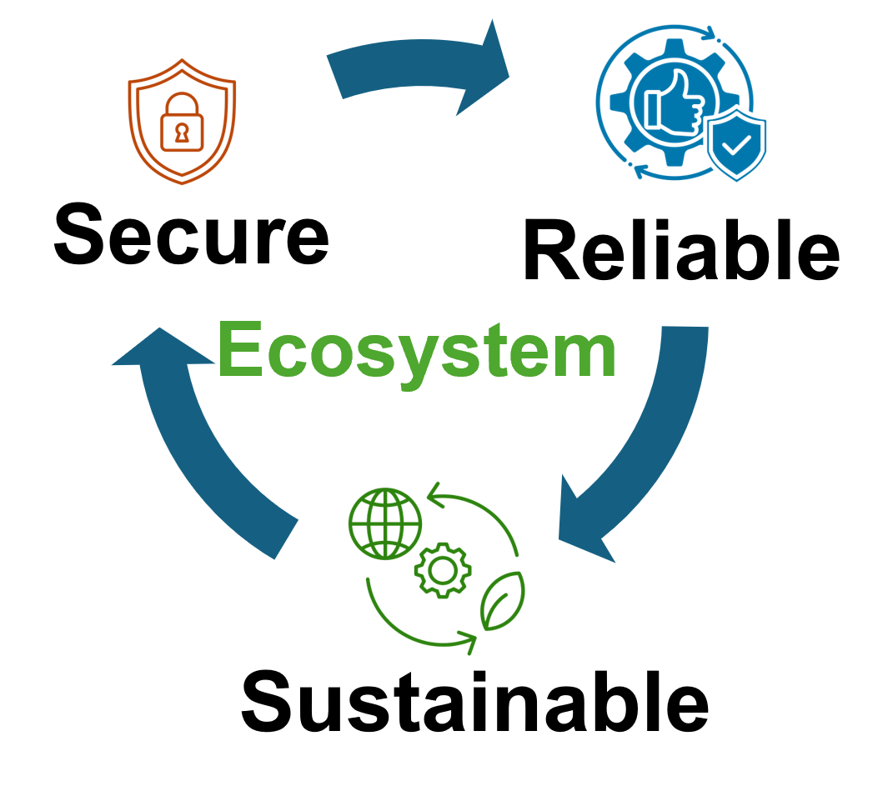


Stealthy SWAPs Adversarial SWAP Injection in Multi-Tenant Quantum Computing Suryansh Upadhyay, Swaroop Ghosh Pennsylvania State University
Presented By,
Syed Emad Uddin Shubha
CS Grad Student, LSU

Slide 2
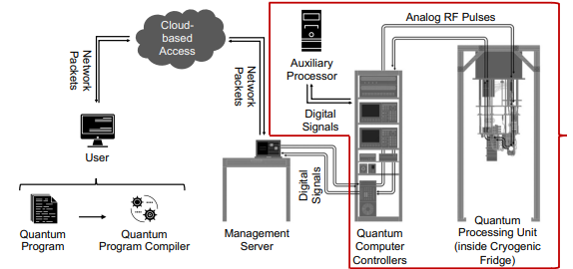
Previous Paper
Assumed single tenant computing

Slide 3
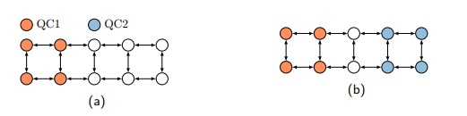
Multi-Tenant Computing (MTC)
A four-qubit circuit is executed on a 10-qubit device. The hardware throughput is 40%.
Two four-qubit circuits are executed on the same device in parallel. The hardware throughput becomes 80%.
How should we allocate qubits to multiple circuits?
Can two circuits run in parallel safely?
How do schedulers decide qubit allocation?
Can a malicious user trick the scheduler?

Slide 4
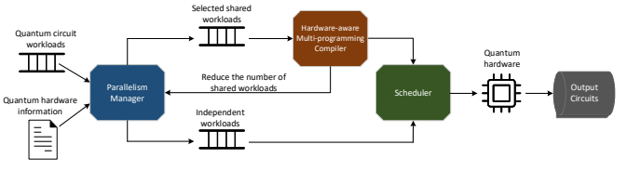
How to allocate qubits to multiple circuits?
QuMC framework
The parallelism manager decides whether to execute circuits simultaneously or independently.
For simultaneous executions, it works with the hardware-aware multi-programming compiler to select an optimal number of shared workloads to be executed in parallel.
These circuits are allocated to reliable partitions and then passed to the scheduler. It makes all the circuits
executable on the quantum hardware and we can obtain the results of the output circuits.

Slide 5
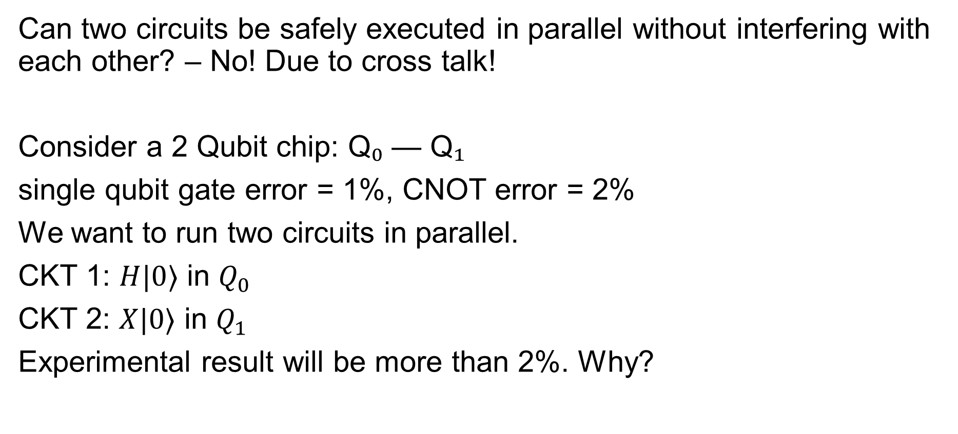
Can two circuits run in parallel safely?
Can two circuits be safely executed in parallel without interfering with each other? – No! Due to cross talk!
Consider a 2 Qubit chip: Q₀ — Q₁
single qubit gate error = 1%, CNOT error = 2%
We want to run two circuits in parallel.
CKT 1: $H|0⟩$ in $Q_{0}$
CKT 2: $X|0⟩$ in $Q_{1}$
Experimental result will be more than 2%. Why?

Slide 6
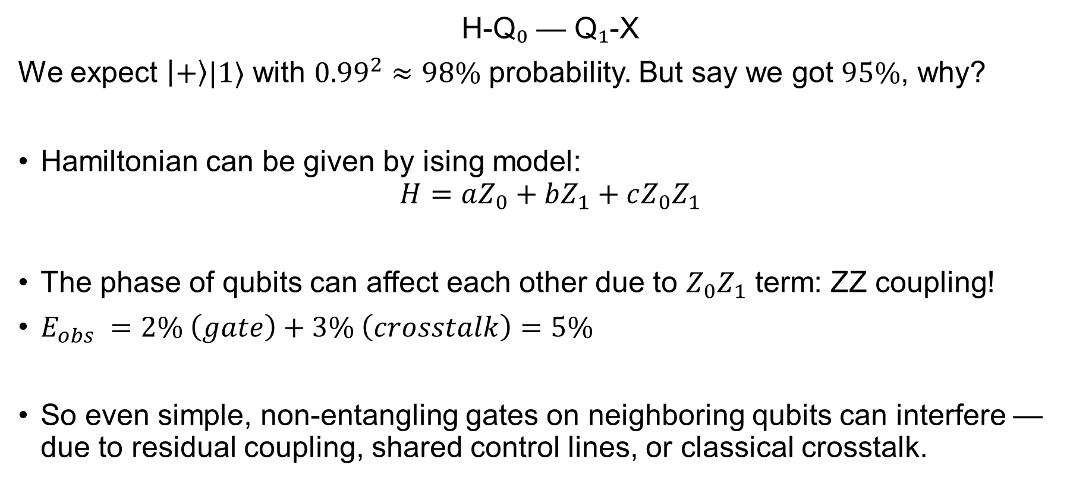
Why is observed error > 2%?
H-Q₀ — Q₁-X
We expect $\left|+\right\rangle |1⟩$ with ${0.99}^{2}≈98\%$ probability. But say we got $95\%$, why?
Hamiltonian can be given by ising model:
$$H=aZ_{0}+bZ_{1}+cZ_{0}Z_{1}$$
The phase of qubits can affect each other due to $Z_{0}Z_{1}$ term: ZZ coupling!
$E_{obs} =2\% \left(gate\right)+3\% \left(crosstalk\right)=5\%$
So even simple, non-entangling gates on neighboring qubits can interfere — due to residual coupling, shared control lines, or classical crosstalk.

Slide 7
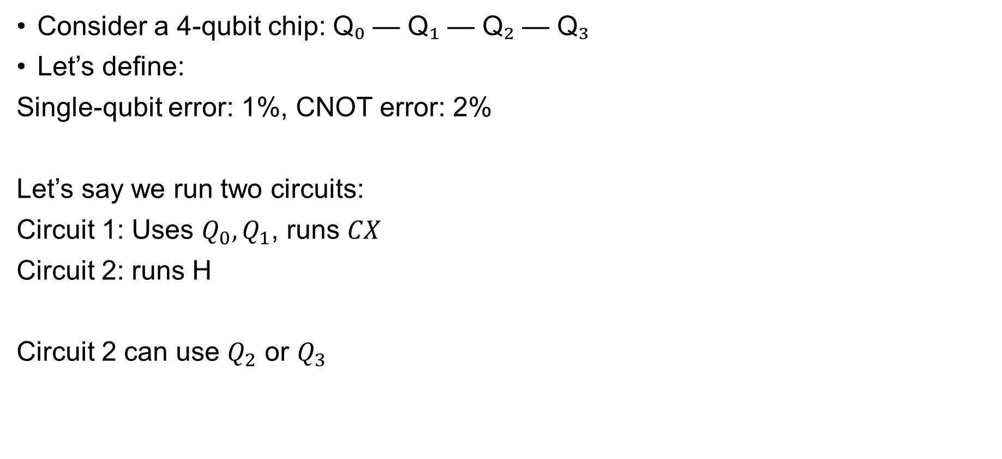
More Qubits, More Problems? (1)
Consider a 4-qubit chip: Q₀ — Q₁ — Q₂ — Q₃
Let’s define:
Single-qubit error: 1%, CNOT error: 2%
Let’s say we run two circuits:
Circuit 1: Uses $Q_{0},Q_{1}$​, runs 𝐶𝑋
Circuit 2: runs H
Circuit 2 can use $Q_{2}$ or $Q_{3}$

Slide 8
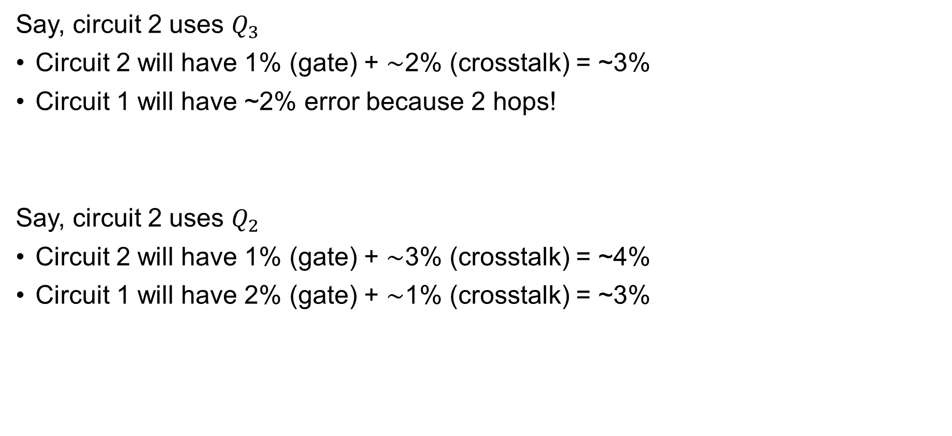
More Qubits, More Problems? (2)
Say, circuit 2 uses $Q_{3}$
Circuit 2 will have 1% (gate) + ∼2% (crosstalk) = ~3%
Circuit 1 will have ~2% error because 2 hops!
Say, circuit 2 uses $Q_{2}$
Circuit 2 will have 1% (gate) + ∼3% (crosstalk) = ~4%
Circuit 1 will have 2% (gate) + ∼1% (crosstalk) = ~3%

Slide 9
How do schedulers decide qubit allocation?
Detects cross talk using Simultaneous Randomized Benchmarking (SRB) to detect crosstalk between qubit pairs.
Use GSP (Greedy Subgraph Partitioning) or QHSP (Qubit Fidelity Degree-based Heuristic) algorithm for efficient partitioning. They considers:
Hardware topology (Connectivity)
CNOT gate errors
Readout error rates
Crosstalk information
*GSP/QHSP tries to avoid assigning circuits to qubits with high readout error.

Slide 10
How Can a Malicious User Trick the Scheduler?
Can users degrade others' programs without touching their code? Yes!
Assumptions:
Multi-tenant cloud (like IBM Q)
One or more honest users
One adversarial user
Adversary Strategy:
Submit small, fake jobs occupying high-quality qubits, just to disrupt optimal allocation for the victim.

Slide 11
Threat Model
Adversary Capabilities:
Cannot modify other users' code
Can see device calibration (connectivity, error rates)
Submit jobs strategically
Scheduler trusts user jobs and assigns qubits based on:
Availability, Error rates, Fairness (e.g., FIFO or priority)

Slide 12
Tricking the Scheduler
Most quantum hardware doesn't have all-to-all qubit connectivity. The compiler maps your circuit to hardware.
If two logical qubits aren’t directly connected → SWAPs are inserted
Without attack:
Q0 — Q1 — Q2 — Q3
| |
Victim uses Q1—Q2 → low SWAP
With attack:
Attacker blocks Q1, forces victim to Q0—Q3
→ Extra SWAPs needed → more error

Slide 13
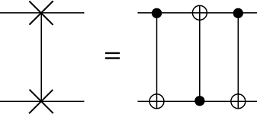
Swap Gate
1 SWAP requires 3 CNOT: increases gate count, circuit depth, and error rate.
Forcing to increase more SWAP can degrade fidelity and performance.

Slide 14
Adversarial SWAP Injection
Scheduler often follow "first-come, first-serve" or priority-based allocation.
Q0 — Q1 — Q2 — Q3
Attacker submits a fake job: Low number of qubits, Few gates, Looks harmless
Scheduler assigns good qubits (Q1–Q2) to attacker’s job
→ Because it sees available, low-error, high-connectivity qubits
Victim’s job arrives later, Needs 2 or more qubits
Now Q1 and Q2 are occupied.
Scheduler maps them to Q0–Q3, which are less connected or farther apart: Extra SWAPs > More CNOTs > Worse Fidelity

Slide 15
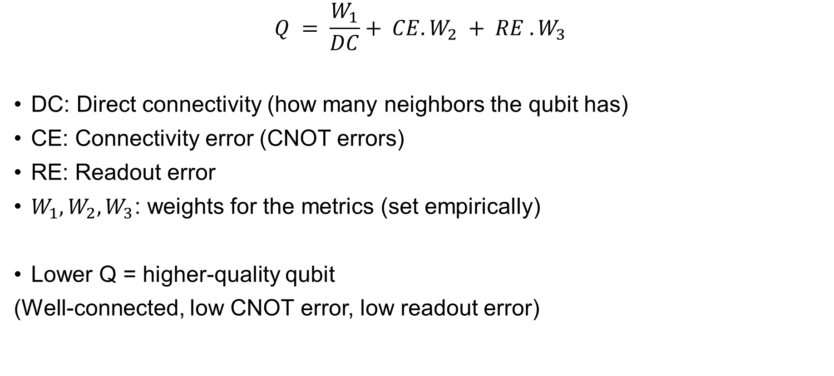
Qubit Quality Metric (Q)
$$Q = \frac{W_{1}}{DC}+ CE.W_{2} + RE .W_{3}$$
DC: Direct connectivity (how many neighbors the qubit has)
CE: Connectivity error (CNOT errors)
RE: Readout error
$W_{1},W_{2},W_{3}$: weights for the metrics (set empirically)
Lower Q = higher-quality qubit
(Well-connected, low CNOT error, low readout error)

Slide 16
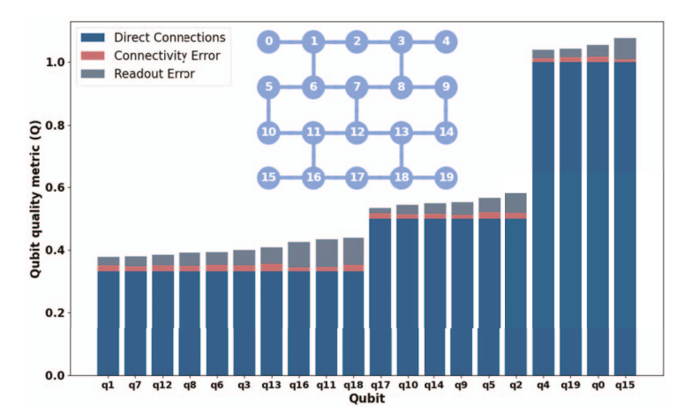
How attacker choose qubits
The lower the Q, the more likely it will be targeted by an adversary

Slide 17
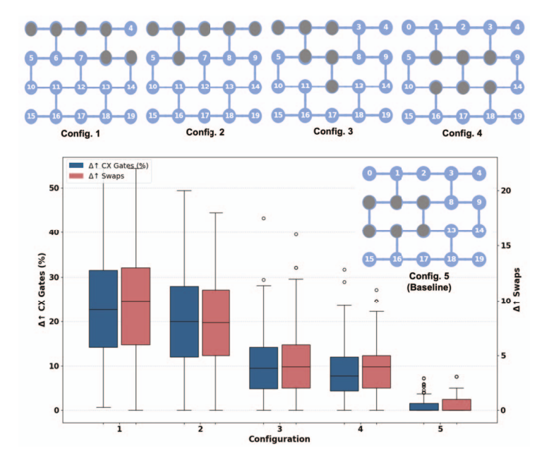
SWAP Overhead Impact
Performance comparison of 100 different 6-qubit programs in five different scenarios of qubit allocation on hardware (fake singapore[20 qubit]).
SWAP overhead (% increase in CNOT gates) and absolute number of additional SWAPs added, for each configuration compared to config. 5 (baseline)
victim circuit compiled after attacker reserves optimal qubits (config 5)

Slide 18
Defense Strategy
Proposes a machine learning–based anomaly detection approach.
One-Class SVM Classifier:
A lightweight, unsupervised detector trained on honest user behavior
It flags jobs that:
Request central qubits repeatedly
Have low gate count (suspiciously small jobs)
Are frequent and bursty
Appear to serve no computational purpose

Slide 19
Training and Result
Input Features for Classifiers
Qubit Location Score→ How close the requested qubits are to the chip center
Gate Count→ Small, simple jobs raise suspicion
Job Submission Frequency→ High-frequency short jobs are suspicious
Temporal Features→ Time of submission, concurrency with other jobs
Evaluation Result:
Classifier achieves 95–99% precision
Low false positive rate
Can be deployed lightweight, real-time, and without disrupting users

Slide 20
Summary
First study to show compiler-level attack in quantum multi-tenant systems
Introduced the Stealthy SWAP Injection attack: Exploits scheduler behavior, Forces compiler to insert more SWAPs → higher error
Demonstrated attack on real IBM devices
Proposed a lightweight anomaly detector using One-Class SVM to catch malicious jobs.

Slide 21
Comments
The attack depends on predictable scheduling (e.g., first-come, first-served). Randomness, dynamic allocation can weaken this attack.
The paper tests only static attack strategies (e.g., fixed fake jobs, fixed qubit blocks). It doesn’t explore how an adaptive attacker could evolve based on detection or scheduling delays.
Only One-Class SVM is explored as a defense.
Can we frame this as a game-theoretic problem between scheduler & attacker?
Thank you!

